Slide 1


Housing Loan Finance
Data Science Hiring Challenge
Dr. Harita Parikh

Slide 2
Problem Statement & Objectives
Housing finance is a long-term investment, which requires plenty of funds.
With speed & trust on top of customers’ agendas, financial institutions need to use capabilities such as automated processing, comprehensive credit scorecards, analytics-based decision making & self-servicing for the effective partnership.
There is a need to leverage the vast data available for digital customers to serve them better.
Objectives:
To predict the home loan amount that can be sanctioned to applicants
To provide business insights

Slide 3
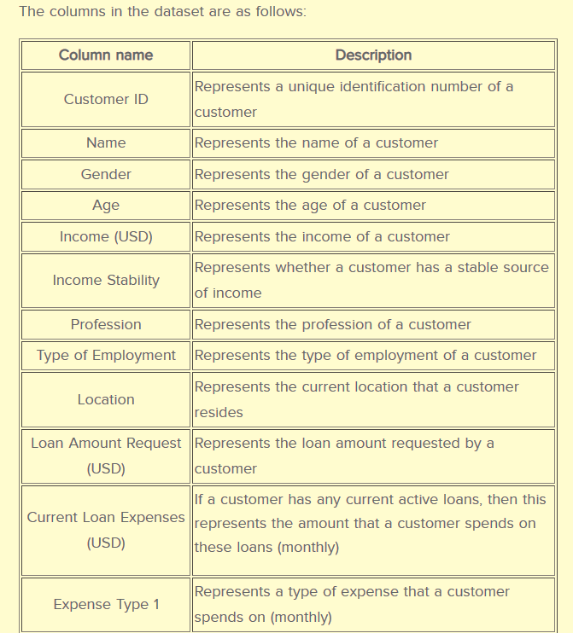
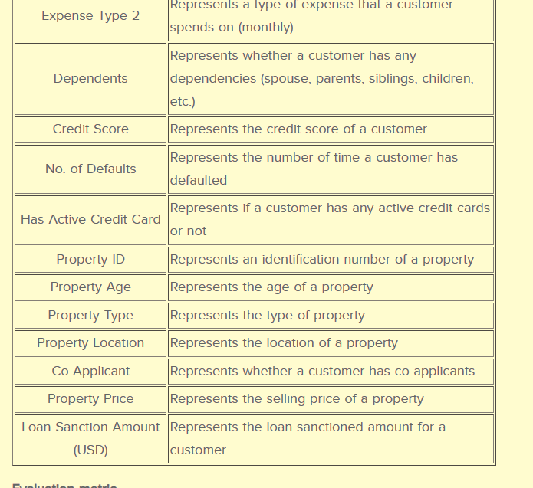
Overview of Available Data
Dependent
variable
Features: 24 Independent: 23 Dependent: 1
Categorical: 12 Numeric: 10 Boolean: 2

Slide 4
Data Exploration & Processing: Pandas Profiling
Step 1: Drop Features
Feature name | Explanation
 | If high cardinality | Missing value % | Autocorrelation w/ | If correlation w/ dependent var | If uniform distribution across classes
Name | ✓ |  |  | ✗
Property ID | ✓ |  |  | ✗
Age |  | 15 | Income Stability | ✗
Gender |  | 0.2 |  | ✗ | ✓
Income stability |  | 5.6 | Age, Profession (included) | ✗
Expense type 2 |  |  | Expense type 1 (included) | ✗
Has active credit card |  | 5.2 |  | ✗ | ✓
Property location |  |  |  | ✗ | ✓
Property type |  |  |  | ✗ | ✓

Slide 5
Data Exploration & Processing: Pandas Profiling
Step 2: Missing Value Treatment
Feature name | Strategy Employed
Income | Impute median
Current Loan Expenses | Impute median
Property Age | Impute median
Property Price | Replace ?, impute median
Co-Applicant | Replace ?, impute median
Dependents | Impute as category “0”
Type of Employment | Impute as category “missing_val”
Loan Sanction Amount | Drop missing
Step 3: Create Categories
Feature name | Above frequency
Type of Employment | 2000
Expense Type 1 | 2000
Profession | 2000
Dependents | 300
Step 4: Outlier Treatment
Feature name | Strategy for clipping data
Income | < (Q1 - 1.5 * IQR) & >(Q3 + 1.5 * IQR)
Current Loan Expenses | < (Q1 - 1.5 * IQR) & >(Q3 + 1.5 * IQR)
Property Age | < (Q1 - 1.5 * IQR) & >(Q3 + 1.5 * IQR)
Loan Sanction Amount | < 0

Slide 6
Machine Learning & Predictions: Python
Evaluation Metric: max(0, 100)*r2_score(actual, predicted)
Interpretation of r-squared:
r-squared (coefficient of determination) is a statistical measure that determines the proportion of variance in the dependent variable that can be explained by the independent variable.
r-squared shows how well the data fit the regression model (the goodness of fit).
Method used for hyperparameter tuning: GridSearchCV
This function is a member of sklearn's model_selection package.
It helps loop through predefined hyperparameters and fit the estimator (model) on training set to select the best parameters

Slide 7
Machine Learning & Predictions: Python
Algorithm | Underlying Intuition | Scores (r-squared) |  |  | Performance Interpretation
 |  | Train | Validation | Test
Linear regression (SGDRegressor) | Linear model fitted by minimizing a regularized empirical loss with SGD | -544939397613 | -544939397613 | 0 | The negative R-squared value means that the prediction tends to be less accurate that the average value of the data set over time.
Support vector regression (svm.SVR) | The best fit line is the hyperplane that has the maximum number of points. | -2354215279 | -2362232657 | 0
Random Forest | Constructs several decision trees and outputs the mean prediction of the individual trees | 85.14 | 79.14 | 80.75 | Categorical vars present along with continuous Trees can accurately divide the data based on categorical vars
Gradient Boosting Machine | Builds an additive model in a forward stage-wise fashion; it allows for the optimization of arbitrary differentiable loss functions. In each stage a regression tree is fit on the negative gradient of the given loss function. | 77.73 | 77.77 | 79.1 | Since it introduces a weak learner to improve the shortcomings of existing weak learners
Notes:
SGD stands for Stochastic Gradient Descent: the gradient of the loss is estimated each sample at a time and the model is updated along the way with a decreasing strength schedule (aka learning rate)

Slide 8
Machine Learning & Predictions: Python
Other algorithms applied:
Stacking: layer 1: random_forest & gradient_boosting
layer 2: random_forest
Stacking: layer 1: random_forest & gradient_boosting
layer 2: sgd_linear
Stacking: layer 1: random_forest & sgd_linear
layer 2: sgd_linear
Bayesian Ridge

Slide 9
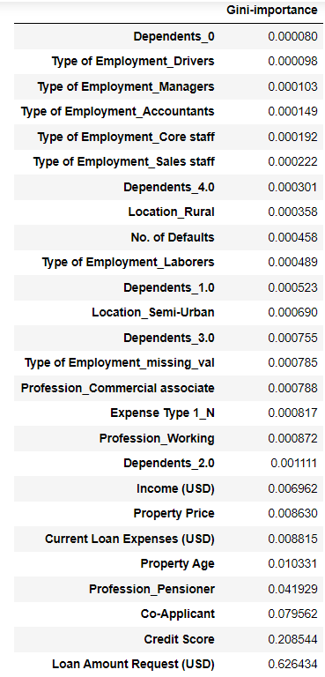
Business Insights
Feature
Importance
Right now, we’re seeing a lot of companies dramatically increase their machine learning investments, with special focus on use cases surrounding process automation and customer experience.
Diego Oppenheimer
CEO and Co-Founder, Algorithmia
- AI Use Cases in 2021, Appen Partner Spotlight
With the objective of improving customer experience at home loan finance and improving the ROI by precise sanction amount predictions, 5 features (highlighted in the image) from the given dataset were found to be most relevant.
The algorithm were run separately on the features found to be of importance using random forest feature_importance_ attribute, and the model gave the same exact output with similar metrics profile.
Not surprisingly, these features were also found to have strong correlation with the dependent variable.

