Slide 1
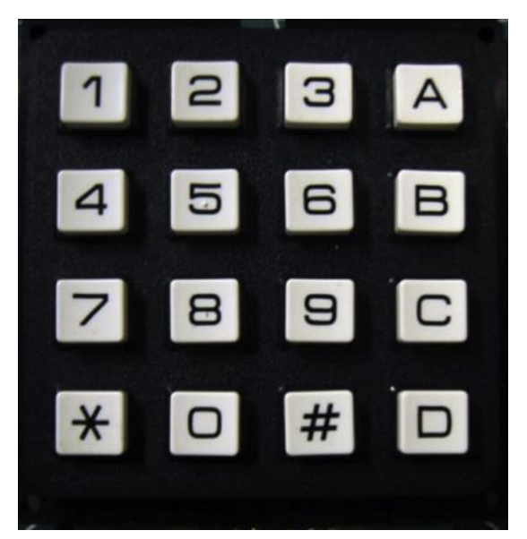
back
x
+
^
/
-
(
)
E
.
PSWD
ANS
CLR ALL
SHFT OFF
=
DEL
SHFT

