Slide 1

CUSTOMER
SEGMENTATION
Analysis & Targeted Marketing
DataMites Client Project | CDACL-002
NAME : G.HARITHA
COURSE : CDA
TEAM ID : PTID-CDA-OCT-26-11111

Slide 2

Project Objective
Understand customer shopping trends from purchase data.
Identify product categories where discount strategies may be considered.
Explore spending patterns by age, season, and location.
Group customers into 3 segments and recommend targeted marketing campaigns.
Customer Segmentation | DataMites Client Project 2

Slide 3

Dataset Overview
Customer shopping data from the U.S. market
3,900
Customer records
18
Dataset columns
0
Missing values reported
Fields include customer demographics, purchase amount, category, location, season, ratings, discounts, and purchase history.
CustomerID was retained for identifying records but excluded from clustering features.
Customer Segmentation | DataMites Client Project 3

Slide 4

Methodology
Python workflow
1. Load data
Read dataset with pandas
2. Select features
Age, purchase amount, review rating, previous purchases
3. Standardize
StandardScaler to align numeric scales
4. Cluster
K-Means with 3 clusters, random_state=42
Clustering used K-Means (k = 3, n_init = 10).
The result is an unsupervised grouping based on selected customer behavior features.
Customer Segmentation | DataMites Client Project 4

Slide 5

Customer Clustering Results
All 3,900 records assigned to a cluster
Cluster 0
1,277 customers | 32.7%
Cluster 1
1,397 customers | 35.8%
Cluster 2
1,226 customers | 31.4%
Cluster 1 is the largest segment.
The cluster sizes are relatively balanced, allowing each group to be considered for differentiated campaigns.
Customer Segmentation | DataMites Client Project 5

Slide 6
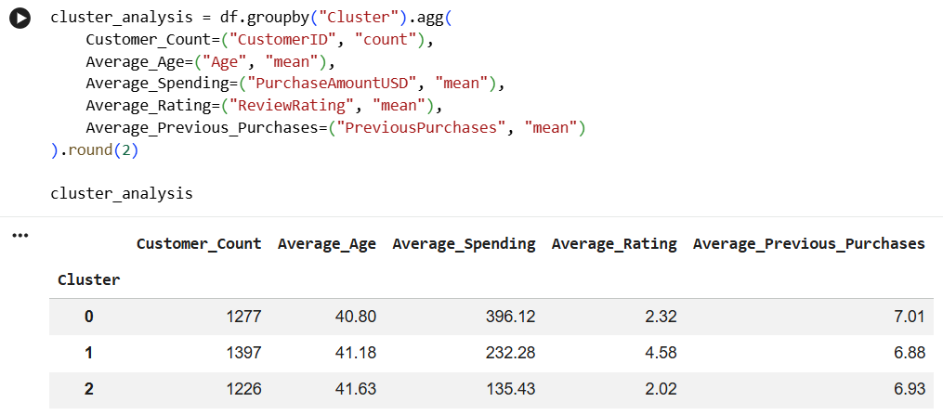

Customer Segment Profiles
Average values from the Colab cluster analysis
Average age and previous-purchase counts are similar across clusters.
Purchase amount and review rating show clearer differences between the groups.
Customer Segmentation | DataMites Client Project 6

Slide 7

Cluster 0 | High-Spending Customers
1,277 customers
Average purchase: $396.12
Highest average purchase amount among the three clusters.
Average review rating is 2.32, so spending is high but customer feedback should be examined.
Campaign ideas: premium product recommendations, exclusive bundles, and loyalty benefits.
Collect feedback and address possible satisfaction issues before relying only on upselling.
Customer Segmentation | DataMites Client Project 7

Slide 8

Cluster 1 | Mid-Spending, Higher-Rated Customers
1,397 customers
Average purchase: $232.28
Largest cluster in the analysis.
Highest average review rating: 4.58.
Campaign ideas: loyalty rewards, personalized recommendations, and relevant cross-selling.
Encourage repeat purchases and positive customer advocacy.
Customer Segmentation | DataMites Client Project 8

Slide 9

Cluster 2 | Lower-Spending Customers
1,226 customers
Average purchase: $135.43
Lowest average purchase amount among the groups.
Average review rating is 2.02, indicating feedback should be reviewed.
Campaign ideas: affordable product suggestions, carefully targeted introductory offers, and value bundles.
Follow up on customer feedback and improve product or service experience.
Customer Segmentation | DataMites Client Project 9

Slide 10

Targeted Marketing Recommendations
Cluster 0 | Premium
Premium offers and loyalty perks; investigate lower ratings.
Cluster 1 | Loyalty
Retention, cross-selling, and personalized product recommendations.
Cluster 2 | Value
Value bundles and selective promotions; improve customer experience.
Use campaign tests and track conversion, revenue, customer satisfaction, and profit before scaling.
Customer Segmentation | DataMites Client Project 10

Slide 11
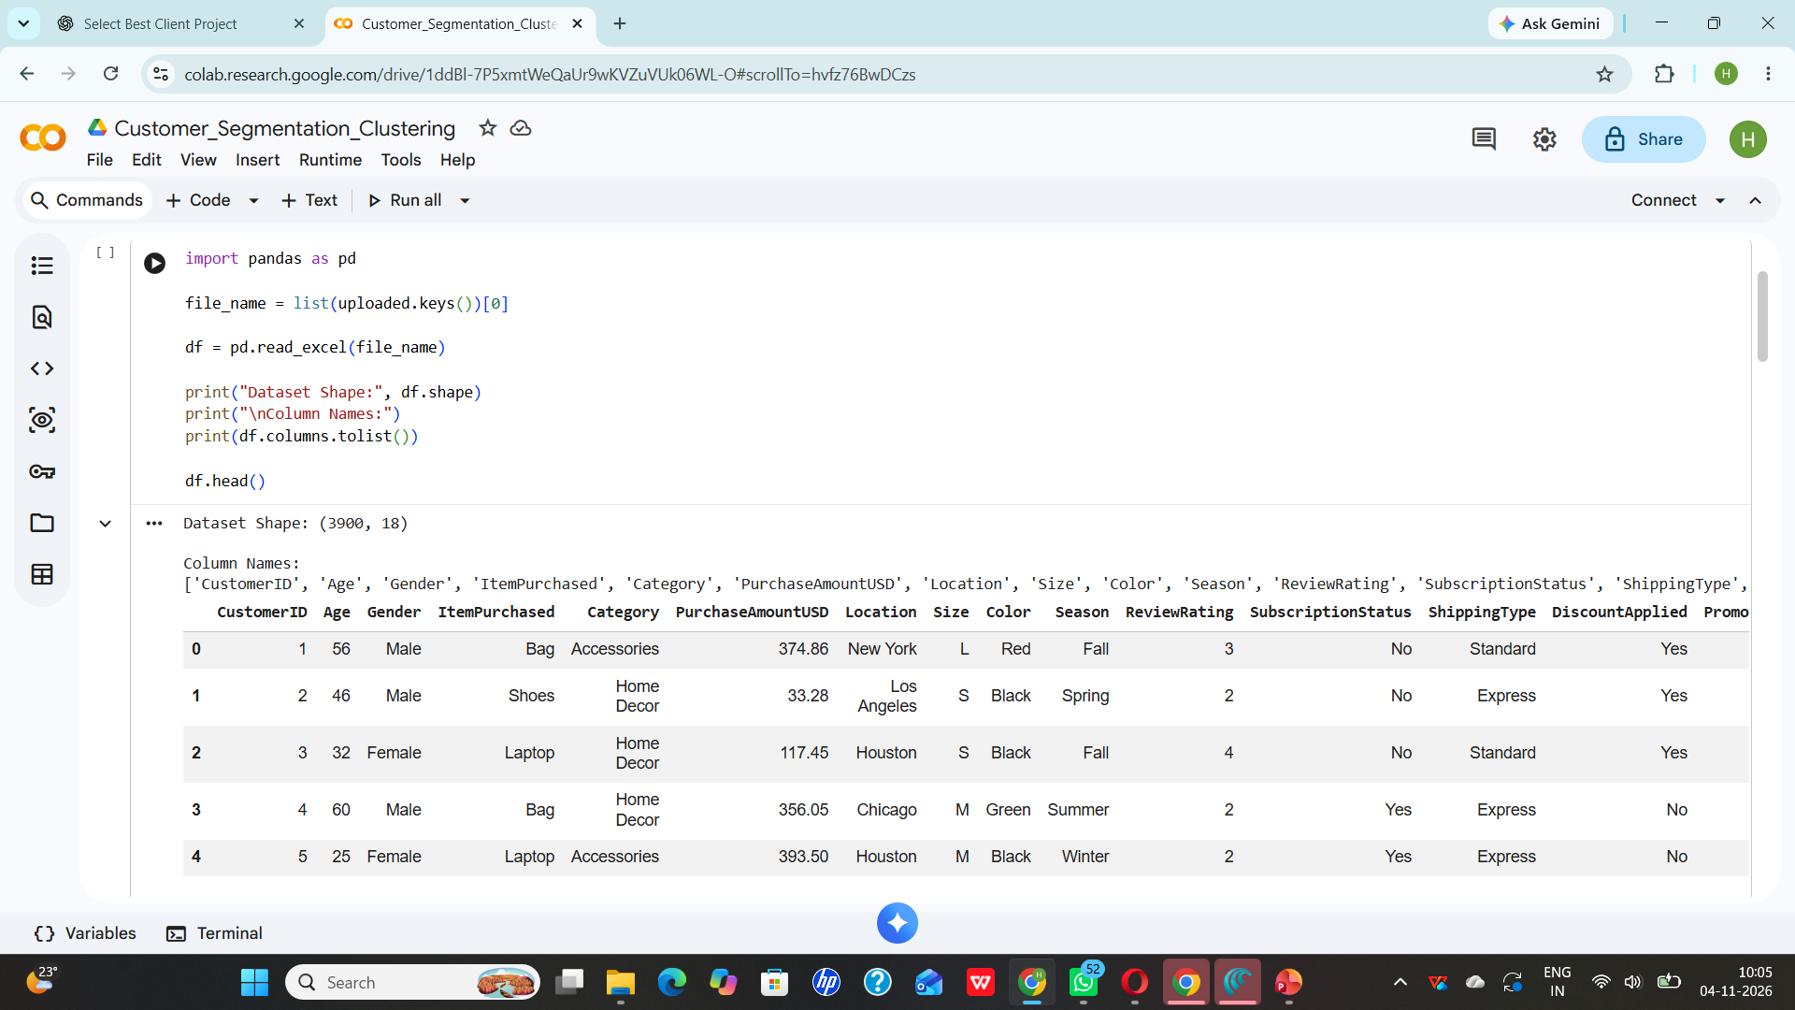

Conclusion
K-Means grouped the 3,900 customers into three distinct spending and rating profiles.
Cluster 0 has the highest average spending; Cluster 1 has the highest rating; Cluster 2 has the lowest spending.
Customer age is similar across segments, so it is not the strongest differentiator in this model.
Segment-based campaigns can support more relevant marketing, while actual campaign impact should be measured.
Customer Segmentation | DataMites Client Project 11

Slide 12

Tools & Project Workflow
Python in Google Colab
pandas — dataset loading and analysis
scikit-learn — StandardScaler and K-Means clustering
Method: feature selection → standardization → clustering → segment profiling → marketing recommendations
THANK YOU
Customer Segmentation | DataMites Client Project 12

