Slide 1
Instagram Clone Team Members: 1. B. Sanjana 2. P. Haritha 3. K. Chandana 4. U. Chandrashekhar

Slide 2
Abstract:
Instagram clone is a blockchain based social networking platform used to post multimedia files. Using blockchain technology to develop this application will protect freedom of expression, which would make the platform truly democratic.
The user posts will be encrypted and copyrighted to that account. Any other similar copy posted later will be detected and warned. The posts will fetch tokens for likes, comments and shares i.e based on it's popularity.

Slide 3
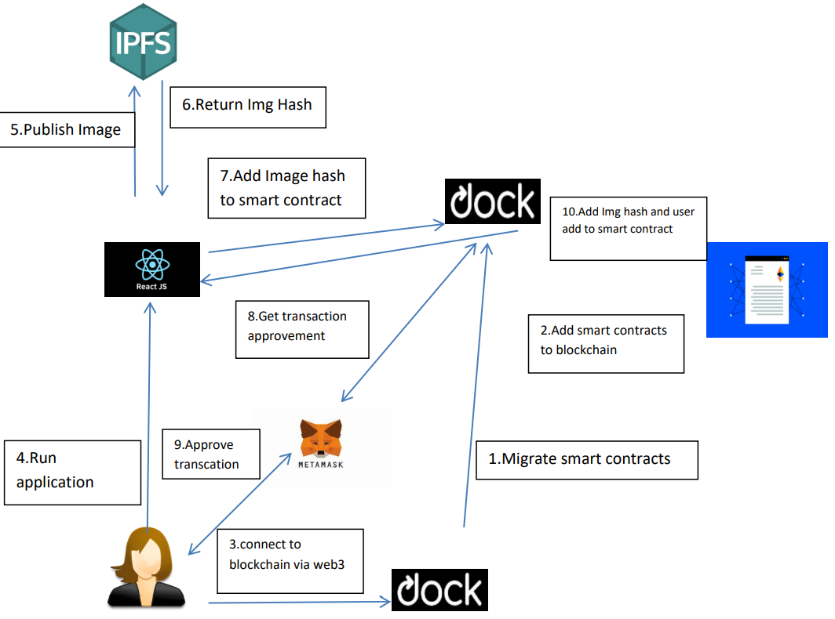
Flow diagram

Slide 4
Thank You

