Slide 1

TrackMe Project
Final Presentation
Haritha Harikumar - Mohini Gupta - Saloni Kyal

Slide 2
Goals
Data4Help
Help third party make requests
Validate Requests
Automated SOS
Monitoring the health status of the subscribed individual and Alerts the nearby ambulance, when the health status of the individual is low, within 5 seconds.
Track4Run
Develops an interface to organise a race for the subscribed 3rd party to the Track4Run service.
Give access to the details of the race once an individual participate in it.
Live visualization of race.
Haritha Harikumar - Mohini Gupta - Saloni Kyal

Slide 3
Requirements and Assumptions
Haritha Harikumar - Mohini Gupta - Saloni Kyal

Slide 4
Architectural
Haritha Harikumar - Mohini Gupta - Saloni Kyal

Slide 5
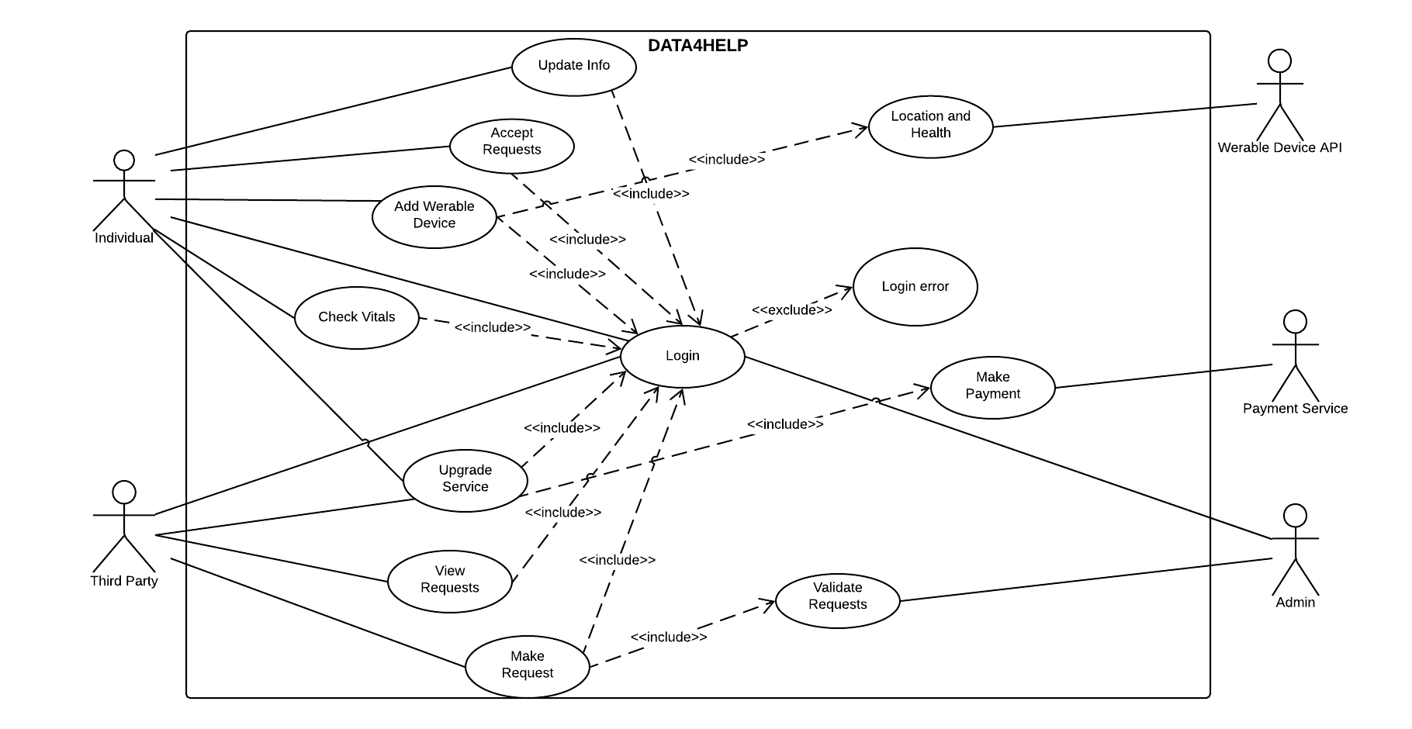
Use Case: Data4Help
Haritha Harikumar - Mohini Gupta - Saloni Kyal

Slide 6
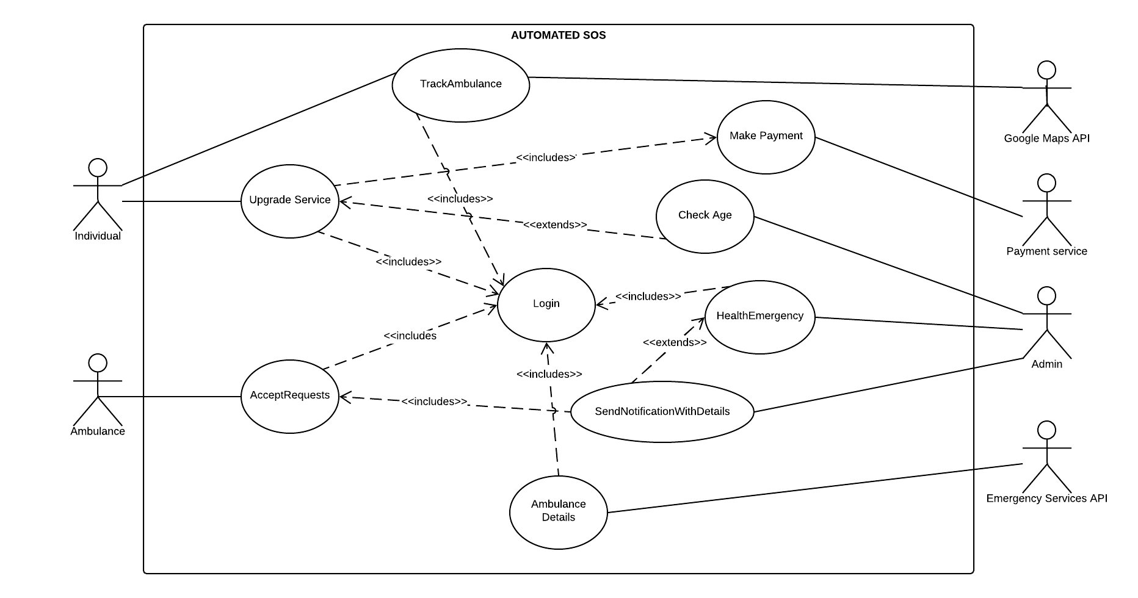
Use Case: Automated SOS
Haritha Harikumar - Mohini Gupta - Saloni Kyal

Slide 7
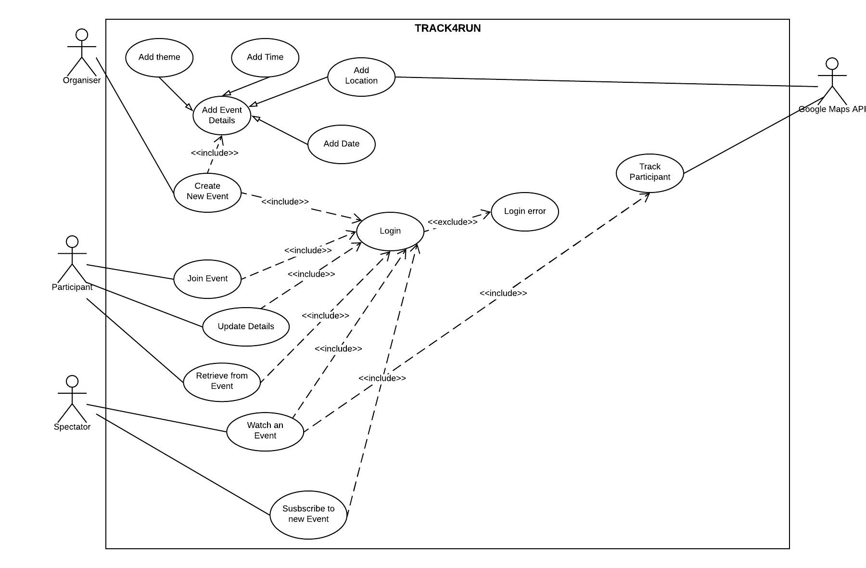
Use Case: Track4Run
Haritha Harikumar - Mohini Gupta - Saloni Kyal

Slide 8
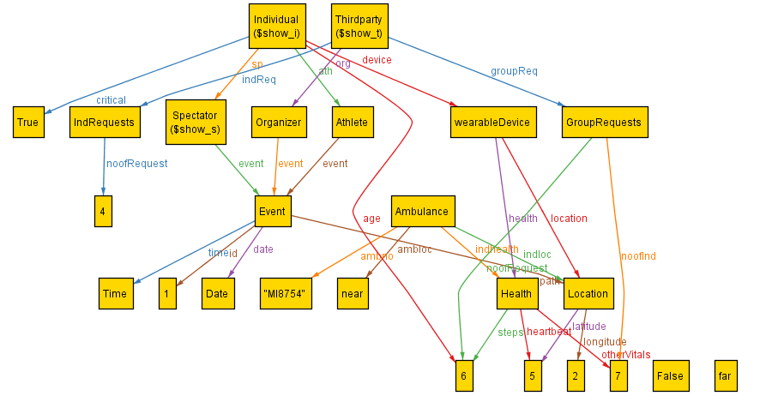
Alloy
Haritha Harikumar - Mohini Gupta - Saloni Kyal

Slide 9
Component: Data4Help
Haritha Harikumar - Mohini Gupta - Saloni Kyal

Slide 10
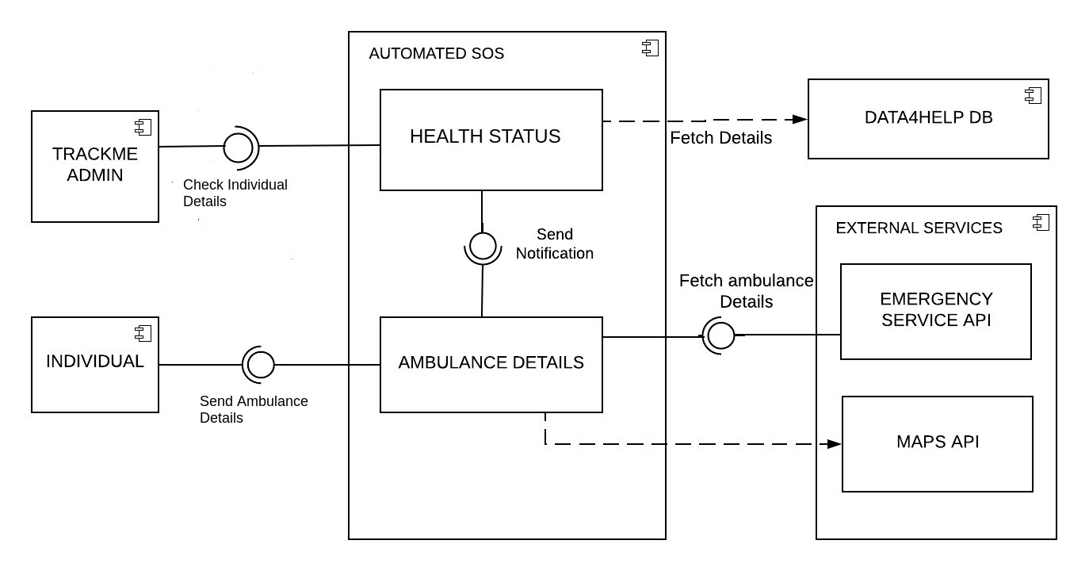
Component: Automated SOS
Haritha Harikumar - Mohini Gupta - Saloni Kyal

Slide 11
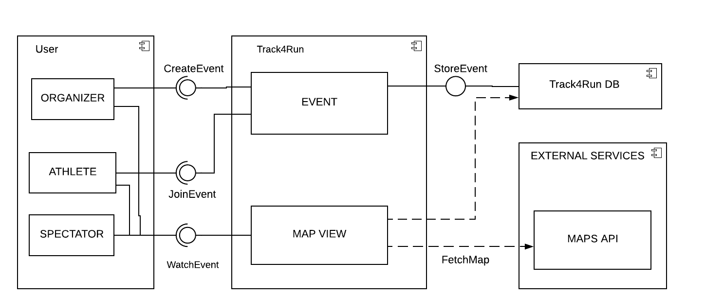
Component: Track4Run
Haritha Harikumar - Mohini Gupta - Saloni Kyal

Slide 12
UX
Haritha Harikumar - Mohini Gupta - Saloni Kyal

Slide 13
Implementation and Testing
Haritha Harikumar - Mohini Gupta - Saloni Kyal

Slide 14
Conclusion
Haritha Harikumar - Mohini Gupta - Saloni Kyal

