Slide 1
'FEMHIRE' - Women Hiring Women
An all-female maintenance platform
Haritha Chandran Yuzhu Shi
Women in Tech Hackathon Student Pack
08/03/2025

Slide 2
PART 01
Concept Introduction
Why we build the FemHire?
How does it work?

Slide 3
Why we build the FemHire?
In the UK's Engineering and Technical Fields:
2.9%
3.1%
Women in Mechanical Technicians and Repairers
Women in Electrical Equipment Installers and Repairers
Women constituted only 2.9% of mechanical technicians and repair workers ¹
Women made up only 3.1% of electrical equipment installers and repairers.
[1] Eyre, E. (2024, November 1). Women with designs on an engineering career. The Times.

Slide 4
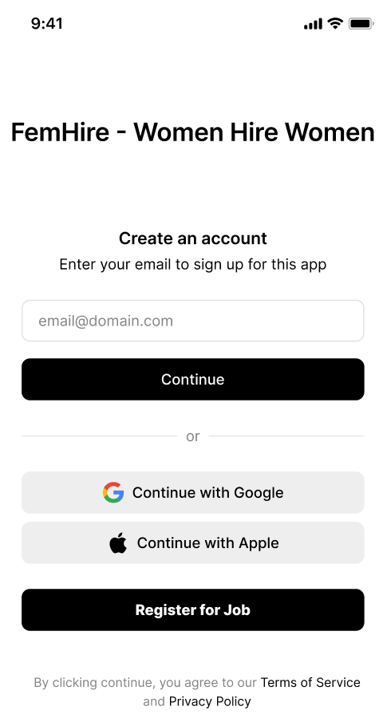


So we build the FemHire,
--- An all-female maintenance platform
Electrical repairs, plumbing, visit accompaniment, cockroach fighting .....
For Customers - Women who living alone just need to register, look up and a woman will help you.
For Workers - Women maintenance workers register on top of the platform to get more job opportunities.
Realise Tools: Figma + Jupyter
Notes:
模板来自于： 第一PPT https://www.1ppt.com/

Slide 5
PART 02
Application content
What is the app looks like?
What should we do in the future?

Slide 6
Future Technology Architecture
D
HTTPS: Use SSL/TLS certificates
A
Database
Secure Data Transmission
MongoDB
B
Node.js with Express.js
To Create REST API's
OAuth
E
Social Login Authentication (Google, Facebook, etc.).
Micrsoft Azure Face API,
Face++, or AWS Rekognition
C
Face Recognition

Slide 7
PART 03
Conclusion
What will it bring us?

Slide 8



Empowering Women in Technical Careers
Providing training and job opportunities to break gender stereotypes in the repair industry.
Safe & Reliable Repair Services
Creating a comfortable and secure experience tailored for female customers.
Unique Positioning & Brand Advantage
Targeting niche markets to build brand loyalty through trust and social influence.
Driving Industry Change & Diversity
Promoting gender inclusivity and setting an example for other technical fields.
Notes:
模板来自于： 第一PPT https://www.1ppt.com/

Slide 9
THANK YOU!
'FEMHIRE' - Women Hiring Women
An all-female maintenance platform
Haritha Chandran Yuzhu Shi
Women in Tech Hackathon Student Pack
08/03/2025

