Slide 1

Keyloggers and security
PRESENTED BY:
K.G .Haritha
P.S.V. COLLEGE OF ENGINEERING AND TECHNOLOGY
B.E COMPUTER SCIENCE AND ENGINEERING

Slide 2

OUTLINE
Problem Statement
Proposed System/Solution
System Development Approach
Algorithm & Deployment
Result and Output Image
Conclusion
Future Scope
References

Slide 3
Problem Statement
EXAMPLE: Develop a discreet keylogger program to silently record all keystrokes made by a user, ensuring compatibility across major operating systems. The keylogger should operate persistently, securely storing logged data and providing authorized access for retrieval. Compliance with legal and ethical standards must be strictly adhered to, with thorough documentation and considerations for user privacy and security.

Slide 4
Proposed Solution
Cross-Platform Compatibility: The keylogger will be developed to work seamlessly across major operating systems, including Windows, macOS, and Linux, ensuring broad compatibility.
Stealth Mode Operation: The keylogger will run silently in the background, without displaying any visible interface or notifications to the user. It will operate discreetly to avoid detection and interference with the user's normal activities.
Persistence Mechanism: To ensure continuous operation, the keylogger will employ a persistence mechanism that allows it to automatically restart and resume logging keystrokes after system reboots or shutdowns.
Key Logging Functionality: The keylogger will capture all keystrokes made by the user, including letters, numbers, symbols, and special keys like Enter, Backspace, Shift, Ctrl, and Alt. It will log this information in a secure manner to prevent unauthorized access.
.

Slide 5
5.Secure Data Storage: Logged keystrokes will be securely stored in an encrypted format to prevent unauthorized access or tampering. The storage location will be chosen carefully to ensure data integrity and protection against potential threats.
6.Authorized Access for Data Retrieval: Authorized users, such as administrators or designated personnel, will have access to retrieve the logged data through a secure interface. Access controls and authentication mechanisms will be implemented to prevent unauthorized access to the logged data.
7.Legal and Ethical Compliance: The development and use of the keylogger will strictly adhere to relevant laws and regulations governing surveillance software. Ethical considerations regarding user privacy and consent will be carefully addressed, and the keylogger will only be deployed in situations where it is legally permissible and ethically justified.
8.Comprehensive Documentation: Detailed documentation will be provided, covering installation instructions, configuration settings, usage guidelines, legal compliance requirements, and ethical considerations. This documentation will serve as a guide for users and administrators to understand and responsibly use the keylogger.

Slide 6

9.Security Measures: Robust security measures will be implemented to protect the keylogger from unauthorized access, tampering, or exploitation by malicious actors. This includes encryption of logged data, secure communication protocols, and regular security updates to address potential vulnerabilities.
10.User Privacy Protection: Measures will be taken to safeguard user privacy, such as ensuring that the keylogger does not capture sensitive information like passwords or credit card numbers unless explicitly authorized for legitimate purposes.

Slide 7

System Approach
The "System Approach" section outlines the overall strategy and methodology for developing and implementing the model . Certainly, here are the key topics within a system approach to key loggers:
1. Hardware Component
2. Software Component
3. Data Capture and Storage
4. User Interaction
5. Detection and Evasion
6. Remote Access and Control
7. Legal and Ethical Considerations
8. Updates and Maintenance

Slide 8
Programming Language: Python for its versatility, ease of use, and availability of libraries like pyput for keyboard monitoring.
Data Storage: SQLite for its lightweight nature and ease of integration, providing a secure storage solution for logged keystrokes.
Cross-Platform Compatibility: Utilize platform-independent libraries and frameworks to ensure seamless operation across Windows, macOS, and Linux environments.
Security: Implement encryption using Python's built-in cryptography library to securely store logged data and adhere to privacy standards.
Documentation: Create detailed documentation using Markdown or reStructuredText, covering installation, configuration, usage guidelines, legal compliance, and ethical considerations to ensure clarity and compliance with relevant regulations.

Slide 9
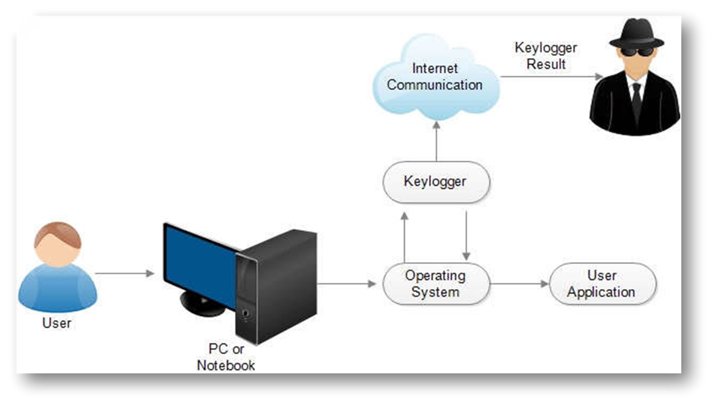
EXAMPLE:

Slide 10
Algorithm & Deployment
ALGORITHM:
Initialization:
Initialize necessary variables and data structures.
Set up hooks for intercepting keystrokes.
Keystroke Interception:
Continuously monitor keyboard input using system-level hooks or low-level keyboard input hooks.
Capture keystrokes, including alphanumeric characters, special keys, and key combinations.

Slide 11
Data Processing:
Process captured keystrokes, filtering out irrelevant input (eg.system keys, mouse events).
Optionally, preprocess data for encryption or compression.
Storage:
Store processed keystrokes securely, either locally or remotely.
Implement encryption to protect stored data from unauthorized access.
Consider periodic flushing or batching of keystrokes to minimize memory usage and improve efficiency.
Stealth Mechanisms:
Implement techniques to run the key logger stealthily, avoiding detection by the user or antivirus software.
Employ code obfuscation, polymorphism, and rootkit-like features to hide the key logger's presence.

Slide 12
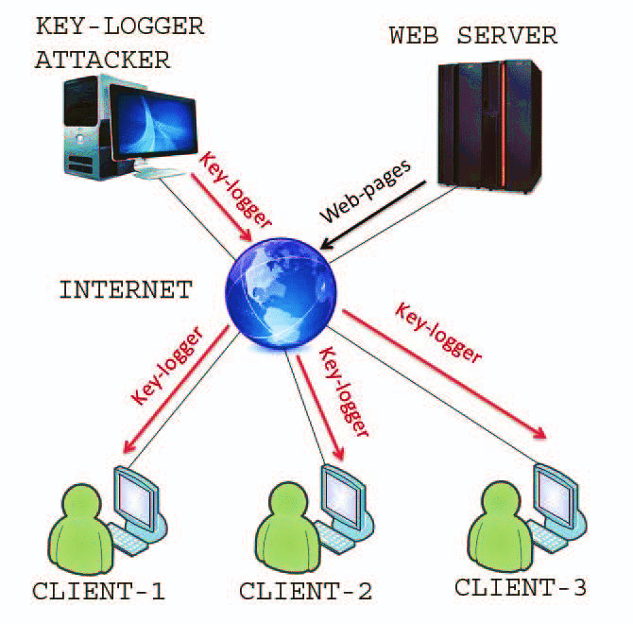
Remote Access (Optional):
Implement remote access functionality to allow monitoring of logged keystrokes from a remote location.
Use secure communication protocols for transmitting data to a remote server.
Error Handling:
Implement error handling mechanisms to handle exceptions and edge cases gracefully.
Log errors and issues for debugging and troubleshooting purposes.

Slide 13
DEPLOYMENT STRATEGY
Software Distribution:
Package the keylogger software into an executable installer or standalone application.
Distribute the software through secure channels, such as direct downloads from a secure website or physical media (e.g., USB drives).
Installation:
Provide clear instructions for installing the keylogger on the target system.
Optionally, include stealth installation options to minimize user awareness of the key logger's presence.
Configuration:
Include a user interface or configuration file for setting up the keylogger parameters (e.g., logging mode, encryption settings).
Ensure that configuration options are easy to understand and use A

Slide 14
Testing:
Conduct thorough testing of the keylogger software to ensure reliability, compatibility, and stealthiness.
Test the keylogger across different operating systems and hardware configurations.
Deployment:
Deploy the keylogger on target systems where monitoring or surveillance is required.
Ensure compliance with relevant laws and regulations governing the use of surveillance software.
Maintenance and Updates:
Establish a process for regular maintenance and updates to address security vulnerabilities and compatibility issues.
Provide users with instructions for updating the keylogger software to the latest version.

Slide 15
Monitoring and Analysis:
Monitor logged keystrokes periodically to gather relevant information or insights.
Analyze logged data for patterns, anomalies, or security threats.
By following this algorithm and deployment strategy, the key logger can be effectively deployed and used for legitimate purposes such as parental control, employee monitoring, or law enforcement investigations, while also considering security, privacy, and ethical considerations.

Slide 16

RESULT: OUTPUT IMAGES:

Slide 17


Slide 18


Slide 19


Slide 20
Result
The result of implementing a key logger system is the successful capture and logging of keystrokes from the target system. Captured keystrokes are securely stored either locally or remotely, ensuring confidentiality and integrity.
The key logger operates stealthily, avoiding detection by antivirus software and other security measures.
Optionally, authorized users can monitor logged keystrokes remotely. Configuration options are provided for customization, and regular maintenance and updates are conducted to address security vulnerabilities.
The use of the key logger complies with relevant laws and regulations, prioritizing security, privacy and ethical considerations.

Slide 21
Conclusion
In conclusion, keyloggers serve as powerful tools for capturing and logging keystrokes on target systems. They provide valuable insights for various purposes such as parental control, employee monitoring, or law enforcement investigations.
Their deployment must be approached with caution, ensuring compliance with legal and ethical standards to protect user privacy and prevent misuse. By implementing effective stealth mechanisms, secure data storage, and regular maintenance practices, keyloggers can be valuable assets for surveillance while prioritizing security and ethical considerations.

Slide 22

Future scope
Enhanced Stealth Techniques
Advanced Encryption Methods
Integration with Artificial Intelligence
Cloud-Based Logging and Analysis
Improved Compatibility with Emerging Technologies
Enhanced User Awareness and Control Features
Integration with Endpoint Security Solutions
Compliance with Evolving Privacy Regulations
Application in Internet of Things (IoT) Devices
Development of Countermeasures and Anti-Keylogging Technologies

Slide 23
References
Research Papers and Academic Journals
Technical Documentation from Security Companies
Books on Cybersecurity and Surveillance Techniques
Online Forums and Discussion Groups
Security Conferences and Seminars
Official Websites of Software Developers
Industry Reports and Whitepapers
Legal and Regulatory Documents
Online Tutorials and Guides
Case Studies and Practical Examples

Slide 24
Academic Journals and Research Papers: Search for peer-reviewed articles and research papers on keyloggers, cybersecurity, and related topics through academic databases such as IEEE Xplore, ACM Digital Library, and Google Scholar.
Books: Look for books on cybersecurity, programming, and software development that cover topics related to keyloggers. Check reputable publishers such as O'Reilly, Wiley, and Springer for relevant titles.
Online Documentation and Tutorials: Explore online documentation and tutorials provided by software developers, programming communities, and cybersecurity organizations. Websites like Stack Overflow, GitHub, and the Python documentation can be valuable resources for learning about keylogger implementation techniques and best practices.

Slide 25
Cybersecurity Blogs and Websites: Follow reputable cybersecurity blogs, news websites, and forums for articles, tutorials, and discussions on keyloggers and related topics. Examples include Krebs on Security, Schneier on Security, and the SANS Institute.
Legal and Ethical Guidelines: Consult legal resources, government websites, and industry guidelines to understand the legal and ethical considerations surrounding the development and use of keylogger systems. Websites like the Electronic Frontier Foundation (EFF) and the Information Commissioner's Office (ICO) provide valuable insights into privacy laws and regulations.

Slide 26
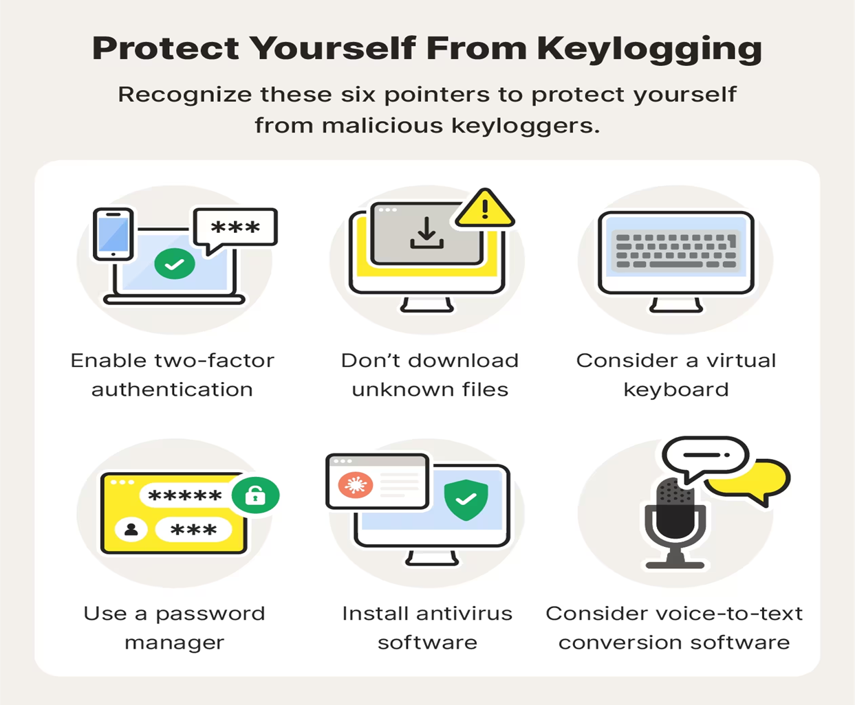

Slide 27
THANK YOU

