Slide 1

Machine Learning Momentum Trading 22 January 2024
Harith Alshuwaykh
Sam Muslin
Ryan Stowers
Erin O’Leary

Slide 2
Agenda
Executive Summary
Materials & Methods
Analysis & Outputs
Lessons Learned
Conclusion
Q & A

Slide 3
Briefer: Erin O’Leary
Problem and Solution
Establishing security trading signals for a neural network for momentum trading.
Solution: Used MACD, verified by ADX, for buy and sell signal generation.
We added more indicators for the neural network for more accurate predictions.
We trained a couple of neural networks for better accuracy.
Notes:
Used MACD, verified by ADX, for buy and sell signal generation.

Slide 4
Briefer: Erin O’Leary
Terms Defined
Moving Average Convergence and Divergence (MACD): a trend-following momentum indicator that shows the relationship between two exponential moving averages (EMAs) of a security's price, with a signal generators when moving averages cross
Average Directional Index (ADX): a technical indicator that analyzes the strength of a trend

Slide 5
Briefer: Harith Alshuwaykh
Flow Chart
Input data
Generate Indicators
Create MACD/ADX Signal
Train Neural Network
Create Neural Network Signal
Calculate MACD Signal returns
Calculate Neural Network Returns

Slide 6
Briefer: Harith Alshuwaykh
So What?
Adding more indicators improves the accuracy of the neural network training through ta library. For example, RSI, simple moving averages, awesome oscillator, and many others.
Train neural network to produce accurate signals for future trades.

Slide 7
Briefer: Harith Alshuwaykh
Materials & Methods
Sam[Data format]
What Data did we use and where did we get it from?
How did we access it?
Select a time period of six years of Microsoft (MSFT) from Alpaca.
Create buy and sell signals from MACD/ADX.
Add additional indicators.
Train neural network for 80% of the period.
Compare accuracy of our neural network with original signal.

Slide 8
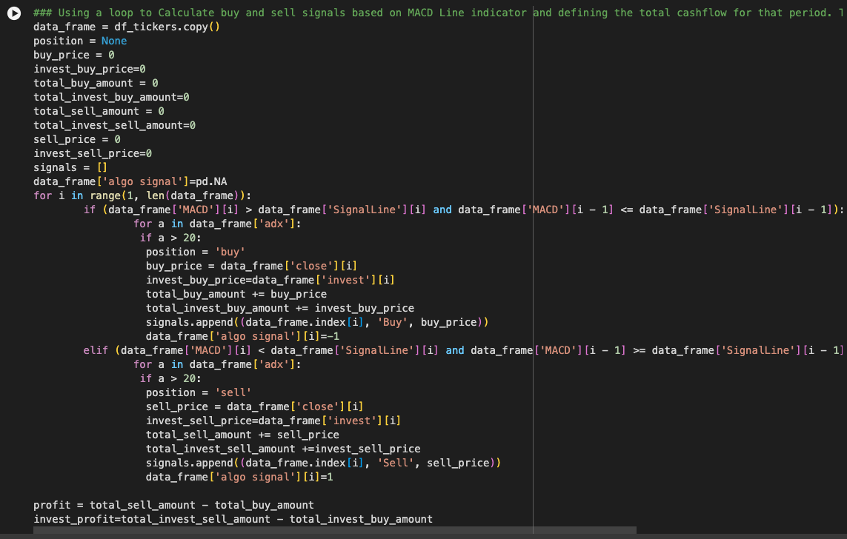
Briefer: Harith Alshuwaykh
Materials & Methods
Sam[Data format]
What Data did we use and where did we get it from?
How did we access it?
MACD/ADX Signal Generation

Slide 9
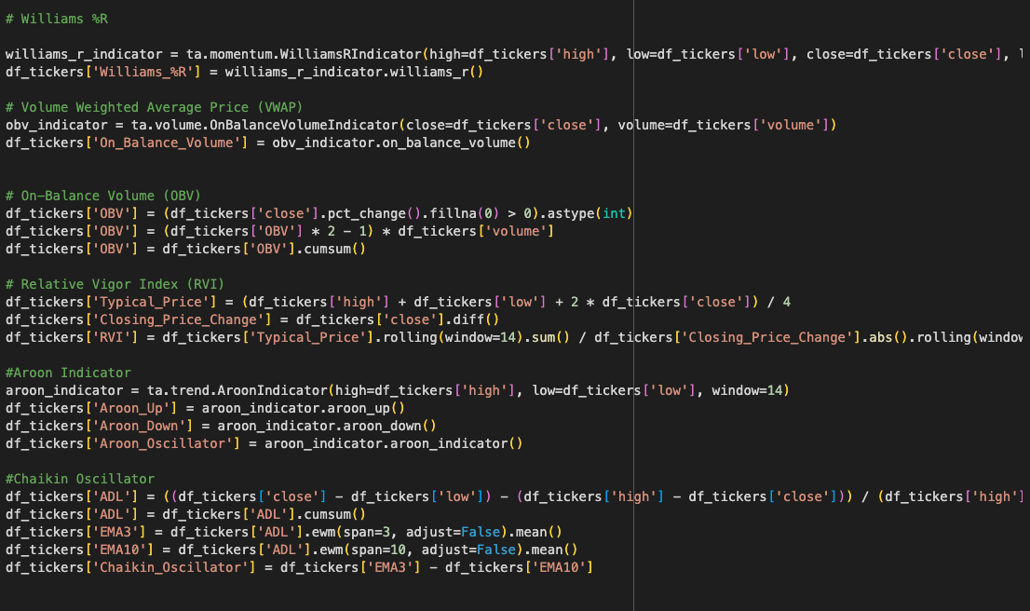

Briefer: Ryan Stowers
Materials & Methods
Sam[Data format]
What Data did we use and where did we get it from?
How did we access it?
Indicators Sample

Slide 10
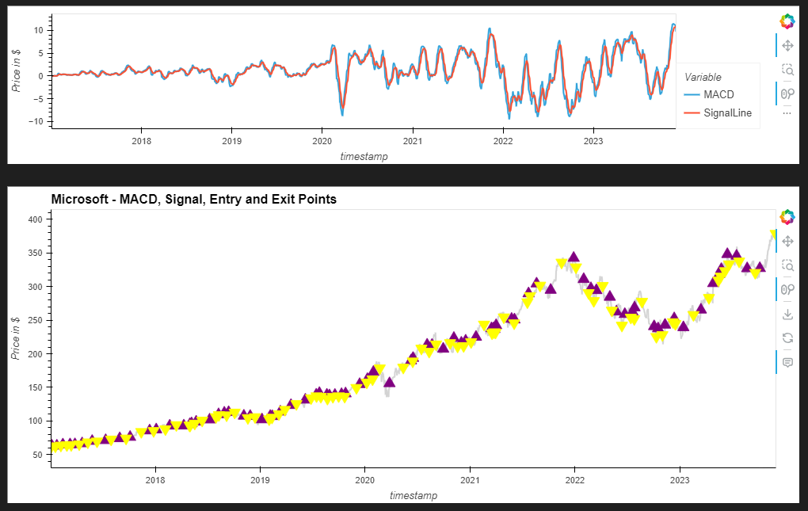
Signal Generation Plot
Entry and Exit Points
Briefer: Ryan Stowers
Sam[Data format]
What Data did we use and where did we get it from?
How did we access it?

Slide 11

Briefer: Ryan Stowers
Materials & Methods
Sam[Data format]
What Data did we use and where did we get it from?
How did we access it?
This was the output:

Slide 12
Briefer: Ryan Stowers
Neural Network Training Accuracy
What were the outputs?
What did the outputs tell us?
Analysis – Michael[SPY] Ryan[AAPL]

Slide 13
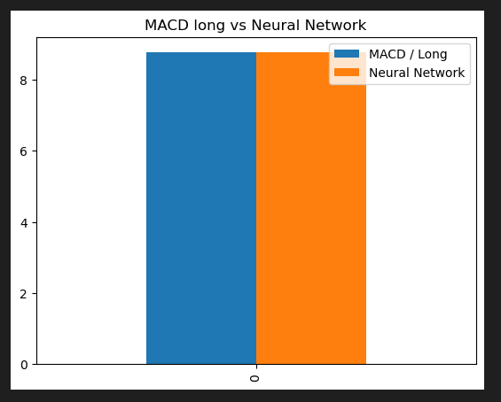
Briefer: Sam Muslin
MACD vs. Neural Network

Slide 14
Briefer: Sam Muslin
Lessons Learned
What we did well:
We successfully created a signal that tells the computer to buy or sell.
We successfully training a neural network with high accuracy to create buy or sell signal.
What we can do better:
Improve signal generation.

Slide 15
Briefer: Sam Muslin
Conclusion
Technical analysis can provide future investment signals for neural networks to train on and produce accurate results.
Fundamental analysis and market sentiment should be taken into consideration while applying technical analysis methods.

Slide 16
Questions?

