Slide 1

MACD Indicator as a Trading Strategy 13 November 2023
Harith Alshuwaykh
Michael Drinkard
Sam Muslin
Ryan Stowers
Erin O’Leary

Slide 2
Agenda
Executive Summary
Materials & Methods
Analysis & Outputs
Lessons Learned
Conclusion
Q & A

Slide 3
Briefer: Erin O’Leary
Frame the Problem
Our project aims at establishing security trading recommendations depending on moving average convergence and divergence, using exponential moving averages of closing prices of time series data frame.
The “MACD” is a popular technical indicator used in trading and investing to identify potential trend reversals, generate buy or sell signals, and assess the overall momentum of an asset.
It consists of two lines: the MACD line and the signal line.

Slide 4
Briefer: Erin O’Leary
Terms Defined
Moving Average Convergence and Divergence (MACD): a trend-following momentum indicator that shows the relationship between two exponential moving averages (EMAs) of a security's price
Exponentially Weighted Moving Average (EWMA): quantitative/statistical measure used to model a time series
Signal line: a nine-period EMA of the MACD line; normally consist of moving averages used in combination with other technical indicators to generate buy or sell signals
Short – “shorting” / “short selling”: an investment or trading strategy that speculates on the decline in a stock price; involves borrowing a security whose price you think is going to fall from your brokerage and selling
Long – “taking a long position”: having a “long” position in a security means that you own the security

Slide 5
Briefer: Harith Alshuwaykh
So What?
Crossovers: When the MACD line crosses above the signal line, it generates a bullish signal, indicating a potential buying opportunity. Conversely, when the MACD line crosses below the signal line, it generates a bearish signal, suggesting a possible selling opportunity.
Divergences: Pay attention to divergences between the MACD and the price action. If the price is making higher highs, but the MACD is making lower highs, it could indicate a weakening trend and a possible trend reversal.

Slide 6
Briefer: Harith Alshuwaykh
Materials & Methods
Sam[Data format]
What Data did we use and where did we get it from?
How did we access it?
MACD line signal formula:
Select a time period (commonly 12 or 26 periods) for the MACD line. Let's assume we choose 12 periods.
Calculate the 12-period exponential moving average (EMA) of the asset's closing prices.
Next, select another time period (often 26 periods) for the signal line. In this case, we'll use 26 periods.
Calculate the 26-period EMA of the closing prices.
Subtract the 26-period EMA from the 12-period EMA to get the MACD line value.
Finally, calculate a 9-period EMA of the MACD line to obtain the signal line.

Slide 7
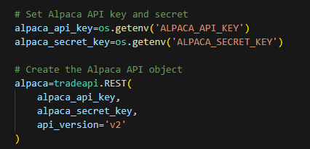
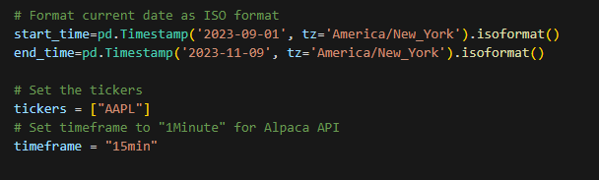
Briefer: Sam Muslin
Materials & Methods
Sam[Data format]
What Data did we use and where did we get it from?
How did we access it?
What data did we use and how did we get it?:
To begin checking our program we pulled historical stock data for Apple from Alpaca

Slide 8
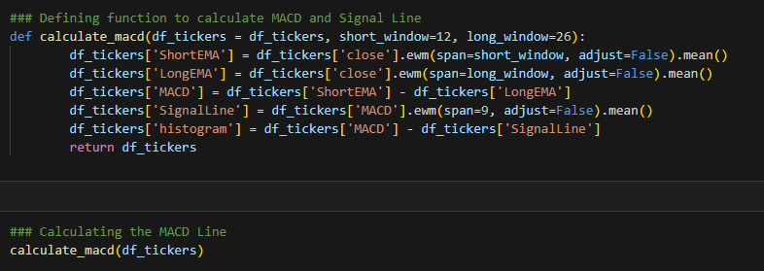
Briefer: Sam Muslin
Materials & Methods
Sam[Data format]
What Data did we use and where did we get it from?
How did we access it?
How did we process the data?
After creating the Alpaca dataframe, we defined functions to calculate the MACD and Signal Line

Slide 9
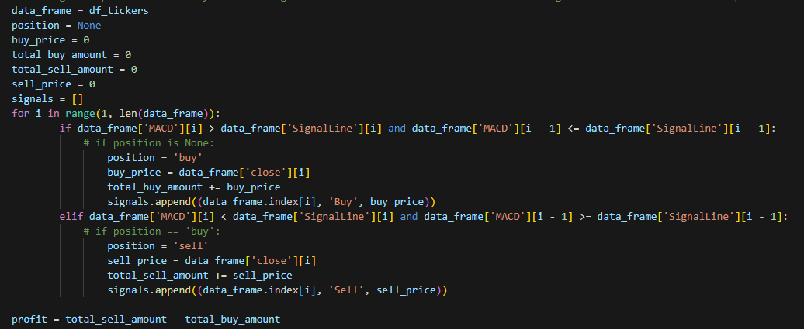
Briefer: Sam Muslin
Materials & Methods
Sam[Data format]
What Data did we use and where did we get it from?
How did we access it?
Using a loop to Calculate buy and sell signals based on MACD Line indicator and defining the total cashflow for that period. This shows if we made a profit or not.

Slide 10
Briefer: Sam Muslin
Materials & Methods
Sam[Data format]
What Data did we use and where did we get it from?
How did we access it?
This was the output:
We then added our EWMs back to the data frame
We then added our MACD line to the data frame
We then added our signal line to the data frame

Slide 11
Briefer: Sam Muslin
Materials & Methods
Sam[Data format]
What Data did we use and where did we get it from?
How did we access it?
This was the output:
We then added our EWMs back to the data frame
We then added our MACD line to the data frame
We then added our signal line to the data frame

Slide 12
Briefer: Sam Muslin
Materials & Methods
Sam[Data format]
What Data did we use and where did we get it from?
How did we access it?
Data format continued:
We then created a returns column in our data frame by calculating the percent change of the close price for each time period.

Slide 13
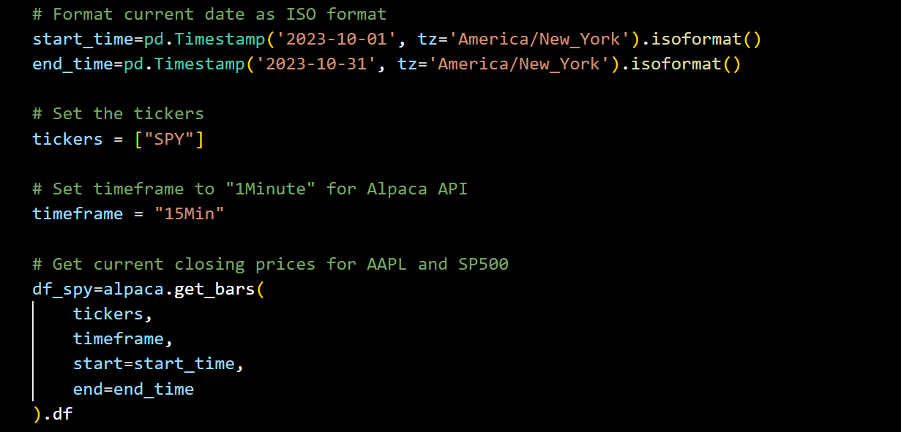
Briefer: Sam Muslin
Materials & Methods
Sam[Data format]
What Data did we use and where did we get it from?
How did we access it?
ADDING SPY INFORMATION AS A CHECK:

Slide 14
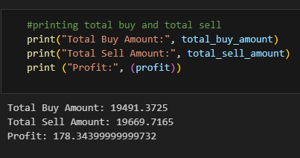
Briefer: Sam Muslin
Materials & Methods
Sam[Data format]
What Data did we use and where did we get it from?
How did we access it?
This was the output:

Slide 15
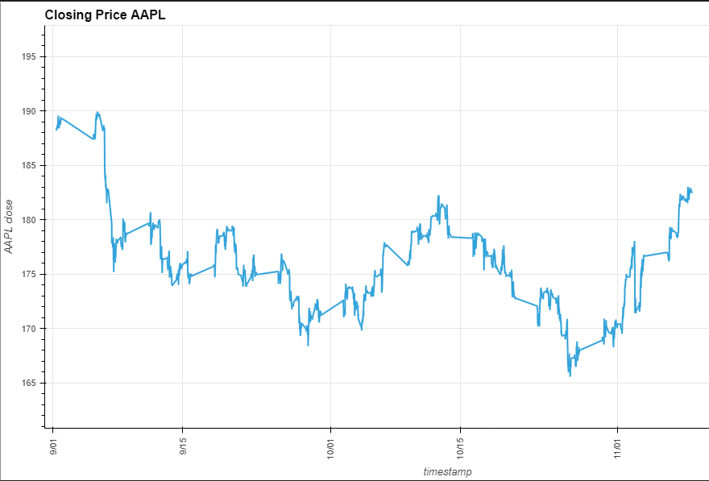
Briefer: Michael Drinkard
Analysis & Outputs
A display of the closing price for AAPL.
What were the outputs?
What did the outputs tell us?
Analysis – Michael[SPY] Ryan[AAPL]

Slide 16
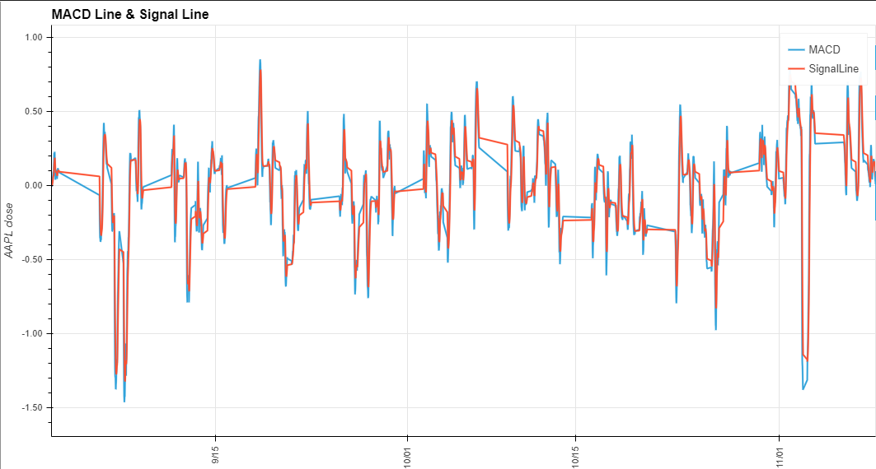
Briefer: Michael Drinkard
Analysis & Outputs
In this next graph, you can see we added the MACD and signal line. We start off buying at the open, then when the MACD line pass the signal line we sell because the signal line is indicating a downwards trend.

Slide 17
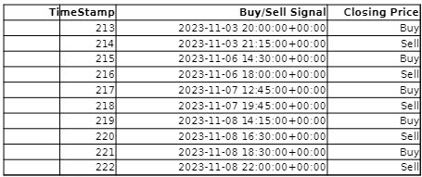
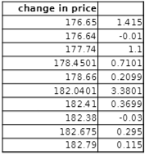
Briefer: Michael Drinkard
Analysis & Outputs
This is a short example of what the trades look like as time stamps. We start off buying at the open, then when the MACD line pass the signal line we sell because the signal line is indicating a downwards trend.

Slide 18
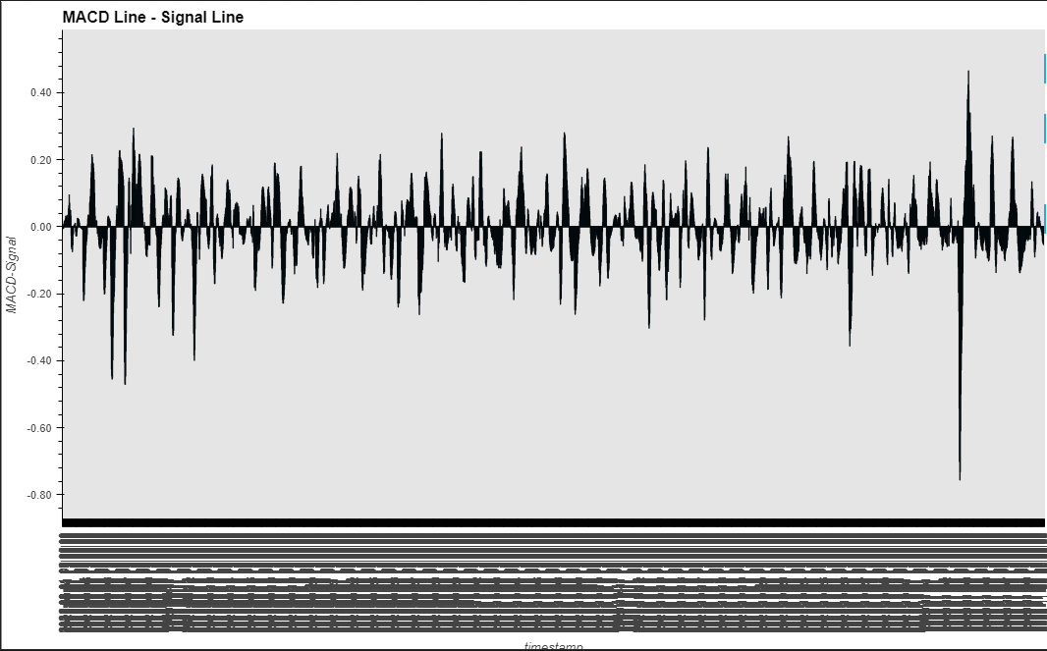
Briefer: Ryan Stowers
Analysis & Outputs
This is the signal line. We start off buying at the open, then when the MACD line pass the signal line we sell because the signal line is indicating a downwards trend.

Slide 19
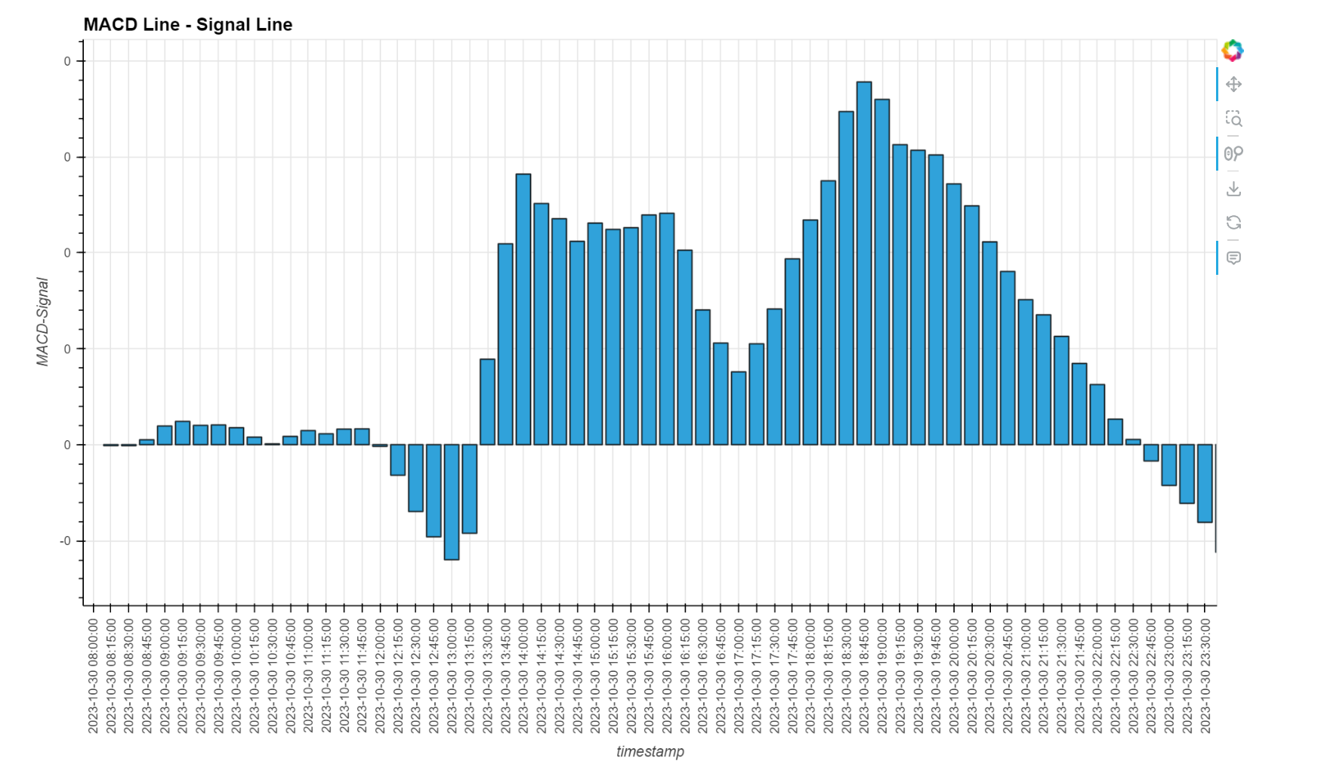
Briefer: Ryan Stowers
Analysis & Outputs
In this last graph you can see a better picture of when we buy and sell. For example, we started with buying at the open, then the MACD passes the signal line we sell until it passes it again. At approximately 1:45 the signal line is indicating a upwards trend where we buy until it crosses again to indicate that we sell.
What were the outputs?
What did the outputs tell us?
Analysis – Michael[SPY] Ryan[AAPL]

Slide 20
Briefer: Michael Drinkard
Lessons Learned
What we did well:
We successfully created a signal that tells the computer to buy or sell
What we can do better:
Add more indicators and make the code do multiple stock analysis at the same time

Slide 21
Briefer: Michael Drinkard
Conclusion
The MACD is just one tool in technical analysis, and it's often used in conjunction with other indicators for more reliable signals.
Always consider the broader context and conduct thorough analysis before making any trading decisions.

Slide 22
Questions?

