Slide 1

Seasonal Agriculture Performance Analysis
[Harithra Muthushanmugam
PSNA College of Engineering and Technology ]
AICTE STU ID : (STU6a3e692cf1ffd1782475052)

Slide 2

PROBLEM STATEMENT
(Agricultural activities are influenced by seasonal variations in environmental conditions, farming practices, resource availability and market conditions. As a result, agricultural performance may differ from one season to another. However, raw agricultural data does not clearly explain how agricultural performance changes across seasons or what patterns can be observed in different seasonal conditions. The problem is to analyze the given agricultural dataset and investigate seasonal differences in agricultural performance by identifying meaningful patterns, trends, relationships and variations within the available data.

Slide 3
Project Description
Objective: Analyze seasonal variation in agricultural performance (yield, profit, water efficiency, and resource usage) across Kharif, Rabi, and Zaid seasons.
Dataset Scope: 4,000 farm records containing environmental conditions, soil metrics, input usage, crop outcomes, and economic indicators.
Methodology: Data cleaning (handling missing values), exploratory data analysis (EDA), and data visualization using Python (Pandas, Matplotlib, Seaborn).
Key Findings: Kharif yields the highest performance (~5.63 T/Ha yield, ₹31.8 Cr total profit), while Zaid exhibits negative net profitability due to elevated irrigation and temperature stress.
Outcome: Provides evidence-based recommendations to optimize crop planning and resource management across different farming seasons.

Slide 4

WHO ARE THE END USERS?
Agricultural Stakeholders & Policymakers: Government agencies and agricultural departments seeking data-driven insights for evidence-based seasonal crop planning and resource distribution.
Farmers & Local Producers: Agricultural decision-makers looking to optimize crop selection, reduce irrigation costs, and maximize seasonal profits.
Agricultural Researchers & Data Analysts: Researchers evaluating the impact of environmental factors, seasonal variations, and irrigation efficiency on crop yield.
Supply Chain & Market Analysts: Economic planners tracking production trends across seasons to manage market pricing and distribution logistics.

Slide 5

Technology Used
  Programming Language: Python 3.x (Core language used for data manipulation, cleaning, and statistical calculations)
  Environment & Tools: Google Colab / Jupyter Notebook (Interactive development environment for writing and executing code)
  Data Manipulation & Analysis: Pandas & NumPy (Used for loading CSV datasets, handling missing values, grouping, and aggregations)
  Data Visualization: Matplotlib & Seaborn (Used for generating bar plots, scatter plots, box plots, and visual distribution analysis)

Slide 6
RESULTS
Key Analytical Findings
Kharif Season (Peak Performance): Generates the highest average yield (5.63 Tonnes/Ha) and total profit (₹31.83 Crores) supported by high natural rainfall (849.2 mm).
Rabi Season (Moderate Performance): Delivers stable yields (5.04 Tonnes/Ha) and positive profit returns (₹14.27 Crores) with moderate resource inputs.
Zaid Season (Low Performance / Deficit): Shows lowest yields (4.64 Tonnes/Ha) and overall negative net profit (-₹1.47 Crores) due to high irrigation costs during dry periods.

Slide 7
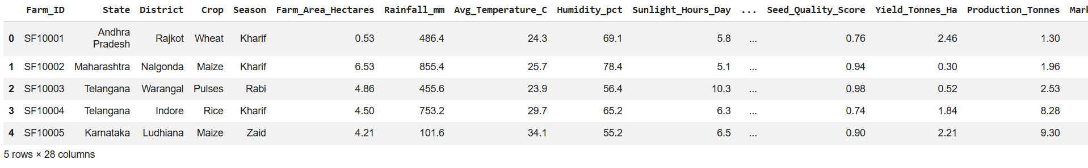
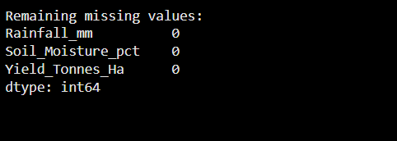
RESULTS

Slide 8
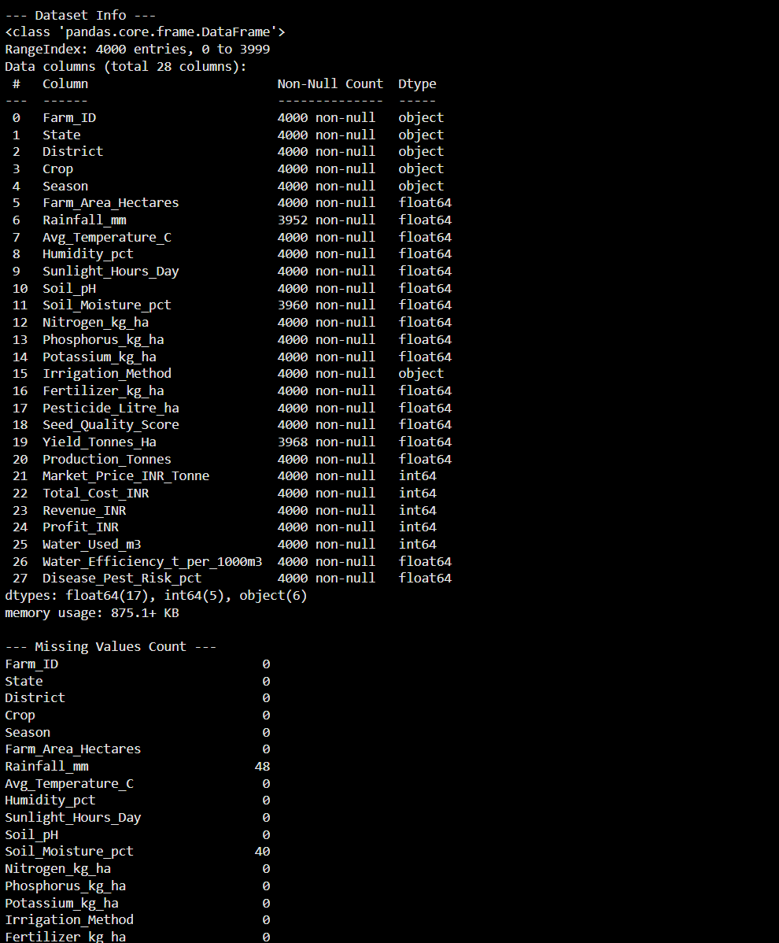
RESULTS

Slide 9
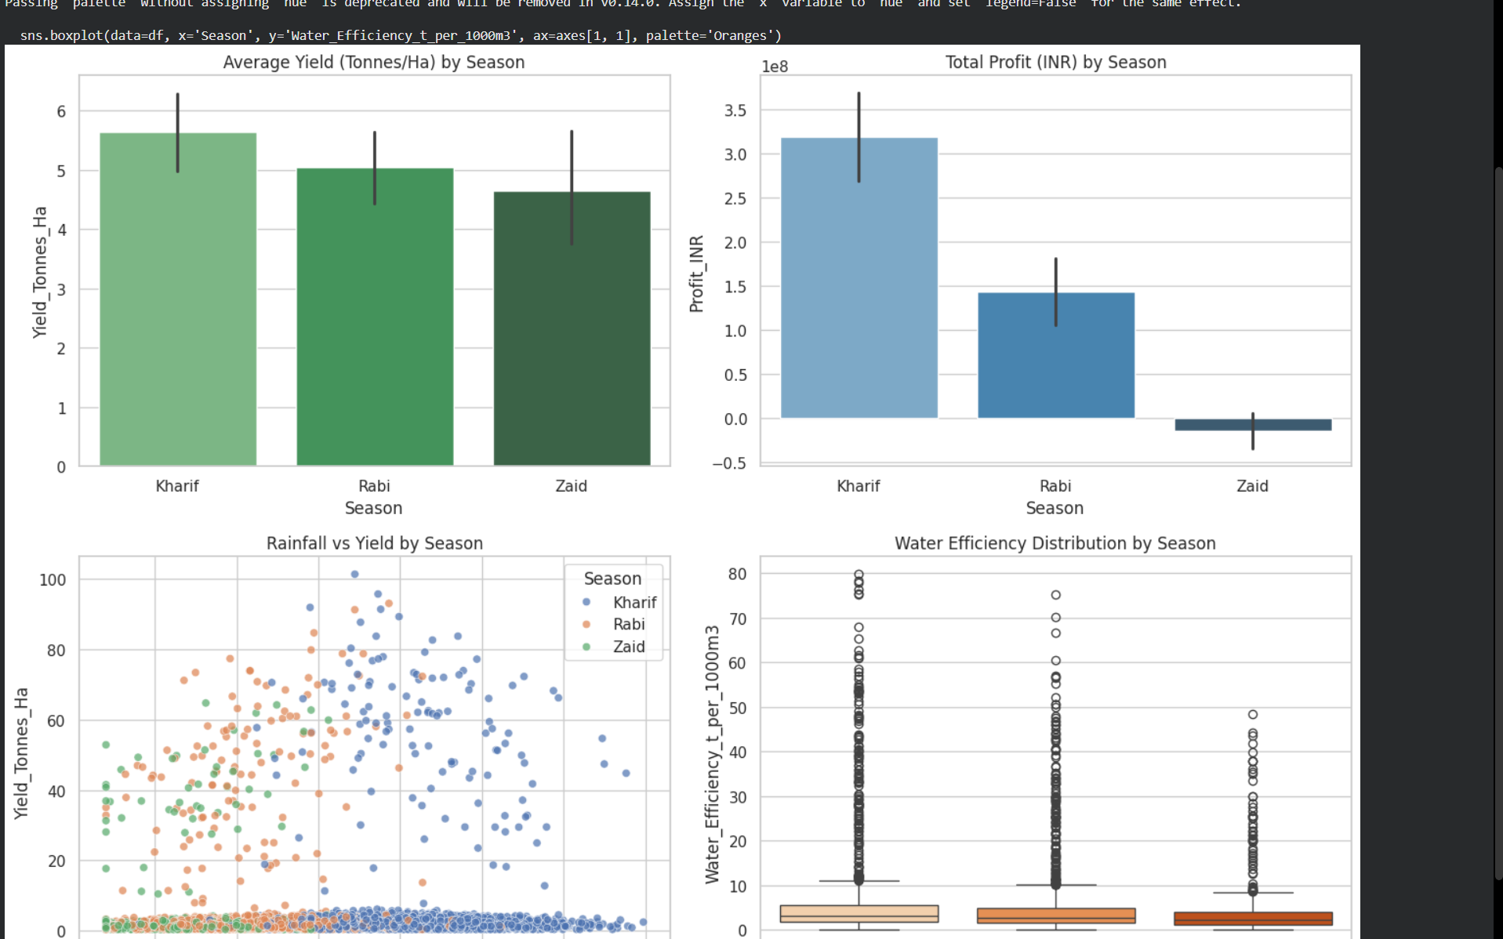
RESULTS

Slide 10
Future scope
Predictive Machine Learning Models: Implement ML algorithms (such as Random Forest or XGBoost) to predict crop yields and profitability based on real-time seasonal and weather forecasts.
IoT & Real-Time Sensor Integration: Integrate IoT soil sensors to collect real-time data on soil moisture, pH, and nutrient levels for automated irrigation and fertigation.
Precision Farming for Dry Seasons (Zaid): Develop specialized crop recommendation systems to suggest high-value, low-water-consuming crops specifically for dry periods.
Economic & Market Integration: Incorporate live market price APIs to help farmers time their crop harvests and sales for maximum profit margins.
Geographic Expansion: Extend the analysis across more states and micro-climatic zones to build a nationwide seasonal agricultural advisory dashboard.

Slide 11
GitHub Link
https://github.com/harithra-muthushanmugam/Seasonal-Agriculture-Performance-Analysis

Slide 12
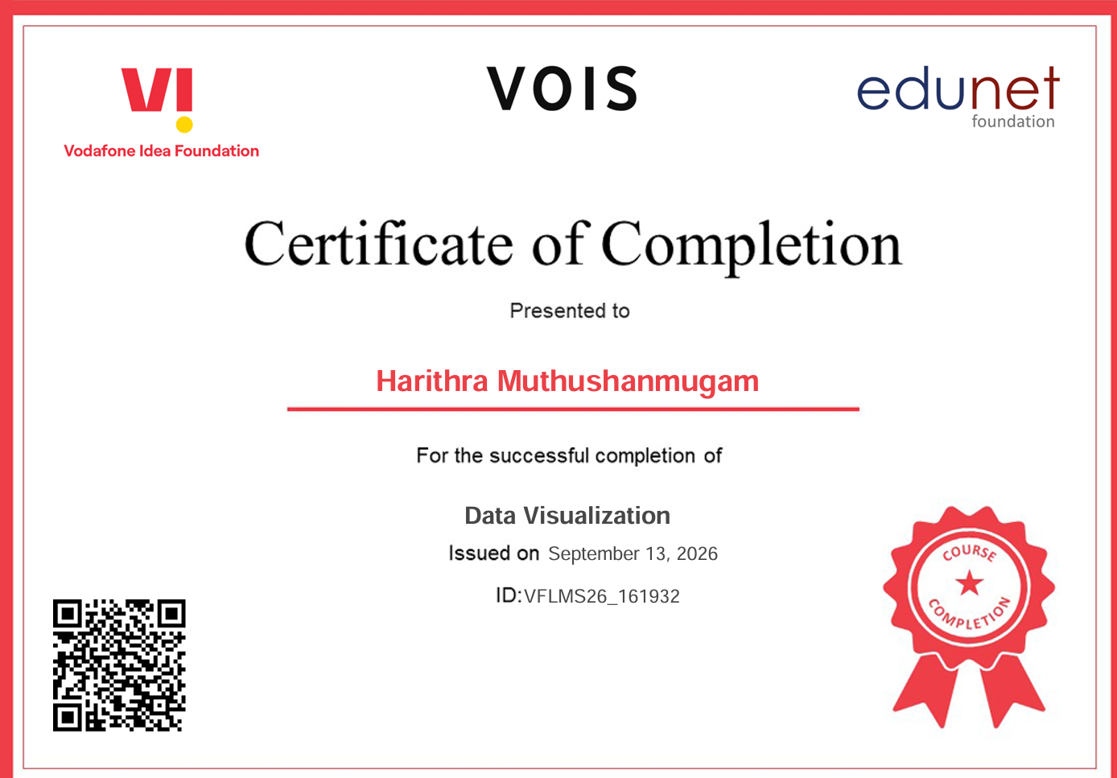
VOIS Course completion certificate -
Course name- Data Visualization

Slide 13
Thank you
Thank You for the valuable internship respected mam and sir!
.
.

