Slide 1
Bachelor’s Thesis Project
PORTFOLIO OPTIMIZATION USING DEEP LEARNING TECHNIQUES
Project Supervisor : Dr. N. Selvaraju
Sakshi Sharma - 170123044
Harit Gupta - 170123020
Indian Institute of Technology, Guwahati

Slide 2
Portfolio Optimisation
A portfolio is defined as a set of financial assets like stocks, bonds, commodities, cash and cash equivalents that are held by an individual, a financial institution or an investment firm.
Portfolio optimization refers to the process of choosing the best portfolio that maximizes expected return and minimizes financial risk.

Slide 3
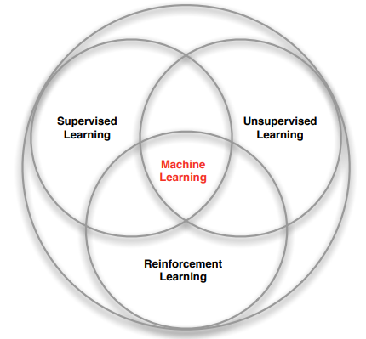
Branches of Machine Learning
Supervised learning
Unsupervised learning
Reinforcement learning

Slide 4
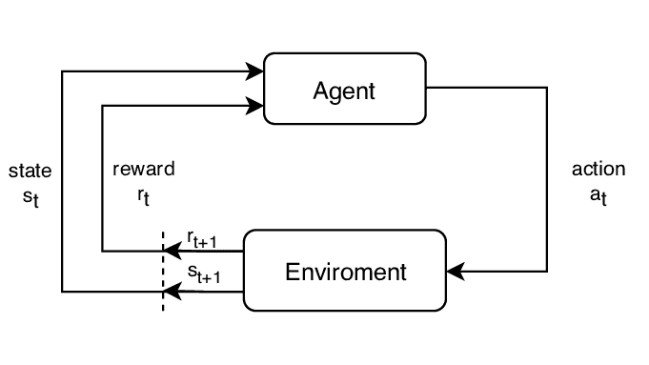
Reinforcement Learning Scheme
Agent (neural network)
Environment (stock market),
Action (buy, sell, hold)
State
Reward (profit / loss)

Slide 5
Components of RL agent
Policy : It is a mapping from state to action that gives actions that the agent can take while it is present in a certain state.
It can be of two types:
i. Deterministic policy: a = π(s)
ii. Stochastic policy: π( a | s) = P[ A_{t} = a | S_{t} = s ]
Value function : It is the expected value of future reward. It is used to evaluate how good or bad a state is and hence make a choice between actions.

Slide 6

Markov Process
History can be regarded as a sequence of all observable variables up to time t (observations, actions and rewards)
State can be described as a function of the history, S_{t} = f(H_{t}).
But, a Markov state contains all the useful information about the history A state S_{t} is Markov if and only if :
P[ S_{t+1} | S_{t} ] = P[ S_{t+1} | S₁ , … , S_{t}].
The state captures all relevant information from the history. The state is a sufficient statistic of the future.

Slide 7
Markov Decision Process
A Markov decision process is a tuple (S,A,P_{a},R_{a}, γ), where
S is the set containing all possible states
A is the set containing all possible actions
P_{a}(s,s') represents the probability of reaching state s’ at time t+1 from state s due to the effect of the action a taken at time t -
P_{a}(s,s') = Pr( s_{t+1} = s' | s_{t} = s, a_{t} = a )
R_{a}(s,s') is the reward gained at time t+1 on moving from state s to s’ due to effect of action a at time t
γ ∈ [0,1] is called the discount factor.

Slide 8

Discounted reward
The return G_{t} is defined as the total discounted reward from time-step as shown:
It can be broken down into two parts -
a)Immediate reward - R_{t+1}
b)Discounted value of the successor state - γV_{π}(S_{t+1})

Slide 9
State value function
For a Markov Decision Process, the state-value function V_{π}(s) is defined as the expected return beginning from state 's', and then following policy π.
Hence the state - value function can be expressed in the form of a well-known formula known as:
Bellman Equation : V_{π}(s) = E_{π}[R_{t+1} + γV_{π}(S_{t+1}) | S_{t} = s]

Slide 10

Action value function
For a Markov Decision Process, the action-value function q_{π}(s, a) is defined as the expected return starting from state 's', choosing action 'a' and then following policy π. It tells the favourability of taking an action 'a' while the agent is in state 's'.
The Bellman Equation corresponding to the action-value function is:
Bellman Equation : q_{π}(s,a) = E_{π}[ R_{t+1} + γq_{π}(S_{t+1} , A_{t+1}) | S_{t} = s, A_{t} = a ]

Slide 11


Optimal Value Function and Policy
The maximum value function that we get considering all the policies, is called optimal state-value function v*(s).
The maximum action-value function that we get considering all the policies, is called the optimal action-value function q*(s,a).

Slide 12
Drawback of Bellman Equation
We solved a known Markov Decision Process. We are assuming that we have with us the transition probabilities from a Markov state s to all its successor states s’, given action a.
We need to explore model-free prediction and control in which we estimate and optimize the value function of an unknown Markov Decision Process.

Slide 13
Model Free Prediction and Control
MDP model is not known but we can sample the experience
The MDP model is known but it is too big to use and can only be used by sampling.
We discussed greedy approach earlier. However, then complete action space may not explored. We may not find the optimal policy.

Slide 14
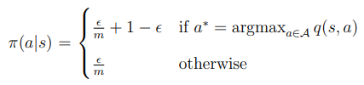
epsilon - Greedy exploration
m = be the number of possible actions from a state.
continual exploration
With probability epsilon, we choose an action at random and
With probability (1 - epsilon), we choose the greedy action.

Slide 15
Q-Learning
Off-policy learning technique for model-free control
Learn from actions that are not a part of the current policy, for example taking random actions.
‘Q’ = quality. In this case, quality depicts the usefulness of a given action in gaining some future reward.

Slide 16
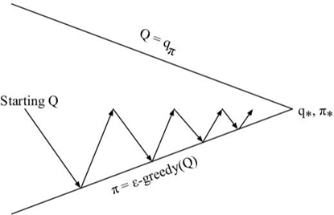
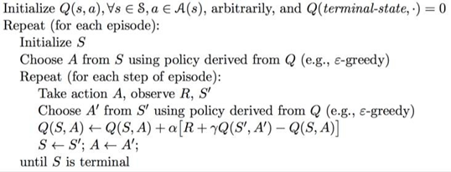
Q - Learning

Slide 17
Motivation for using RNN with LSTM
Neural Networks lack persistence.
Stock market is complex and volatile. We chose to include the class of neural networks that use earlier stages of observations to learn and forecast future trends
Recurrent Neural Network (RNN) uses earlier stages of observations to learn and forecast future trends. But RNN can't utilize long term memory.
LSTM effectively utilizes information from the previous events. Better suited to work on the dynamic structure of stock movement and predict with accuracy.

Slide 18
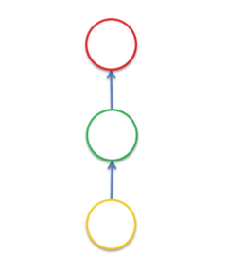
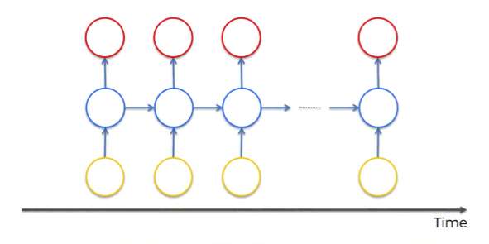
Recurrent Neural Network
Recurrent Neural Networks are an up-gradation to the simple Neural Networks because they use memory to forecast time series, which gives them an edge.
On the left we have simple neural network and on the right a recurrent neural network . But, RNN though superior has its shortcomings.

Slide 19
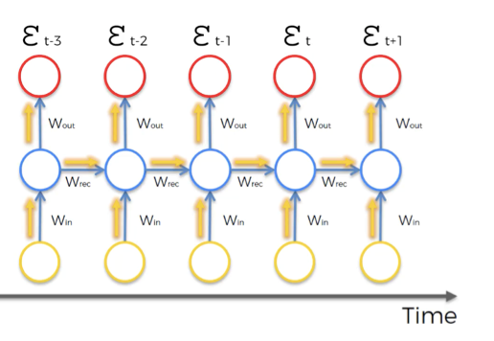
Working of RNN
In simple neural networks, information travels from the direction of input neurons to the output neurons.
The error term is computed and is backpropagated along the neural network, which adjusts the weights accordingly to reduce the cost function
In RNN, there’s an additional component of complexity.

Slide 20
After the cost function ε_{t} has been computed. Backpropagation of the error takes place to adjust the network’s weights.
Every neuron responsible for calculating the output associated with this cost function would be affected.
The weights are updated to minimize that error.
In RNNs, for any time point t, all the neurons with previous time points contributed for the computation of ε_{t} . So, all neurons in this time frame need to be updated.

Slide 21
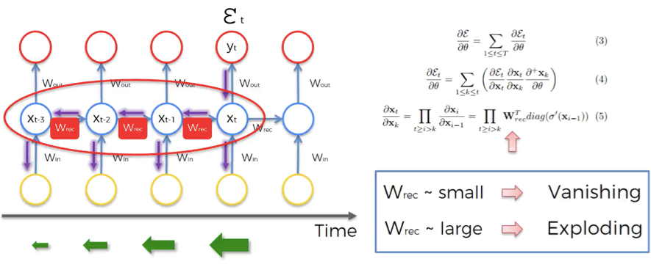
Vanishing Gradient Problem
The issue is associated with adjusting the value of W_{rec}.
So, W_{rec} is getting multiplied several times, and this leads to a problem: A number after getting multiplied by a small number multiple times, its value diminishes very quickly

Slide 22
Implications for RNN
The smaller the gradient value, the more difficult it is to train the network.
Input for a layer depends on the output of the previous layers.
This implies that training at some point t is based on the previous inputs, which are not trained themselves.
To conclude: a small value of W_{rec} leads to vanishing gradient problem, and large value of W_{rec} leads to exploding gradient problem.

Slide 23
Solutions to Vanishing Gradient Problem
Introduce skip connections which join two different hidden layers that are far in time.
Can have gated networks - Long Short-Term Memory Networks (LSTMs).

Slide 24
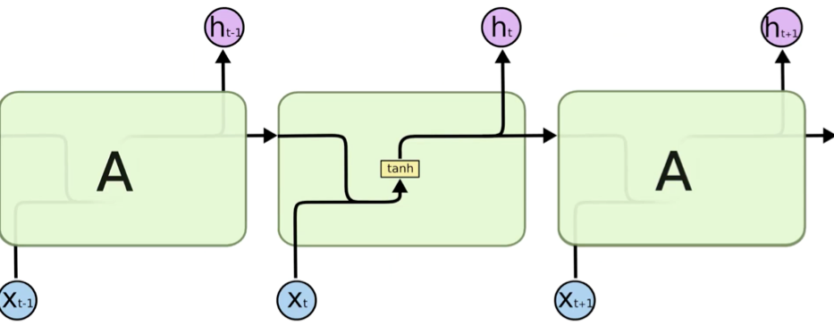
LSTM
LSTM are a specific type of RNN which is capable of having long-term dependencies, by taking W_{rec} = 1.
The hidden layer in the central block receives input X_{t} from the input layer and also from itself in time point t-1, then it generates output h_{t} and also another input for itself but in time point t+1.

Slide 25
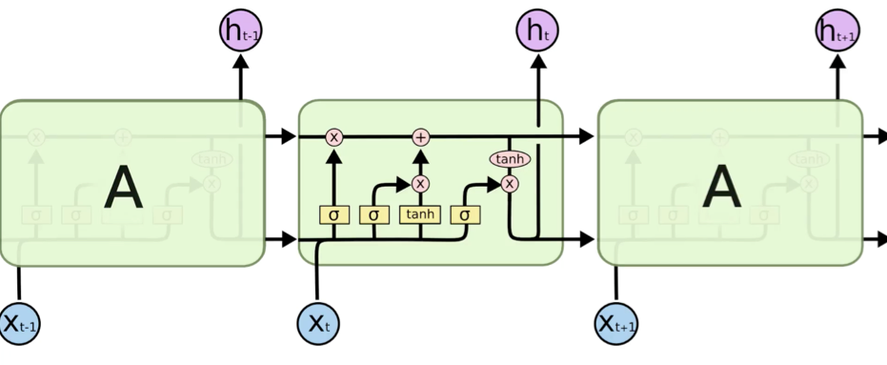
One of the main differences between RNN and LSTM is their architecture.
Unlike RNNs, the hidden layer of LSTM consists of a gated unit.
RNNs neural net layer consists of a single tanh component. Whereas there are three logistic sigmoid gates in addition to the one tanh layer in LSTM.
The purpose of gates is to put a restriction on the movement of information through the cell.

Slide 26
Experimental Results

Slide 27
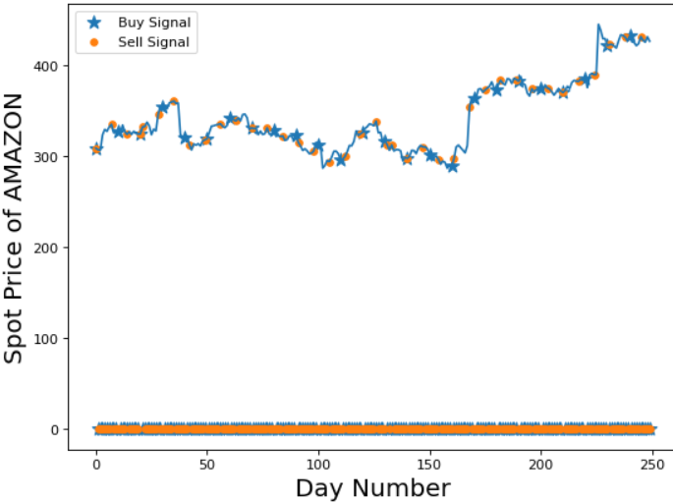
Amazon Stock Price Using DeepQ
Training Period – 1st Jan 2014 to 31st June 2014.
Test Period –1st July 2014 to 1st July 2015
Profit Earned: $162.73

Slide 28
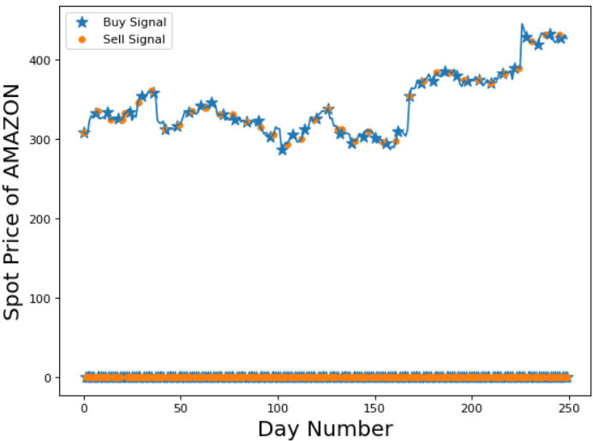
Amazon Stock Price Using LSTM
Training Period – 1st Jan 2014 to 31st June 2014.
Test Period –1st July 2014 to 1st July 2015
Profit Earned: $193.45

Slide 29
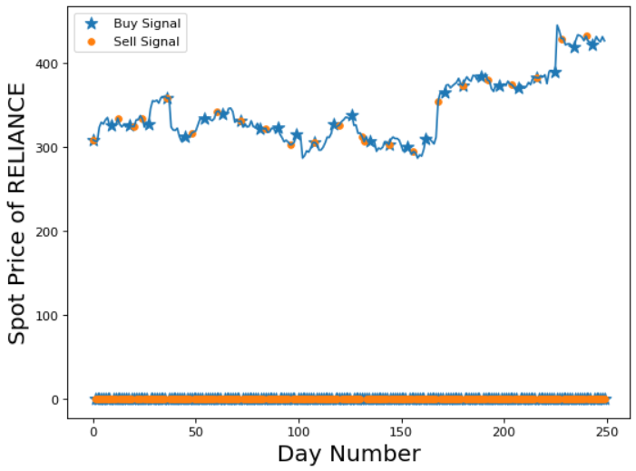
Reliance Stock Price Using DeepQ
Training Period – 1st Jan 2014 to 31st June 2014.
Test Period –1st July 2014 to 1st July 2015
Profit Earned: Rs 254.25

Slide 30
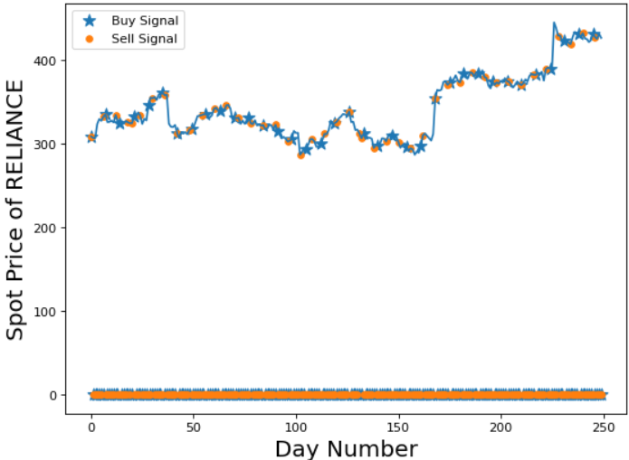
Reliance Stock Price Using LSTM
Training Period – 1st Jan 2014 to 31st June 2014.
Test Period –1st July 2014 to 1st July 2015
Profit Earned: Rs 370.14

Slide 31
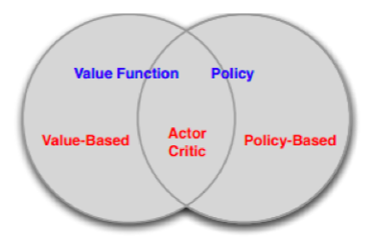
Continuous Time Step on a portfolio of Stocks
Our goal will be to extend the model to take continuous actions and optimize a multi-stock portfolio. We also increased number of parameters.
Policy Based Learning Methods, incrementally develop the most basic REINFORCE algorithm.
Actor-Critic methods optimize REINFORCE algorithm by reducing variance. Combine Value-Based and Policy-Based Learning techniques.
DDPG to develop the improved trading model.

Slide 32
Policy based learning
In policy-based methods, instead of learning a value function that tells us what is the expected sum of rewards given a state and an action, we learn directly the policy function that maps state to action (select actions without using a value function).
Make efficient use of space, which is beneficial when working with continuous action spaces and high-dimensional state spaces.

Slide 33
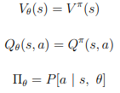
Policy based learning
Value-Based Learning parametrizes the value function using a parameter θ and approximates the optimized values by Q-Learning methods.
Goal is to formulate an algorithm using Policy-Based Learning to parametrize the policy, using an objective function.
Parameterized policy:

Slide 34

Objective function
The reward optimization function (objective function) for a single step MDP Policy-Based Learning is given by:
We're taking average reward per time step – get most reward per time step.
Policy based reinforcement learning is an optimisation problem Find θ that maximises J(θ).

Slide 35

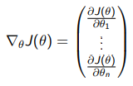
Policy gradient
By changing the gradient's direction, the Policy Gradient algorithm will converge to a maximum in J(θ). In this case, the change in θ is given by:
here, alpha is the learning rate and ∇_{θ}J(θ) is the policy gradient.

Slide 36
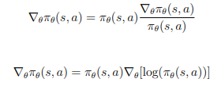


Optimisation of Policy Objective Functions
Using Likelihood Ratios, we form an analytic function in order to obtain the policy gradient.
The optimisation function J(θ) can be restated as :
For a general MDP, we can replace the instantaneous reward with the action-value function as follows:

Slide 37
REINFORCE Algorithm
The most basic algorithm that optimizes the policy by an unbiased sampling of state-action episodes.
Uses Monte Carlo sampling to generate sample episodes.
Has high variance and bias problems because of noise and randomness in Monte Carlo episode generation which may generate very deviating trajectories.
To improve the stability of REINFORCE algorithm, we introduce actor-critic methodology.

Slide 38
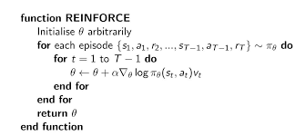
Pseudo Code of Reinforce Algorithm

Slide 39
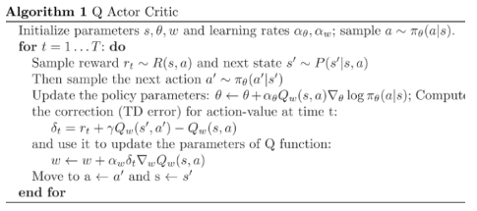
Actor - Critic Method
Critic - Computes action-value function and updates parameter w
Actor- Takes cue from critic and changes the policy parameter θ in direction suggested by critic accordingly
Pseudocode of actor-critic (on Policy Gradient) algorithm:

Slide 40

Deep Deterministic Policy Gradient
While maximising rewards, algorithms like Deep-Q Network and Policy Gradient choose actions by finding the action for which the optimised action-value function has the highest value.
For discrete action spaces, it simply chooses the action a*(s) :
For continuous action spaces, the usual optimization method will make calcu-lation of Q*(s,a) computationally inefficient.
DDPG algorithm provides a direct approximate map to optimised action for each state transition.

Slide 41

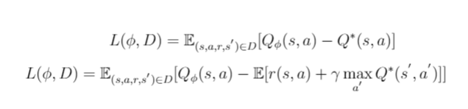
Q learning
The Bellman Equation for optimising the action-value function is
This Bellman equation is the starting point for learning an approximator to Q*(s,a). Suppose the approximator is a neural network Q_{φ}(s,a), with parameters φ, and that we have collected a set D of transitions (s,a,r,s’) .
We can set up a mean-squared Bellman error (MSBE) function, which tells us roughly how closely Q_{φ} comes to satisfying the Bellman equation:

Slide 42
Replay Buffers
The key element of DDPG Q-Learning is Replay Buffers. The algorithm maintains the set of experienced transitions and rewards in a set D.
These set of experiences are sampled to learn the Q-Value and decrease the MSBE.
If the set D stores large number of experiences, then algorithm becomes computationally inefficient.
If the set D stores only recent experiences, then there is risk of over-fitting.

Slide 43


Policy Learning
The goal of the algorithm is to learn a deterministic policy for each state transition. We need to arrive at a policy μ_{θ}(s) which will optimise the action-value function Q_{φ}(s,a). The objective function can be formulated as -
We need to find the parameter θ which maximizes J(θ). We'll use gradient ascent method to optimize the objective function J(θ). The gradient of objective function is formulated as

Slide 44
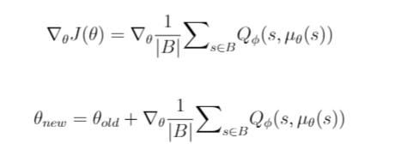
As explained earlier, DDPG employs replay buffers to sample experiences for Q-Learning, same process is applied for Q-Learning as well.
Suppose the method samples a batch of transitions B from experience set D, then the gradient for J(θ) and parameter update equations are given by -
In each iteration, once the algorithm updates Q-value and Policy itself, target networks are updated changing them in the direction of optimized learned networks.

Slide 45
Experimental Results
Our model rather than trading on a single stock, trades on our portfolio which consists of stocks from NASDAQ100 that we feel are representative of different sectors in the index fund.
The price on each day contains open, high, low and close. We use data from 2012-08-13 to 2015-08-12 as training data and data from 2015-08-13 to 2017-08-11 as testing data.
We have used DDPG model and have made 2 cases. One with normal CNN neural networks and the other using LSTM. Also we have taken different window sizes of neural networks to compare the results.

Slide 46
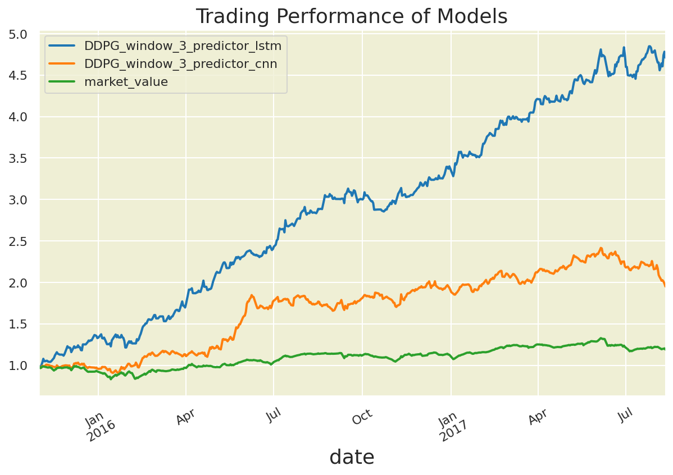
Portfolio Value using window size of 3

Slide 47
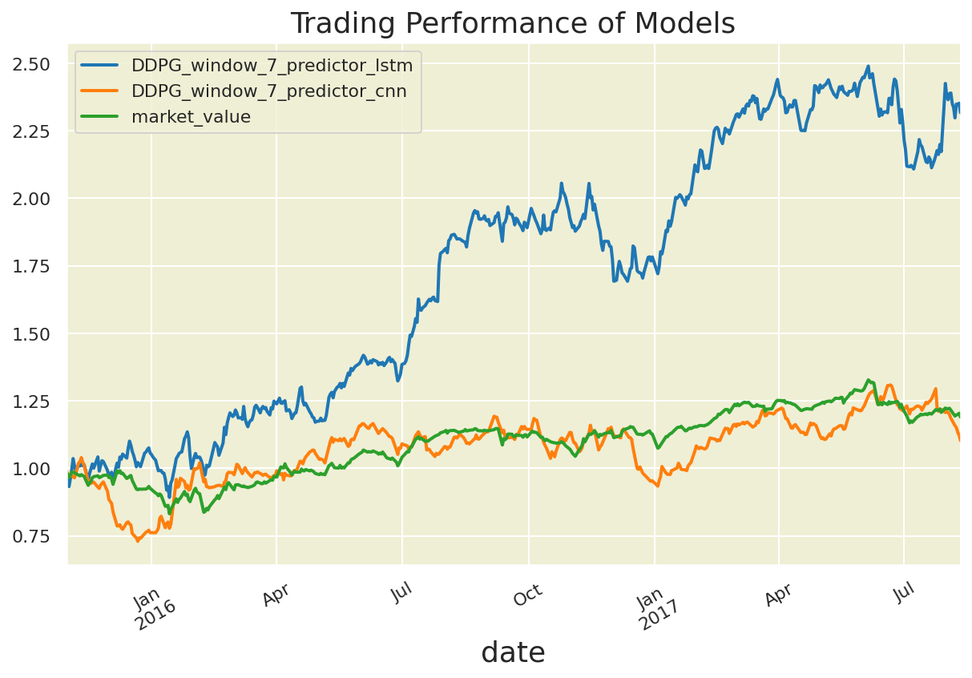
Portfolio Value using window size of 7

Slide 48
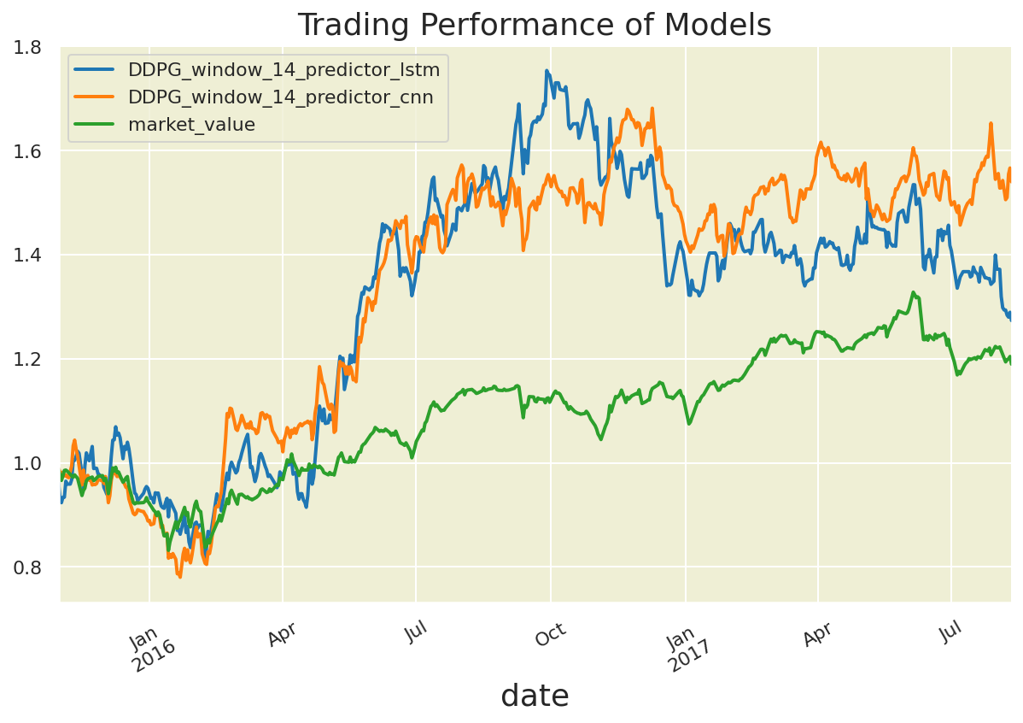
Portfolio Value using window size of 14

Slide 49
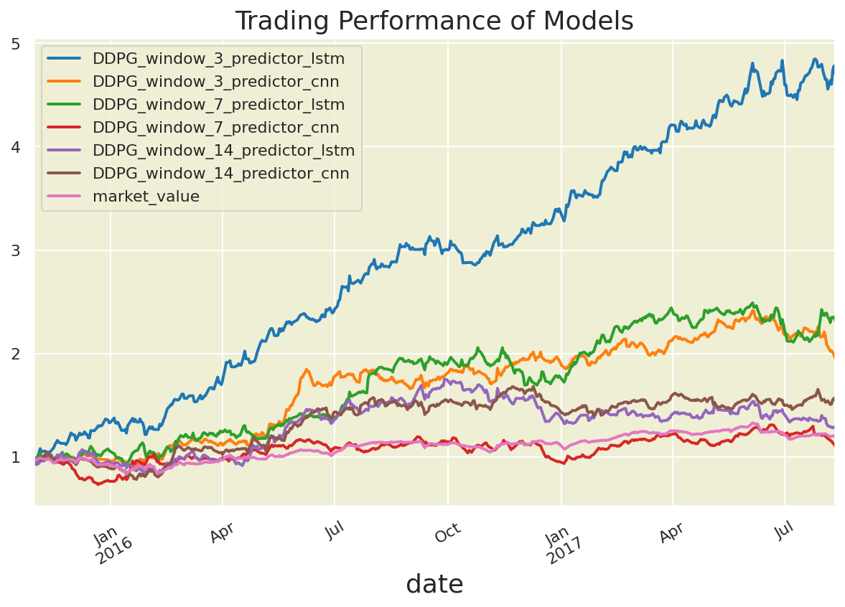
Portfolio Value of all window sizes

Slide 50
Proposed Future Work
A potential enhancement to the algorithm is that we can implement other state-of-art continuous reinforcement learning algorithms such as Proximal Policy Optimization (PPO) and Policy Gradient (PG) in portfolio management for continuous actions.

Slide 51
References
David Silver - UCL Course on Reinforcement Learning
Chien Yi Huang. Financial trading as a game: A deep reinforcement learning approach, 2018.
Zhengyao Jiang, Dixing Xu, and Jinjun Liang. A deep reinforcement learning framework for the financial portfolio management problem, 2017.
Timothy P. Lillicrap, Jonathan J. Hunt, Alexander Pritzel, Nicolas Heess, Tom Erez, Yuval Tassa, David Silver, and Daan Wierstra. Continuous control with deep reinforcement learning, 2019.
Towards Data Science. Understanding actor critic methods.

Slide 52
Thank You!
Sakshi Sharma (170123044)
Harit Gupta (170123020)

