Slide 1
Bachelor’s Thesis Project
PORTFOLIO OPTIMIZATION USING DEEP LEARNING TECHNIQUES
Project Supervisor : Dr. N. Selvaraju
Sakshi Sharma - 170123044
Harit Gupta - 170123020
Indian Institute of Technology, Guwahati

Slide 2
Portfolio Optimisation
A portfolio is defined as a set of financial assets like stocks, bonds, commodities, cash and cash equivalents that are held by an individual, a financial institution or an investment firm.
Portfolio optimization refers to the process of choosing the best portfolio that maximizes expected return and minimizes financial risk.

Slide 3
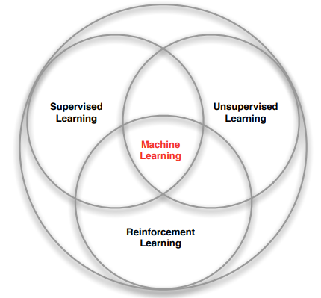
Branches of Machine Learning
Supervised learning
Unsupervised learning
Reinforcement learning

Slide 4
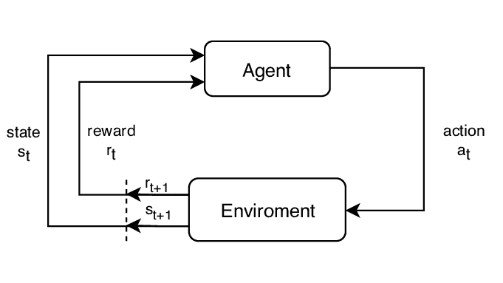
Reinforcement Learning Scheme
Agent (neural network)
Environment (stock market),
Action (buy, sell, hold)
State
Reward (profit / loss)

Slide 5
Reinforcement Learning
Agent maximizes value of a cumulative reward
Agent gets rewards or penalties for the actions it performs and learns from that feedback, no explicit supervisor
Feedback is not instantaneous, might be delayed upto some steps or till the end (eg. learning to play a game)
Time plays an important part (data is sequential)
Examples : self-navigating vacuum cleaners, driverless cars, robots

Slide 6
Components of RL agent
Policy : It is a mapping from state to action that gives actions that the agent can take while it is present in a certain state.
It can be of two types:
i. Deterministic policy: a = π(s)
ii. Stochastic policy: π( a | s) = P[ A_{t} = a | S_{t} = s ]

Slide 7
Components of RL agent
Value function : It is the expected value of future reward. It is used to evaluate how good or bad a state is and hence make a choice between actions.
Model: A model predicts the future movements of the environment.

Slide 8
Why do we take Markov Decision Processes as dicounted?
Mathematically convenient
Avoids infinite returns in cyclic Markov processes
For financial rewards, immediate rewards may earn more interest than delayed rewards
Animal/human behaviour shows preference for immediate reward
It is sometimes possible to use undiscounted Markov reward processes (i.e. γ = 1), e.g. if all sequences terminate.

Slide 9

Markov Process
History can be regarded as a sequence of all observable variables up to time t (observations, actions and rewards)
State can be described as a function of the history, S_{t} = f(H_{t}).
But, a Markov state contains all the useful information about the history A state S_{t} is Markov if and only if :
P[ S_{t+1} | S_{t} ] = P[ S_{t+1} | S₁ , … , S_{t}].
The state captures all relevant information from the history. The state is a sufficient statistic of the future.

Slide 10
Markov Decision Process
A Markov decision process is a tuple (S,A,P_{a},R_{a}, γ), where
S is the set containing all possible states
A is the set containing all possible actions
P_{a}(s,s') represents the probability of reaching state s’ at time t+1 from state s due to the effect of the action a taken at time t -
P_{a}(s,s') = Pr( s_{t+1} = s' | s_{t} = s, a_{t} = a )
R_{a}(s,s') is the reward gained at time t+1 on moving from state s to s’ due to effect of action a at time t
γ ∈ [0,1] is called the discount factor.

Slide 11

Discounted reward
The return G_{t} is defined as the total discounted reward from time-step as shown:
It can be broken down into two parts -
a)Immediate reward - R_{t+1}
b)Discounted value of the successor state - γV_{π}(S_{t+1})

Slide 12
State value function
For a Markov Decision Process, the state-value function V_{π}(s) is defined as the expected return beginning from state 's', and then following policy π.
Hence the state - value function can be expressed in the form of a well-known formula known as:
Bellman Equation : V_{π}(s) = E_{π}[R_{t+1} + γV_{π}(S_{t+1}) | S_{t} = s]

Slide 13

Action value function
For a Markov Decision Process, the action-value function q_{π}(s, a) is defined as the expected return starting from state 's', choosing action 'a' and then following policy π. It tells the favourability of taking an action 'a' while the agent is in state 's'.
The Bellman Equation corresponding to the action-value function is:
Bellman Equation : q_{π}(s,a) = E_{π}[ R_{t+1} + γq_{π}(S_{t+1} , A_{t+1}) | S_{t} = s, A_{t} = a ]

Slide 14


Optimal Value Function and Policy
The maximum value function that we get considering all the policies, is called optimal state-value function v*(s).
The maximum action-value function that we get considering all the policies, is called the optimal action-value function q*(s,a).

Slide 15
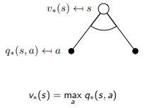
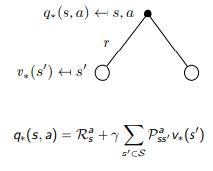
Bellman Optimality Equation

Slide 16
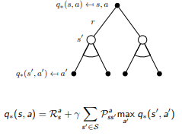
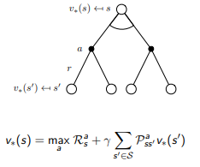
Bellman Optimality Equation

Slide 17
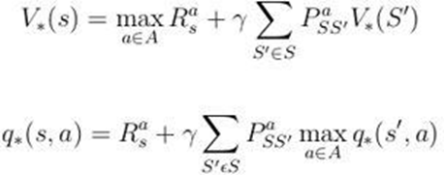
Bellman Optimality Equation
Optimize the value function (or, action-value function), that is, find an optimal policy, using greedy approach.

Slide 18
Drawback of Bellman Optimality Equation
We solved a known Markov Decision Process. We are assuming that we have with us the transition probabilities from a Markov state s to all its successor states s’, given action a.
We need to explore model-free prediction and control in which we estimate and optimize the value function of an unknown Markov Decision Process.

Slide 19
Model Free Prediction and Control
MDP model is not known but we can sample the experience
The MDP model is known but it is too big to use and can only be used by sampling.
We discussed greedy approach earlier. However, then complete action space may not explored. We may not find the optimal policy.

Slide 20
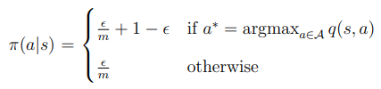
epsilon - Greedy exploration
m = be the number of possible actions from a state.
continual exploration
With probability epsilon, we choose an action at random and
With probability (1 - epsilon), we choose the greedy action.

Slide 21
Q-Learning
Off-policy learning technique for model-free control
Learn from actions that are not a part of the current policy, for example taking random actions.
‘Q’ = quality. In this case, quality depicts the usefulness of a given action in gaining some future reward.

Slide 22
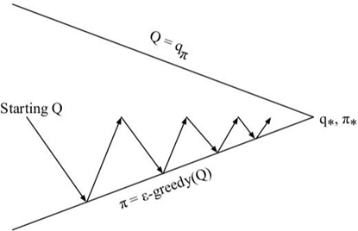
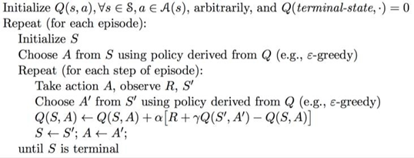
Q - Learning

Slide 23
Motivation for using RNN with LSTM
Neural Networks lack persistence.
Stock market is complex and volatile. We chose to include the class of neural networks that use earlier stages of observations to learn and forecast future trends
Recurrent Neural Network (RNN) uses earlier stages of observations to learn and forecast future trends. But RNN can't utilize long term memory.
LSTM effectively utilizes information from the previous events. Better suited to work on the dynamic structure of stock movement and predict with accuracy.

Slide 24
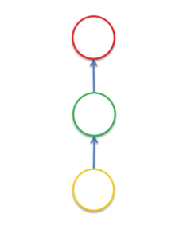
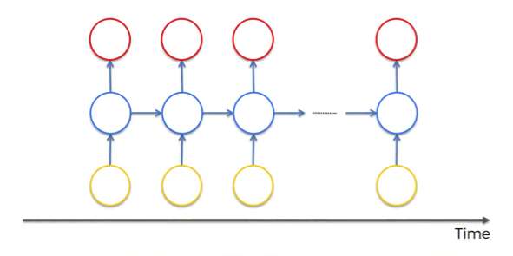
Recurrent Neural Network
Recurrent Neural Networks are an up-gradation to the simple Neural Networks because they use memory to forecast time series, which gives them an edge.
On the left we have simple neural network and on the right a recurrent neural network . But, RNN though superior has its shortcomings.

Slide 25
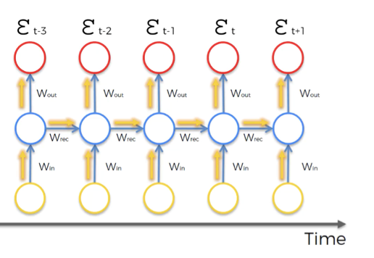
Working of RNN
In simple neural networks, information travels from the direction of input neurons to the output neurons.
The error term is computed and is backpropagated along the neural network, which adjusts the weights accordingly to reduce the cost function
In RNN, there’s an additional component of complexity.

Slide 26
After the cost function ε_{t} has been computed. Backpropagation of the error takes place to adjust the network’s weights.
Every neuron responsible for calculating the output associated with this cost function would be affected.
The weights are updated to minimize that error.
In RNNs, for any time point t, all the neurons with previous time points contributed for the computation of ε_{t} . So, all neurons in this time frame need to be updated.

Slide 27
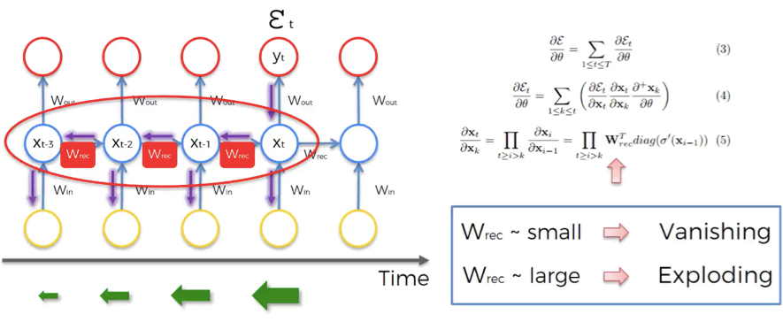
Vanishing Gradient Problem
The issue is associated with adjusting the value of W_{rec}.
So, W_{rec} is getting multiplied several times, and this leads to a problem: A number after getting multiplied by a small number multiple times, its value diminishes very quickly

Slide 28
Implications for RNN
The smaller the gradient value, the more difficult it is to train the network.
Input for a layer depends on the output of the previous layers.
This implies that training at some point t is based on the previous inputs, which are not trained themselves.
To conclude: a small value of W_{rec} leads to vanishing gradient problem, and large value of W_{rec} leads to exploding gradient problem.

Slide 29
Solutions to Exploding Gradient Problem
• Stop backpropagating after some time point.
• Can manually reduce gradient value.
• Can put a threshold maximum limit on the value of gradient.

Slide 30
Solutions to Vanishing Gradient Problem
Initializing weights to reduce the extent of vanishing gradient.
Introduce skip connections which join two different hidden layers that are far in time.
Can have gated networks - Long Short-Term Memory Networks (LSTMs).

Slide 31
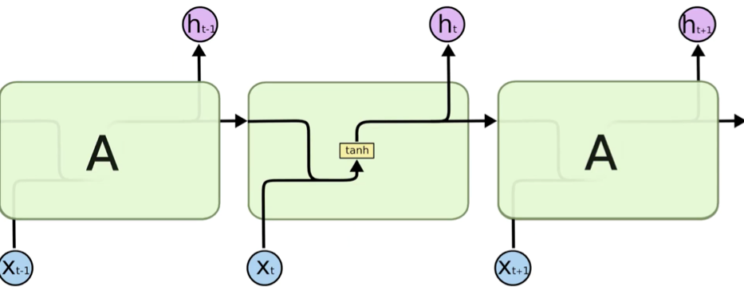
LSTM
LSTM are a specific type of RNN which is capable of having long-term dependencies, by taking W_{rec} = 1.
The hidden layer in the central block receives input X_{t} from the input layer and also from itself in time point t-1, then it generates output h_{t} and also another input for itself but in time point t+1.

Slide 32
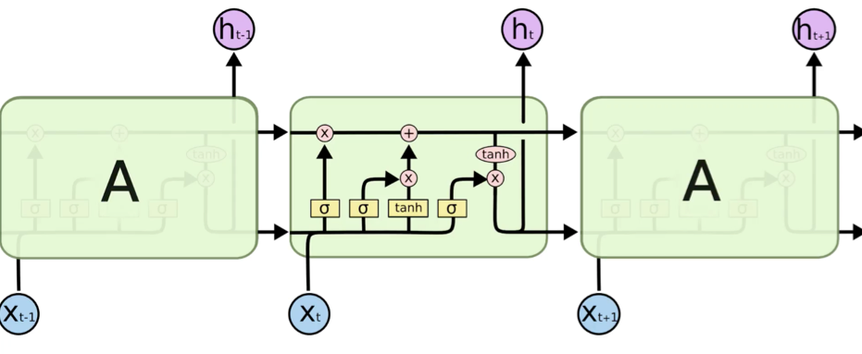
One of the main differences between RNN and LSTM is their architecture.
Unlike RNNs, the hidden layer of LSTM consists of a gated unit.
RNNs neural net layer consists of a single tanh component. Whereas there are three logistic sigmoid gates in addition to the one tanh layer in LSTM.
The purpose of gates is to put a restriction on the movement of information through the cell.

Slide 33
Experimental Results

Slide 34
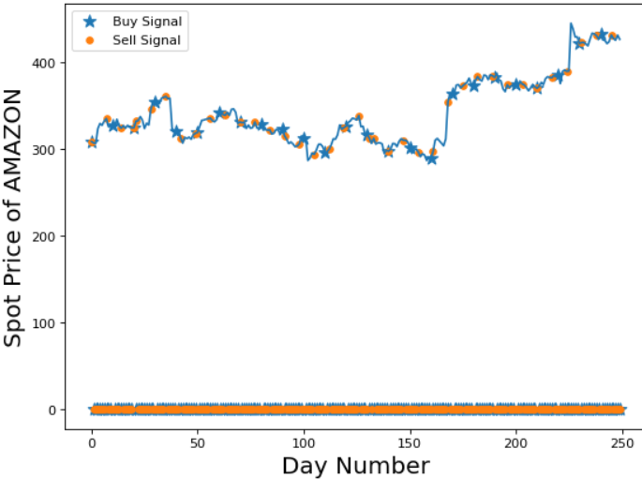
Amazon Stock Price Using DeepQ
Training Period – 1st Jan 2014 to 31st June 2014.
Test Period –1st July 2014 to 1st July 2015
Profit Earned: $162.73

Slide 35
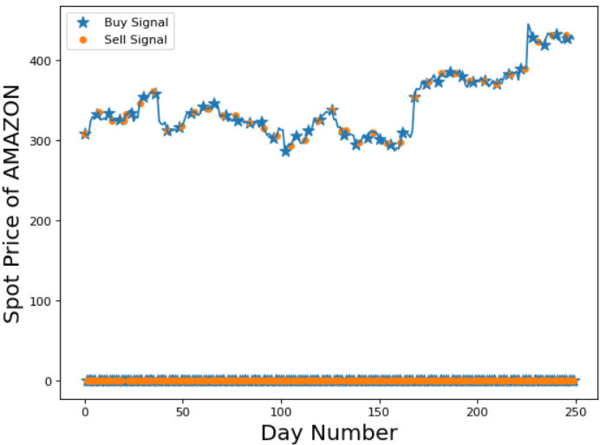
Amazon Stock Price Using LSTM
Training Period – 1st Jan 2014 to 31st June 2014.
Test Period –1st July 2014 to 1st July 2015
Profit Earned: $193.45

Slide 36
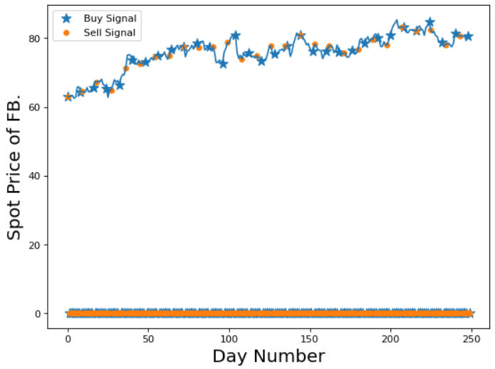
FB Stock Price Using DeepQ
Training Period – 1st Jan 2014 to 31st June 2014.
Test Period –1st July 2014 to 1st July 2015
Profit Earned: $90.57

Slide 37
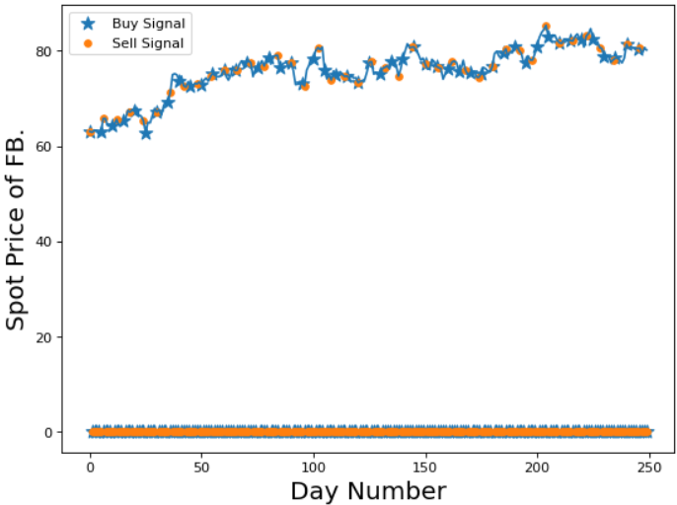
FB Stock Price Using LSTM
Training Period – 1st Jan 2014 to 31st June 2014.
Test Period –1st July 2014 to 1st July 2015
Profit Earned: $122.59

Slide 38
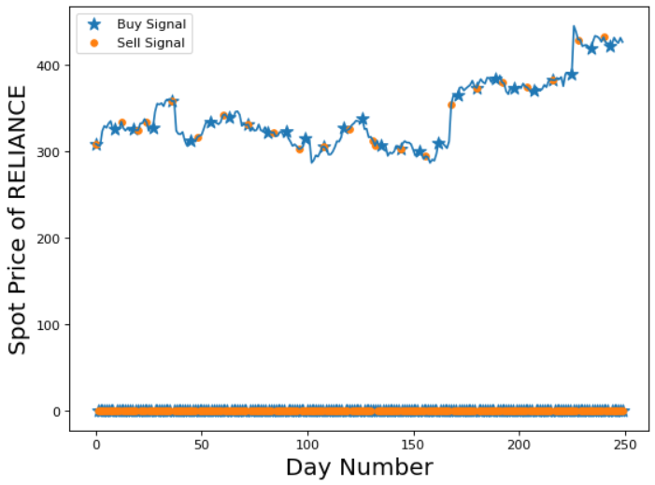
Reliance Stock Price Using DeepQ
Training Period – 1st Jan 2014 to 31st June 2014.
Test Period –1st July 2014 to 1st July 2015
Profit Earned: Rs 254.25

Slide 39
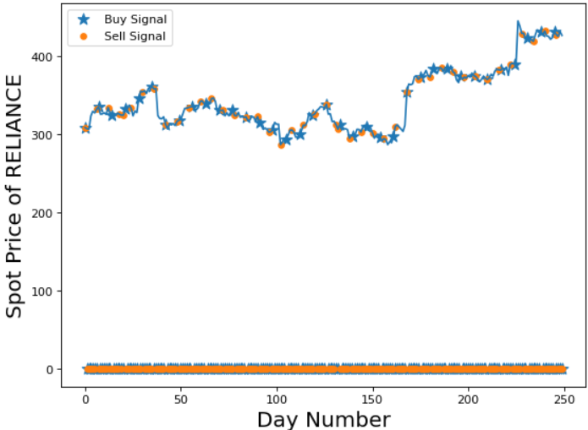
Reliance Stock Price Using LSTM
Training Period – 1st Jan 2014 to 31st June 2014.
Test Period –1st July 2014 to 1st July 2015
Profit Earned: Rs 370.14

Slide 40
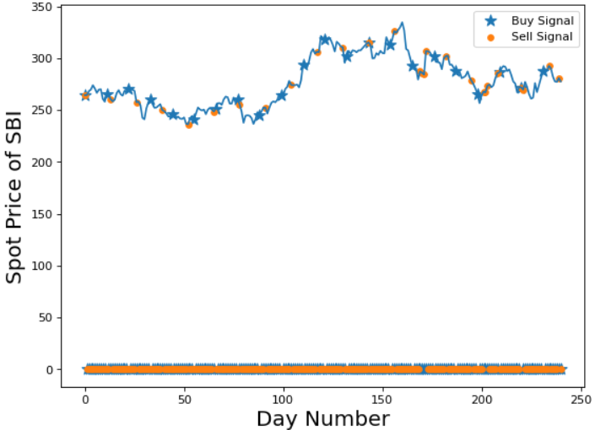
SBI Stock Price Using DeepQ
Training Period – 1st Jan 2014 to 31st June 2014.
Test Period –1st July 2014 to 1st July 2015
Profit Earned: Rs 332.64

Slide 41
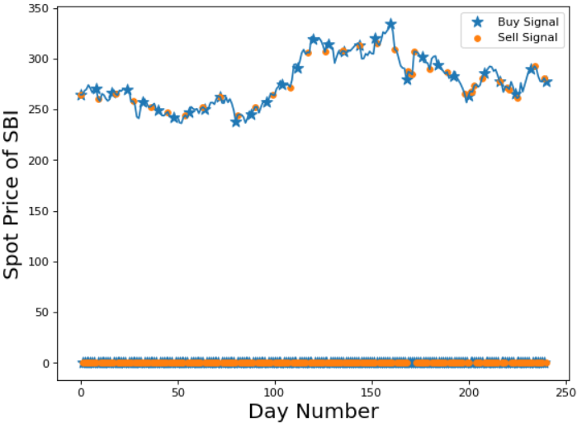
SBI Stock Price Using LSTM
Training Period – 1st Jan 2014 to 31st June 2014.
Test Period –1st July 2014 to 1st July 2015
Profit Earned: Rs 354.25

Slide 42
Proposed Future Work
Including more parameters
Examining and optimising multi-stock portfolio
Sentiment analysis
Use API for data extraction

Slide 43
References
David Silver - UCL Course on Reinforcement Learning
Chien Yi Huang. Financial trading as a game: A deep reinforcement learning approach, 2018.
Christopher Olah. Understanding lstm networks, 2015
Yoshua Bengio. Learning long-term dependencies with gradient descent is difficult, (1994).
Razvan Pascanu, Tomas Mikolov, and Yoshua Bengio. On the difficulty of training recurrent neural networks, 2013
Zhichao Zou and Zihao Qu. Using lstm in stock prediction and quantitative trading. CS230: Deep Learning, Winter 2020:1,5, 2020.

Slide 44
Questions? Thank You!
Sakshi Sharma (170123044)
Harit Gupta (170123020)

