Slide 1
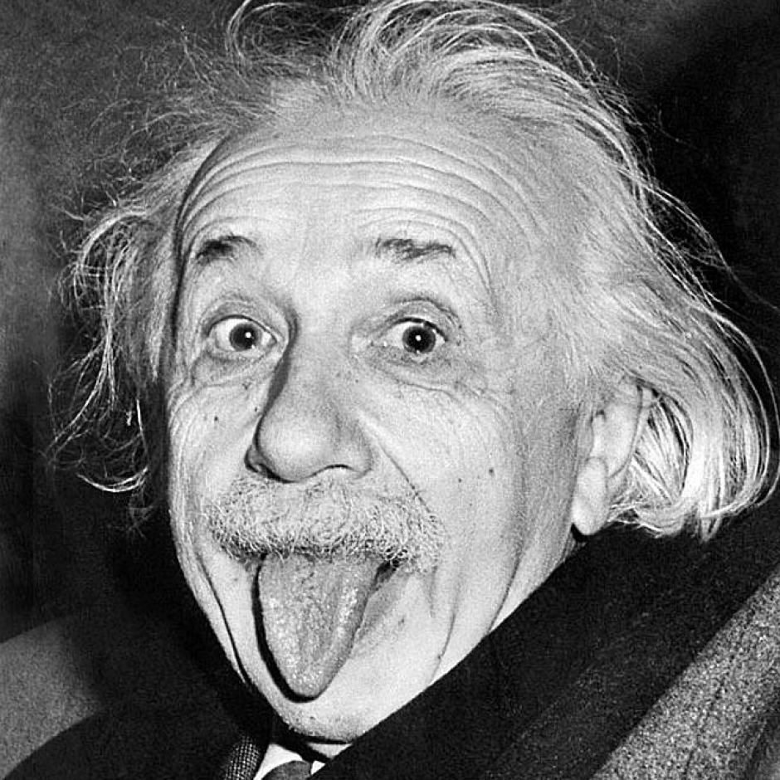
“In theory, theory and practice are the same. In practice, they are not.”
Albert Einstein.

Slide 2
Outline
Who am I and who is Optiver
Theory and Reality and how we think
Algorithms in the wild
Software Development Processes
Easy to fail
Comparisons waterfall versus agile
How to cope with:
Uncertainty
Change
Complexity
Scale

Slide 3
Who Am I…
Andrew Maxwell
Education:
Bachelor Science (hons)
Masters Applied Finance
20 years experience
Many industries:
Consulting, Finance, Telecoms, Defence, Technology, Government, Industrial…
Many companies:
Optiver, Goldman Sachs, Macquarie Bank, Lehman Brothers, BNP – Paribas, Commonwealth Bank, Telstra, Siemens, Sun, NSW Police…
Practitioner… applying theory to reality
Notes:
I’ll put talk in terms of the company I currently work for… Optiver

Slide 4

Optiver: Best Place to Work in Australia!
Best and brightest people, who love doing best and brightest work
Informal atmosphere – short, t-shirts, thongs
Perks: Annual company holiday, Company chef cooks breakfast, lunch (and dinner), Barrister (unlimited espresso coffee), Gym memberships, personal training sessions, massages, Pool tables, table tennis tables, video games, paid charity time…

Slide 5

Who are Optiver?
Amsterdam
USA
Europe
ASIAPAC
Notes:
Ok, so who are we?
We started as a group of market makers on the Amsterdam trading floor in 1986 and today, 25 years later, we are the largest privately owned trading house in Europe and the Asia Pacific Region with a growing presence in the US.
Who do we work for? we work for ourselves so we don’t have any clients, we are a proprietary trading firm, we use our own money (company money), make our own trading decisions and set our own risk parameters. We take all the profits and any losses.
Founded in Amsterdam in 1986
↘
Largest privately owned trading house in:
Europe
Asia Pacific
USA Proprietary trading firm

Slide 6

Market Making
We are Market Makers
We make money by being the most accurate at pricing a product right now instead of predicting what it will be worth in the distant future.
Make bids/offers in derivative markets around where we think the derivative is worth
Notes:
Maybe what’s more relevant is how we differ from a broker or an investment bank?
(We only trade) Trading is our speciality. Options in particular. We do trade other products but our main focus is derivatives.
Our business is not in attempting to make long term predictions about the future price of a product. Instead, we attempt to make money at pricing the current value of a product more accurately than our competitors.

Slide 7
Arbitrage Trading
Quantify arbitrage relationships between correlated products
Provide the tightest bids/offers in these products
Why do we love it?
Low risk (small overnight positions)
Minimal capital requirement
Natural progression for our automated trading systems
What do you need?
Speed
Best pricing
Smart trading algorithms
Notes:
The pricing of options, stocks, futures and other financial products are closely related.
You can often price one in terms of the other (or a combination others), but these relationships are complex.
If we can more accurately price a product than anyone else, we can clearly identify when its pricing is out of whack, and capitalise on the difference - this is called arbitrage.

Slide 8
IT
Having the best IT is critical to our success!

Slide 9

Infinitely Complex World
Notes:
Lets start with where are brains were formed… (solving other peoples problems is often easier than solving our own)
As humans evolved there was great reward in solving some problems… and natural selection did the rest…
Imagine yourself on the plains of Africa 100,000s of years ago a scene like this…
What’s important to you?

Slide 10
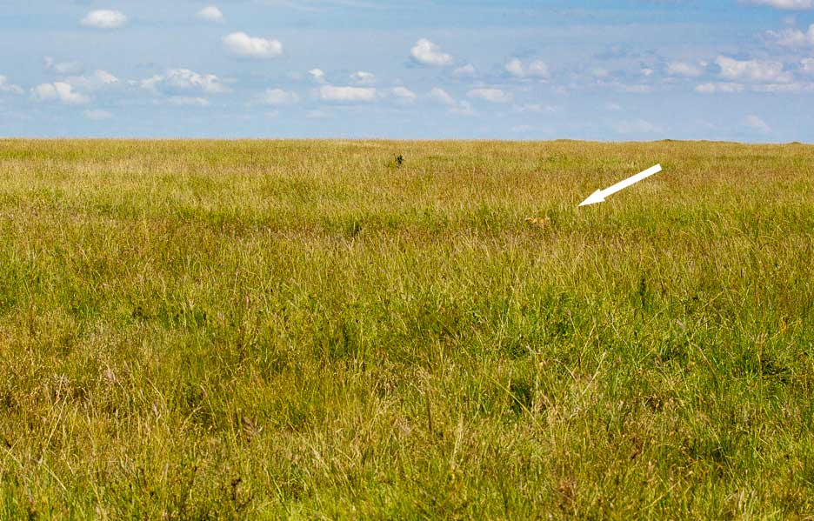

How can a finite brain cope?
Notes:
How can our brain’s possibly process that much information?

Slide 11
How do you avoid being lion lunch!
Two steps
Deduce
Thorough but slow
e.g. look at each blade of grass in picture!
Match to a model/pattern in mind… theory
Jump straight to the answer from same inputs
Super quick
Problem becomes solvable!...
BUT be carefule…
Notes:
Why is this relevant???
Because its how our brains developed and software is about the reality of our brain

Slide 12
Reality → Theory; but Theory ≠ Reality
Theory is less than infinite!
We have to choose the “right” theory at the right time
Paradoxes: Two “correct” theories that are contradictory… will happen!
If we only use the “short cuts” of theory it will blind us to reality (we only see the “theory”)
Your brain is hard wired to “instinctively” react off your theory (logical model)… without thinking!!! (Remember the lion)
Notes:
Theory lets you learn the accumulated knowledge of all who came before you… however it does not help you apply it… that’s your responsibility!

Slide 13
Algorithms
Theory will teach us about the speed of an algorithm.
How do they perform in practice?
… read the “fine print”…
Base on many generalising assumptions that often don’t apply

Slide 14

Algorithm Assumption 1
Asymptote as inputs reach infinity
Practice:
Real problems are often smaller than infinity ☺
Implication:
In most scenarios it doesn’t matter.
Creating/maintaining data structures are not free

Slide 15
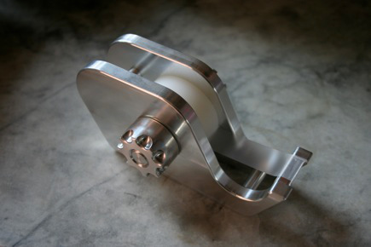
Algorithm Assumption 2
Focus on worst case, not typical case.
Eg. Quicksort:
Worst Cast: O(n²),
Average Case O( n log n)
Reality… even better!
Oven doors for windows
Notes:
Countless examples of people focusing on “worst case”

Slide 16
Algorithm Assumption 3:
Assumption: All memory access costs are equal
Practice: Random access memory is rarely accessed randomly, so CPUs use caches…and hardware prefetching.
L1 cache reference:
L2 cache reference:
Main memory reference:
Disk seek:
0.5 ns
7 ns
100 ns
10,000,000 ns

Slide 17
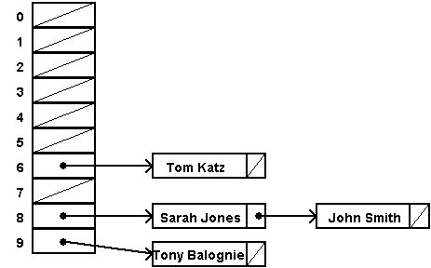
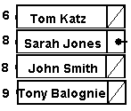
Example: map lookup…
Hash Table
Array

Slide 18
How do you write big complex software?
In practice… most do it badly…it’s hard!
…The report notes that the Queensland Government paid IBM some $25.7 million for the replacement payroll system, after the original contract price was $6.2 million. However, the cost of operating the system has been estimated by KPMG to be $416.6 million for the three years to 30 June this year, as well as a further $836.9 million for the five years ending 30 June 2017.
Notes:
http://delimiter.com.au/2013/08/07/anatomy-of-qld-health-it-disaster%E2%80%A8-ibm-should-never-have-been-appointed/

Slide 19


Theory: Have a great process
PRINCE2
Agile
Scrum
Kanban
Extreme
These are like a tradesman’s tools. Don’t try to build a house without them!
You can have a ute full of great tools, but it’s how you use them that will make you a great builder.
Notes:
No guarantee of success
Help you make some of the generalised decisions that are common and for which there is a generalised solution… not all problems are like that.
Help you learn ways to avoid making mistakes
Again I’m not criticising these methodologies… what I’m warning against is blind reliance on them. You must think. If you can deduce the conclusions from first principals then you will find it almost impossible to apply

Slide 20
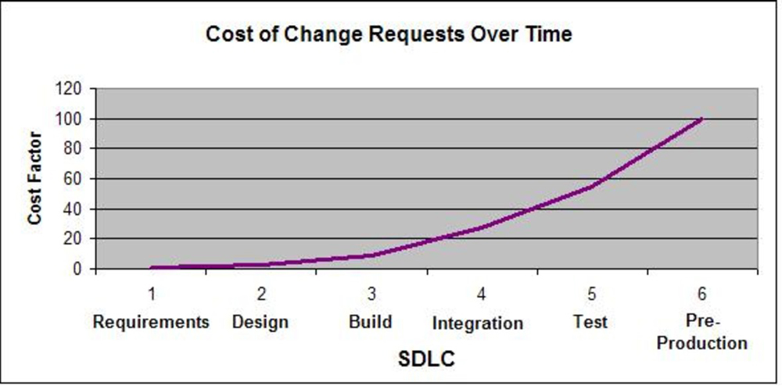
Theory: Don’t code before thorough analysis and design
Cost of change is exponential through cycle
Great software happens beyond the keyboard
Notes:
http://conversationswithandrew.blogspot.com.au/

Slide 21

Paradox: Waterfall vrs Agile
Waterfall make so much more sense!
Surely you plan before you do it… who builds a house without detailed plans?
But Agile can work so much better… Why?
Is it always better???

Slide 22
Uncertainty
Uncertainty of success: Scale project scope with success
Many possible projects, so allocate more to the successful ones.
Uncertainty of details: Can’t know if you know everything
No better way to minimise uncertainty that to do it!
Failures:
* Commonwealth Bank – couple of words can double scope!
* Universal connectivity project – try to cater for every possibility
Notes:
For many systems (especially Optiver’s) the scope of the project depends on how successful the software is. There is a very real possibility that the idea will fail and so the software will be thrown away. However if it’s successful more will be wanted.
For complex systems analysing upfront is massive, and you can’t prove you haven’t forgotten something.

Slide 23
Change
Requirements change
Our understanding changes… we learn!
People Change
Failures:
* Digital camera system
Notes:
Software needs to be different soon after you write the spec
Eg regulations and market conditions change constantly
Our understanding of many things changes:
Requirements
Problems
Best solutions
Risks
We learn!
Practice: the people with the knowledge will change
Jobs
get bored
Sick
Jury duty
Go on holidays
have personal issues…

Slide 24
Complexity
90/10 rule
KISS
Complexity often becomes simple after you start
Failure:
Black box trading algorithms
GFC
Notes:
Theory might argue that highly complexity demands more upfront planning… sensible…hard to argue with!
Practice: 90/10 rule
If you asked the person paying the bill “do you want to spend 90% of your budget on this 10%”... most will say: NO WAY!
Practice: KISS
Do as much as you can with the least you can
Leave the “corner cases” in the corner
Practice: you’ll often avoid much of the complexity when you do the stuff around it.
Discover a way to avoid it totally
Discover a way to make it simple

Slide 25

Scale
Projects don’t scale linearly!!!
< 1 person: inefficient
> 1 person: Productivity is (at very best!) square root of the number of people involved.
Inter-dependencies kill
Give people a clear boundary or responsibility… then don’t micro manage.
Failures:
No one sees the end-to-end
Throw more people at a big project
Notes:
If project bigger than one person… just add more people… right?
Practice: People and projects don’t scale linearly!!!
< 1 person Inefficient - Effort to manage them is greater than the effort to do them
> 1 person
Productivity is (at best!) square root of the number of people involved.
Avoid inter-dependencies of people (and software)
Need interfaces… but that has a cost
Interfaces are rarely perfect
Interfaces are hard to change
No one sees end-to-end… busy-work

Slide 26
Functionality
Deliver functional requirements, not software requirements
Interfaces “hide” complexity, then tail wags the dog
Failures:
Two teams working to a protocol for multiple years
Projects trying to build database abstraction layers rather than deliver

Slide 27
Conclusion
How to succeed and avoid failures:
Know your theory!
Understand the why behind what you learn
Learn from experience
Don’t ever stop thinking (challenge everything)
Common sense that isn’t all that common
Remember in theory Optiver shouldn’t exist…

Slide 28

Get Some Experience!
Optiver IT Jobs
* Summer intern, applications June, for 12 week rotation, real projects
* Graduate IT, applications August
Software Developers
Applications Engineers
Network Engineers

