Slide 1
Machine Maintenance Insight
MechaCare Industrial Systems | DS Sprint — Use Case 25
Business question: What operating patterns indicate machines that require maintenance attention?
Objective: move from reactive repair to evidence-led inspection priorities.
Data status: synthetic demonstration dataset; replace with official records before claiming company findings.

Slide 2
1. Data preparation and analysis design
Inspected missing values, duplicate machine–timestamp keys, inconsistent alarm labels and extreme sensor values.
Standardized alarm categories and preserved outlier flags; analysis copies are clipped only for robust summaries.
Joined sensor readings to machine metadata; aggregated sensor and alarm data to machine-week before merging with usage.
Kept maintenance analysis at machine/service-event level to avoid row multiplication and false correlations.

Slide 3
2. What the data suggests
Illustrative findings from synthetic data — recalculate if official files are provided
Highest heuristic-priority machine in this generated dataset: M053 (CNC); score 127.5.
Machines with 2+ service events: 32 of 60.
Most frequent standardized alarm category: general_warning (636 events).
Machine type with highest mean service events per machine: Compressor.
These are generated-data results, not verified operational facts about MechaCare.

Slide 4
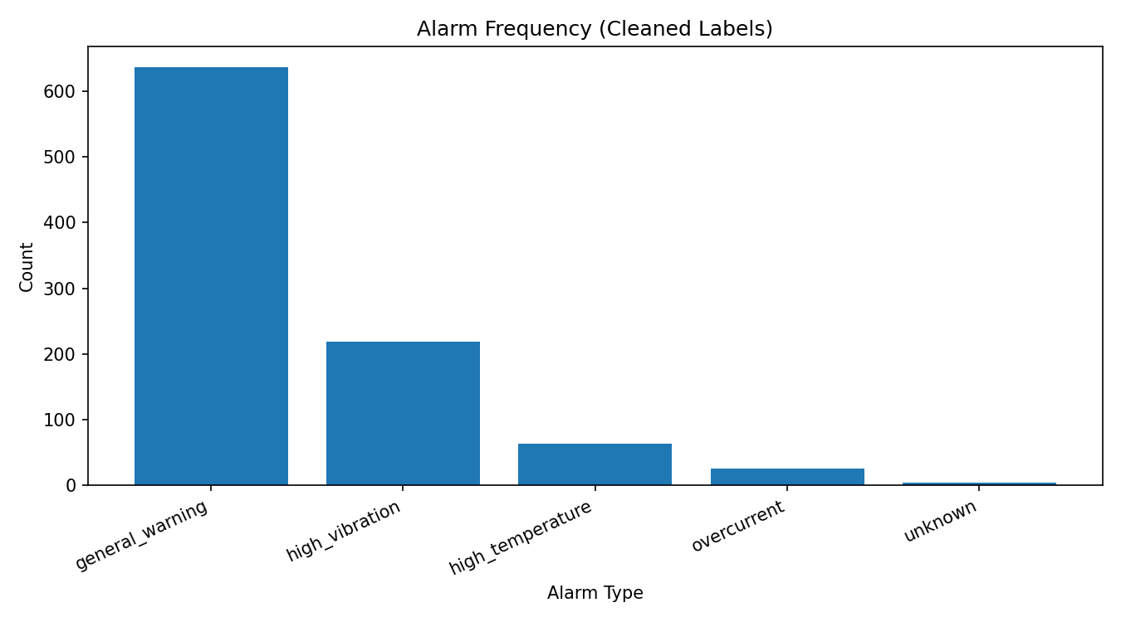
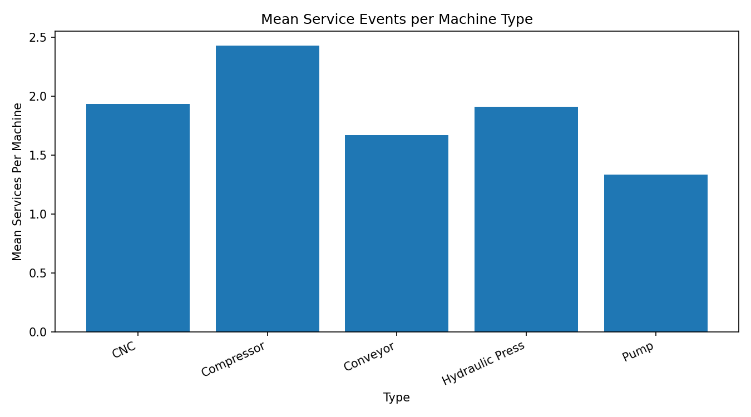
3. Visual evidence

Slide 5
4. Recommended management actions
Prioritize inspection when multiple independent signals persist: repeated alarms, abnormal sensor ranges, repeat service and high known downtime.
Review high-priority machines weekly; inspect sensor calibration, lubrication, bearings, motor current and cooling where relevant.
Use a consistent alarm taxonomy and record service action, downtime, parts replaced and failure cause for every intervention.
Track leading indicators: warning weeks, alarm rate per runtime hour, repeat service within 30/60/90 days, and downtime per operating hour.
Validate thresholds with maintenance engineers before automating alerts; avoid treating correlation as causation.

Slide 6
5. Limitations and next steps
This package contains synthetic records; real conclusions require the official assessment dataset.
Missing downtime is unknown, not zero; missing alarm matches are not automatically interpreted as no alarms.
The priority score is a transparent heuristic, not a trained or validated failure prediction model.
Next: replace raw files, rerun notebook, refresh Excel pivots/charts, and update every numeric claim in the pitch.
Decision requested: approve a targeted inspection of the top-ranked machines and improve maintenance data capture.

