Slide 1
Sentiment Analysis

Slide 2
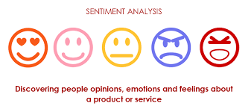
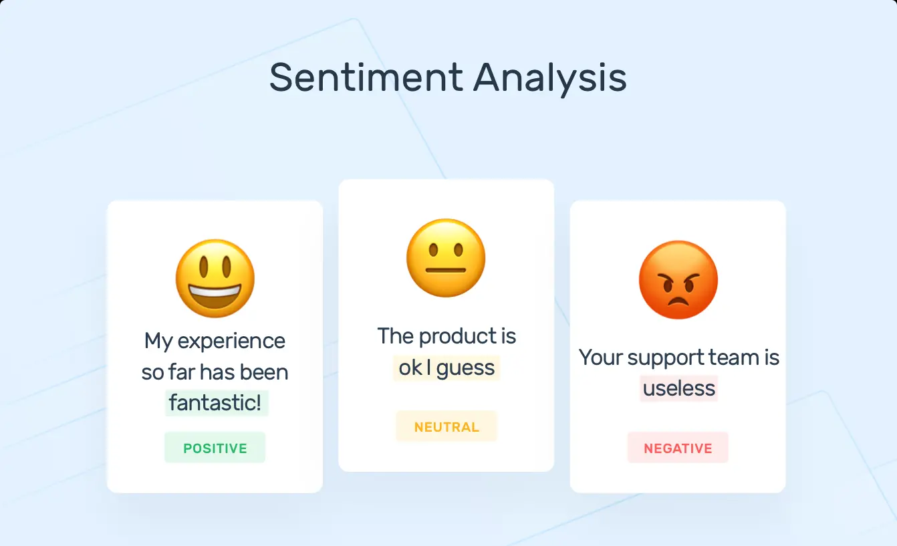
What is Sentiment Analysis ?

Slide 3
Why Sentiment Analysis ?
Movie: is this review positive or negative?
Products: what do people think about the new iPhone?
Public sentiment: how is consumer confidence? Is despair increasing?
Politics: what do people think about this candidate or issue?
Prediction: predict election outcomes or market trends from sentiment

Slide 4
Basic Approach for Sentimental Analyzer :
1. Tokenization
2. Feature Extraction
3. Classification using different classifiers
Naïve Bayes
SVM

Slide 5
How are we going to implement this?
Understand the Problem Statement
Tweets Preprocessing and Cleaning
Story Generation and Visualization from Tweets
Extracting Features from Cleaned Tweets
Model Building: Sentiment Analysis

Slide 6
Understand the Problem Statement
The objective of this task is to detect hate speech in tweets. For the sake of simplicity, we say a tweet contains hate speech if it has a racist or sexist sentiment associated with it. So, the task is to classify racist or sexist tweets from other tweets.
Formally, given a training sample of tweets and labels, where label ‘1’ denotes the tweet is racist/sexist and label ‘0’ denotes the tweet is not racist/sexist, your objective is to predict the labels on the given test dataset.

Slide 7

Tweets Preprocessing and Cleaning
Take a look at the pictures below depicting two scenarios of an office space – one is untidy and the other is clean and organized.

Slide 8
Story Generation and Visualization from Tweets
What are the most common words in the entire dataset?
What are the most common words in the dataset for negative and positive tweets, respectively?
How many hashtags are there in a tweet?
Which trends are associated with my dataset?
Which trends are associated with either of the sentiments? Are they compatible with the sentiments?

Slide 9

Extracting Features from Cleaned Tweets and Model Building
To analyze a preprocessed data, it needs to be converted into features. Depending upon the usage, text features can be constructed using assorted techniques – Bag-of-Words, TF-IDF, and Word Embeddings. In this workshop , we will be covering only Bag-of-Words and TF-IDF.
We will use logistic regression to build the models. It predicts the probability of occurrence of an event by fitting data to a logit function.
The following equation is used in Logistic Regression:

