Slide 1
Recommender Systems

Slide 2
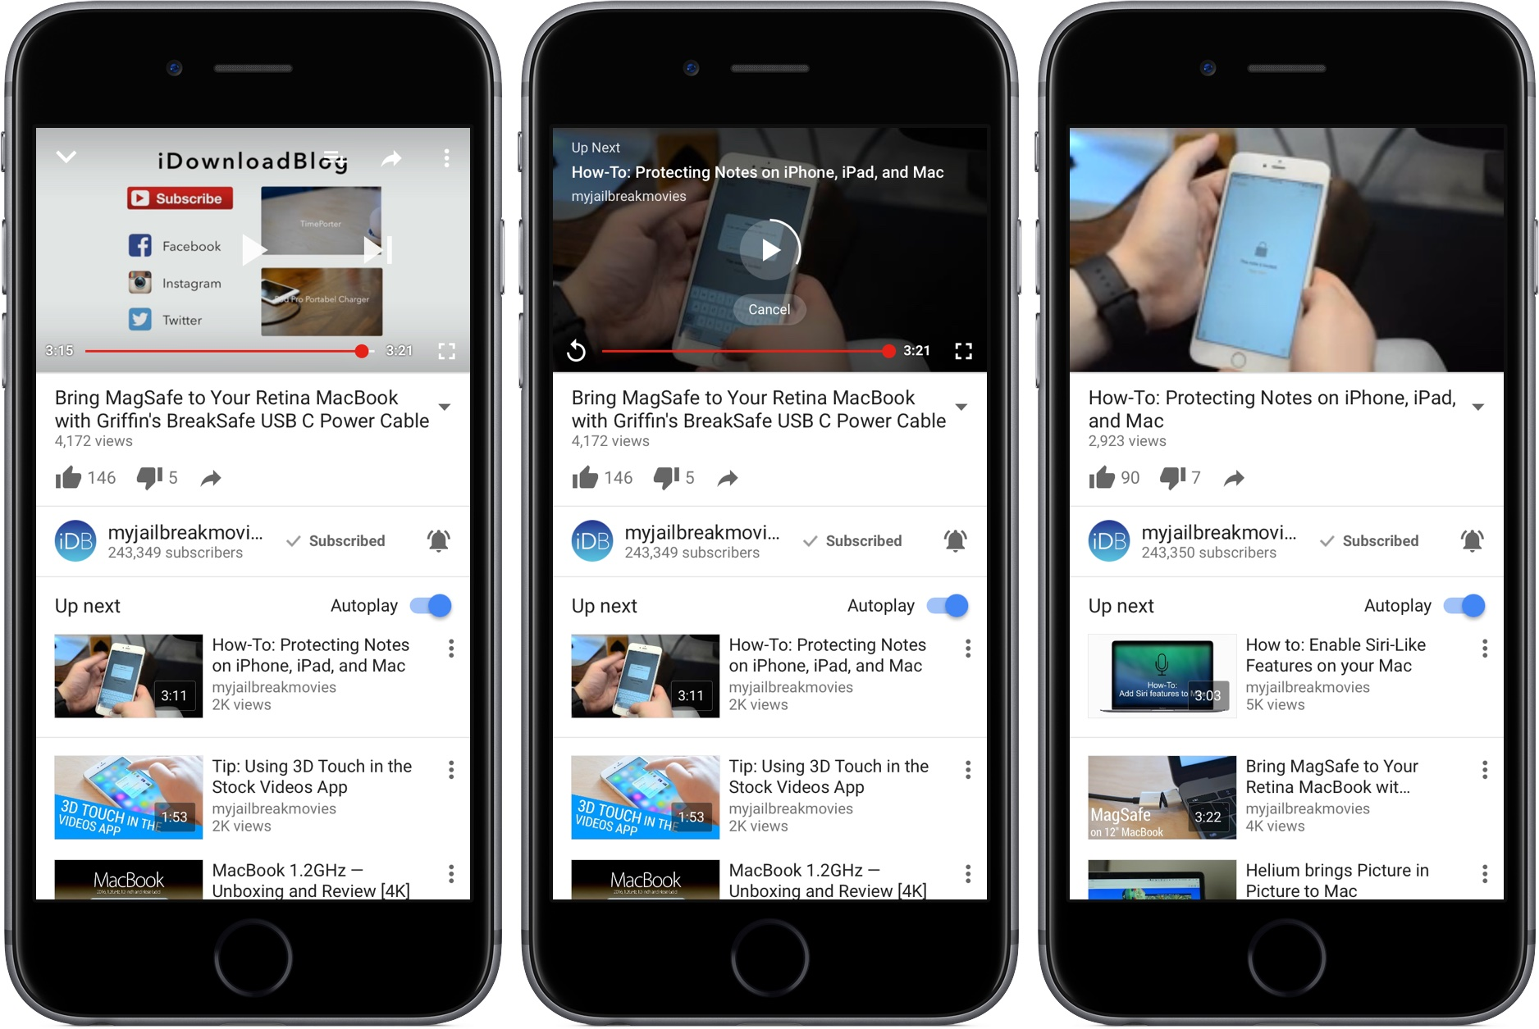
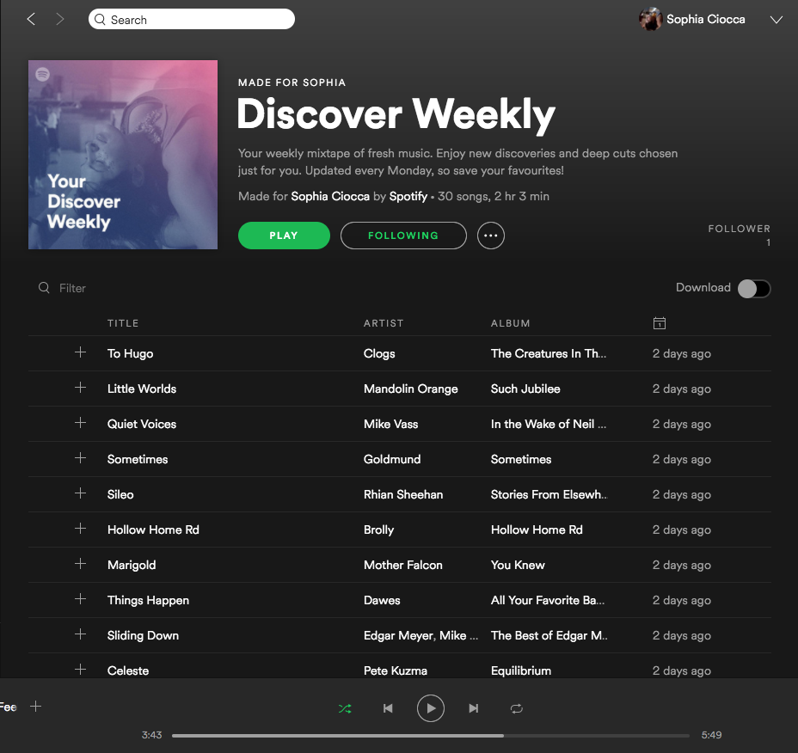
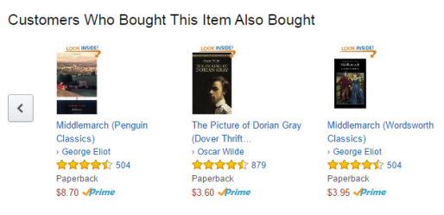
What is a Recommender System ?
Youtube Amazon Spotify

Slide 3
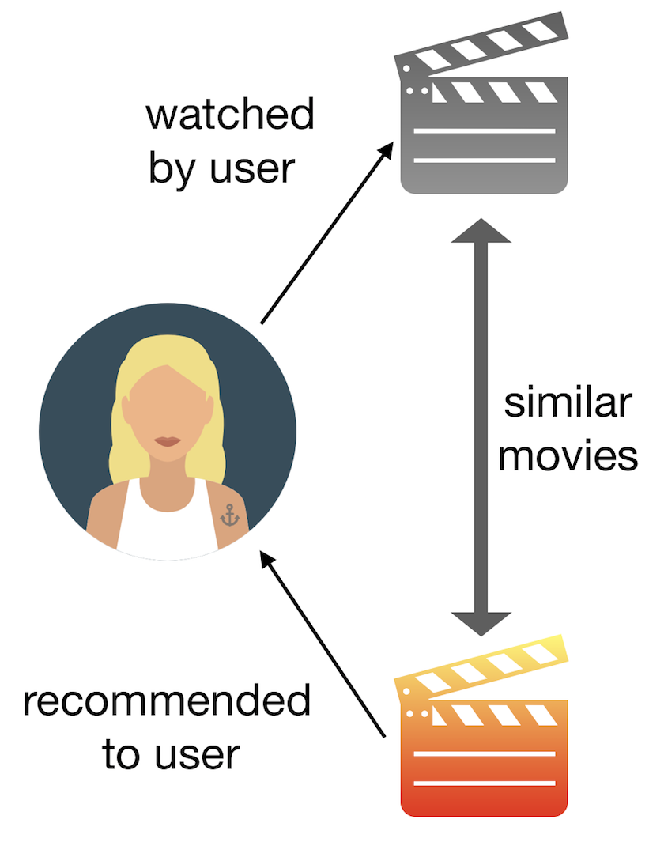
1. Content based method
Recommend items based on the properties of items that user likes.
Ex: genres of music.

Slide 4
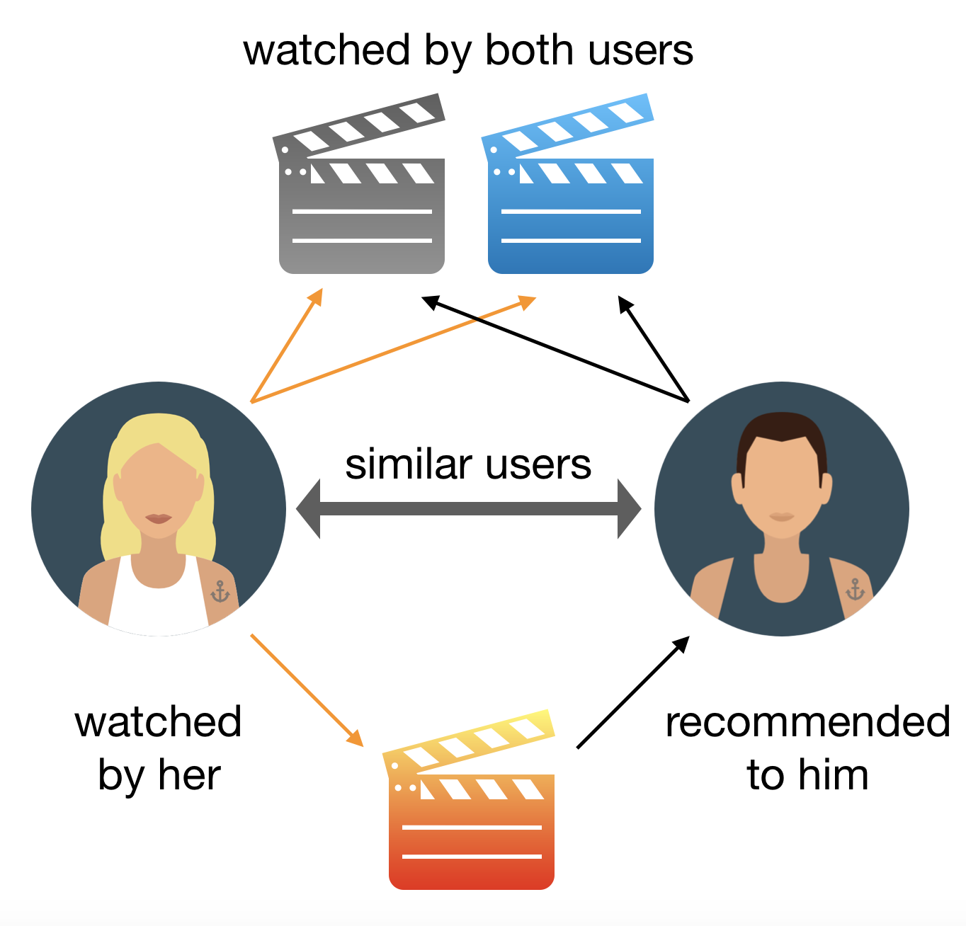
2. Collaborative method
Recommend items based similar user’s interest
Ex: location based video recommendations.

Slide 5
Steps to implement a movie recommender system
1. Filter data by rating count [ ex: count>100]
2. Generate the pivot table
3. Find the correlation of movie/user with others
4. Fix a correlation threshold and recommend movies > threshold

