Slide 1
IBM Bob Gujarat State level Hackathon Project Submission
“Exploring the Power of Agentic AI with IBM Granite and IBM Bob”

Slide 2

Project Tile – [Network Intrusion Detection Using Machine Learning]
Domain of Project – [Electronics and Telecommunications Engineering – Machine Learning]
Student Name | Recent Passport Photo | Email ID | Mobile number [WhatsApp]
HARIWIN P |  | hariwin305@gmail.com
Recommended font style and size:
Font Style: Arial
Font Size (Heading): 28
Font Size (Content): 20

Slide 3
Problem Statement -
Problem Statement : Network Intrusion Detection
The Challenge
Create a robust Network Intrusion Detection System (NIDS) using machine learning. The system should analyze network traffic data to identify and classify different types of cyber-attacks such as DoS, Probe, R2L and U2R, and distinguish them from normal network activity.
The Objective
Develop a machine-learning-based system that can:
Analyze network traffic data
Detect normal and malicious network activity
Classify different types of network attacks
Provide early warning of malicious activities
Technology:
IBM Cloud Lite services are mandatory for the project.
This matches the problem statement shown in your provided document.

Slide 4
Proposed Solution -
Proposed Solution:
Develop a Machine Learning-based Network Intrusion Detection System (NIDS) that analyzes network traffic and identifies whether the activity is normal or malicious.
Load and analyze the network intrusion detection dataset.
Preprocess the network traffic data for machine learning.
Train a machine learning model to detect network anomalies.
Predict whether network traffic is normal or an intrusion.
Classify malicious traffic into attack categories such as DoS, Probe, R2L and U2R.
Use IBM Bob to assist with the development and implementation of the project.
Store the project code and model files in a GitHub repository.

Slide 5
Technology Used
IBM Bob – Used as the AI-assisted development platform for building and implementing the project.
Python – Used for data processing, machine learning, and network intrusion detection.
Pandas – Used for loading, exploring, and preprocessing the network traffic dataset.
Scikit-learn – Used for machine learning model training and prediction.
Random Forest – Used as the machine learning model for detecting network anomalies/intrusions.
IBM Cloud Lite – Used as the required IBM cloud technology for the project.
GitHub – Used to store and manage the project notebook and trained model files.

Slide 6
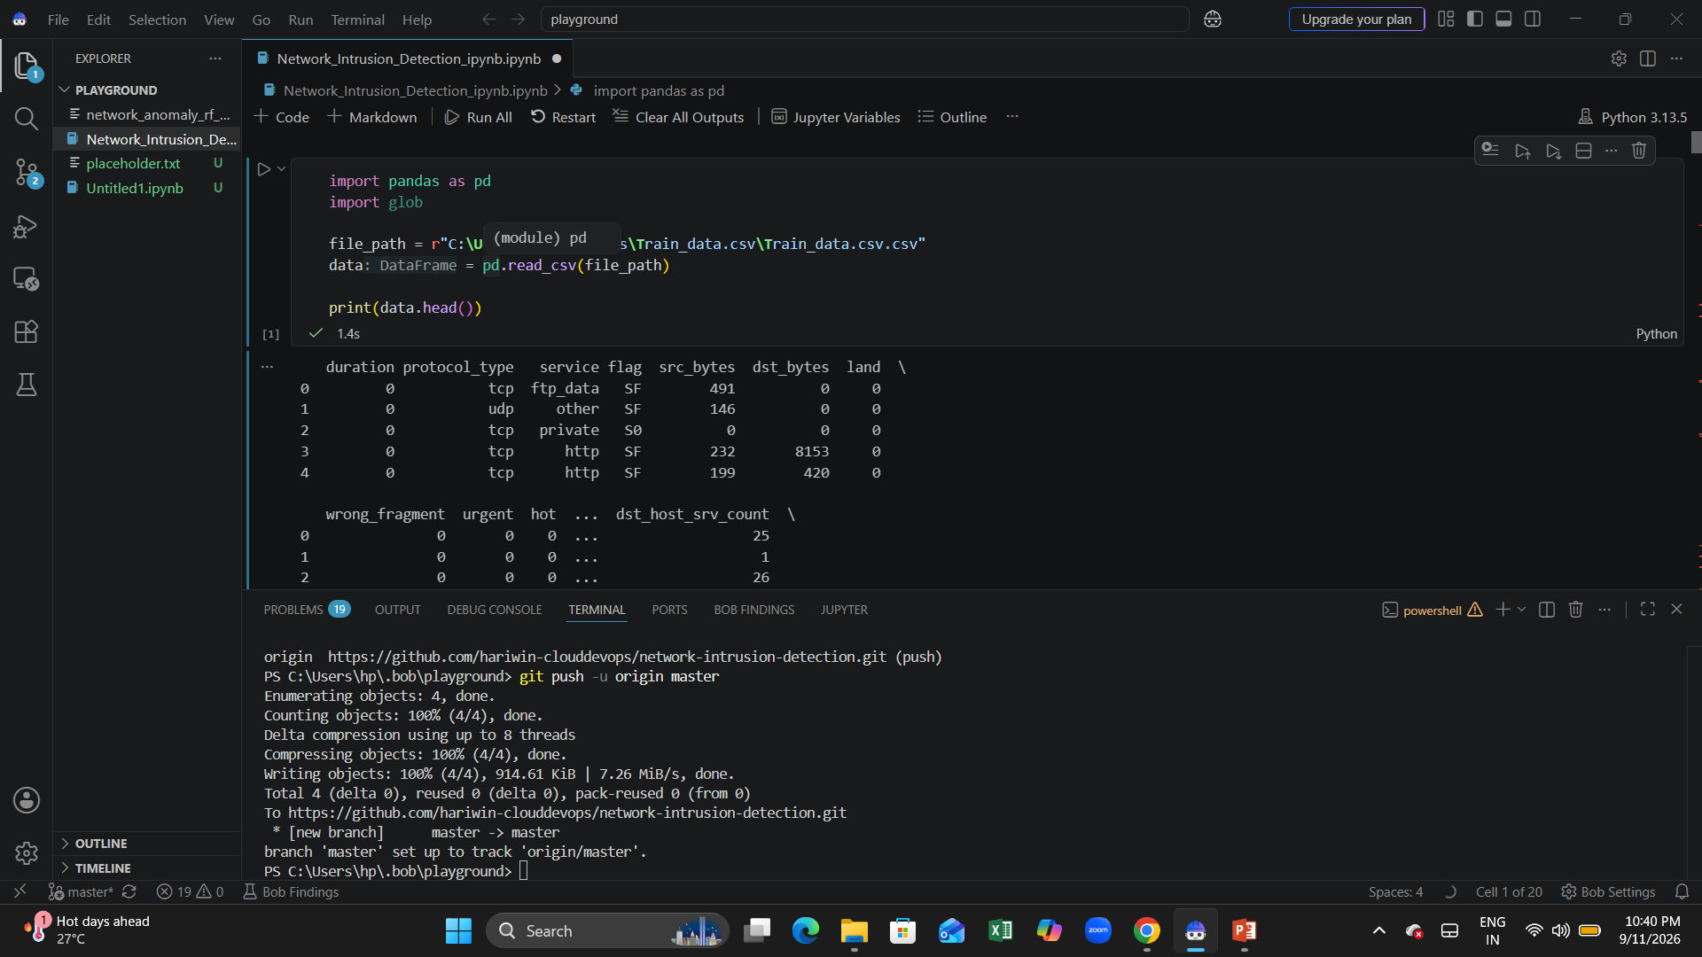
Required Files created using IBM bob -

Slide 7
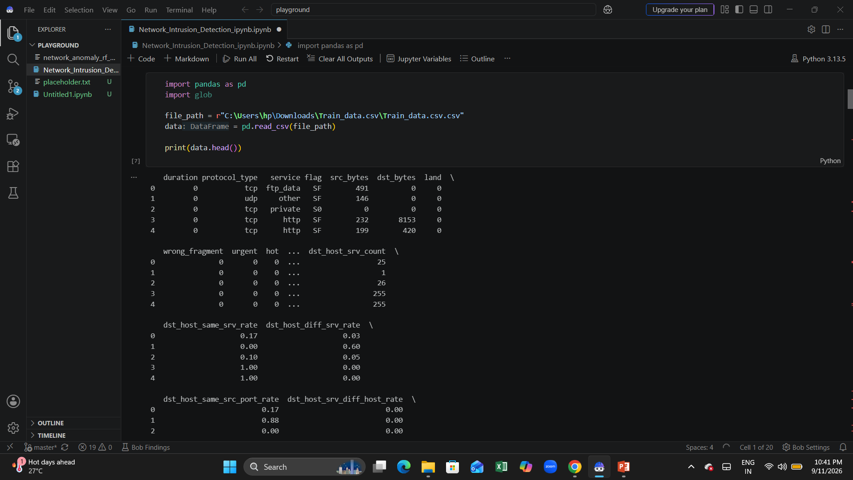
IBM Bob Screenshots:

Slide 8
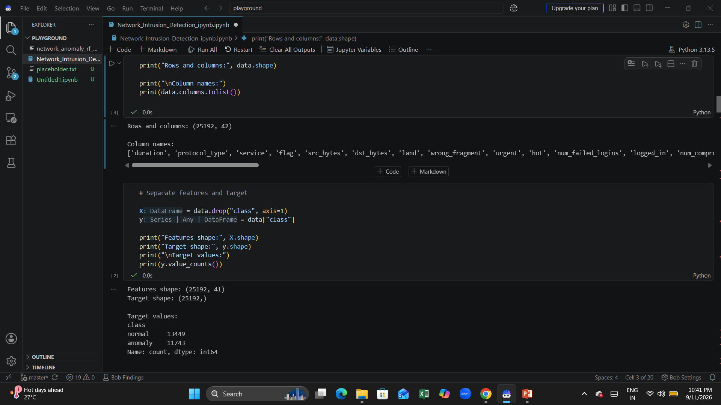
IBM Bob Screenshots:

Slide 9
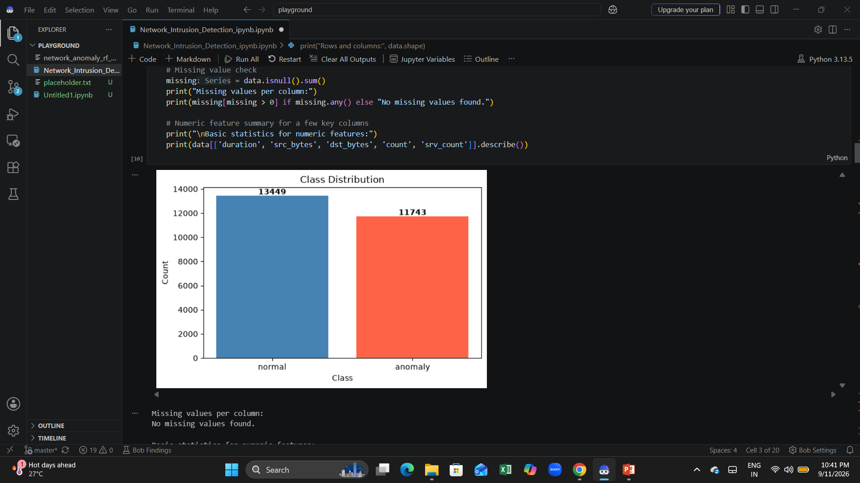
IBM Bob Screenshots:

Slide 10
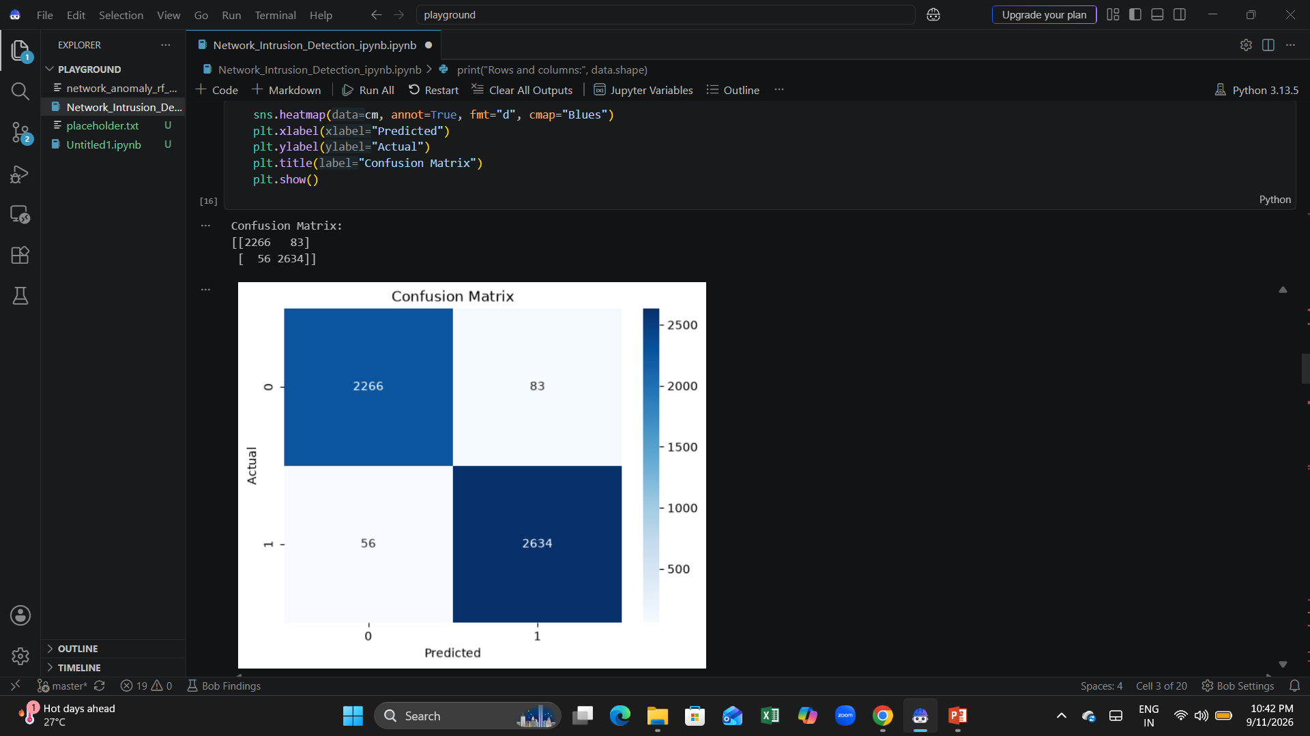
IBM Bob Screenshots:

Slide 11
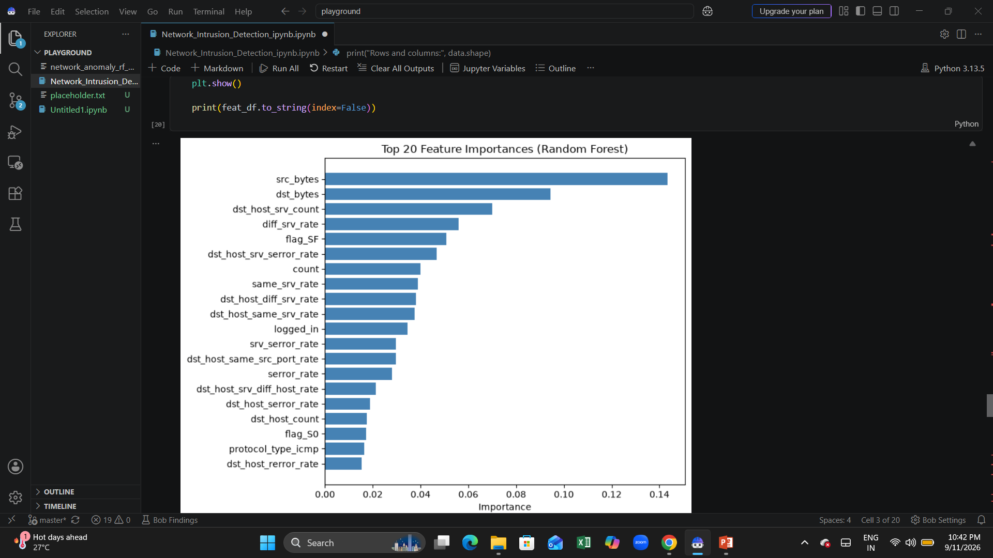
IBM Bob Screenshots:

Slide 12
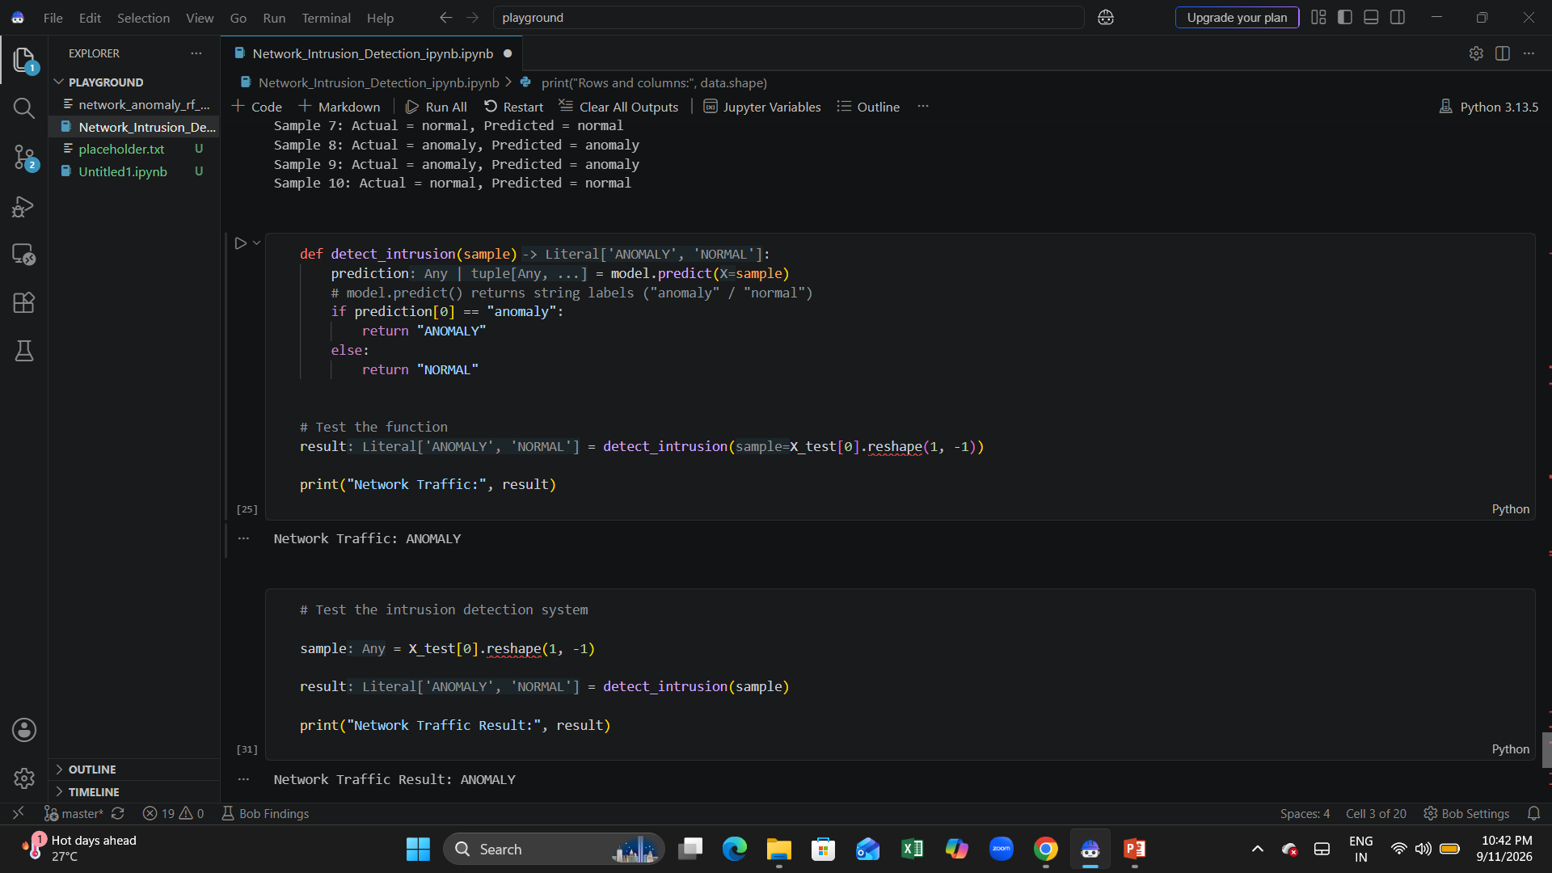
IBM Bob Screenshots:

Slide 13
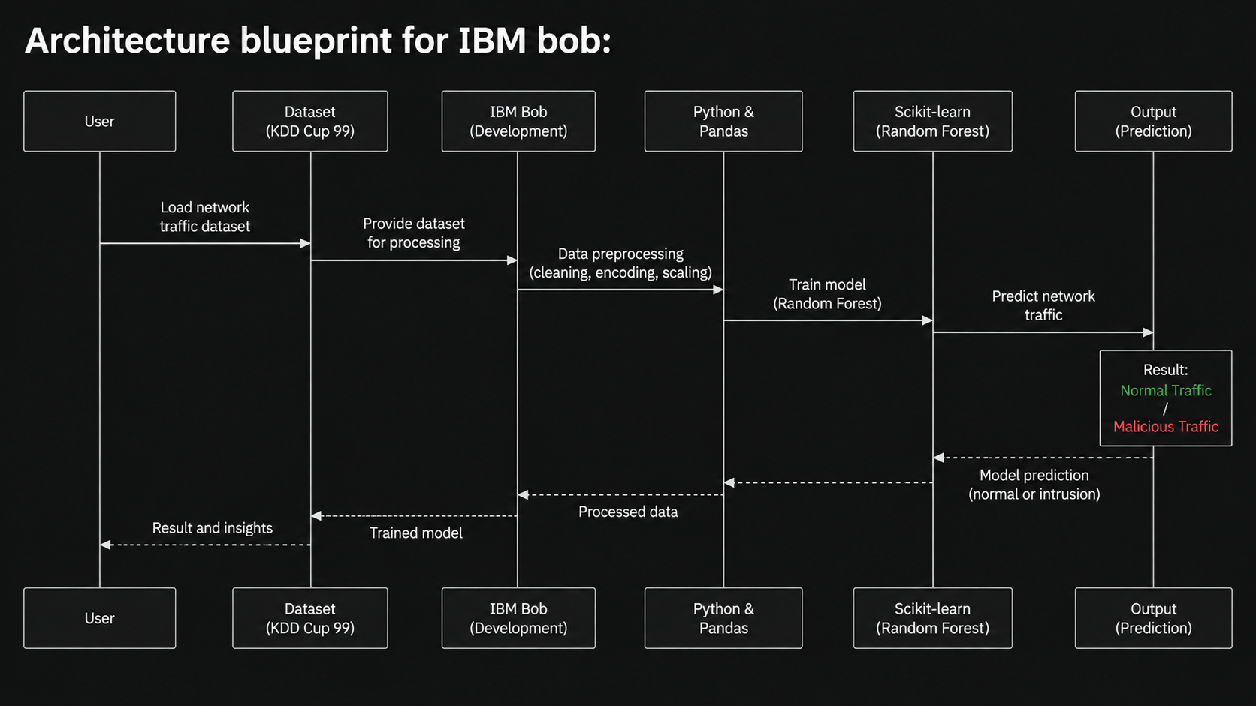
Architecture Blueprint for Network Intrusion Detection

Slide 14
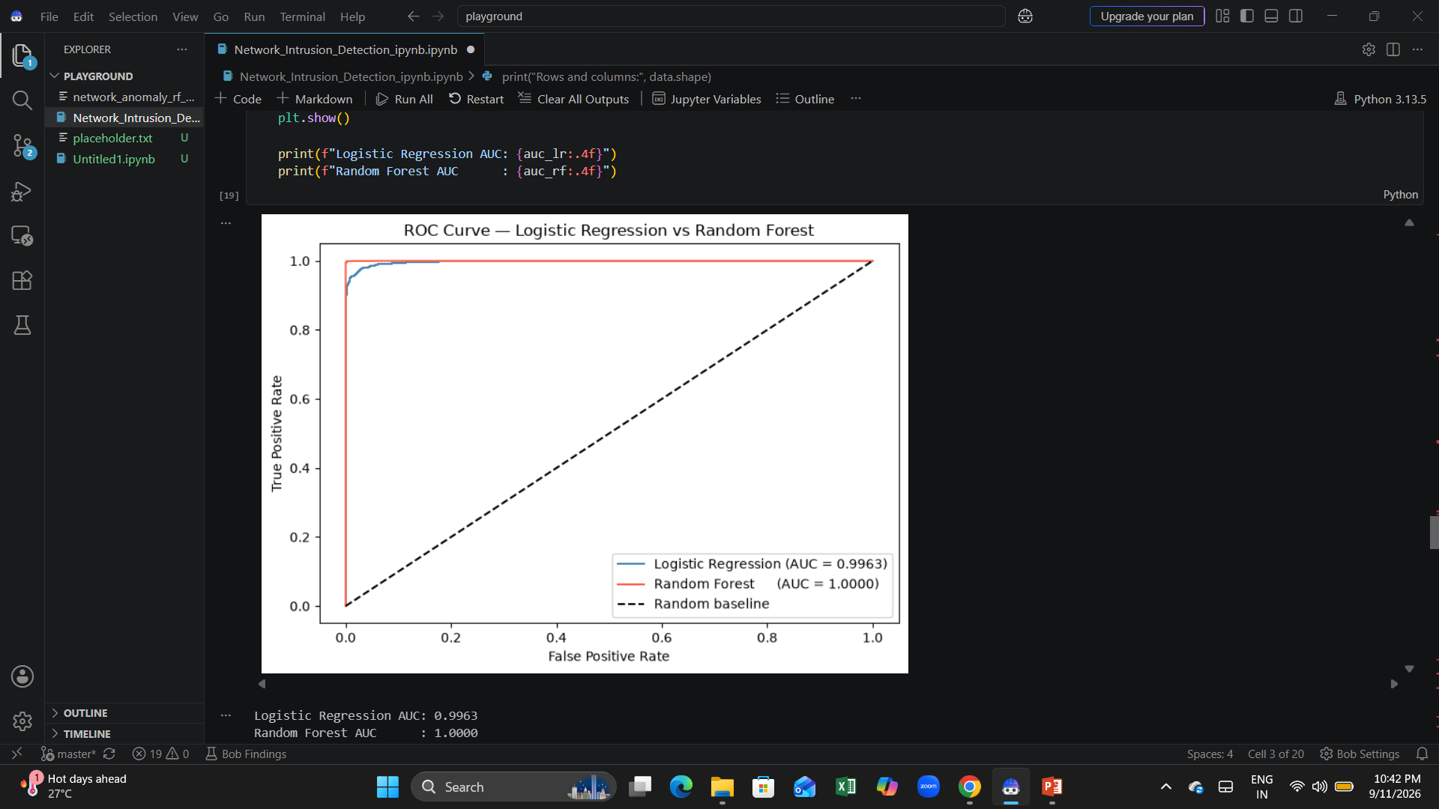
Role of Agentic AI in the solution
Role of Agentic AI in Network Intrusion Detection
IBM Bob was used as an AI-assisted development platform during the development of the Network Intrusion Detection System. It helped understand the project requirements, generate and improve Python code, troubleshoot errors, and organize the machine-learning workflow.
The AI-assisted workflow supported the following activities:
• Dataset Analysis – Assisted in understanding and exploring network traffic data.
• Data Preprocessing – Helped develop code for preparing and transforming the dataset.
• Model Development – Assisted in implementing the Random Forest machine-learning model.
• Prediction – Supported the development of code to identify normal and malicious network traffic.
• Troubleshooting – Helped identify and resolve coding and implementation issues.
• Documentation – Assisted in organizing the project workflow and documentation.
Overall, IBM Bob supported the development process while the final machine-learning model was implemented using Python, Pandas and Scikit-learn.

Slide 15
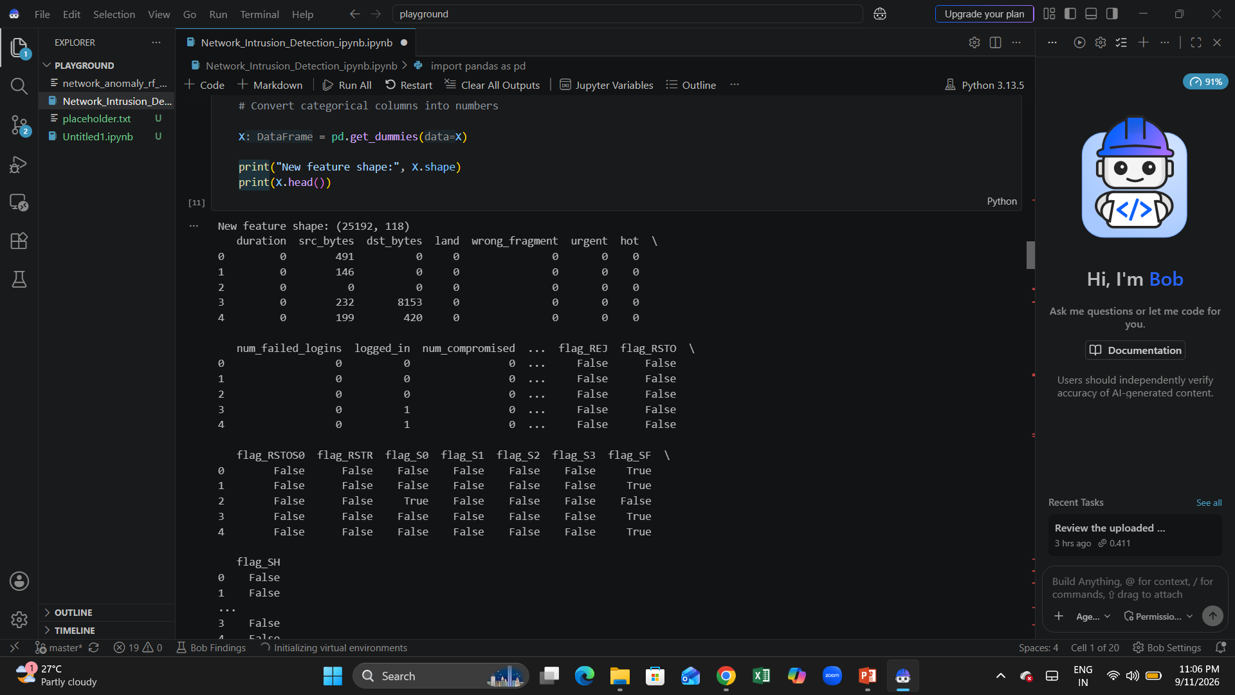
Project Output Screenshot
Please put IBM Bob output screenshots with 2-3 prompts.
You can take 2-3 more slides for each screenshot
·
·
·

Slide 16
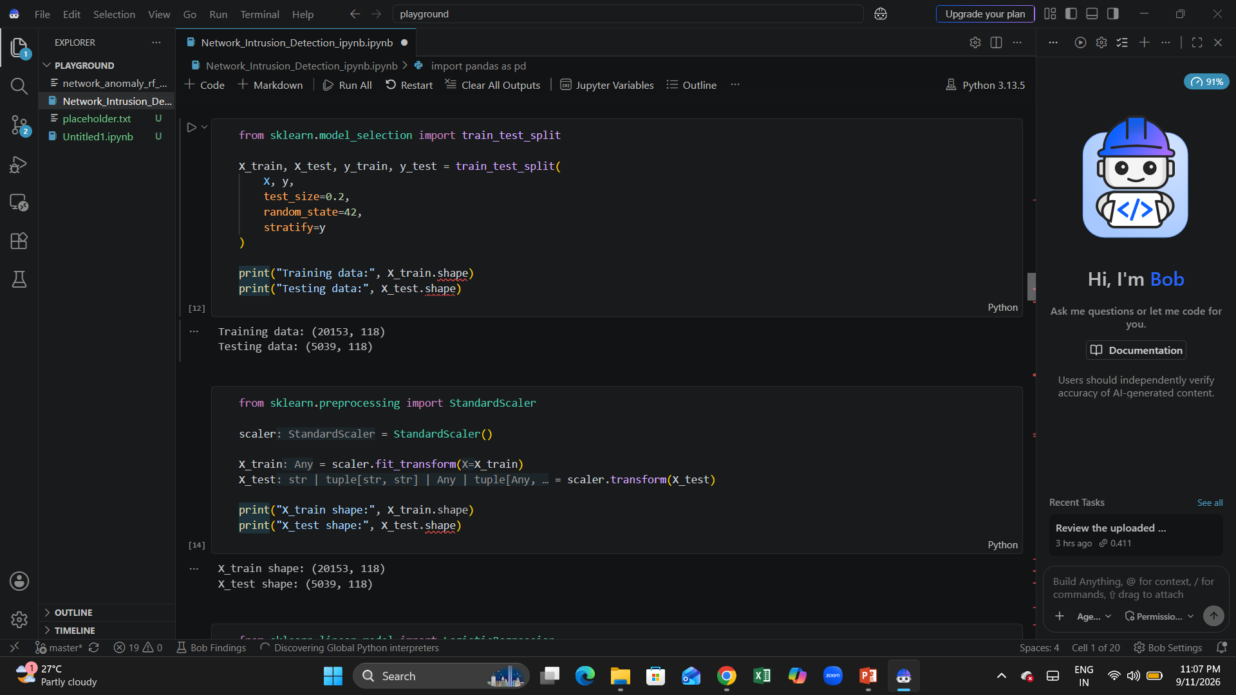
Project Output Screenshot
Please put IBM Bob output screenshots with 2-3 prompts.
You can take 2-3 more slides for each screenshot
·
·
·

Slide 17
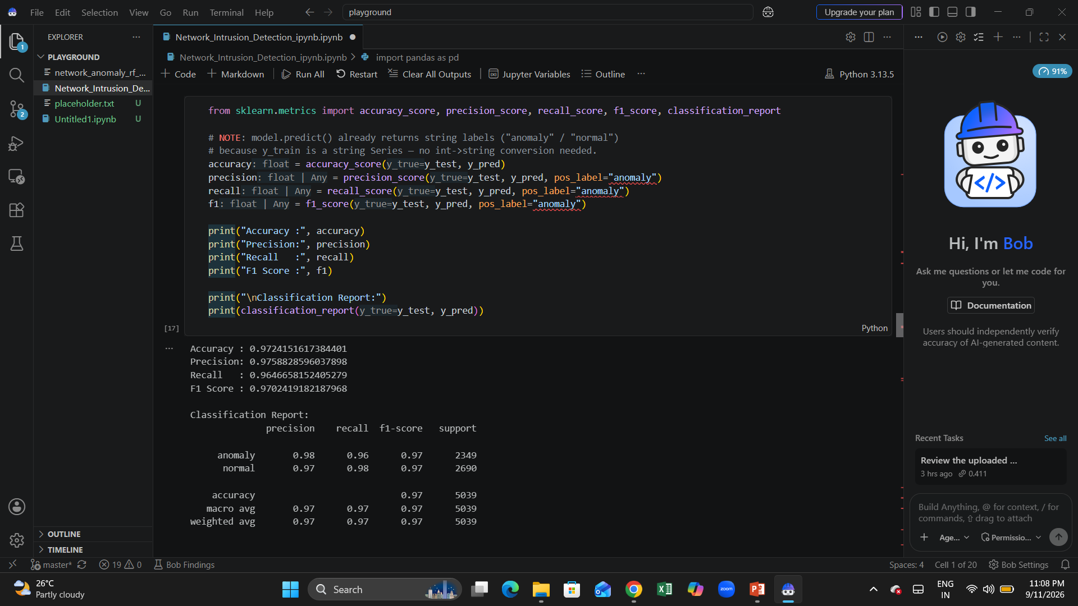
Project Output Screenshot
Please put IBM Bob output screenshots with 2-3 prompts.
You can take 2-3 more slides for each screenshot
·
·
·

Slide 18
The Wow Factor Behind Your Project
Accurate Network Intrusion Detection
The system uses a Random Forest machine-learning model to distinguish between normal and anomalous network traffic.
Strong Model Performance
The model achieved approximately 97.24% accuracy, with an F1-score of approximately 97.02% on the test data.
Multiple Evaluation Metrics
Accuracy, precision, recall, F1-score, and the classification report were used to evaluate the model performance.
Practical Security Application
The system can help identify suspicious network activity and provide an early indication of possible intrusions.
AI-Assisted Development
IBM Bob was used to assist with dataset analysis, preprocessing, model development, prediction, troubleshooting, and documentation
·
·
·

Slide 19
Novelty and Uniqueness
The proposed Network Intrusion Detection System stands out by combining machine learning, network traffic analysis, and AI-assisted development to identify suspicious network activity.
Machine Learning Detection – Uses a Random Forest classifier to distinguish normal network traffic from anomalous traffic.
Automated Classification – The system automatically classifies network activity as normal or anomaly, reducing the need for manual traffic analysis.
Data-Driven Approach – Uses network traffic features from the intrusion detection dataset to train and evaluate the model.
Multiple Performance Metrics – Evaluates the model using accuracy, precision, recall, F1-score, and classification report.
Early Threat Identification – Helps identify potentially malicious network activity at an early stage.
AI-Assisted Development – IBM Bob supported dataset analysis, preprocessing, coding, troubleshooting, and documentation.
Practical Security Application – The approach can be used as a foundation for detecting suspicious activity in communication networks.

Slide 20
Future Scope
1. Real-Time Network Monitoring –
The system can be extended to analyze live network traffic continuously and detect suspicious activities in real time.
2. Multi-Class Attack Detection –
The model can be enhanced to classify different attack categories such as DoS, Probe, R2L, and U2R, instead of only distinguishing normal and anomalous traffic.
3. Cloud-Based Deployment –
The intrusion detection system can be deployed on IBM Cloud to provide scalable and accessible network security monitoring.
4. Automated Security Alerts –
Future versions can generate automatic alerts when suspicious or malicious network activity is detected.
5. Improved Machine Learning Models –
Other machine-learning and deep-learning algorithms can be tested to improve detection accuracy and reduce false positives.
·
·
·

Slide 21
Git Hub Link
· Please create public github repository (Enable Add README button while creating repository) with format – Network-Intrusion-Detection
Please test and Paste the working Github URL –https://github.com/yourusername/Network-Intrusion-Detection
Make sure you have Uploaded following three files into your github repository
1) All Agent relevant files of IBM Cloud , 2) yourproblemstatement.pdf file 3) your projectpresntation.pptx file 4)any other files
·
·
·

Slide 22
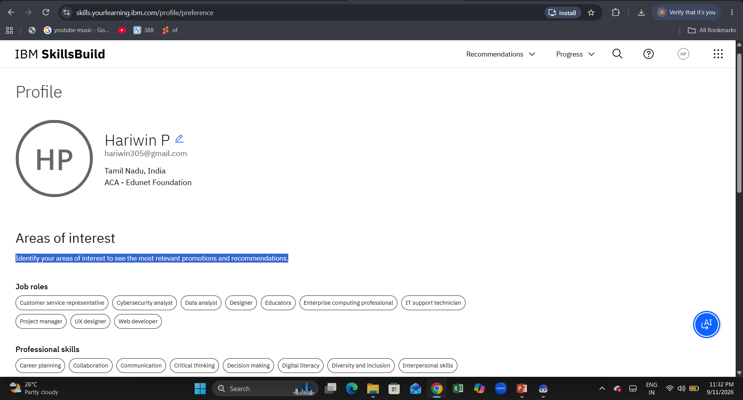
Skills build profile screen shot

Slide 23

Certificates Earned:
Please add your credly certificate(Getting Started with Artificial Intelligence)

Slide 24

Certificates Earned:​
Add your IBM BOB Certificate

Slide 25


