Slide 1

Department of Computer Science and Engineering VIGNAN’S LARA INSTITUTE OF TECHNOLOGY AND SCIENCE
Project Review on
AI Powered Gaze Tracking Using Facial Recognition Techniques
Presented By
Batch No: B12
N. Jaswanth 21FE1A05C5
M. Praveen Kumar 21FE1A05B6
M. Lakshman 21FE1A0598
P. Abhiraam 22FE5A0511
Under the Esteemed Guidance of
Dr. A. Senthil Kumar
Professor
CSE Department
02/04/2025

Slide 2

TITLE
AI Powered Gaze Tracking Using Facial Recognition Techniques
Department of Computer Science and Engineering 2

Slide 3
CONTENTS
Title
Abstract
Introduction
Literature Survey
Existing System
Proposed System
System Architecture
Working Instructions
System requirements
UML Diagrams
Advantages
Result Analysis
Conclusion
References
Department of Computer Science and Engineering 3

Slide 4
ABSTRACT
This project presents an innovative application of facial recognition technology designed to facilitate human-computer interaction, providing an alternative and accessible input method for users, particularly beneficial for those with mobility challenges. Developed using Python, OpenCV for image processing, and pyautogui for mouse control, the system incorporates key features such as real-time facial detection and tracking, landmark detection and analysis, gesture recognition and control, an intuitive user interface, cross-platform compatibility, performance optimization, and continuous user testing and feedback. By leveraging facial recognition technology, AI Powered Gaze Tracking offers a hands-free, intuitive, and responsive human-computer interaction experience, eliminating the traditional reliance on mouse and keyboard inputs and enhancing overall user satisfaction, efficiency, and inclusivity. The system aims to provide a transformative and user-centric solution that enhances accessibility, functionality, and user experience in computing environments, fostering a more inclusive and accessible computing ecosystem.
Keywords: Real-time Processing, Computer Vision, Gesture Detection, Facial Landmarks, Mouse Control, Speech commands.
Department of Computer Science and Engineering 4

Slide 5
INTRODUCTION
Moving the computer cursor using a mouse or finger has been the standard method of navigation for years. While this approach works well for most users, it creates a significant barrier for individuals with physical disabilities. Those who cannot use their hands, such as amputees or individuals with motor impairments, face challenges in interacting with digital devices, limiting their access to technology.
For people with physical limitations, an alternative method of cursor control is necessary. By leveraging eye-tracking technology, we can map a user’s eye movements to control the cursor on a screen. This innovative solution allows individuals with disabilities to navigate digital interfaces without requiring hand movement, making technology more accessible and inclusive.
Many individuals with disabilities have the expertise to use computers but lack accessible interfaces. This limitation prevents them from fully utilizing their skills in the digital world. An eye-tracking cursor system empowers them to interact seamlessly, overcoming physical barriers.
Department of Computer Science and Engineering 5

Slide 6
INTRODUCTION
Our system utilizes a camera to detect and track real-time eye movements, providing precise control over the cursor. OpenCV’s advanced computer vision algorithms process this data efficiently, ensuring smooth and accurate pointer movement. By integrating these technologies, we create a reliable and effective solution that enhances user experience and usability.
Unlike traditional input devices, this system offers a completely hands-free approach to navigation. By simply moving their eyes, users can control the cursor with ease, creating a natural and efficient interaction. The real-time responsiveness of the system ensures seamless navigation, making digital interactions more intuitive and user-friendly for individuals with disabilities.
Department of Computer Science and Engineering 6

Slide 7
LITERATURE SURVEY
TITLE | AUTHOR | ALGORITHM(s) USED
Eyeball movement tracking using Raspberry Pi | Int. J. Man-Mach | Cognitive psychology, MATLAB
Tracking Students’ Cognitive Processes During Program Debugging | Cheng- Chih Wu, Ting-Yun Hou | Eye tracking, Cognitive psychology, matlab
Cognitive strategies and looping constructs: An empirical study | Ehrlich,K. and Soloway,E | Cognitive psychology, Empirical study
LookCursorAI: Machine Learning-Eye Powered Interaction | V. S. Saranya, U. Ganesh Naidu, J. Karthik, A. Sundaram | Eye Tracking
Department of Computer Science and Engineering 7

Slide 8
EXISTING SYSTEM
Human-computer interaction primarily relies on a mouse and keyboard, which may not be suitable for individuals with mobility challenges. This dependence on traditional input devices limits accessibility and makes it difficult for people with physical impairments to navigate digital systems. To ensure inclusivity, alternative interaction methods must be explored.
Many assistive technologies require additional hardware or involve complex setup procedures, making them less accessible to users. These extra requirements can create barriers for individuals who need a simple and effective solution. A user-friendly system that eliminates the need for specialized equipment is essential for enhancing accessibility.
Some existing assistive solutions lack the precision, responsiveness, and adaptability necessary for seamless interaction. Without these qualities, users may experience delays, inaccuracies, or difficulties in controlling digital interfaces effectively. A system that offers real-time responsiveness and adaptability can significantly improve the user experience for individuals with diverse needs.
Department of Computer Science and Engineering 8

Slide 9
DISADVANTAGES
The traditional human-computer interaction methods primarily relying on mouse and keyboard inputs may not be accessible or intuitive for users with mobility challenges, limiting their ability to interact effectively with the system.
Existing assistive technologies often require complex setup processes and additional hardware, which can be cumbersome, time-consuming, and may require technical expertise to configure and operate, reducing their accessibility and usability.
Many existing systems may lack the precision, responsiveness, and adaptability required to provide a seamless and efficient user experience, particularly for individuals with diverse needs and preferences
Department of Computer Science and Engineering 9

Slide 10
PROPOSED SYSTEM
Our system enhances human-computer interaction by leveraging AI-powered gaze tracking. Developed using Python, OpenCV, and pyautogui, it provides an alternative input method for users with mobility challenges. This technology ensures a more accessible and seamless computing experience.
The system accurately tracks facial landmarks such as the eyes, nose, and mouth under different conditions. By analyzing aspect ratios, it interprets facial gestures like winking and mouth opening with high precision. These gestures are then used to dynamically control the mouse cursor for intuitive navigation.
The system features an intuitive interface that provides real-time feedback and system status updates. With customizable accessibility settings and cross-platform compatibility, it ensures smooth performance across devices. Continuous user testing helps refine its functionality for better accuracy and efficiency.
Department of Computer Science and Engineering 10

Slide 11
ARCHITECTURES
Face Capturing
Successful capture
Face Landmark Detection
Speech Recognition Activation
Speech command processing
Detect Face Movement
Detect Right Wink
Detect Left Wink
Escape Key Pressed
Speech command
Map movement
Map wink to click
Map wink to click
Action
Mouse Movement
Mouse Right Click
Mouse Left Click
End operation
Department of Computer Science and Engineering 11

Slide 12
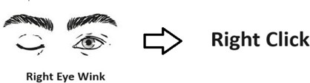
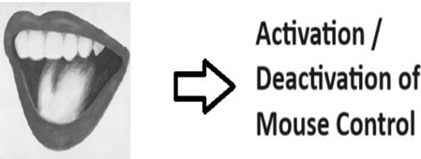
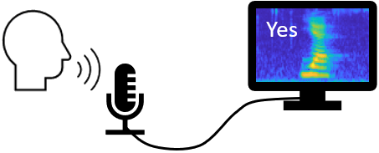
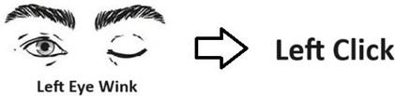
WORKING INSTRUCTIONS
Speech Command
Department of Computer Science and Engineering 12

Slide 13
SYSTEM REQUIREMENTS
HARDWARE REQUIREMENTS:
System : Pentium Dual Core.
Hard Disk : 120 GB.
Ram : 2GB.
SOFTWARE REQUIREMENTS:
Operating system : - Windows 7 or Above.
Coding Language :python
Tool : Anaconda
Library : OpenCV
Department of Computer Science and Engineering 13

Slide 14
USECASE DIAGRAM
Facial Mouse
Run Program
Calculate direction
Detect MAR
Detect EAR
pyautogui
Perform Click
Move Mouse
Speech-to-text
Cv2(open cv)
Facial Mouse
Display Feedback
Capture Video
Resize Video
Convert Color
Display Text
User
Activate Program
User
Interact with Interface
Control Mouse & keyboard

Slide 15
USECASE DIAGRAM
Set Threshold
Values
Initialize frame
Counters
Dilb Hog Face
Detector
Grab Indexes
Of Face
PREPROCESSING
Video Capture
Convert To
Gray-Scale
Detect Facial
Land Marks

Slide 16
CLASS DIAGRAM
PREPROCESSING
OPENCV
USER
+Compute Eye Ratio()
+Mouth Aspect Ratio()
+Calculate Eye Blink()
+Perform Operation()
+Collect taste()
+Load Land Mark Data()
+Select Model()
+Eye Movement()
+Perform Operations()
+Set Treshold Values()
+Initialize Frame Counters()
+Dlib Hog Face Detector()
+Grab Indexes of Face()
+Video Capture()
+Convert To Gray-Scale()
+Detect Facial Land Marks()
Department of Computer Science and Engineering 16

Slide 17
SEQUENCE DIAGRAM
FacialMouse
pyautogui
cv2
Activate Program
user
Detect Face
Detect Face
If face Detected?
Get Landmarks
Calculate Aspect ratios
Is Mouth Open?
Activate Input Mode
Is Wink Detected?
Perform Click
Is Speech-to-text Active?
Perform Speech-to-text
Display Feedback
Display Feedback
FacialMouse
pyautogui
cv2
user
Department of Computer Science and Engineering 17

Slide 18
SEQUENCE DIAGRAM
Opencv
Compute Eye Ratio
Mouth Aspect Ratio
Calculate Eye Blink
Perform Operation
Compute Eye Ratio
Mouth Aspect Ratio
Calculate Eye Blink
Perform Operation
Department of Computer Science and Engineering 18

Slide 19
DATA FLOW DIAGRAM
USER
SEGMENTED
IMAGE
INPUT
FEATURE
EXTRACTION
DETECTION
MECHANISM
USER FACE
MOUSE MOVEMENT/
CLICK
Department of Computer Science and Engineering 19

Slide 20
Activity Diagram
Detect Face
Yes
No
If Face Detected?
Get Landmarks
Detect Face
Calculate Aspect Ratio
Yes
Is Mouth Open?
No
Activate Input Mode
Calculate Aspect Ratios
Yes
Is Wink Detected
No
Perform Click
Calculate Aspect Ratios
Yes
Is Speech to text Active?
No
Activate Speech to text
Activate Speech to Text
Display Feedback
Department of Computer Science and Engineering 20

Slide 21
ADVANTAGES
The proposed system offers a hands-free and intuitive input method, providing an accessible and inclusive solution for users with mobility challenges, thereby fostering greater independence and empowerment.
By leveraging facial recognition technology, the system offers a more natural, seamless, and responsive human-computer interaction experience, eliminating the traditional reliance on mouse and keyboard inputs and enhancing overall user satisfaction and efficiency.
The system is compatible and interoperable with various platforms, operating systems, and applications, providing a consistent and reliable user experience.
The system provides customizable accessibility settings and user profiles, allowing users to adjust sensitivity, speed, and other parameters.
To accommodate individual preferences and specific accessibility requirements effectively.
Department of Computer Science and Engineering 21

Slide 22
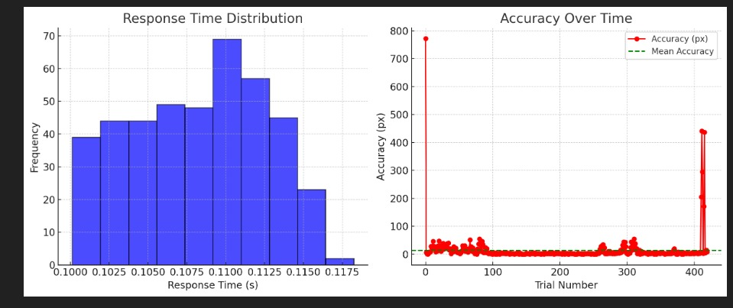
RESULT ANALYSIS
Department of Computer Science and Engineering 22

Slide 23
RESULT ANALYSIS
Summary Statistics:
Metric | Response Time(s) | Accuracy(px) | False Positive
Count | 420 entries | 420 entries | 420 entries
Mean | 0.108 s | 13.35 px | 7.14%(low false positives)
Standard Deviation | 0.004 s | 52.12 px (high variation) | 0.26
Min value | 0.100 s | 0 px | 0
Max value | 0.118 s | 772 px (outlier) | 1
Department of Computer Science and Engineering 23

Slide 24
RESULT ANALYSIS
Accuracy Calculation:
We calculate accuracy as a percentage using:
Accuracy=(Successful Predictions/Total Predictions)*100
Where:
Successful Predictions = Cursor movements with accuracy <30 px.
Total Predictions = All gaze-based cursor movements recorded.
Calculation:
Total Predictions=420
Successful Predictions=388
Percentage calculations:
(388/420)*100=92.38%
Final Accuracy of our Gaze Tracking System is 92.38%
Department of Computer Science and Engineering 24

Slide 25
CONCLUSION
The technology improves accessibility and usability by using gestures to provide a hands-free, user-friendly interface. In addition to improving user engagement and comprehension, visual feedback approaches ensure consistent performance due to their longevity and dependability in a range of contexts. By enabling those with disabilities to interact with technology in ways that work for them, this effort not only showcases technological breakthroughs but also a strong commitment to inclusivity. Ultimately, it provides proof of how innovation may provide digital experiences that are more potent, inclusive, and available to all users.
Gaze tracking stands as a groundbreaking advancement in the realm of assistive and accessible technology, showcasing the transformative potential of facial recognition technology in significantly enhancing user experience and accessibility in computing environments. By offering adaptive, alternative, and hands-free input methods, Gaze tracking represents a major leap forward in creating a more inclusive, accessible, and user-centric computing ecosystem, where technology seamlessly adapts to the user's needs, capabilities, and preferences, fostering greater independence, empowerment, and inclusivity in the digital world.
Department of Computer Science and Engineering 25

Slide 26
REFERENCES
W Fhuman-machine interaction based on inertia measurement.” IEEE Access 8: 45924-45937, 2020.
Robert J. K. Jacob, “The use of eye movements in human-computer interaction techniques: what you look at is what you get”. ACM Trans. Inf. Syst. 9, 2, pp. 152–169, 1991. doi: 10.1145/123078.128728
Mistry, Pranav and Maes, Pattie, “SixthSense: a wearable gestural interface”. ACM SIGGRAPH ASIA 2009 Sketches. 85. Doi: 10.1145/1667146.16671
Tang, Yushou, and Jianhuan Su, “Eye movement prediction based on adaptive BP neural network”. Scientific Programming (2021)
Networked Liaqat, Sidrah, et al., “Predicting ASD diagnosis in children with synthetic and image-based eye gaze data”. Signal Processing: Image Communication 94 (2021): 116198.
J. Cannan and H. Hu, Human-Machine Interaction (HMI): A Survey. Colchester, U.K.: Univ. Essex, 2011
ahim, Shahriar Rahman, et al., “A visual analytic in deep learning approach to eye movement for
Department of Computer Science and Engineering 26

Slide 27
REFERENCES
A. B. Schmid, P. A. Kubler, V. Johnston, and M. W. Coppieters, ‘‘A vertical mouse and ergonomic mouse pads alter wrist position but do not reduce carpal tunnel pressure in patients with carpal tunnel syndrome,’’ Appl. Ergonom., vol. 47, pp. 151–156, Mar. 2015. VOLUME 8, 2020 45935 S. R. Fahim et al.: Visual Analytic in Deep Learning Approach to Eye Movement for HMI Based on Inertia Measurement.
F. N. Iandola, S. Han, M. W. Moskewicz, K. Ashraf, W. J. Dally, and K. Keutzer, “SqueezeNet: AlexNet-level accuracy with 50x fewer parameters and <0.5MB model size” 2016, arXiv:1602.07360.
D. P. Kingma and J. Ba, “Adam: A method for stochastic optimization,” 2014, arXiv:1412.6980.
S. Ruder, “An overview of gradient descent optimization algorithms,” 2016, arXiv:1609.04747.
R. N. Roy, S. Charbonnier, and S. Bonnet, “Eye blink characterization from frontal EEG electrodes using source separation and pattern recognition algorithms,” Biomed. Signal Process. Control, vol. 14, pp. 256-264, Nov. 2014.
M. Dehnavi and M. Eshghi, “Design and implementation of a real time and train less eye state recognition system,” EURASIP J. Adv. Signal Process., vol. 2012, no. 1, p. 30, Feb. 2012.
Department of Computer Science and Engineering 27

