Slide 1
Phonepe Pulse Data Visualization and Exploration: A User-Friendly Tool Using Streamlit and Plotly
Name : HARI YOGESH RAM B
Contact : 9345367376
Mail-Id : hariyogeshram882@gmail.com
Batch : MDTM017
Course : DATA SCIENCE
Credits : GUVI

Slide 2
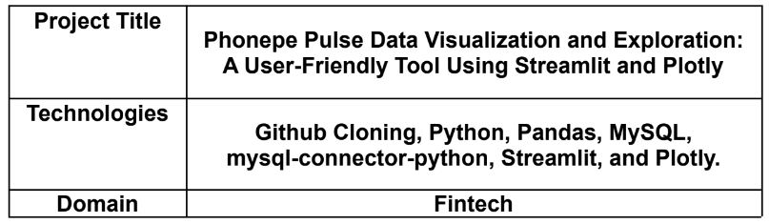
PROJECT NAME / TECHNOLOGIES / DOMAIN

Slide 3
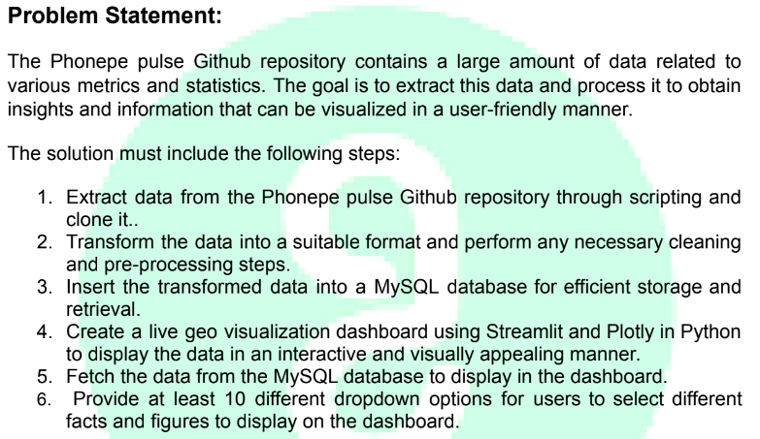
PROJECT - PROBLEM STATEMENT

Slide 4

PhonePe is an Indian digital payments and financial services.
Company headquartered in Bengaluru, Karnataka, India.
PhonePe was founded in December 2015, By Sameer Nigam, Rahul Chari and Burzin Engineer.

Slide 5
ABOUT PROJECT
The project aims to develop a user-friendly tool for visualizing and exploring data from the PhonePe Pulse GitHub repository.
It involves extracting, processing, and visualizing data to provide valuable insights through an interactive dashboard.
PhonePe Pulse is a GitHub repository containing a vast amount of data related to various metrics and statistics.
It serves as a valuable resource for understanding trends and patterns in fintech.

Slide 6
TECHNLOGIES / LIBRARIES USED IN THIS PROJECT
GitHub Cloning
Python
Pandas
MySQL
Streamlit
Plotly

Slide 7
PROCESS INVOLVED IN THE PROJECT
Data extraction from GitHub repository.
Data transformation and cleaning.
Database insertion.
Dashboard creation using Streamlit and Plotly.
Data retrieval for dashboard display.
Deployment and testing of the solution.

Slide 8
KEY FEATURES
Extraction of data from the PhonePe Pulse GitHub repository.
Transformation and cleaning of data.
Storage of transformed data in a MySQL database.
Creation of an interactive geo visualization dashboard using Streamlit and Plotly.
Dynamic updating of the dashboard with the latest data.
Multiple dropdown options for users to select different facts and figures.

Slide 9
CHALLENGES FACED IN THIS PROJECT
Handling large volumes of data efficiently.
Ensuring data consistency and accuracy during transformation.
Creating a visually appealing and intuitive dashboard interface.

Slide 10
ADVANTAGES
Provides valuable insights and information about fintech trends.
User-friendly dashboard interface.
Efficient storage and retrieval of data using MySQL.
Dynamic updating ensures the dashboard reflects the latest data.

Slide 11
PROJECT - GOALS
Creating a user-friendly tool for visualizing and exploring data
Leveraging Python and its libraries for efficient data processing
Deploying a secure and efficient dashboard accessible to users.

Slide 12
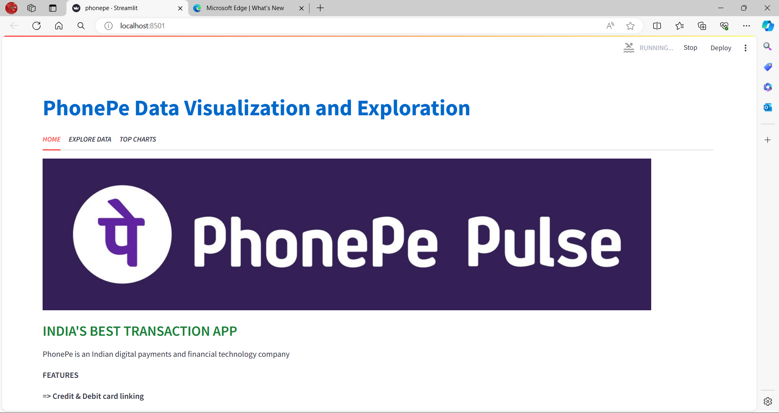
STREAMLIT - HOME PAGE

Slide 13
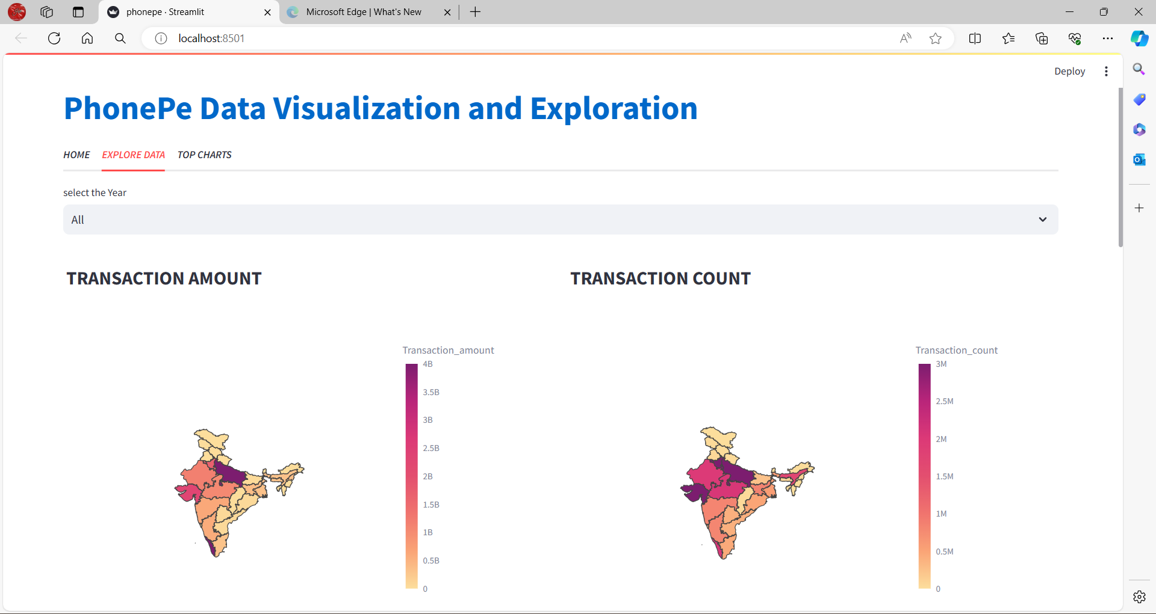
STREAMLIT - EXPLORE DATA

Slide 14
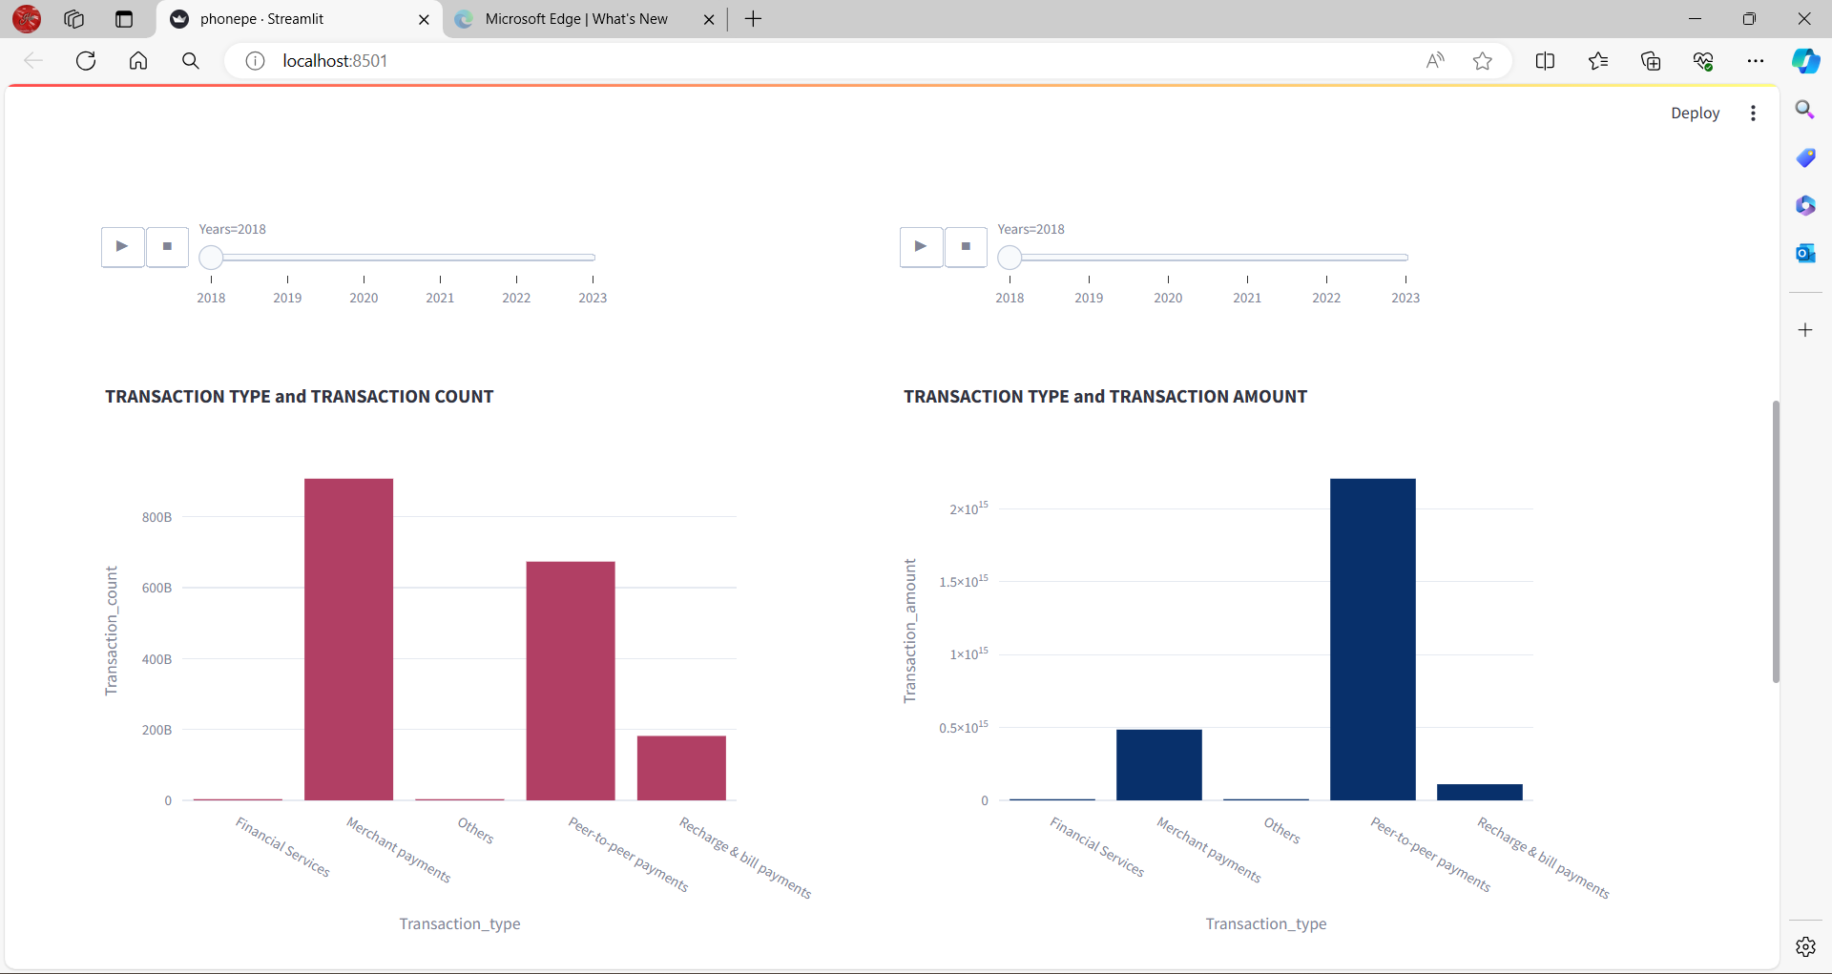
STREAMLIT - EXPLORE DATA

Slide 15
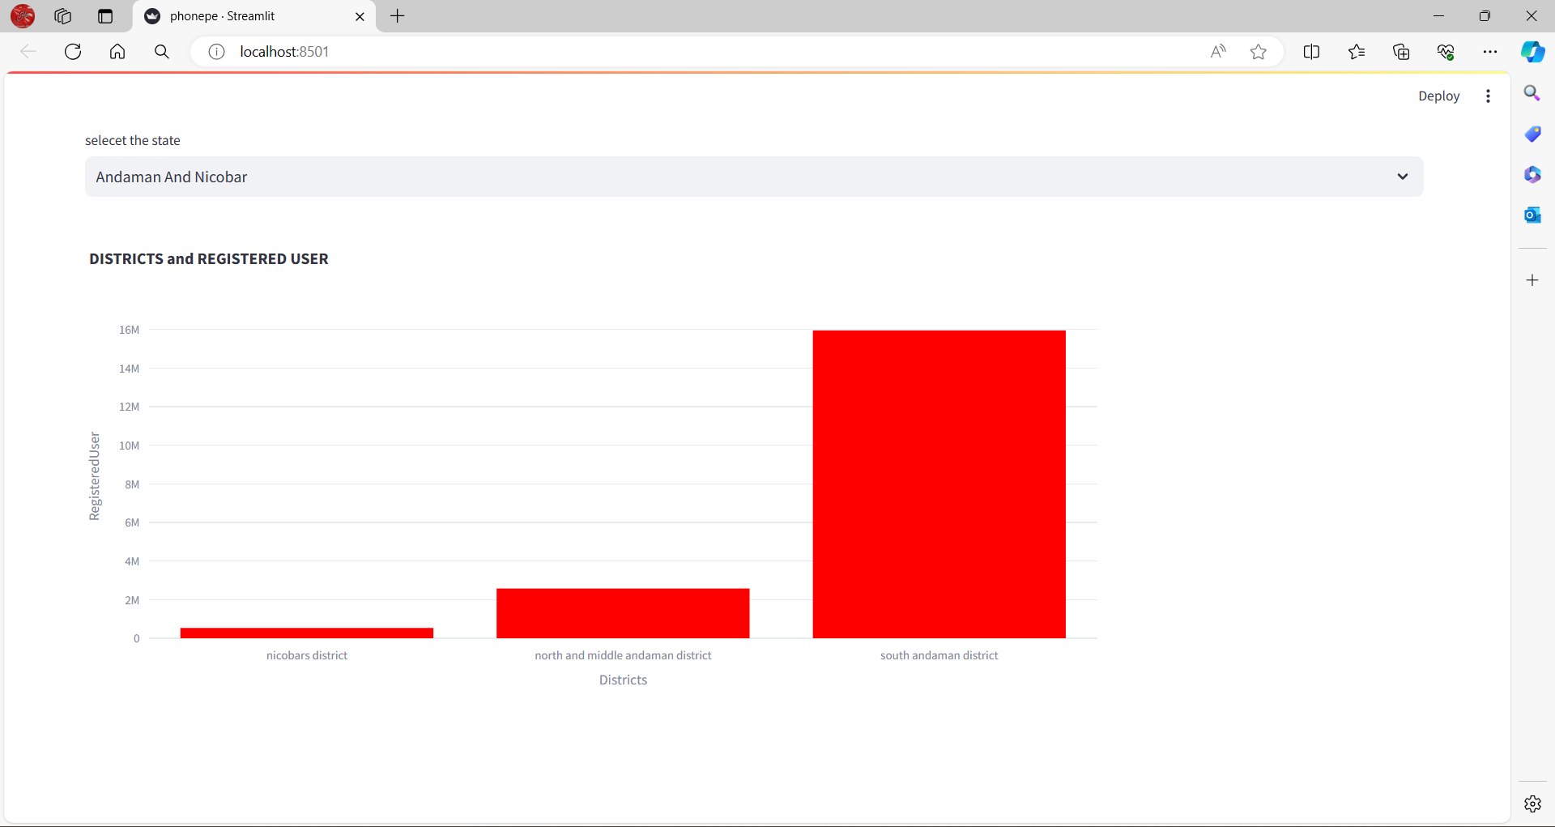
STREAMLIT - EXPLORE DATA

Slide 16
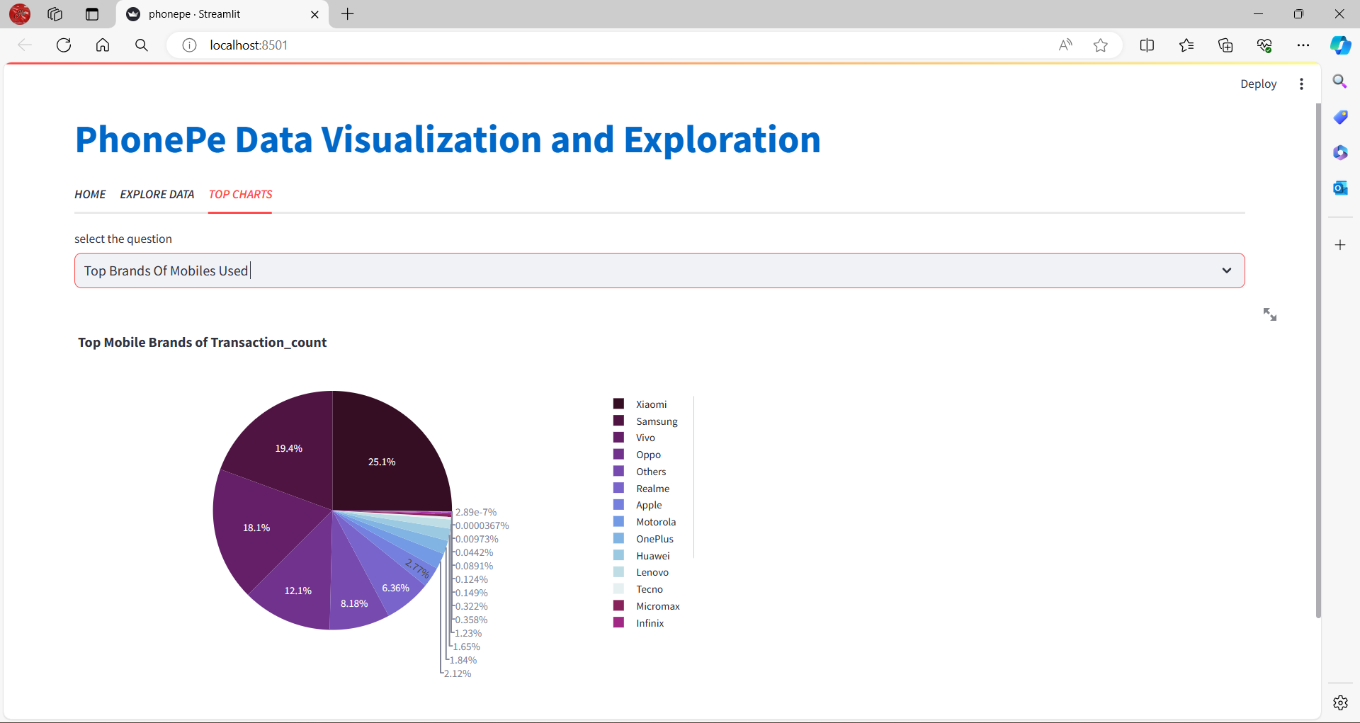
1) TOP BRANDS OF MOBILES USED

Slide 17
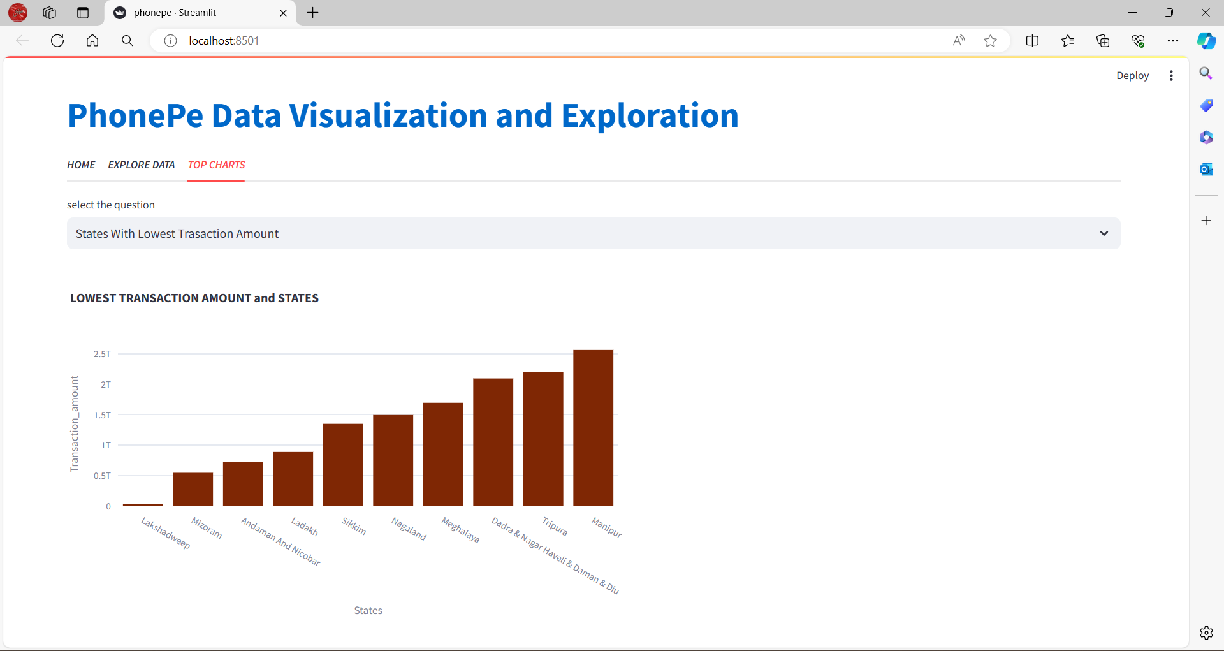
2) STATES WITH LOWEST TRANSACTION AMOUNT

Slide 18
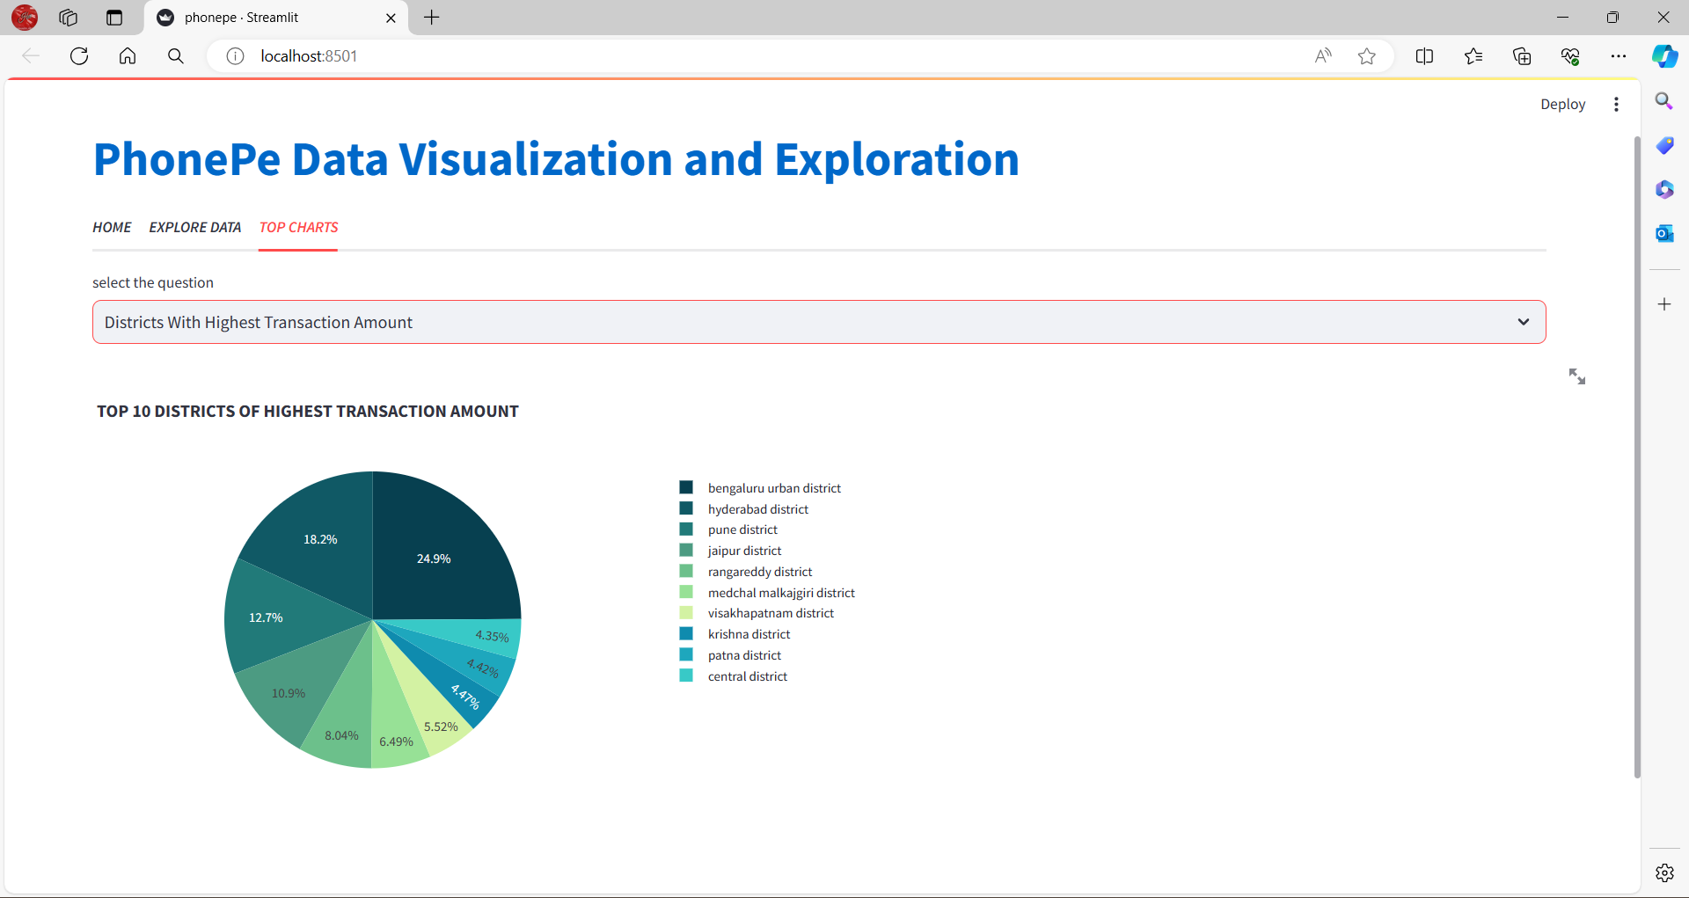
3) TOP 10 DISTRICTS WITH HIGHEST TRANSACTION AMOUNT

Slide 19
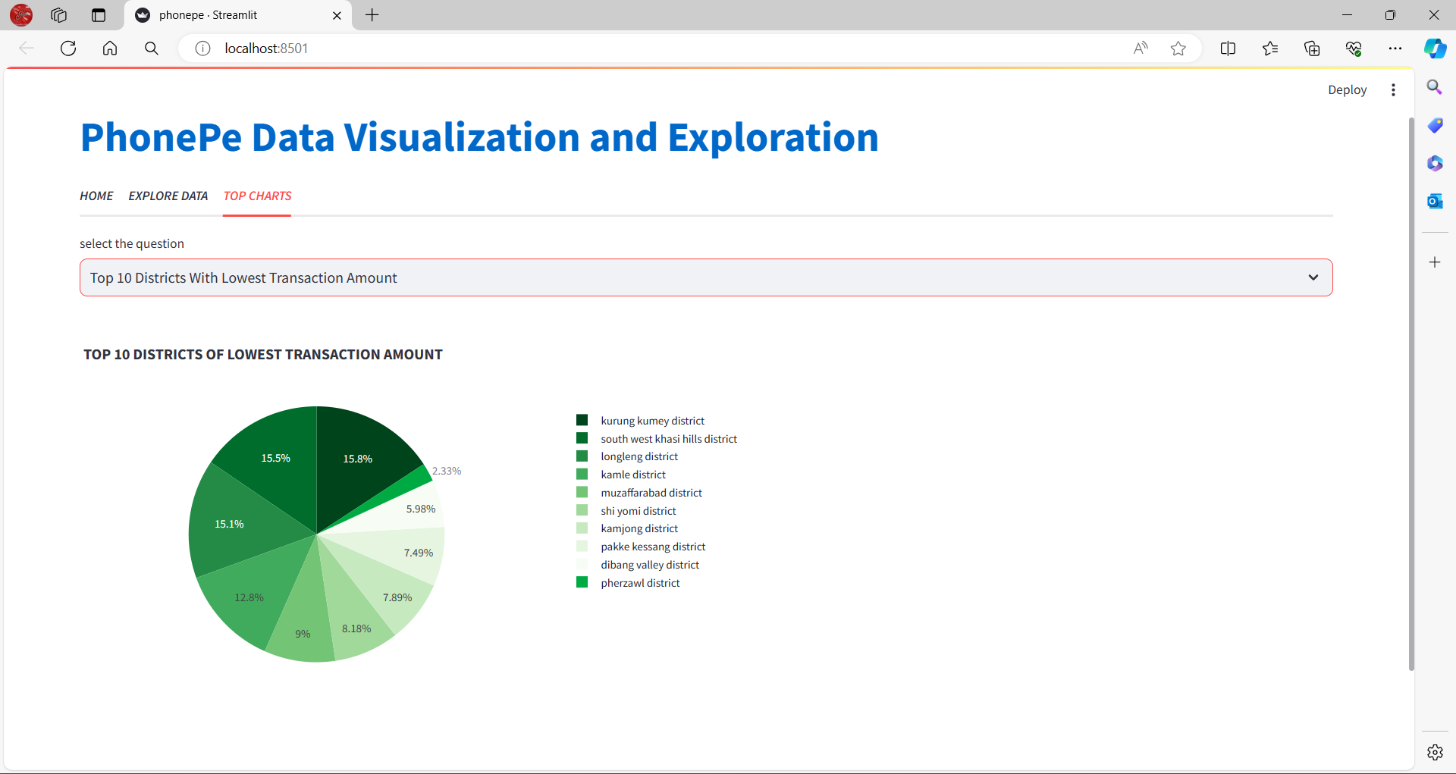
4) TOP 10 DISTRICTS WITH LOWEST TRANSACTION AMOUNT

Slide 20
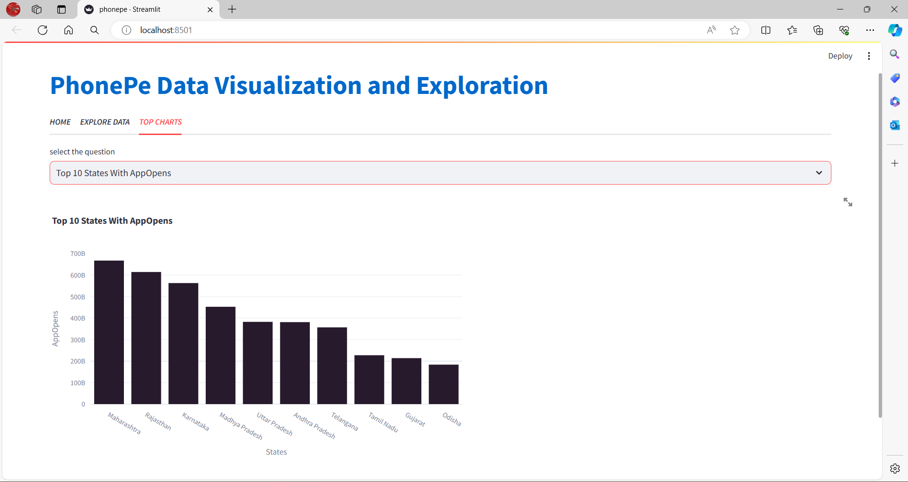
5) TOP 10 STATES WITH APP OPENS

Slide 21
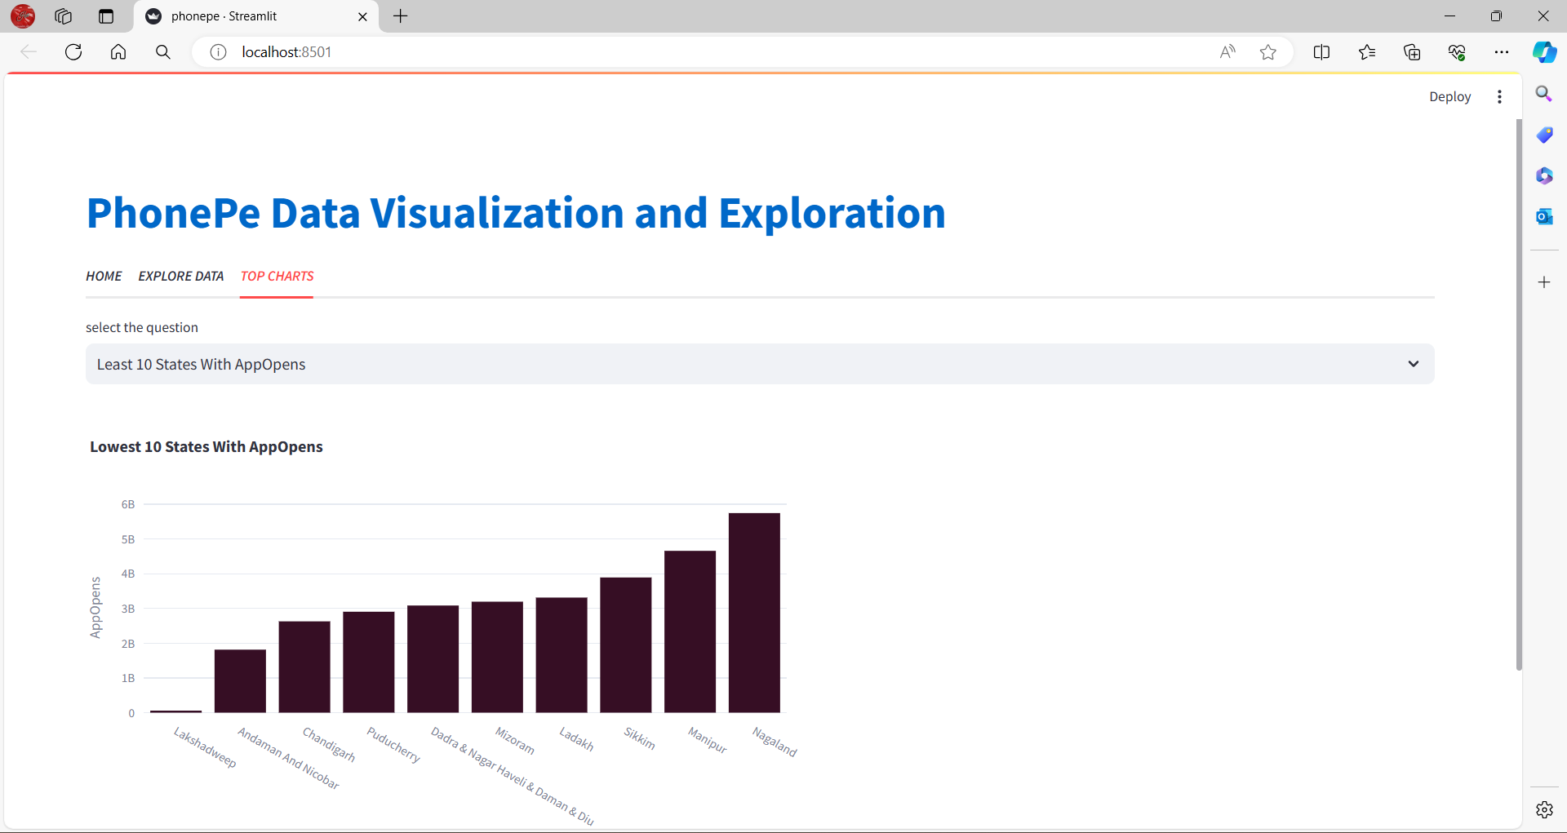
6) LEAST 10 STATES WITH APP OPENS

Slide 22
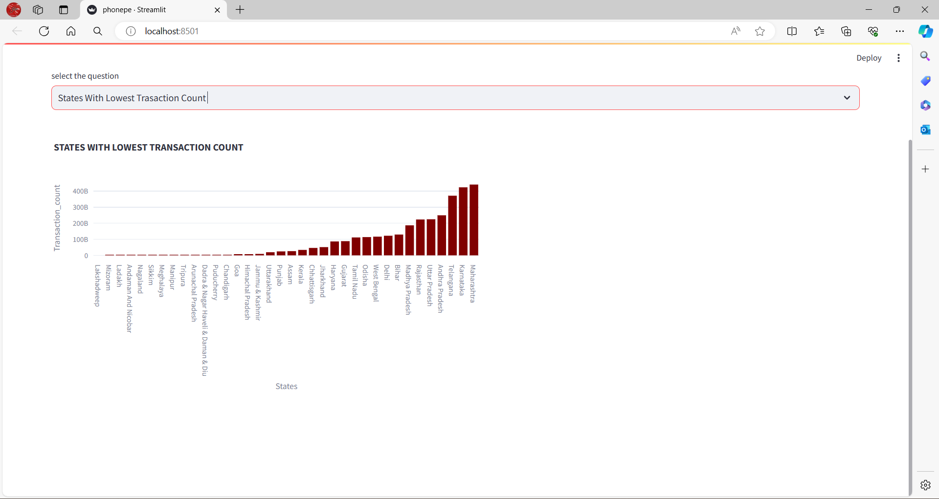
7) STATES WITH LOWEST TRANSACTION COUNT

Slide 23
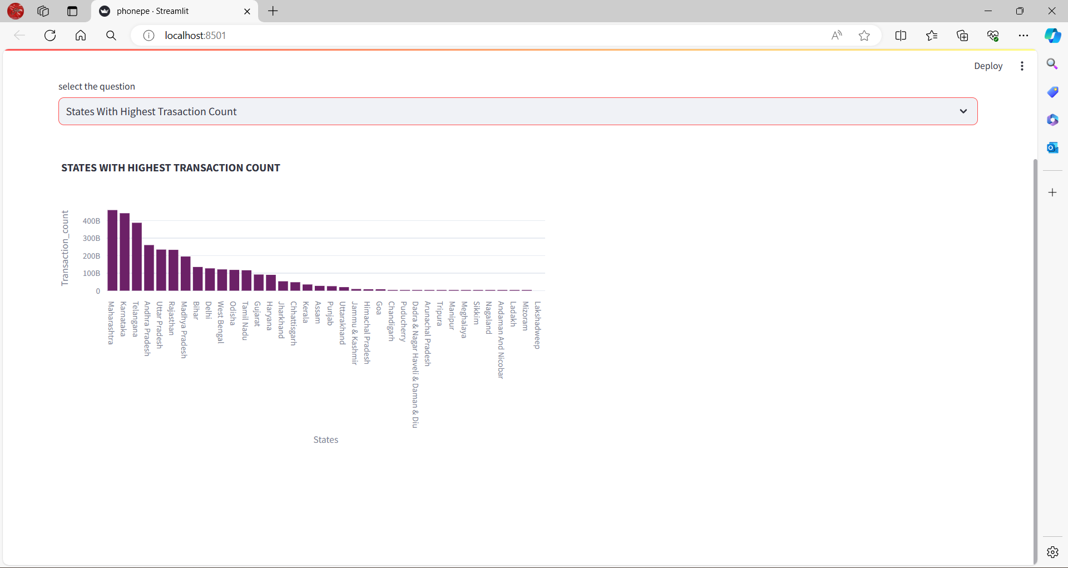
8) STATES WITH HIGHEST TRANSACTION COUNT

Slide 24
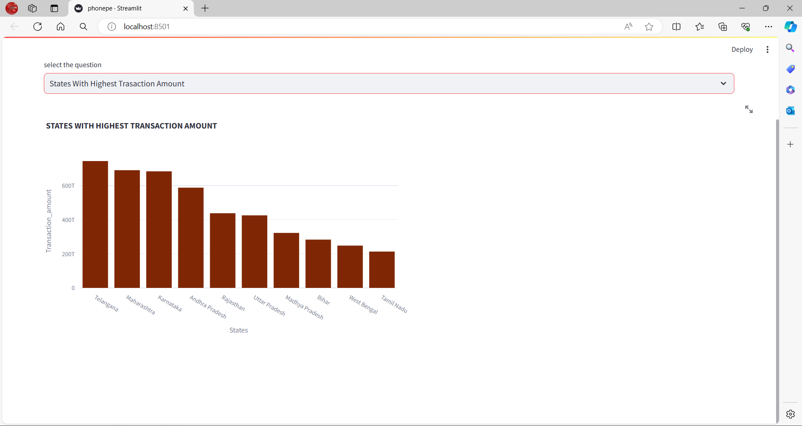
9) STATES WITH HIGHEST TRANSACTION AMOUNT

Slide 25
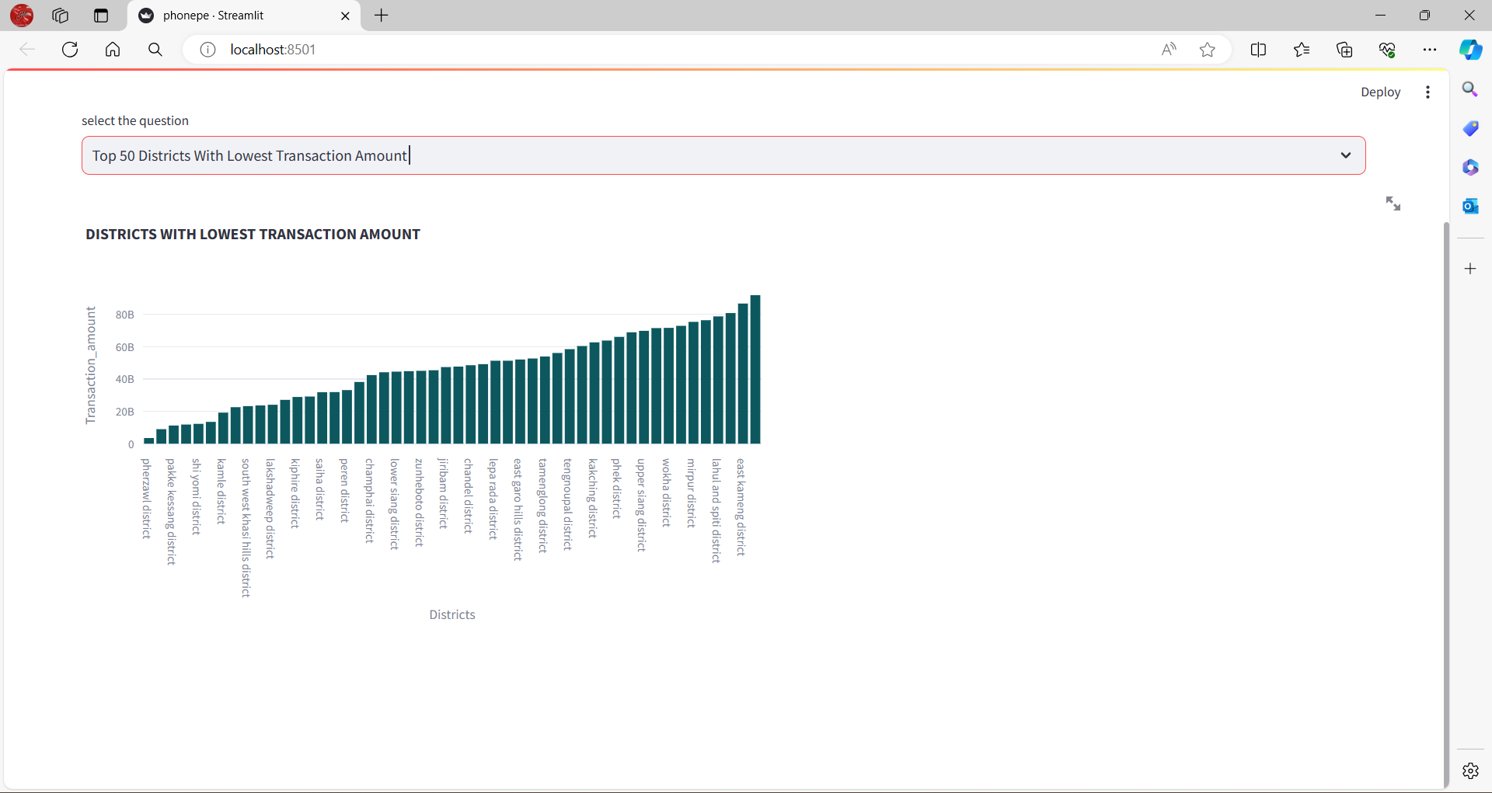
10) TOP 50 DISTRICTS WITH LOWEST TRANSACTION AMOUNT

Slide 26
RESULTS
Users will be able to access the dashboard from a web browser and easily navigate the different visualizations and facts and figures displayed.
The dashboard will provide valuable insights and information about the data in the Phonepe pulse
Github repository, making it a valuable tool for data analysis and decision-making.
Overall, the result of this project will be a comprehensive and user-friendly solution
For extracting, transforming, and visualizing data from the Phonepe pulse Github repository.

Slide 27
GITHUB LINK
https://github.com/hariyogeshram/Phonepe_Pulse_Data_Visualization_And_Exploration/blob/main/phonepe.py

Slide 28
THANK YOU

