Slide 1
First Checkpoint Documentation
https://public.tableau.com/profile/hariz.hisham#!/vizhome/first_checkpoint/Trends?publish=yes

Slide 2
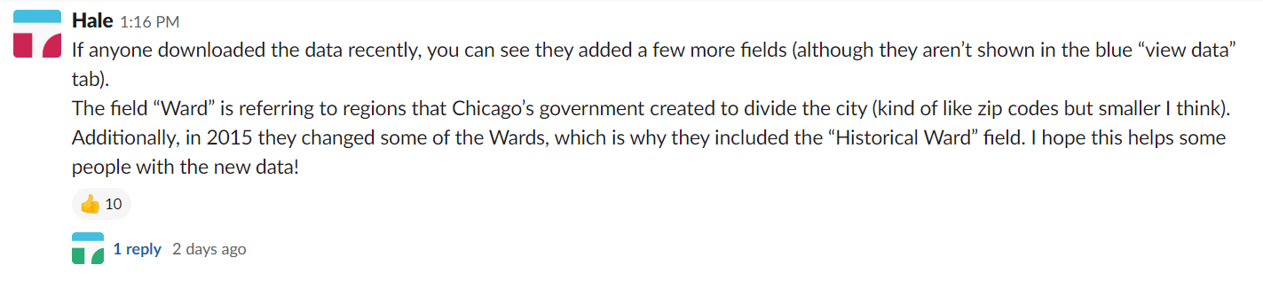
I first saw this comment made by Hale about the dataset being updated
It was the exact solution I needed to divide the dataset into geographic regions

Slide 3
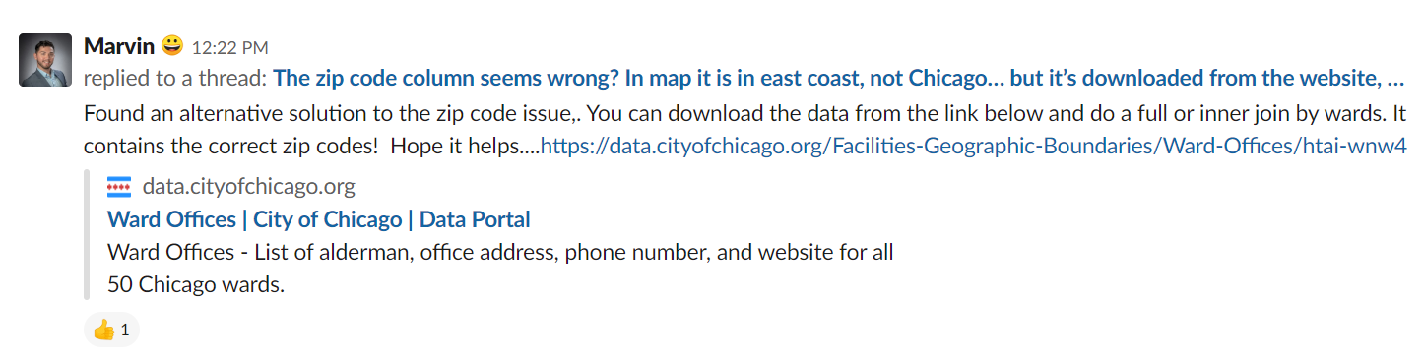
Then, Marvin gave this really great tip to get the Zipcode using the ward number

Slide 4
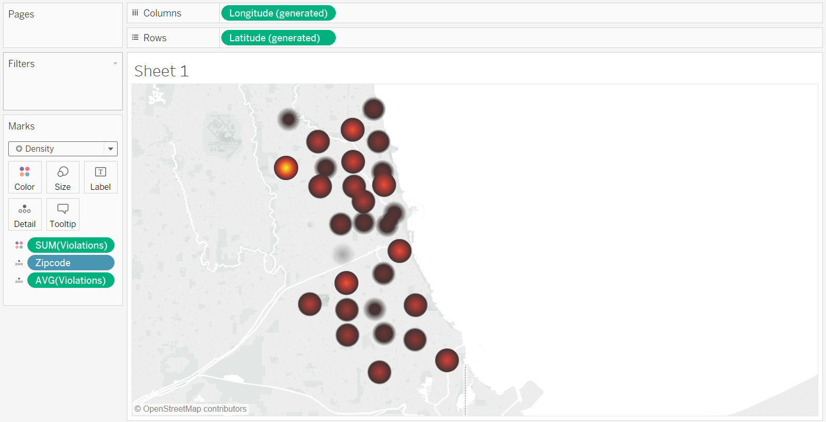
I then came up with this very boring heatmap as my first iteration – which doesn’t really say much

Slide 5
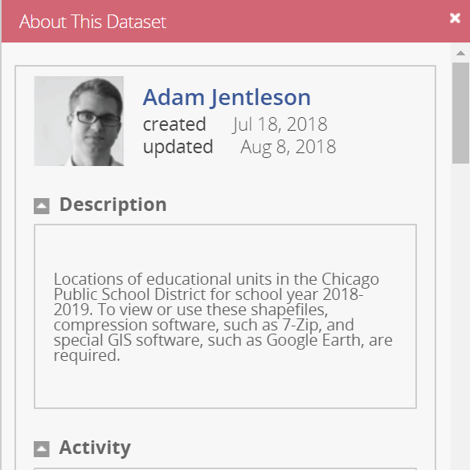
I decided to pivot, and downloaded Chicago school information
https://data.cityofchicago.org/Education/Chicago-Public-Schools-School-Locations-SY1819/8vyn-k2j3

Slide 6
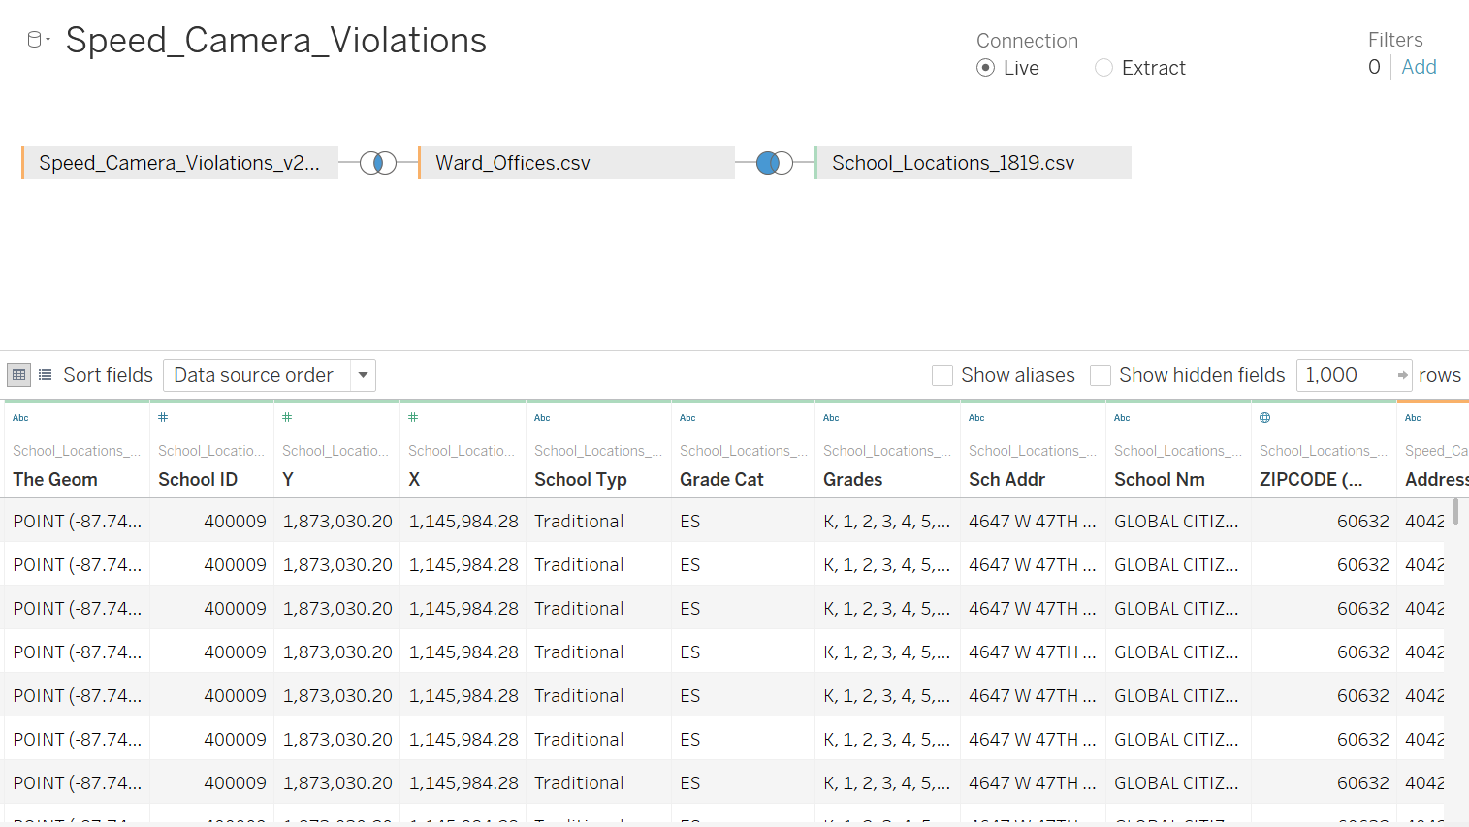
This is what my merged dataset looks like in Tableau…

Slide 7
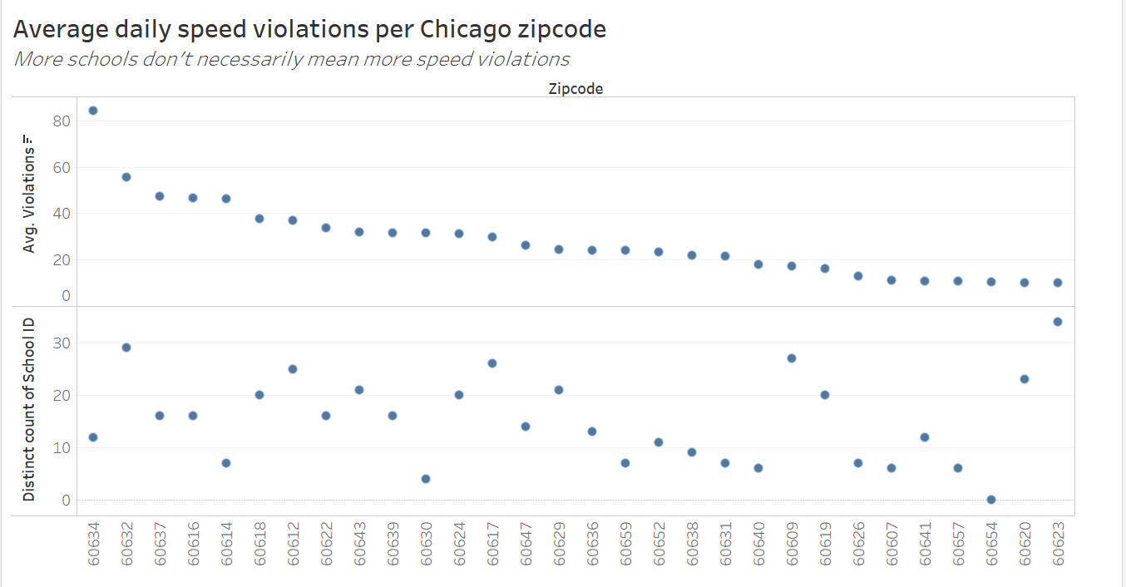
And this is the first chart I’m happy with

Slide 8
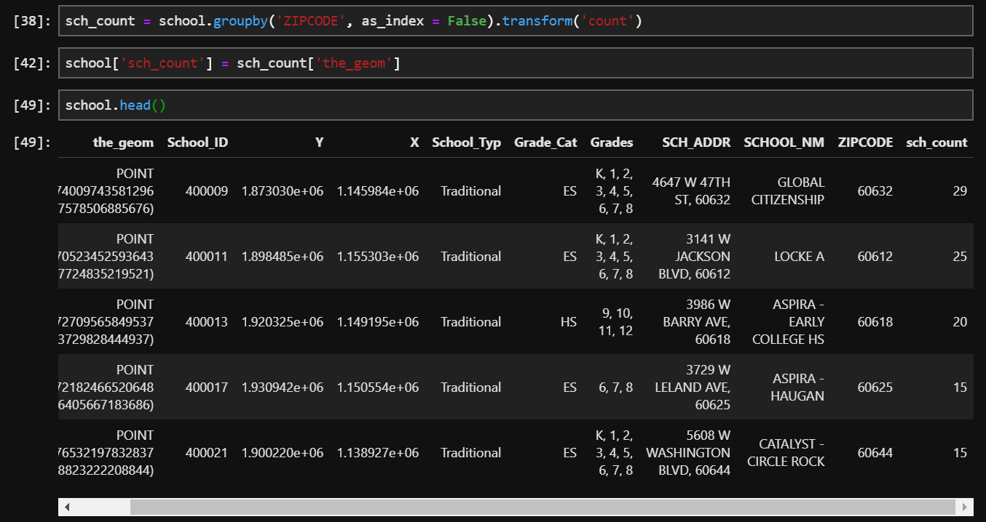
Next, I took some pointers in class and attempted to include a calculated field
To do this, I calculated the number of schools per Zipcode using Python and merged it back onto the original dataset

Slide 9
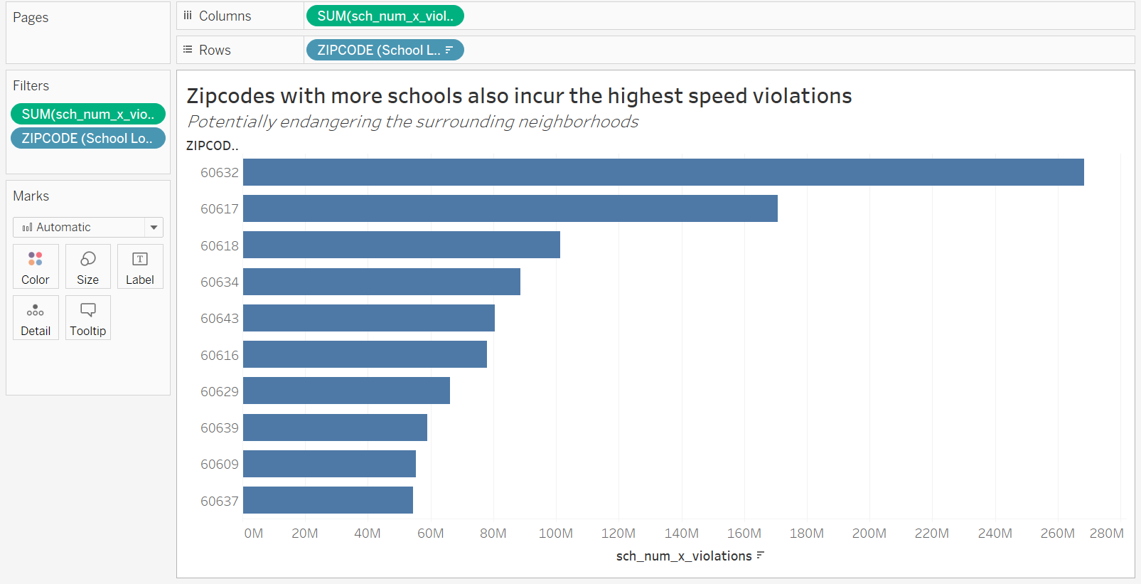
And this is what I came up with by using calculated fields (school number * violations), filtered to top 10 Zipcodes
The idea is that zips with more schools AND higher num of violations are a safety risk to households as well

Slide 10
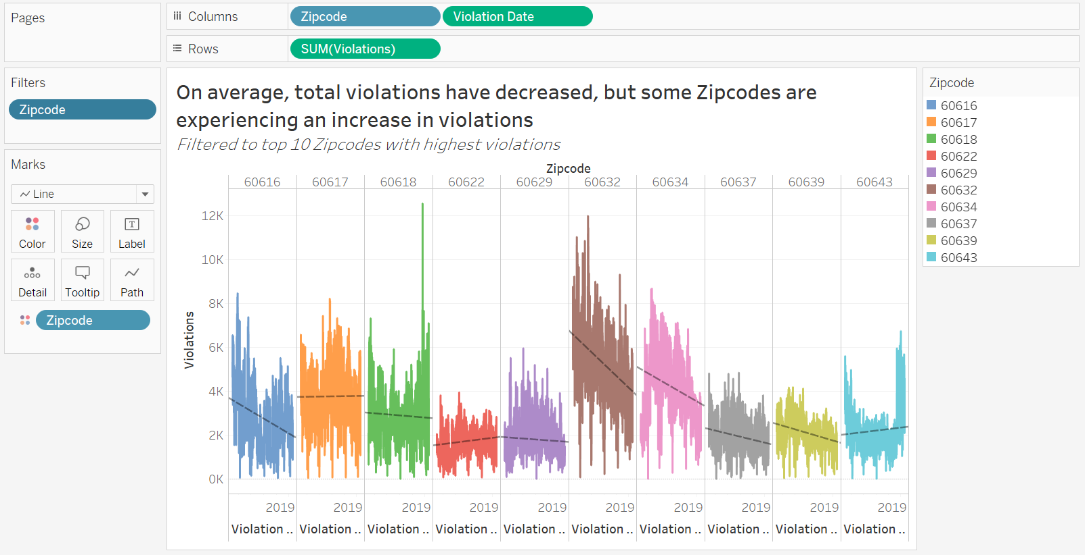
Finally, I wanted a conservative chart that showed trends of violations over time. Hopefully, this would help answer the question if the Chicago PD are doing a good job of implementing speed cameras.
To do this, I employed a simple line chart, but split it into top 10 zipcodes

