Slide 1

POL-I-SEE:
The Policy Reader App
“With Pol-I-See, Know Your App’s Privacy”

Slide 2
Problem Statement
Pol-I-See
01
04
Motivation & Challenges
Operating Plan
02
05
Novelty & Potential Impacts
Current Solutions
03
06
Loads of tedious privacy policies and their hidden danger points
Our solution: “With Pol-I-See, Know Your App’s Privacy”
What motivated us and the challenges to tackle.
How does the app work?
Many solutions exist but we want something more.
Discussing the current & future prospectus of the application

Slide 3
01/02
PROBLEM
STATEMENT
MOTIVATION
&
CHALLENGES

Slide 4
PROBLEM STATEMENT
Apps have pages long terms and conditions and policies.
Sometimes, the policy may have some terms which are very ambiguous/not-acceptable, that we might ignore.
Users fall into traps of such apps.

Slide 5
MOTIVATION & CHALLENGES
First, a privacy policy outlines how a company collects, uses, and shares our personal information
By skipping it, we may not know how your data is being used and who it is being shared with.
This can leave us vulnerable to identity theft, data breaches, and other privacy violations
Second, a privacy policy may contain important information about our rights and personal data.

Slide 6
03
CURRENT
SOLUTIONS

Slide 7



CURRENT SOLUTIONS
LexCheck
Seal
Evisort
An AI-powered contract review platform that identifies risky clauses in legal contracts.
An AI powered contract analytics platform that identifies
critical information from legal contracts and flags potentially risky clauses or language
An AI-powered contract management platform that uses natural language processing to extract key information from legal contracts. ETC…

Slide 8
04
OUR
SOLUTION
POL-I-SEE
“With Pol-I-See, Know Your App’s Privacy”

Slide 9


What is POL-I-SEE?
Summarize
Threats &
Alternatives
Update Alters
Pol-i-see summarizes the terms and conditions of the app that the user is downloading.
Pol-i-see will point out the potential threats that it sees in the terms and conditions.
Pol-i-see will recommend you better, safer apps with similar features.
Pol-i-see will notify you if any app on your phone updates it’s terms and conditions.

Slide 10
05
OPERATING PLAN
Let’s look at the methodology of our app: “POL-I-SEE”

Slide 11
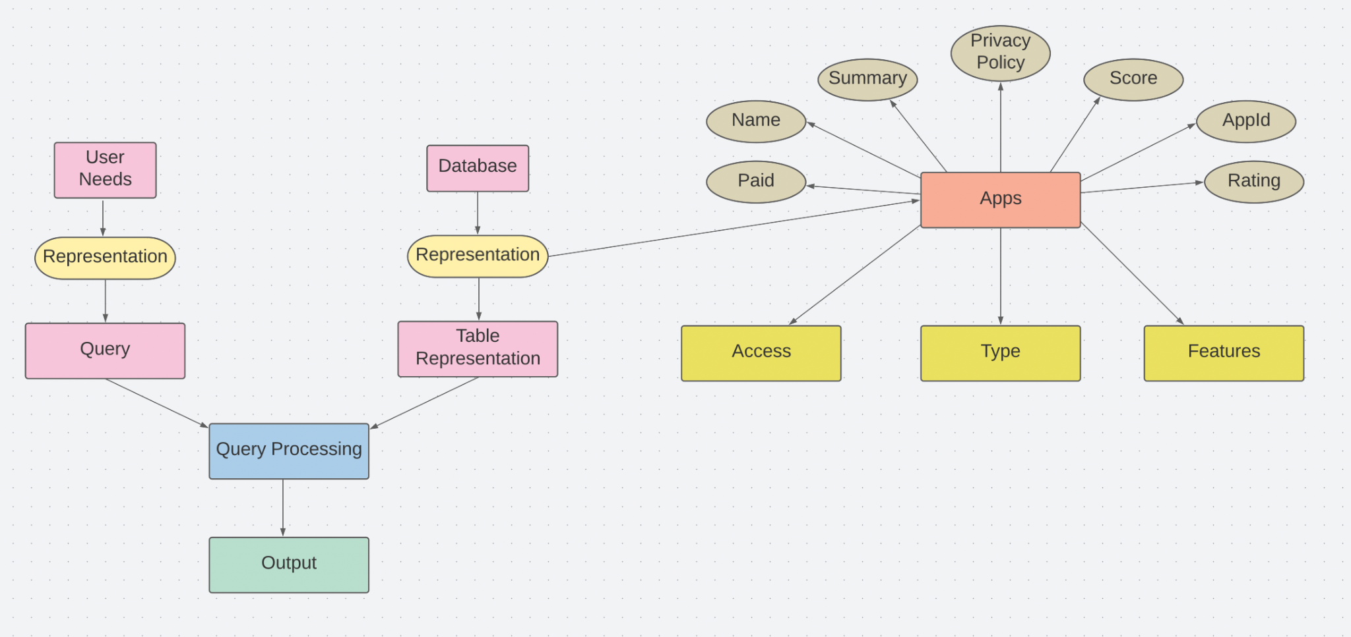
WORK-FLOW
A PICTURE ALWAYS REINFORCES THE CONCEPT
Images reveal large amounts of data, so remember: use an image instead of long texts

Slide 12
STEP 1: DATA COLLECTION
Data has been collected from various sources.
For the pol-i-see application, the text for the Privacy Policy has been taken from the official Privacy Policy document linked to the application from Google Play Store. These privacy policy documents are available on the internet as well for various applications.
Moreover, for our database general information about what permissions the application asks for when we install it is checked from settings of the mobile device.
For applications that are not in our database, we have employed gpt api to help us attain the text for the privacy policy for that application.
We have stored our data in an excel sheet and for better retrieval positional and inverted index have been created for permissions, features and other categories of information and for privacy policy text.

Slide 13
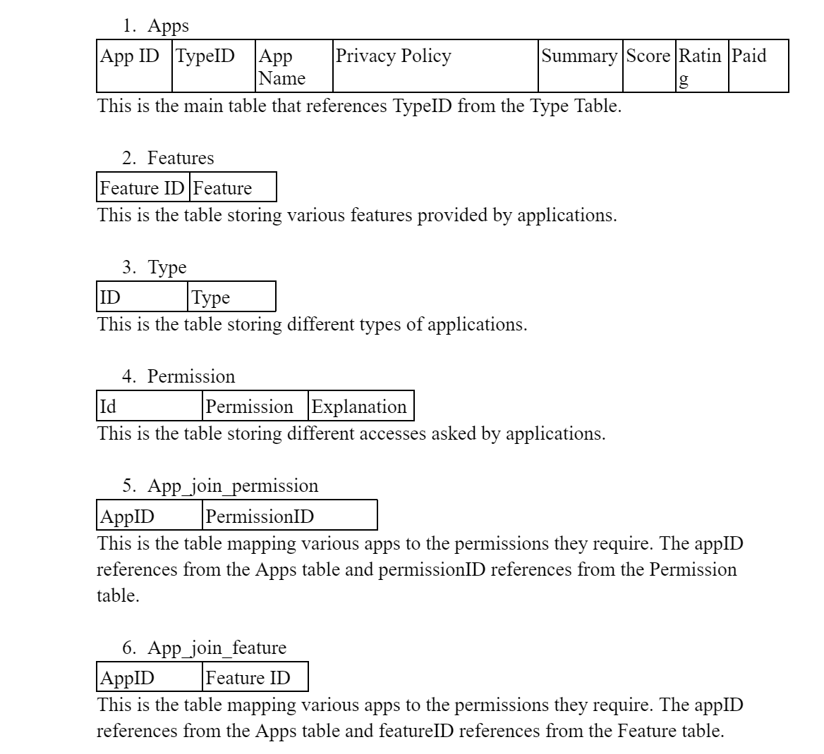
OUR DATABASE

Slide 14
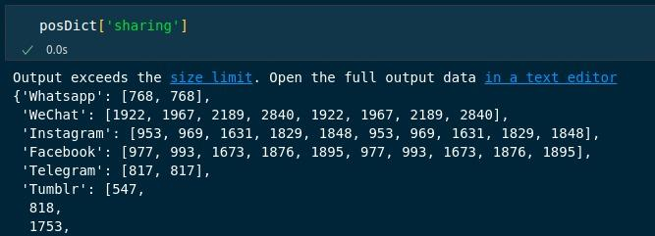
Inverted and positional index to store features and permissions

Slide 15
STEP 2: SUMMARIZATION
Keyword Extraction
We extracted the main keywords for each app by firstly using the Count Vectorizer to obtain unigram features from the entire corpus of privacy policies. After that, using 'all-mpnet-base-v2' sentence transformer we obtain word embeddings for each app's document and for the unigram keywords. Further, using cosine similarity we focus on specific keywords for an app.
Summarising
We have used Pre-trained “Transformer” model T5-Small to summarize the privacy policies of different Apps. The T5 (Text-to-Text Transfer Transformer) model is a pre-trained transformer-based language model developed by Google. We added the keywords as prefix to our original text to increase their weights in the summary, giving us a more balanced output.

Slide 16
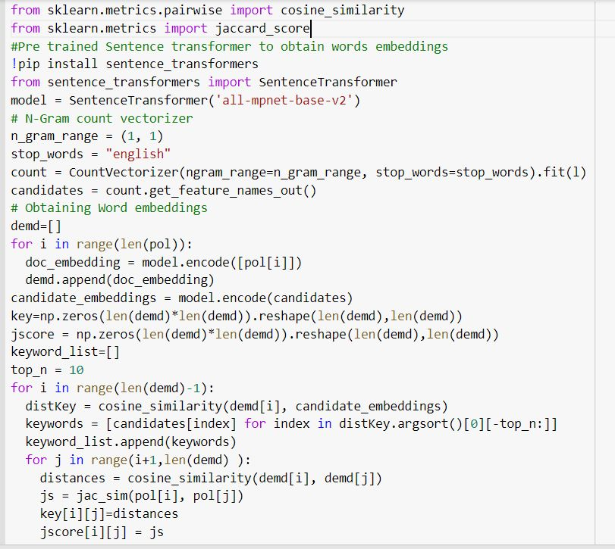
Code for Keyword extraction

Slide 17
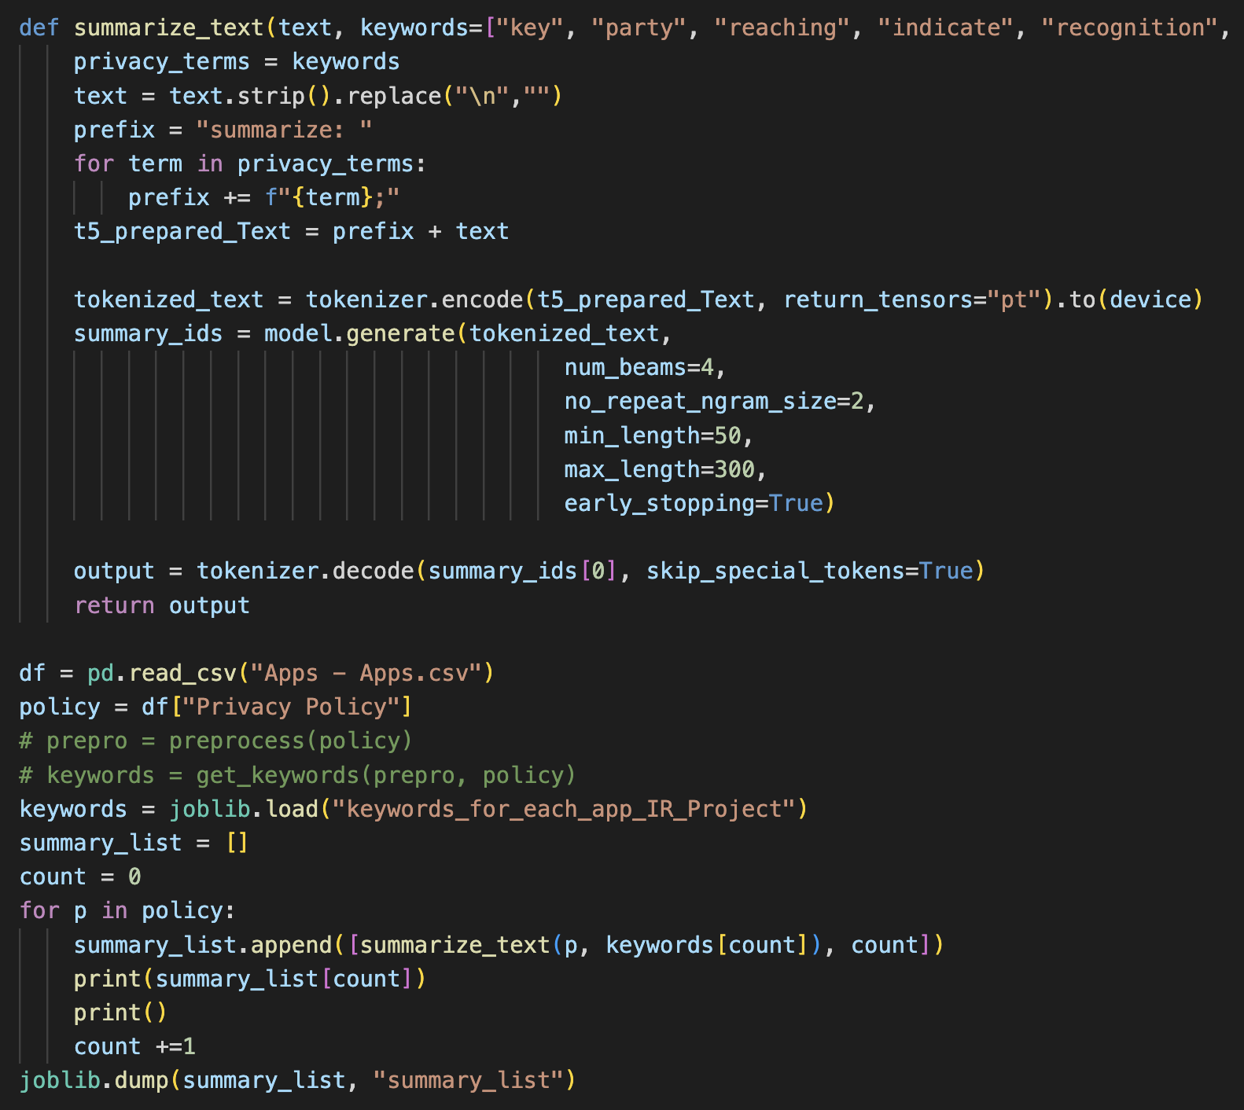
Code for Summarization

Slide 18
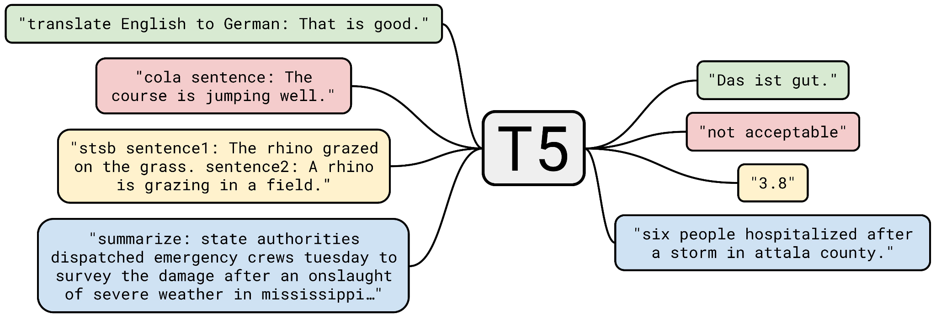
T5 MODEL ARCHITECTURE
The T5 architecture is based on the transformer model and consists of an encoder-decoder structure. The encoder takes the input sequence and converts it into a fixed-length vector representation, while the decoder uses the encoder output along with a task-specific prompt to generate the final output sequence.

Slide 19
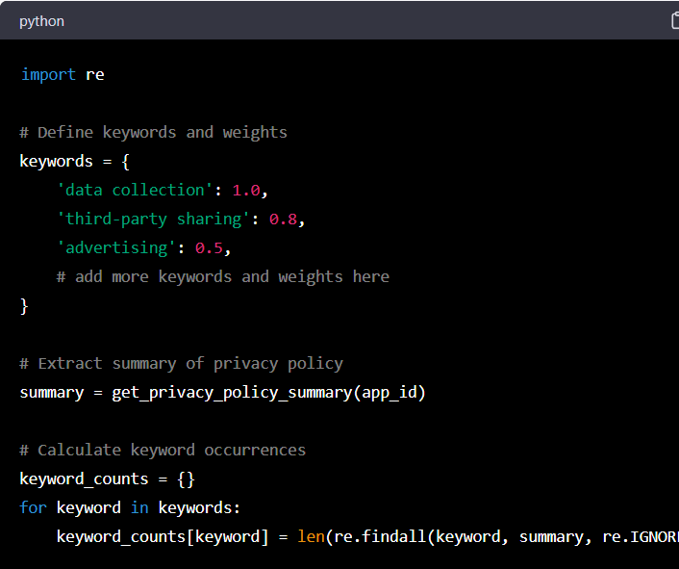
STEP 3: EVALUATION (BASE LINE)
For our baseline evaluation we simply use weighted sums to determine whether the current app is safe or not.
Define a list of keywords that relate to user privacy, such as "data collection", "third-party sharing", "advertising" etc.
Extract the summary of the privacy policy for the app.
Calculate the number of occurrences of each keyword in the summary.
Assign a weight to each keyword based on its importance in terms of user privacy.
Calculate the overall app score based on the weighted sum of the keyword occurrences.
An Example for the the evaluation metric(src: ChatGpt)

Slide 20
Performance Evaluation for summarizer
We have used to metrics for our evaluation:
ROUGE (Recall-Oriented Understudy for Gisting Evaluation): ROUGE is a set of metrics that measures the overlap between the generated summary and the reference summary in terms of n-gram matches. It computes precision, recall, and F1 scores.
OBTAINED ROUGE SCORE OF :- 0.65
BLEU (Bilingual Evaluation Understudy): BLEU measures the similarity between the generated summary and the reference summary in terms of n-gram matches. It computes precision, recall, and a geometric mean of these two scores.
OBTAINED BLUE SCORE :- 0.7

Slide 21
STEP 3: APP RECOMMENDATION
Our application incorporates an inbuilt recommendation system that suggests safer alternatives when a new app is installed. The system makes use of the Jaccard similarity metric, which measures the similarity between the feature vectors of the newly installed app and the apps present in our database. The feature vector is a vector of all the distinct feature IDs present in the app.
We calculate a score for each app in the database, which classifies it as safe or unsafe. Based on this score and the degree of similarity between the newly installed app and the apps in our database, our system recommends the apps that are both similar and safer.
The score is inversely proportional to the safety of the app, i.e., the lower the score, the safer the app. In this way, we provide alternative recommendations to our users that are safer than the installed app.

Slide 22
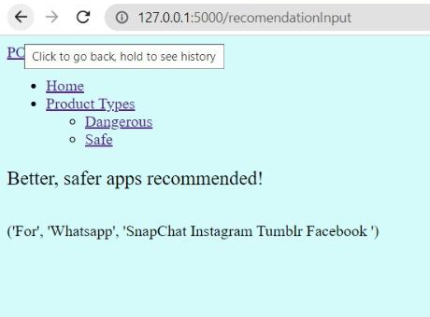
Recommender
Here, as we can see when asked for recommendations for Whatsapp we get SnapChat, Instagram, Tumblr and Facebook which according to out score evaluator are safer apps.

Slide 23
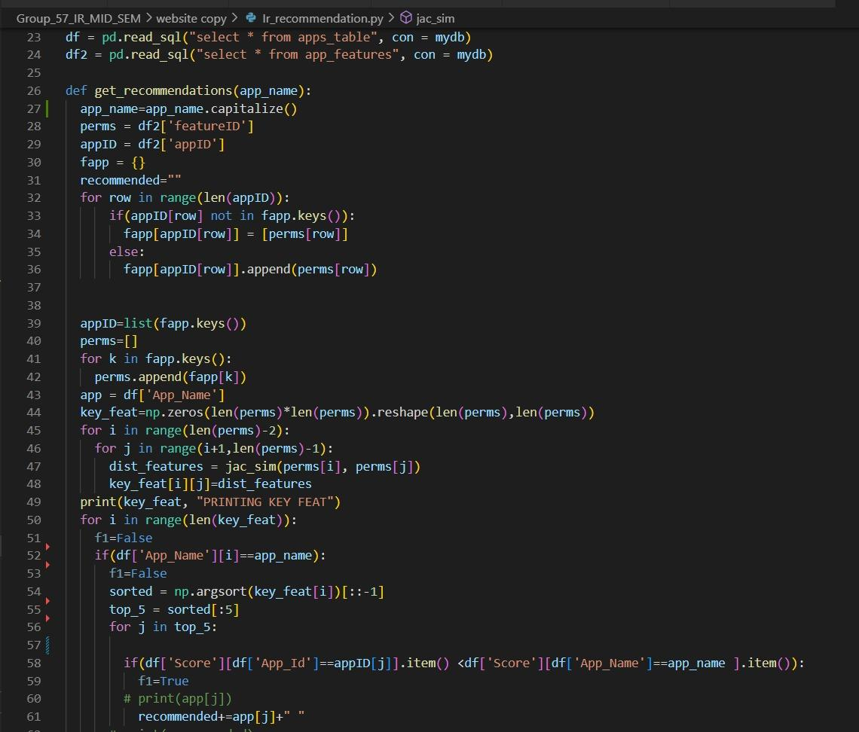
Recommender
(Code for nerds)

Slide 24
STEP 3: CHAT BOT
Our application has a chatbot based on the GPT-3 API that has been fine-tuned using our privacy policy data. This enables the chatbot to provide users with accurate and efficient responses to their queries, while also reflecting our commitment to protecting their personal data.
We preprocessed our privacy policy data in JSONL format to facilitate prompt and accurate responses. By training the GPT-3 model on this preprocessed data, our chatbot has developed a deep understanding of our privacy policy guidelines.

Slide 25
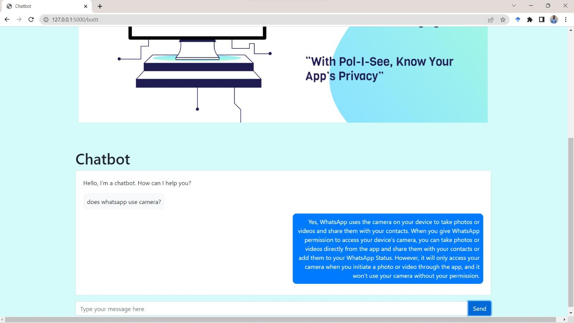
Chatbot

Slide 26
06
NOVELTY
&
IMPACTS

Slide 27
NOVELTY
How is POL-I-SEE unique?
We aim to build a system that will not only provide a summarized version of the privacy policy of the downloaded apps, classifying it as safe or unsafe by assigning a score between 0 to 10, but it will also give recommendations from the database for better, safer apps.
This will provide users with greater transparency and enhance their understanding of the apps they intend to download.
Moreover, our application also has a chatbot to allow the users to easily interact with our system and answer any doubts.

Slide 28
07
USER FEEDBACK
We created a Google Form and distributed it among our peers, friends, and family to gather basic information about their privacy policy and data breach behavior. Our survey aimed to determine if users would be willing to utilize an application with the functionalities that Pol-I-See aims to provide.
These are some of the insights from the survey -

Slide 29
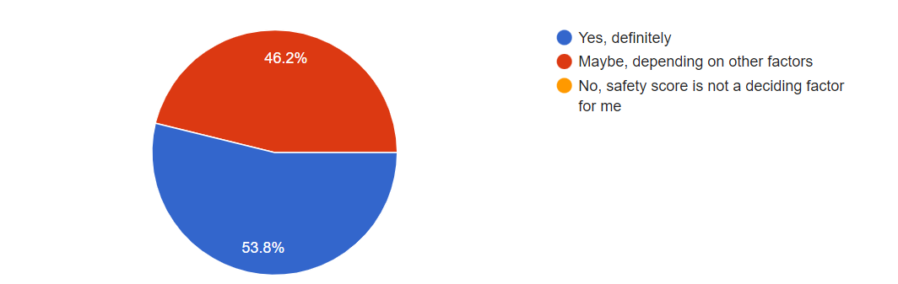
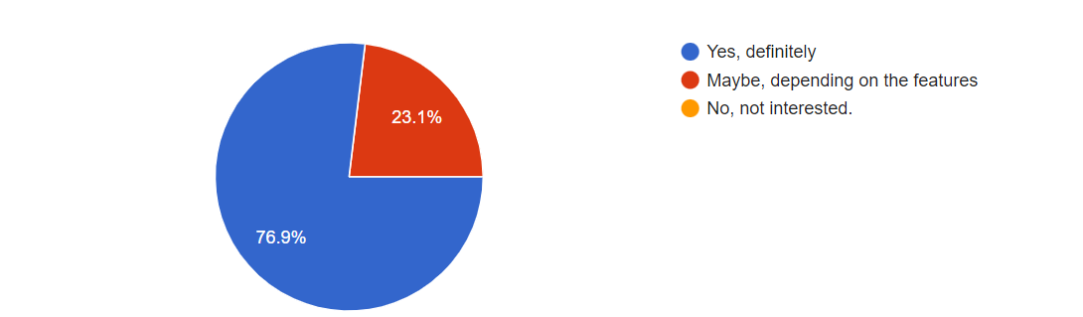
Q. Would you be more likely to download an app if it had a higher safety score compared to a similar app with a lower safety score?
Q. Would you be interested in an app/website that suggests alternate apps with similar features, but with a better privacy score?

Slide 30
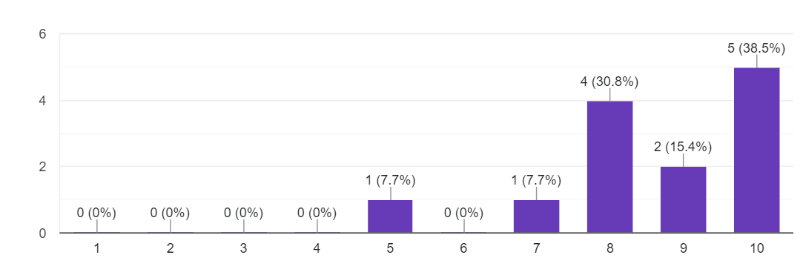
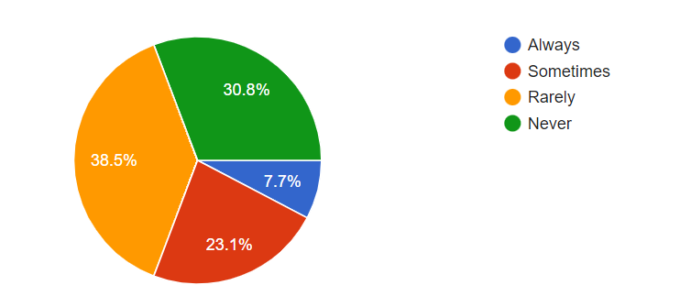
Q: How important (on a scale of 1-10) is the safety score of an app to you when downloading it?
Q: How often do you read the privacy policies of the apps you download?
We acted on the user feedback, made the website more user friendly and added a chatbot for ease of communication.

Slide 31
POTENTIAL IMPACTS
Increased comprehension
Greater transparency
Compliances
Improved Trust
Time and Efforts
It can increase comprehension by breaking down important parts of the policy into easy-to-understand language.
It can promote transparency by helping companies communicate their data collection and usage practices more clearly.
It can ensure compliance with laws and regulations related to privacy policies.
It can improve trust by demonstrating that companies value their users' privacy and are committed to transparency.
A privacy policy summarizer can also save time and effort for both users and companies by making it easier to review and understand privacy policies, reducing the need for lengthy and complex legal documents.

Slide 32
OUR TEAM
This presentation is a joint effort by:
Aaditya Gupta(2020552)
Varun Parashar(2020482)
Harjeet Singh Yadav(2020561)
Diya Ahuja(2020431)
Samriddh Singh(2020466)
Ishita Sindhwani(2020305)

Slide 33
THANKS!
We are open to questions now…

