Slide 1
Design Uber
.

Slide 2
Matching System
ETA/ Mapping
Matchers
Nearby Cabs Finder
Matchers
Match Driver
S2 Library
Matchers
Matchers

Slide 3
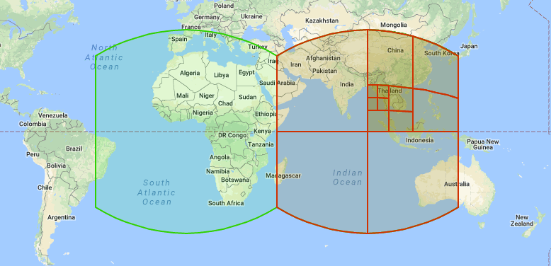
S2 Libaray

Slide 4
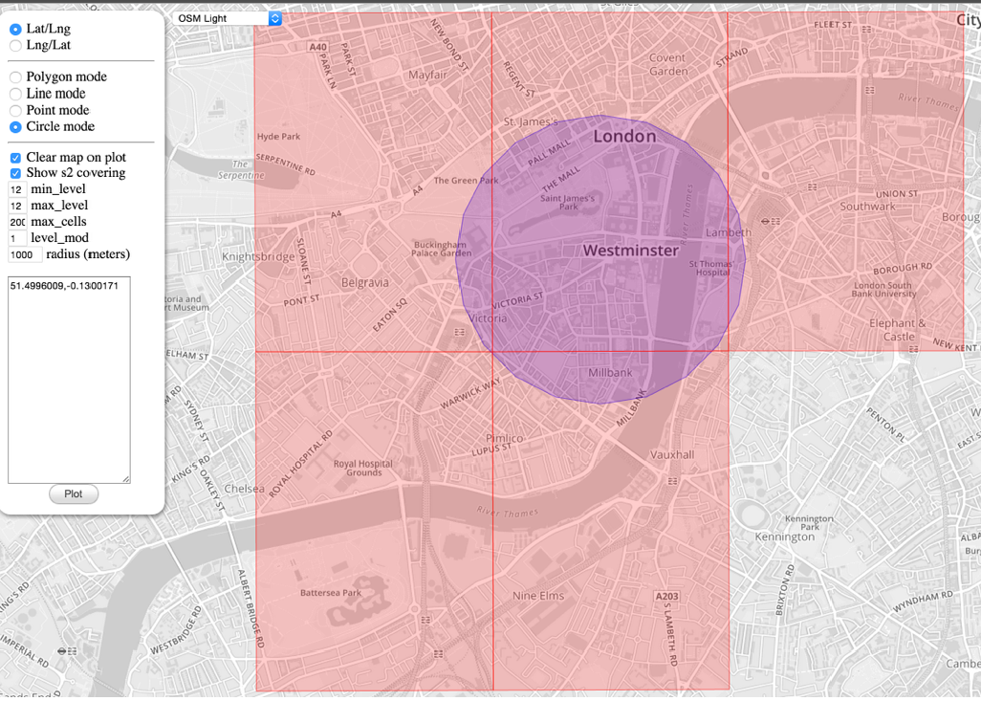
S2 Cells

Slide 5
Calculate ETA
Track Active GPS Locations in that AREA
Historical Traffic Data

Slide 6


Final Design
LB
NoSql
Hadoop
Kafka
ETA Service
LB
Matching System
Nearby Cab Finder

