Slide 1
Effects of Treatment and Growth Factor on Gene Expression
Analysis Overview
Dr. Karl Berator
Institute of -omics, Adelaide

Slide 2
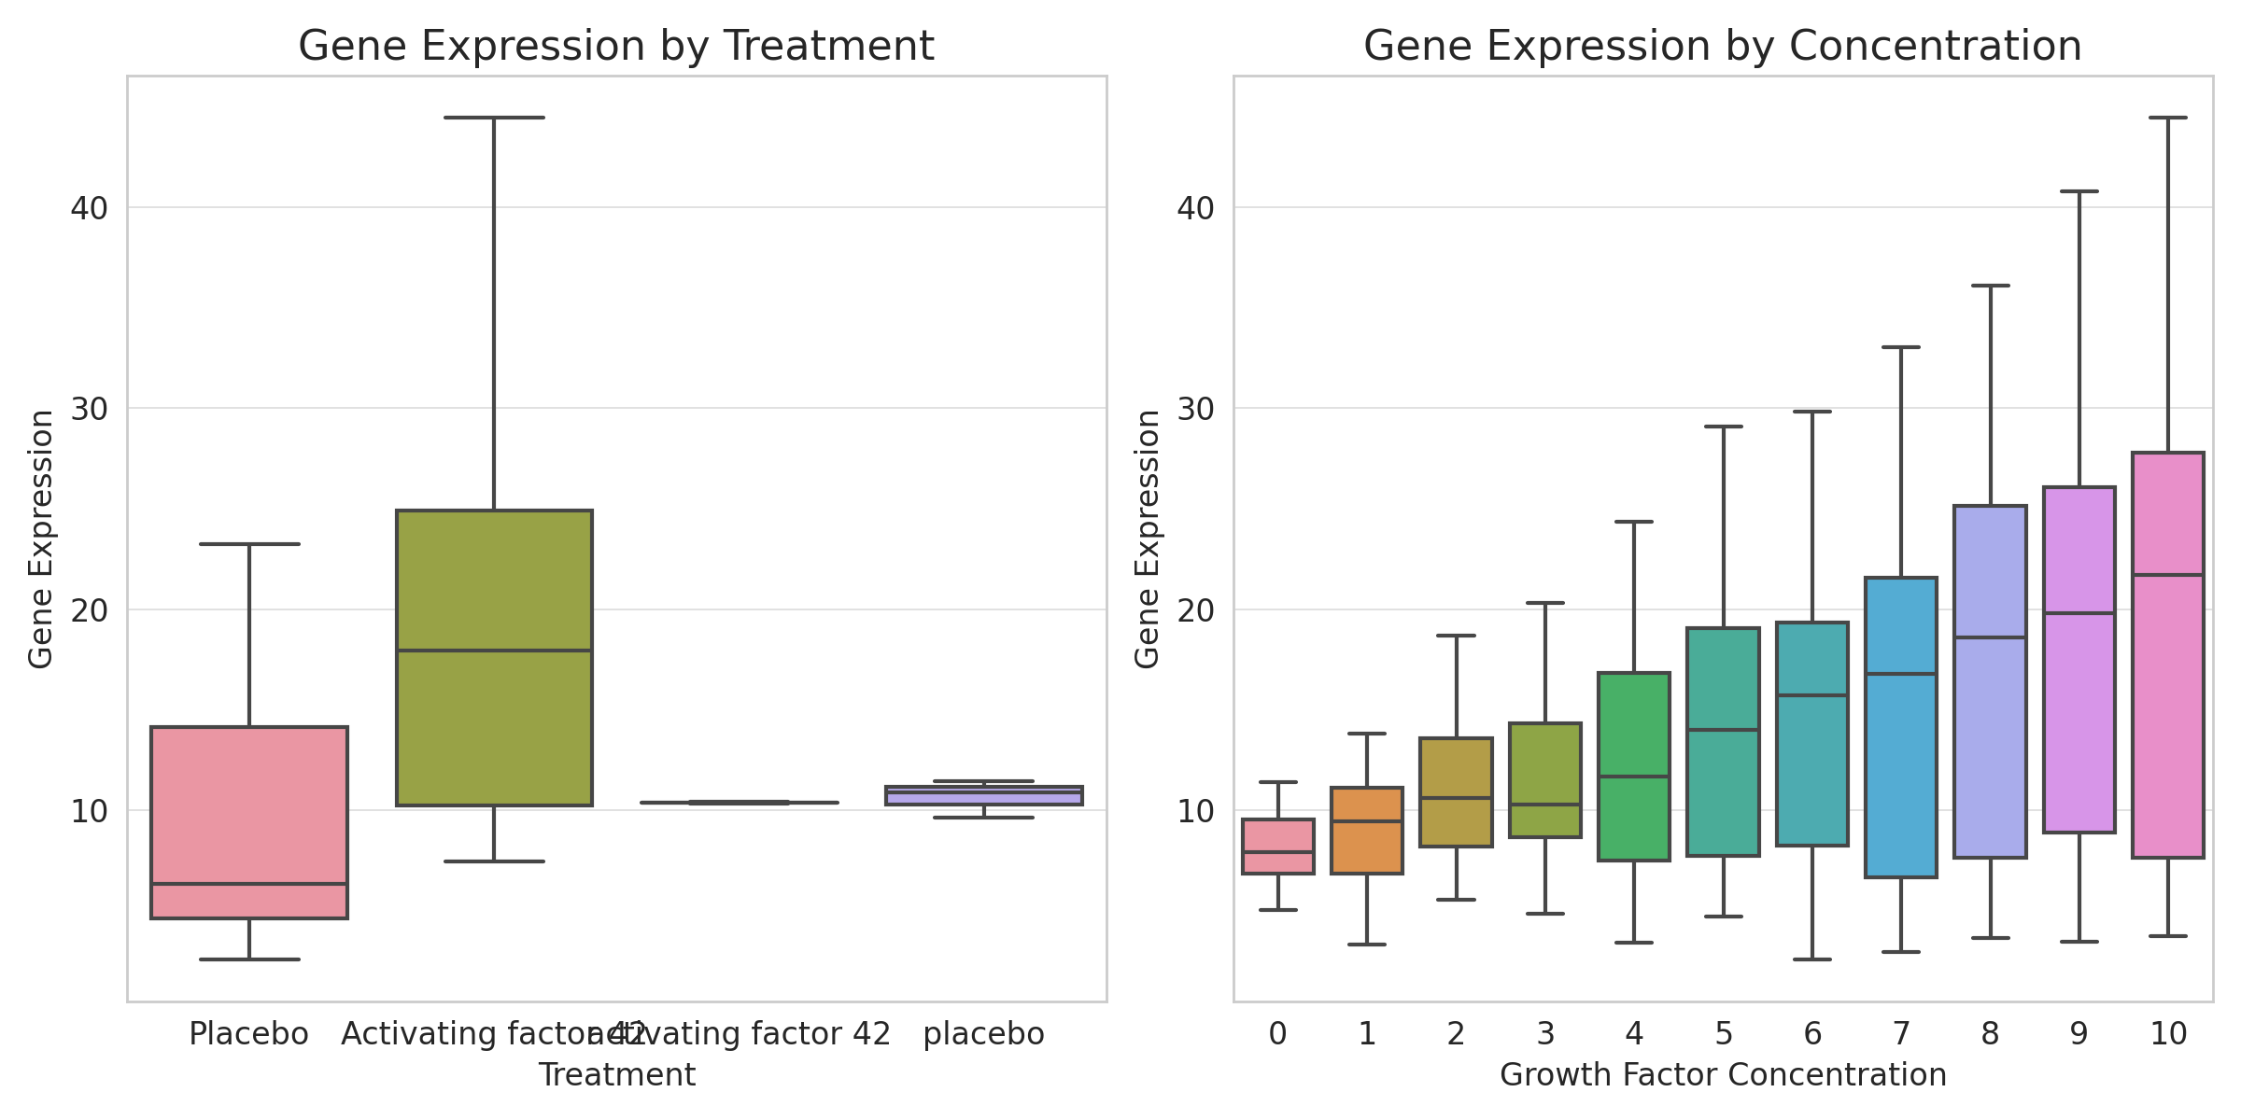
Treatment and Concentration Effects on Gene Expression

Slide 3
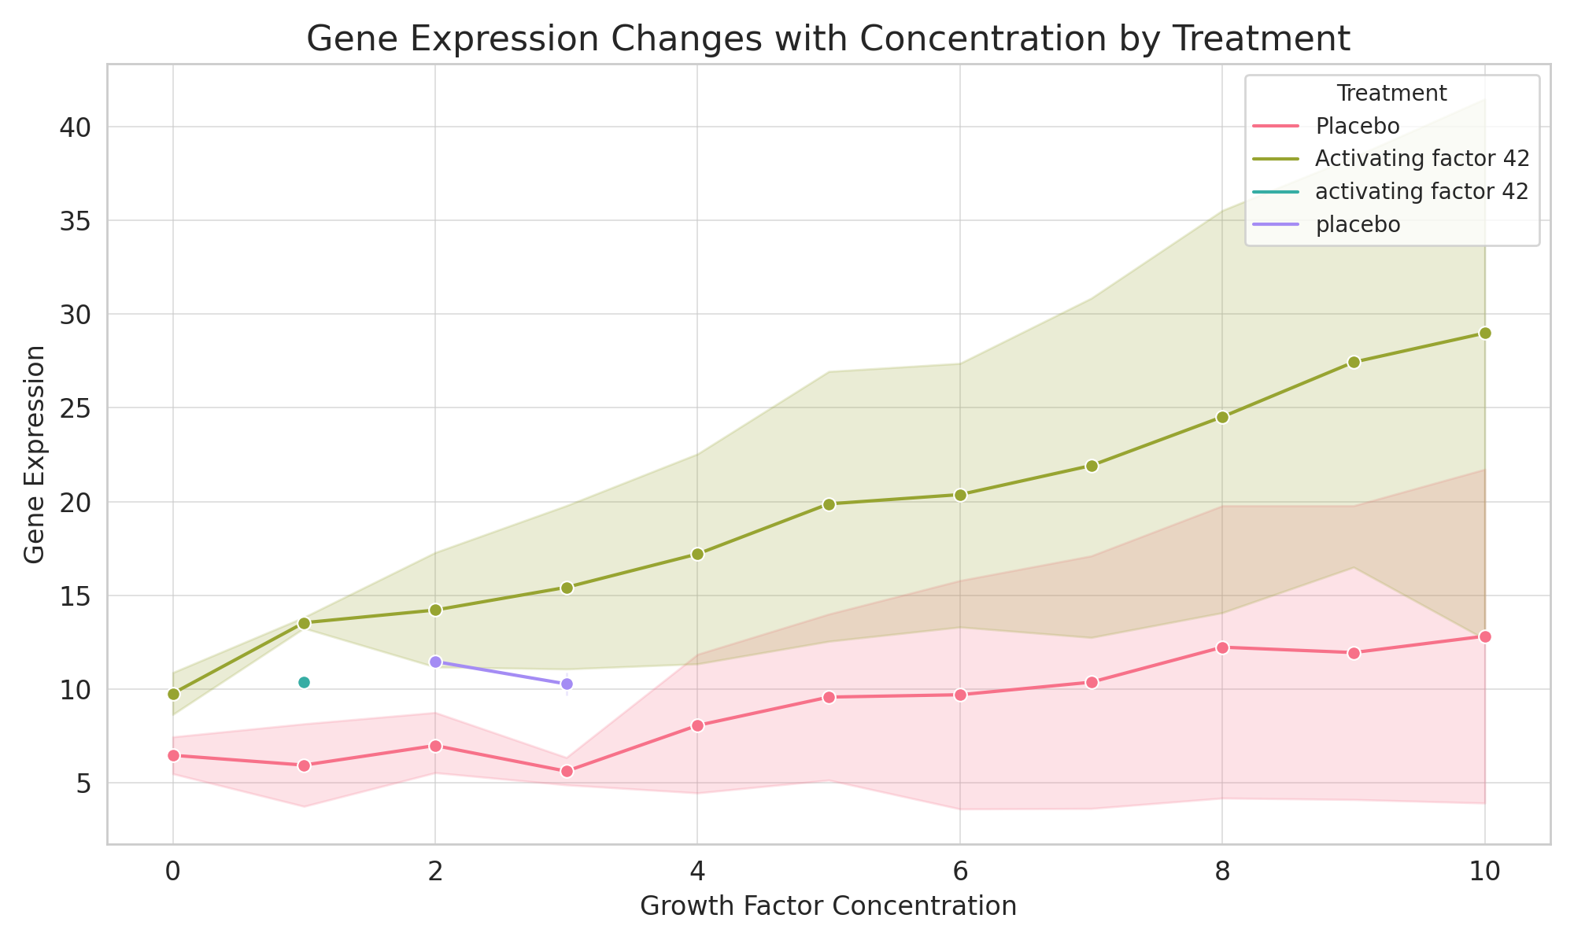
Gene Expression Changes with Concentration by Treatment

