Slide 1
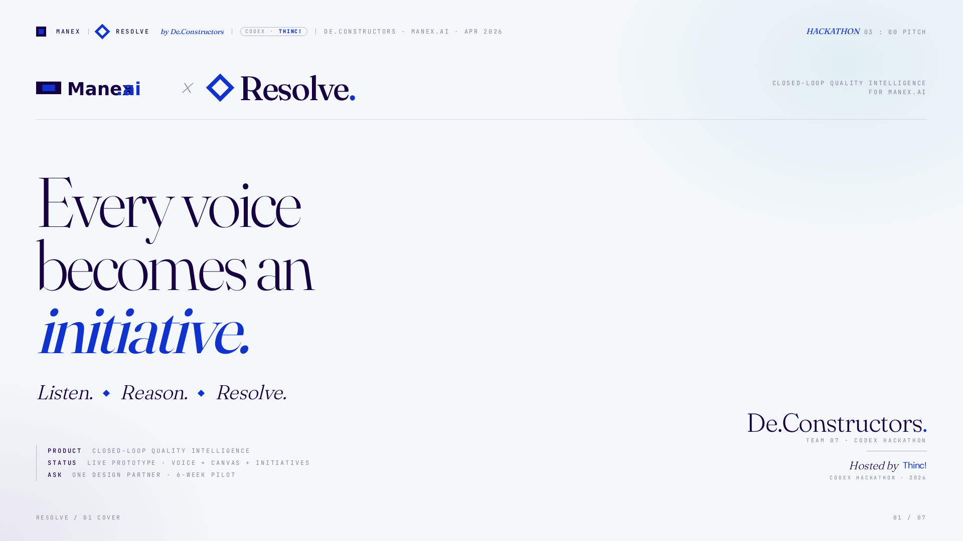
Notes:
Picture four in the morning on a plant floor. A boiler trips. The senior technician mutters the fix into his radio — check the sensor, not the pump. Three weeks later the same failure trips at a sister site and nobody remembers. That muttered sentence is the most valuable data your factory produces — and today it vanishes the moment the shift ends. We built Resolve, a module inside Manex, to catch it — and turn every voice into an initiative.

Slide 2
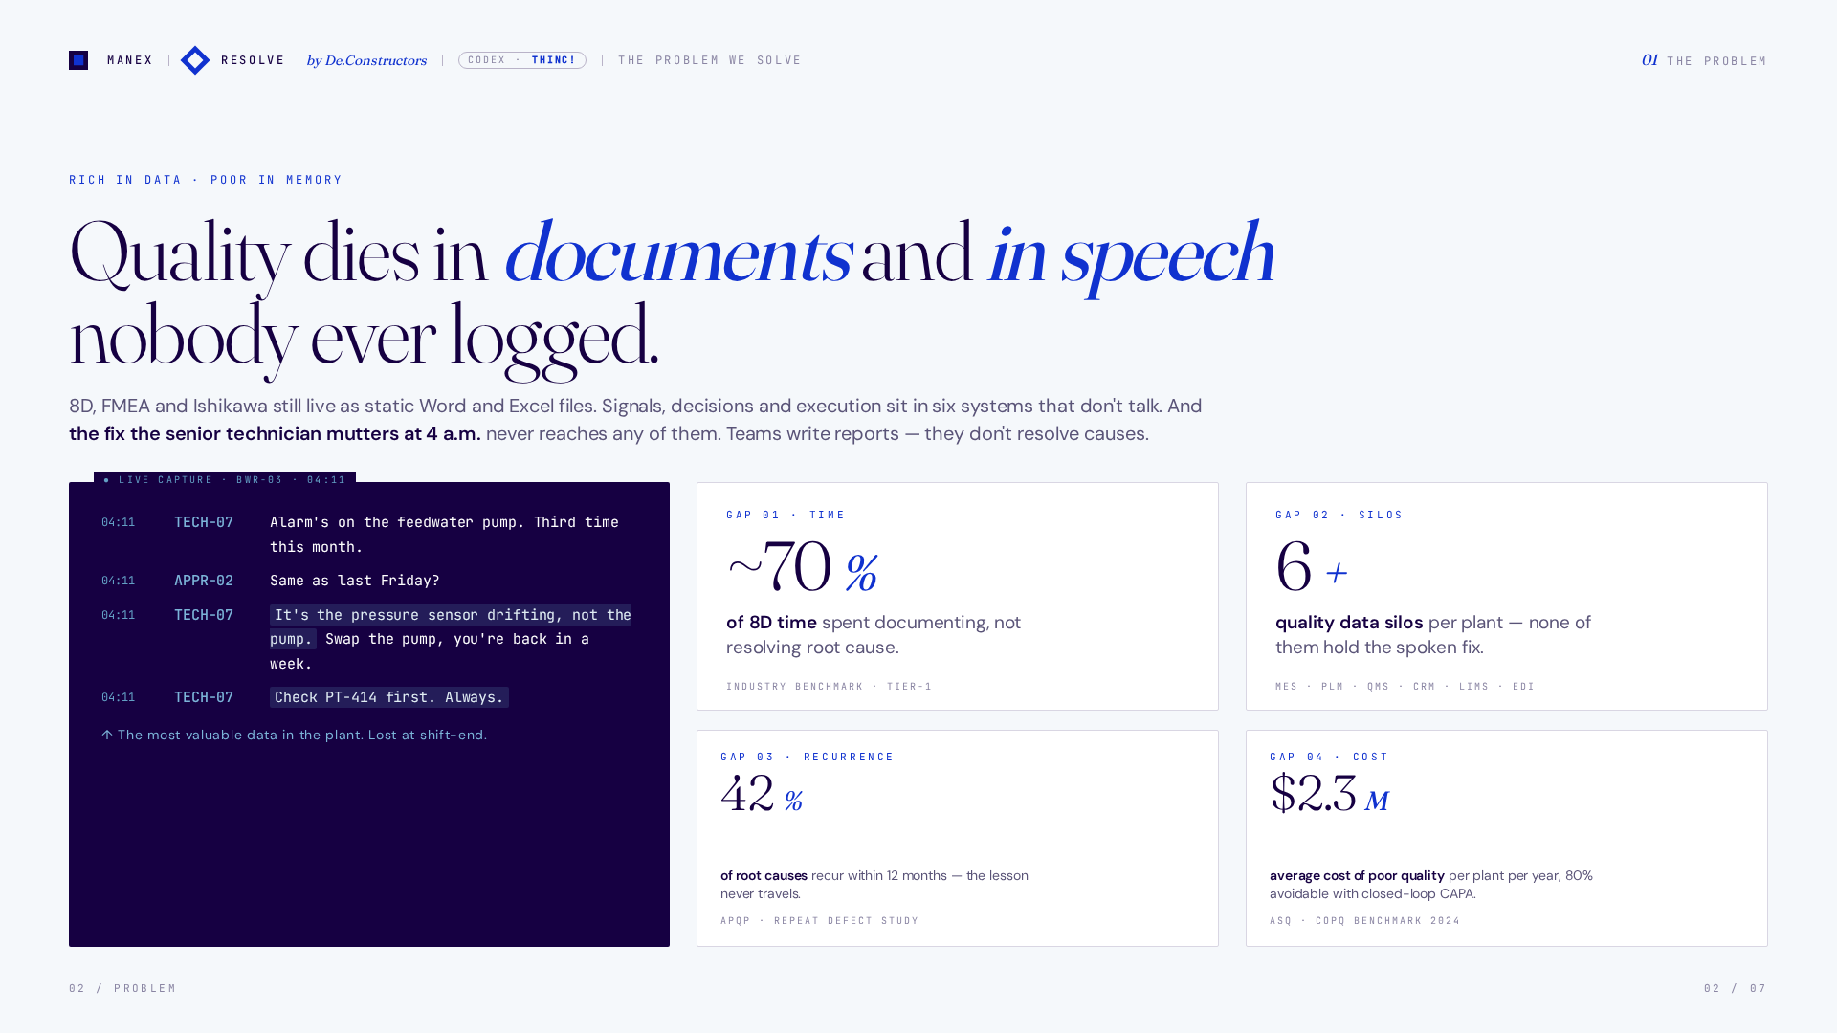
Notes:
The loop breaks after the signal. Manex already captures MES, QMS, CRM, LIMS, PLM, EDI — the data exists. What doesn't exist: the spoken fix at 4 a.m., the engineer's approval trail, the verified countermeasure writing itself back as a lesson. Seventy percent of 8D time is spent documenting, not resolving. Six-plus silos per plant, and none of them hold the voice.

Slide 3
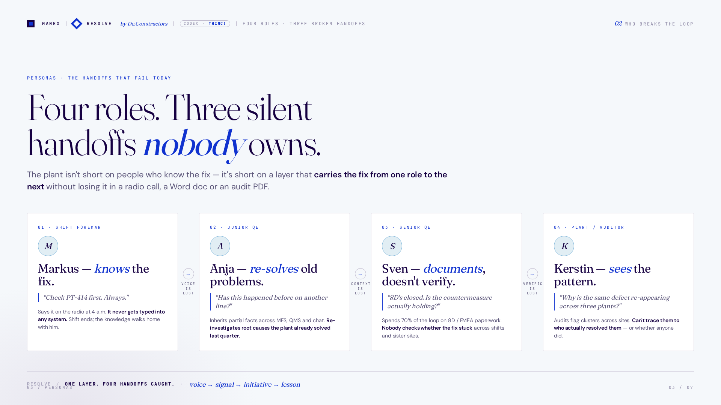
Notes:
Four personas, three broken handoffs. The foreman knows the fix — he just said it out loud, and it never typed itself into the system. The junior QE inherits a messy chain of partial facts and re-investigates a root cause the plant already solved last quarter. The senior QE writes a beautiful 8D, but nobody tracks if the countermeasure actually held. The auditor sees the same defect re-appear across plants and can't tell who owns it. Resolve is one layer that catches all four handoffs.

Slide 4
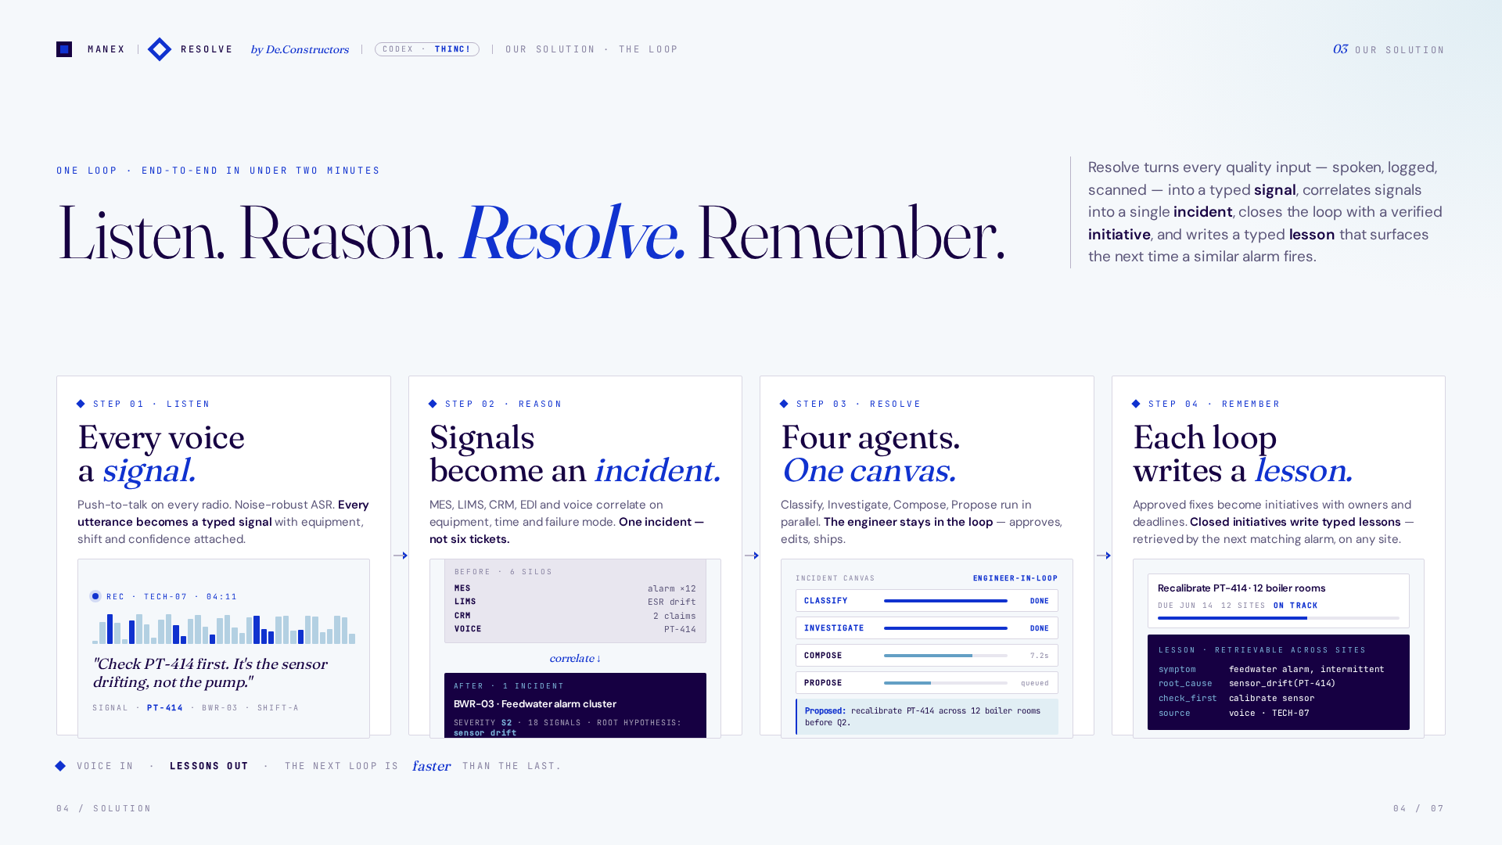
Notes:
Resolve closes the loop in four moves, in under two minutes. Listen — every voice, every alarm, every ticket becomes a typed signal. Reason — signals correlate into a single incident, automatically. Resolve — four agents classify, investigate, compose, propose; the engineer approves. Remember — the closed initiative writes a typed lesson that surfaces the next time a similar alarm fires, on any site. Voice in. Fewer incidents out. The next loop is faster than the last.

Slide 5
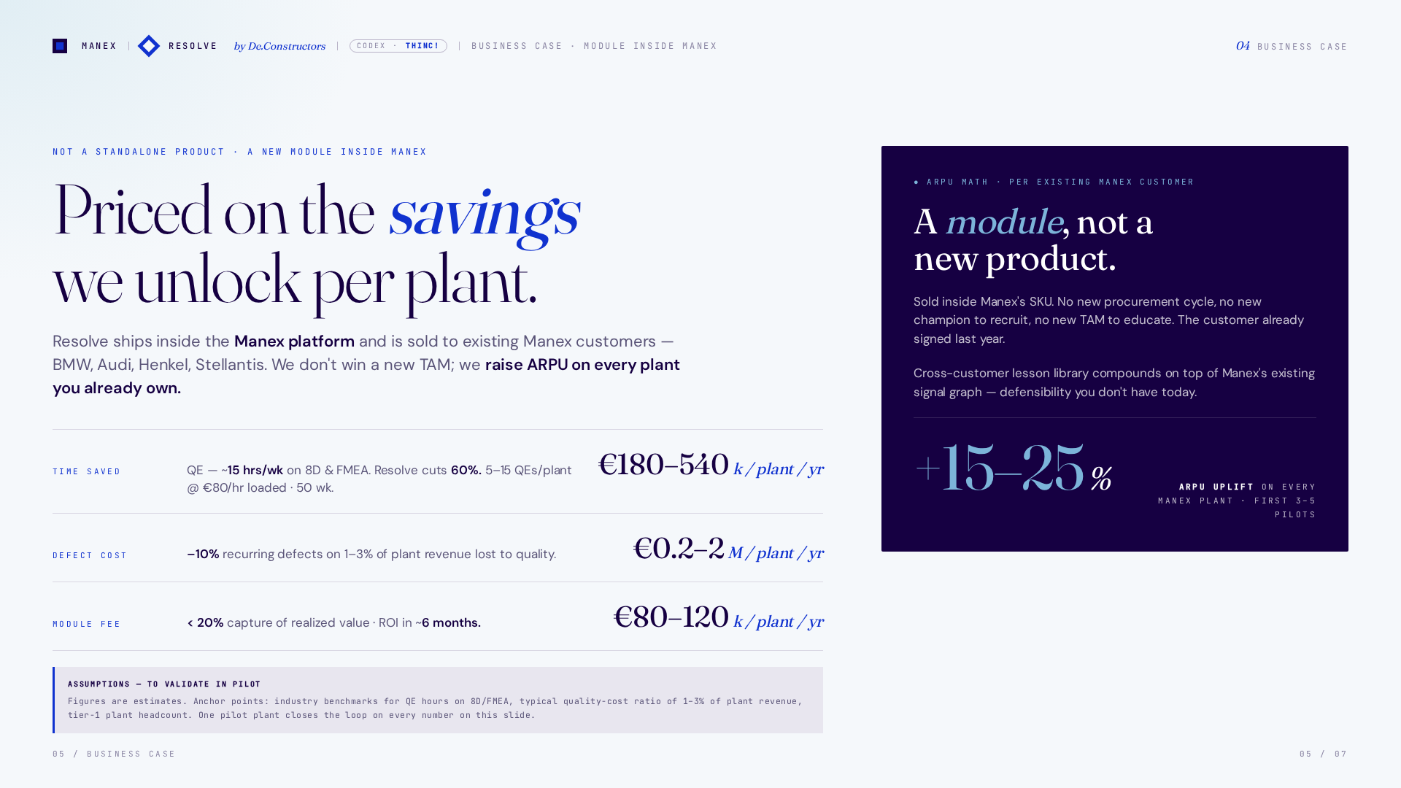
Notes:
Now the business case. Resolve is not a standalone product — it's a new module inside the Manex platform, priced on the savings it unlocks per plant. A tier-one plant has five to fifteen QEs spending roughly fifteen hours a week on 8D and FMEA. Resolve cuts that by sixty percent — one hundred eighty to five hundred forty thousand euros per plant per year just in returned engineering time. A ten-percent drop in recurring defects on a one-to-three-percent quality loss base adds two hundred thousand to two million more. Our module fee — eighty to one hundred twenty thousand per plant per year — is under twenty percent capture. Six-month ROI. Fifteen to twenty-five percent ARPU uplift on every Manex customer.

Slide 6
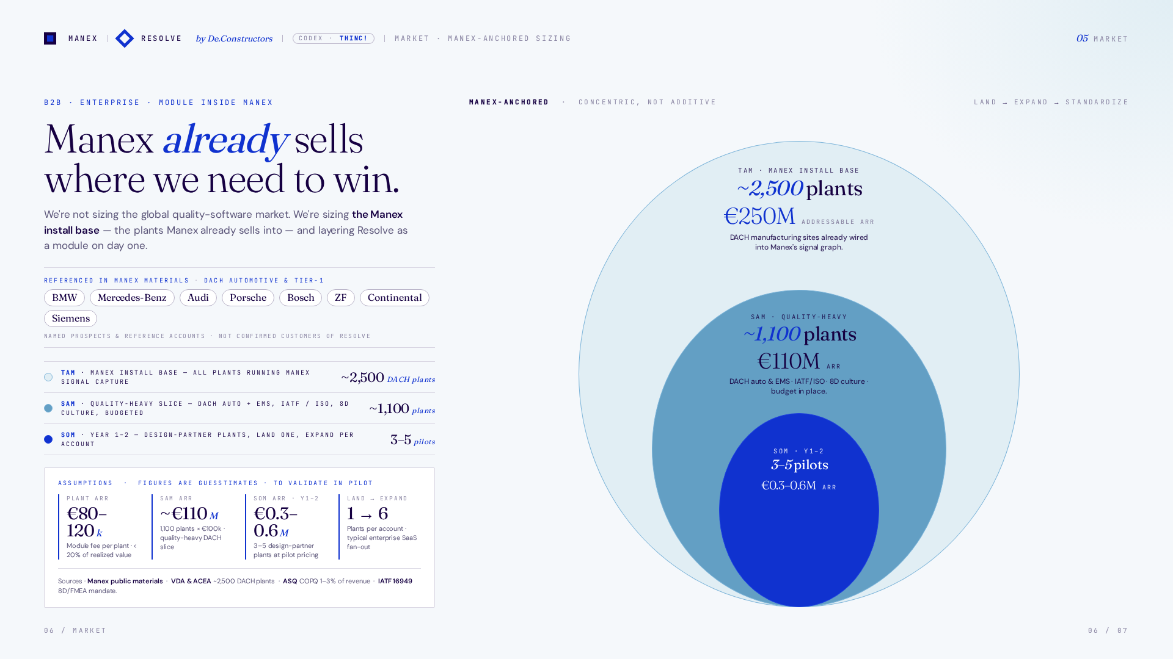
Notes:
Sizing through a Manex-anchored lens. TAM is the Manex install base — every plant already running your signal capture, ready to light up Resolve as a module on day one. SAM is the quality-heavy slice — DACH automotive and EMS, IATF and ISO exposure, 8D culture, budgeted. SOM in year one to two is three to five pilot plants — land on one, expand per account. We don't have to win a new market; the buyer is already inside your SKU.

Slide 7
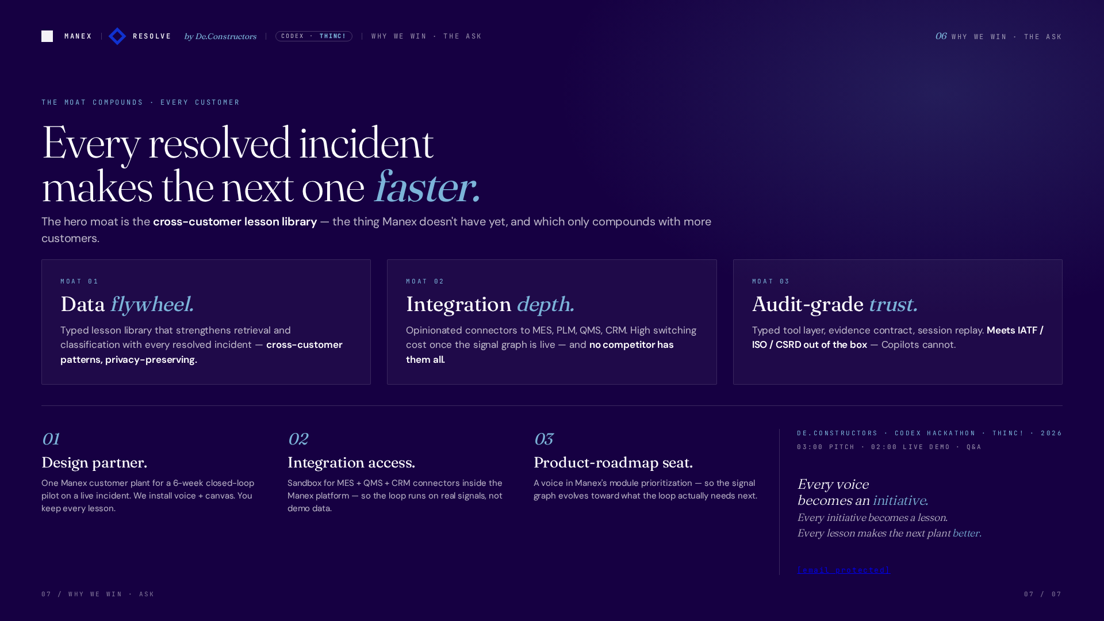
Notes:
Why we win. Three compounding moats. One — the data flywheel: every closed loop writes a typed lesson that strengthens retrieval across every customer, privacy-preserving. Two — integration depth: opinionated connectors to MES, QMS, CRM, PLM — no competitor has them all. Three — audit-grade trust: typed tool layer, evidence contract, session replay — meets IATF and ISO out of the box. Copilots cannot. Our ask — one design partner plant for a six-week pilot, sandbox integration access inside Manex, and a product-roadmap seat when this module ships. Every voice becomes an initiative. Every initiative becomes a lesson. Every lesson makes the next plant better. Thank you.

