Slide 1
“TO BUY OR NOT TO BUY”
Benjamin Palathinkal, Harry Singh

Slide 2

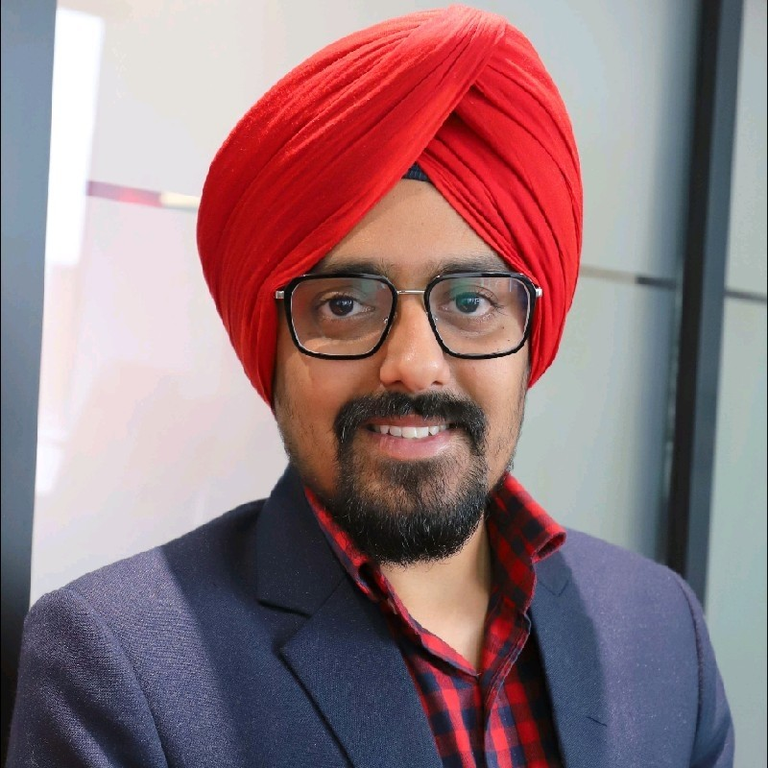
OUR TEAM
Benjamin Palathinkal
Harry
Singh

Slide 3
THE PROJECT
GOAL #1
Exploratory Data Analysis
Reporting Interesting Insights
GOAL #2
Building Predictive Models
Evaluating Models
GOAL #ADD.
Potential Improvements in Model & Data
Additional Analysis Conducted

Slide 4
LET’S
FIND OUT!
“X” is a customer who purchased chicken wings, a face wash, some apples and ice-cream.
Who is “X”? How old is “X”? What gender does “X” associate with?
How can the store build a better targeted promotional campaign?

Slide 5
THE PROCESS
01
02
03
04
05
06
Raw Data
Observation
Data Preparation
Data Cleaning
Visualization
Modelling & Evaluation

Slide 6
GRAPHICAL VISUALIZATION

Slide 7
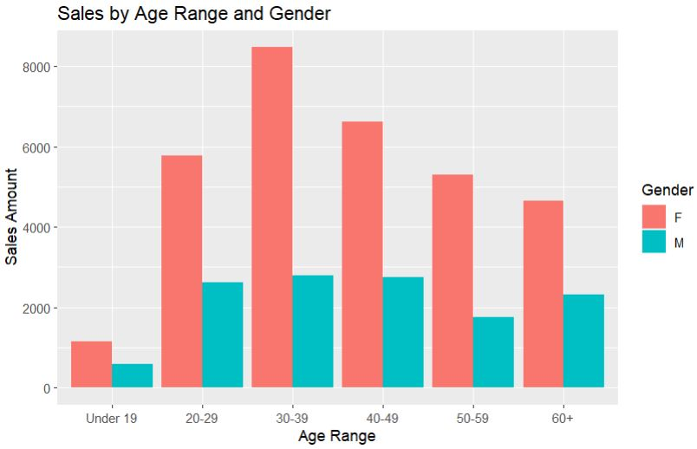
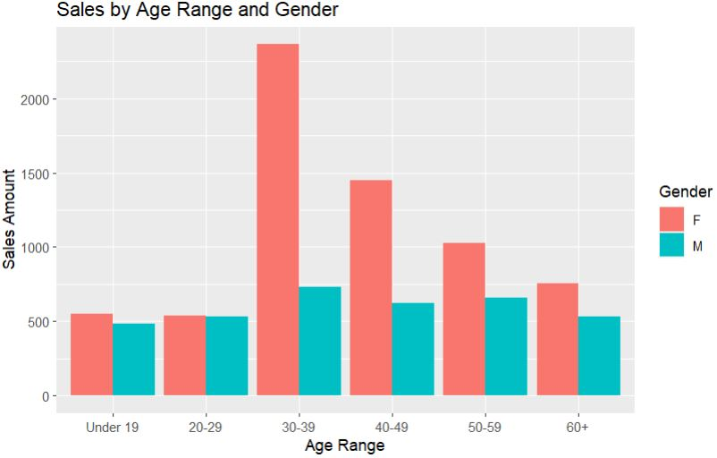
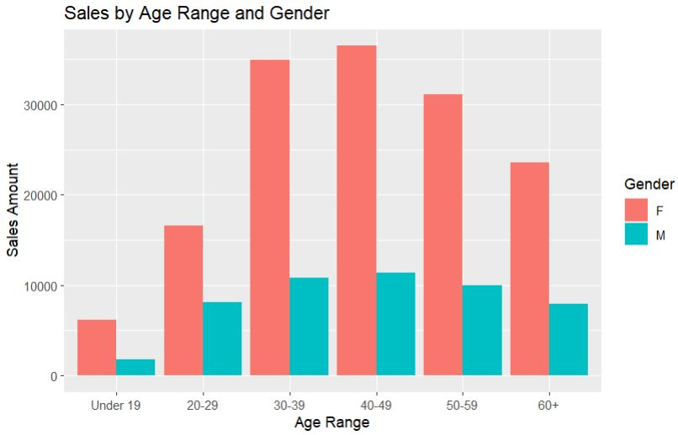
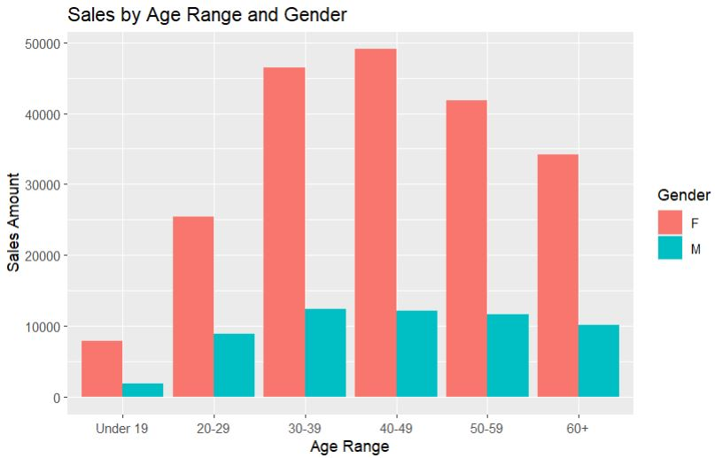
Health & Beauty
All sub-depts
Meat
Produce

Slide 8
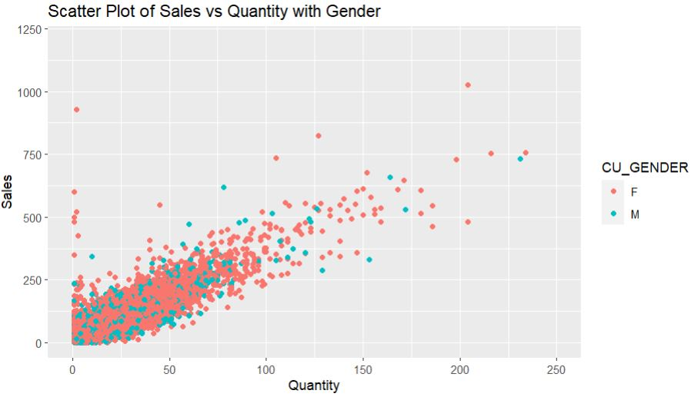

Slide 9
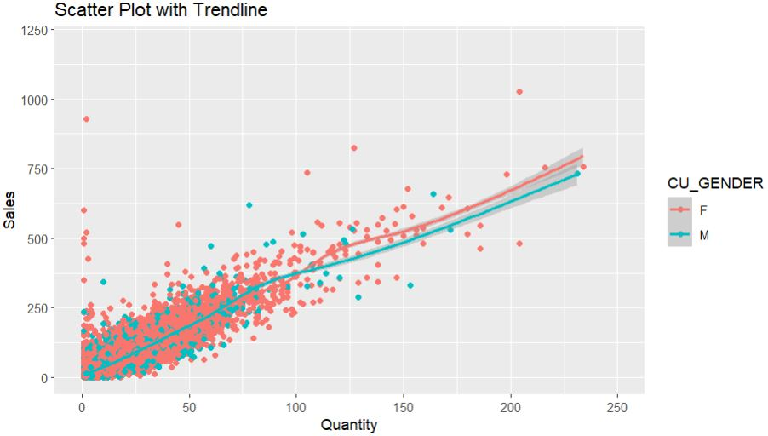

Slide 10
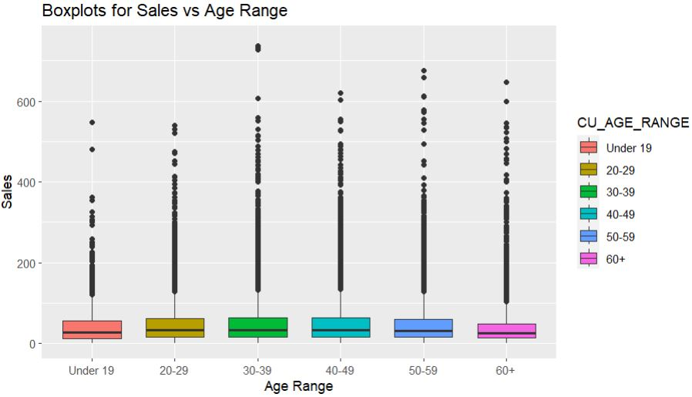

Slide 11
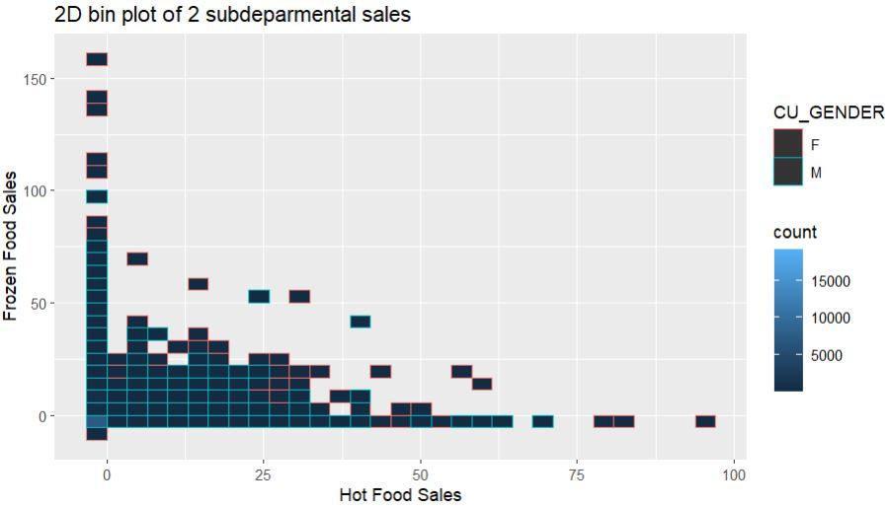
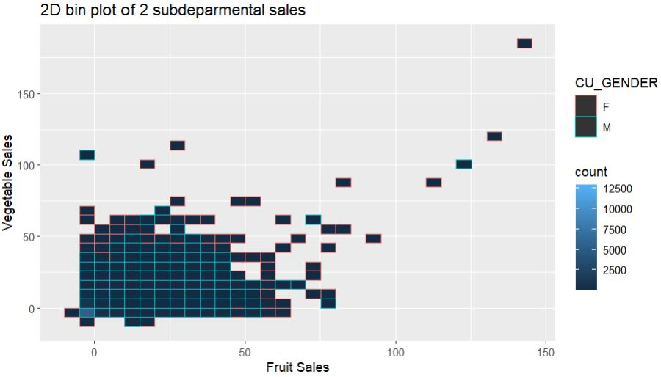
Directly
Proportional
Inversely
Proportional

Slide 12
PREDICTIVE
MODELS

Slide 13

Can We Predict Customer Demographics?
We are interested in predicting customer demographics based on transaction data . Therefore train a model using transaction data to predict demographics.
Increased ability to target promotions and advertisements online (click and collect).
Personalization of recommended products that would apply to a demographic.
Target Variables
Gender
Age (Over or Under 50)

Slide 14
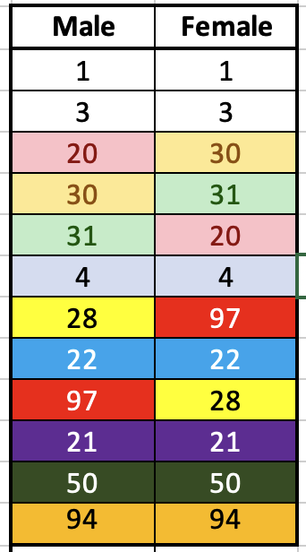
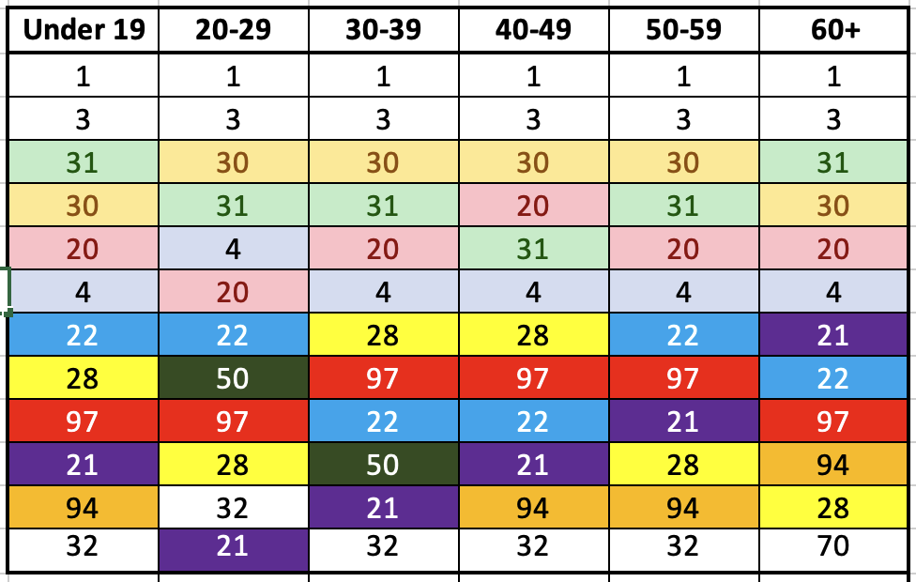
Determining Input Attributes
Used subdepartment transaction totals to determine if they could predict demographics. Compared to using specific products they should be:
A large amount of transaction data
Easy to filter compared to finding a product type
A Ranking of Total Sub Department Transactions by Demographic
4 - Frozen Food
20 - Beef
22 - Poultry
21 - Pork
28 - Deli Meat
30 - Fruit
31 - Vegetable
50 - Health
94 - Hot Food
97 - Salad

Slide 15
Initial Model Results (KNN)
Sub Departments used: Beef, Fruit, Vegetables, Frozen Food, Deli-Meat, Poultry, Salad, Pork, Health,
Beauty, Hot Food
Gender ~ Sub Departments
Over 50 ~ Sub Departments
Result -> TOO MANY TIES
Added Sales Amount and Quantity Purchased as input variables.
Results on validation set:
Gender
 | F | M
F | 3742 | 572
M | 1428 | 243
Over 50?
 | Over | Under
Over | 838 | 1529
Under | 1104 | 2514

Slide 16
Interpretation of the Initial KNN Result
Gender:
Overall error rate = 33%, Class 1 Error = 14%, Class 2 Error = 85% (too many predictions of female)
Over 50:
Overall error rate = 43%, Class 1 Error = 64% (too many under 50 predictions), Class 2 Error = 30%
Gender
 | F | M
F | 3742 | 572
M | 1428 | 243
Over 50?
 | Over | Under
Over | 838 | 1529
Under | 1104 | 2514

Slide 17
KNN Interpretation Cont’d
For Gender, were Cost, Quantity, and Sub Departments any better than a random number? For Gender:
 | Sales+Quant+SubDept | Random # | SubDept + Random # | Sales, Quantity +Random #
Overall Error | 33.5 | 33.2 | 33.3 | 32.3
Class 1 | 13.4 | 12.5 | 13.9 | 12.1
Class 2 | 85.6 | 86.8 | 83.5 | 84.6
Prediction model is not much better than inputting a random number.

Slide 18
KNN Interpretation Cont’d
What if we randomly sampled the female data so it equal to the male sample size?
Gender
 | F | M
F | 845 | 846
M | 740 | 852
Essentially a coin-toss.

Slide 19
Initial Model Results (LDA)
LDA model initially predicted everyone to be Female and Under 50 with the initial sample data.
With equal female and male sample sizes:
Gender
 | F | M
F | 696 | 956
M | 479 | 1152
Overall Error Rate = 44%, Class 1 Error = 58%, Class 2 Error = 29%
Good at predicting males at the expense of predicting females.

Slide 20
Potential Improvements
Improvements in Data:
Very difficult to choose appropriate inputs into the model.
Data appears very random and did not strongly predict demographics.
Filtering for “CUSTOMER” led the data to be skewed.
Improvements in Model:
Underestimated the number of iterations required between data query/cleaning and exploration.
Could try to use more sub-departments or departments to improve the model.
Or many, many specific products.

Slide 21
ADDITIONAL ANALYSIS CONDUCTED
Analysis #1
Challenge
Predicting “pepsi” and “coke” sales based on other basket items like chips, pizza, popcorn and deli chicken.
The KNN model resulted in too many ties, and null values were being introduced by coercion.
Analysis #2
Challenge
Predicting “pepsi” and “coke” sales based on customer demographics and transaction value.
The KNN model could not incorporate demographics as inputs (both in factor and categorical type).

Slide 22
— W. Edwards Deming
“Only in God, we trust. All others must bring data.”

Slide 23

THANK YOU!

