Slide 1

AstroSage Call Center Performance Analysis
A Data-Driven Operational and Revenue Analysis
Project by: Harkirat Singh
Date : 28/02/2026

Slide 2
PROBLEM STATEMENT
DATA DESCRIPTION
DATA CLEANING
ANALYSIS OF OBJECTIVE QUESTIONS WITH KEY METRICS AND VISUALIZATIONS
SUBJECTIVE QUESTION FOR INSIGHTS
Agenda

Slide 3
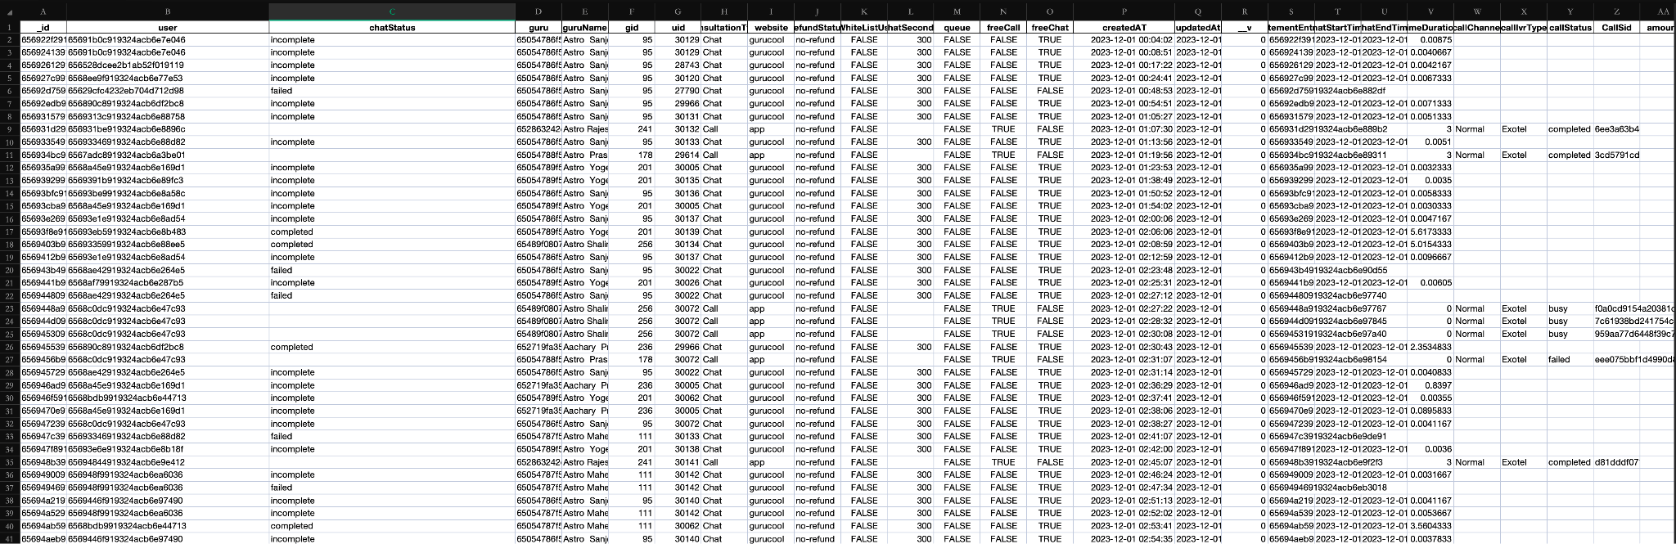
Problem
Statement
AstroSage has received a 1 crore investment and aims to optimize its call center operations. The goal is to determine how to allocate this investment to maximize operational efficiency, customer satisfaction, and profitability. The analysis will consider historical call data, performance metrics, and market trends to make informed decisions.

Slide 4

Introduction
AstroSage operates a consultation-based platform where users connect with astrologers through calls and chats. The performance of the call center directly impacts customer satisfaction, agent efficiency, and revenue generation.
This project analyzes call volume trends, customer satisfaction ratings, revenue contribution, workload distribution, and operational efficiency using structured data analysis techniques in Excel/WPS.
The purpose of this analysis is to identify operational bottlenecks, performance gaps, and data-driven improvement opportunities.

Slide 5

Objective
To analyze daily and hourly call patterns to understand demand fluctuations.
To evaluate customer satisfaction trends across time and segments.
To measure agent workload distribution and performance consistency.
To identify revenue contribution by consultation type.
To examine the relationship between ratings, earnings, and performance.
To provide actionable recommendations based on data insights.

Slide 6

Data Cleaning & Preparation
Cleaning Steps:
Blank numerical values were replaced with 0.
Blank categorical values were replaced with "Unknown".
Invalid or missing time values were standardized.
Duplicate entries were verified and removed where necessary.
Date fields were transformed into Month and Year for trend analysis.
Created a calculated column: Per Agent Per Day for workload evaluation.
Tools Used:
Pivot Tables, Filters, ISBLANK(), COUNT(), Data Validation.
This ensured consistent and analysis-ready data.

Slide 7
Key Performance Indicators (KPIs)
The following KPIs summarize overall performance:
These KPIs provide a high-level overview of operational scale, customer engagement, and service quality.
Average Daily Calls
824.3235294
Total Users | Total NetAmount
28027 | 213987.3153
Total Astrologer Earnings | Average Rating
99146.57095 | 2.93463446
Operational Cost | Total Gurus
99146.57095 | 149

Slide 8
Daily Call Volume Trend
A Line Chart was used to analyze call volume across days.
Key Observations:
Call volume fluctuates significantly across days.
Certain days show peak spikes exceeding 1,300 calls.
Some days drop below 400 calls.
Insight:
This variability indicates demand seasonality and highlights the need for flexible staffing and demand forecasting.

Slide 9
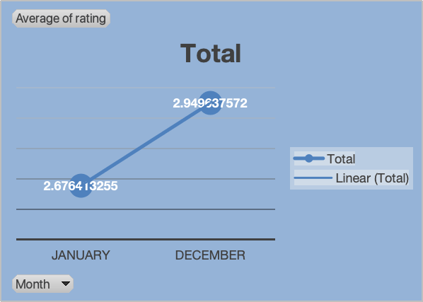
Customer Satisfaction by Month
Chart Used:
📈 Line Chart – Average Rating by Month
Results:
January: 2.68
December: 2.95
Overall: 2.93
Insight:
Customer satisfaction shows slight improvement over time, but the overall rating remains moderate and requires enhancement.

Slide 10
Repeat Caller Analysis
Data Used:
Description:
Nearly half of the customer base consists of repeat callers, indicating strong customer retention and recurring engagement.
Insight:
High dependency on repeat users.
Opportunity for loyalty programs.
Service consistency is critical.
Function Used:
Pivot Table
COUNT()
Percentage formula
Total Callers | 8508
Total Repeat Callers | 1277
Calls By Repeat Callers | 6156
Percentage | 72.36

Slide 11
Rating wise User Distribution
Chart Used:
📊 Bar Chart – User Rating vs No. of User
Findings:
Rating 0 has the highest users (7,256)
Ratings 2 & 3 also show high counts (4,329 and 4,407)
Higher ratings (6–8) have the lowest users (~1,800 each)
Total Users: 28,027
Standard Deviation (Ratings): 2.55 (Skewed toward lower ratings)
Insight:
A large number of users gave low ratings (0–3), indicating potential customer dissatisfaction.
Lower satisfaction levels suggest product/service improvement opportunities.

Slide 12
Correlation Analysis
Analysis Performed:
Examined relationship between:
Rating & Earnings
Duration & Rating (if done)
Used: CORREL()
Insight:
Higher-rated interactions tend to generate better financial performance, reinforcing the importance of service quality.

Slide 13
Revenue by Consultation Type
Chart Used:
📊 Bar Chart – consultation Type vs Sum of amount
Results:
Call: ₹168,520 (~79%)
Chat: ₹45,494 (~21%)
Others negligible
Insight:
Revenue is highly concentrated in call consultations, making the business model heavily dependent on this segment.

Slide 14
Top 10 Gurus by Consultation Volume
Chart Used:
📊 Horizontal Bar Chart – Top Gurus by Calls
Description:
This chart highlights the gurus who handled the highest number of consultations.
Findings:
• A few gurus dominate the consultation volume
• The top performers handle significantly more calls than others
Insight:
Top performers contribute heavily to platform activity.
However, over-dependence on a few gurus may create:
• Service bottlenecks
• Unequal workload distribution
Balancing consultations among gurus could improve efficiency and service quality.

Slide 15
Website Distribution
Chart Used:
📊 Pie Chart – Platform-wise User Distribution
Results:
Majority of users (~20,225) are from Gurucool platform.
App contributes around 7,800 users.
Dashboard usage is almost negligible (~2 users).
Insight:
Gurucool dominates user traffic, indicating it is the primary engagement platform. Dashboard adoption is extremely low and may require attention or redesign.

Slide 16
Call Distribution Over Hours
Chart Used:
📈 Line Chart – Calls vs Hours
Findings:
• Call volume increases steadily from early morning till peak hours.
• Peak observed between 6 AM – 10 AM and again around 3 PM – 5 PM (~1700–1900 calls).
• Significant drop after evening (post 6 PM).
Insight:
Call demand follows a clear daily pattern with morning and afternoon peaks. Staffing should be optimized for these peak hours to ensure efficiency.

Slide 17
Rating Wise Guru Distribution
Chart Used:
📊 Horizontal Bar Chart – Guru Rating vs Count
Results:
Lowest rating category has the highest count (~7,256 gurus).
Ratings 2 and 3 also have high counts (~4,300–4,400).
Higher ratings (6–8) have comparatively fewer gurus (~1,800 range).
Insight:
Distribution is skewed towards lower ratings, indicating potential quality issues or stricter rating patterns. Improvement strategies may be required for guru performance.

Slide 18
Call & Chat Status Distribution
Chart Used:
📊 Pie Chart – Communication Type Distribution
Findings:
• Calls dominate with ~19,514 interactions.
• Chats contribute ~8,508 interactions.
• Complementary/Public live calls are negligible (~3).
Insight:
Users strongly prefer calls over chat, indicating higher reliance on direct communication. Investment in call infrastructure and optimization will have maximum impact.

Slide 19
Region Performance Comparison
Region | Avg Rating | Total Calls
Indian | 5.64 | 9019
Unknown | 1.65 | 19008
Insight:
The "Unknown" segment contributes higher call volume but significantly lower satisfaction. The Indian segment shows better service quality despite lower volume.
Functions Used:
SUM()
AVERAGE()
Pivot Table

Slide 20

Dashboard Overview

Slide 21

Components Included:
KPI Cards
Daily Call Trend
Revenue Distribution
Satisfaction Trend
Agent Workload
Slicers (Region, Year)

Slide 22

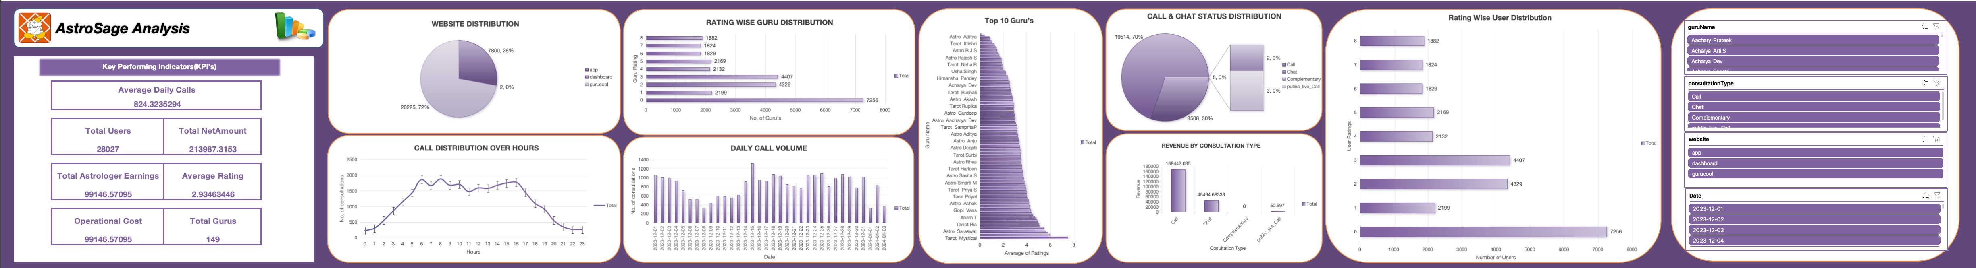
AstroSage Kundli : Dashboard

Slide 23

Risks & Investment Evaluation
Increasing the number of agents may raise fixed salary costs and lead to underutilization during low-demand periods, especially given the high fluctuation in daily call volume.
Training programs may not show immediate financial returns and can temporarily reduce productivity while employees undergo skill development.
Technology upgrades require significant upfront investment and may face resistance from staff adapting to new systems.
Data shows high workload imbalance (STDEV 321.88), meaning investment decisions must be data-driven rather than reactive.
A balanced allocation strategy is necessary to reduce financial risk while improving operational efficiency and customer satisfaction.

Slide 24

Improvements / Suggestions
Implement intelligent call routing to evenly distribute workload and reduce burnout among high-performing agents.
Use demand forecasting based on daily call trends to optimize staffing and avoid over- or under-hiring.
Introduce targeted training programs to improve the overall customer satisfaction score, which currently averages 2.93.
Diversify revenue streams by promoting chat consultations and developing loyalty strategies for the 48.94% repeat users.
Strengthen real-time performance monitoring through dashboard tracking to support continuous improvement and faster decision-making.

Slide 25

Final Insights & Recommendations
AstroSage demonstrates strong call volume (28,027 total calls) but experiences significant demand volatility across days.
Revenue is highly concentrated in call consultations (≈79%), creating dependency risk in the current business model.
Customer satisfaction is moderate (2.93 average), indicating room for service quality improvement.
Agent workload distribution is uneven, with some agents handling disproportionately high call volumes.
A strategic combination of workforce optimization, targeted training, and technology implementation will improve efficiency, profitability, and long-term sustainability.

Slide 26

Conclusion
The AstroSage call center demonstrates strong platform engagement with 28,027 total consultations, indicating a stable customer base and active usage.
Call demand shows high volatility, with daily spikes exceeding 1,300 calls, highlighting the need for better demand forecasting and flexible staffing strategies.
Revenue is heavily dependent on call consultations (≈79%), which creates business risk due to limited diversification.
Customer satisfaction remains moderate with an average rating of 2.93, suggesting opportunities to improve service quality and agent interaction effectiveness.
Agent workload distribution is highly uneven, confirmed by a standard deviation of 321.88, which may lead to agent burnout and operational inefficiencies.
A balanced investment strategy focusing on technology implementation, agent training, and selective hiring will improve operational efficiency, enhance customer satisfaction, and support sustainable business growth.

Slide 27
Thank You

