Slide 1
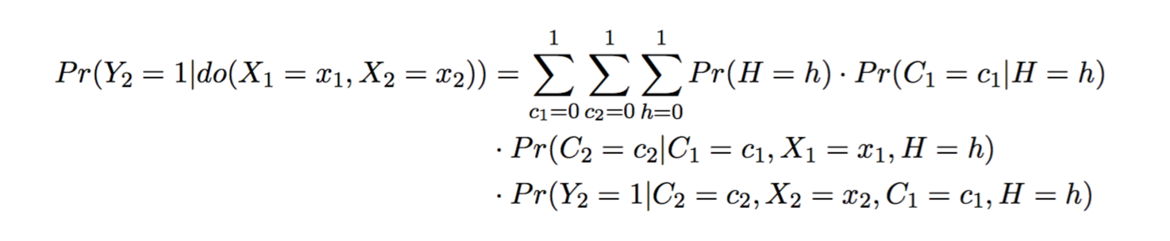
θ₈
H
θ₈
Y₁
Y₂
θ₃
θ₇
θ₃
θ₂
θ₅
θ₂
X₁
X₂
θ₅
θ₁₁
θ₉
θ₆
θ₉
θ₁
θ₁
θ₁₀
C₁
C₂
θ₉
Z
θ₄
θ₆
X₁ C₂
Y₁ X₂
H Y
Z X,Y
H Z
X₁ X₂
θ₇
θ₁
C X
H X
X Y
C₁ C₂
C₂ Y
θ₈
θ₂
θ₉
θ₃
θ₁₀
θ₄
θ₁₁
θ₅

Slide 5
H
Y₁
Y₂
θ₃
θ₃
θ₂
θ₂
X₁
X₂
θ₁₁
C₁
C₂
Z

Slide 8
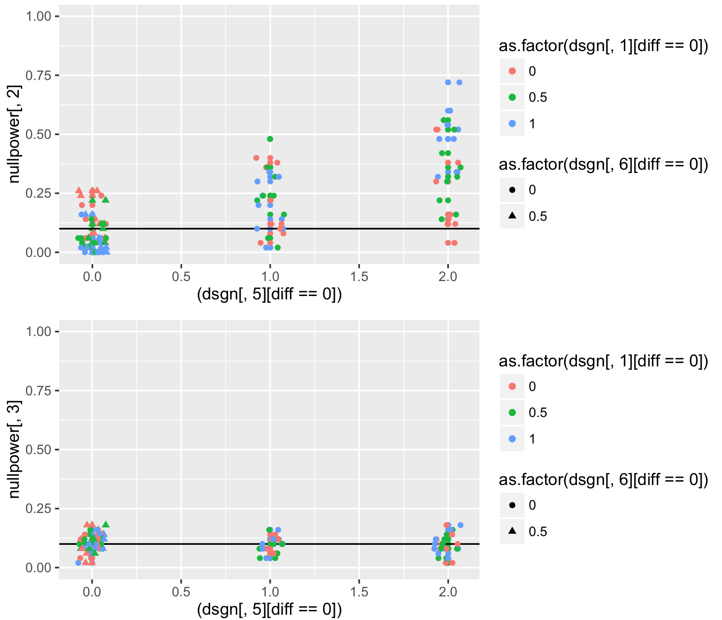

Slide 10
H
Y₁
Y₂
θ₃
θ₇
θ₃
θ₂
θ₅
θ₂
X₁
X₂
θ₁₁
θ₅
θ₆
θ₁
θ₁
C₁
C₂
Z
θ₄

Slide 11
Unless you condition on Y1, theta2 becomes a big problem when theta5 is high and theta 6 =0.
lvls[[1]] <- c(0) # violation
lvls[[2]] <- c(0, 0.5, 1, 6)
lvls[[3]] <- c(0)
lvls[[4]] <- c(0,0.5,1)
lvls[[5]] <- c(0, 1, 5)
lvls[[6]] <-c(0, 0.5)
lvls[[7]] <- c(0) # violation
lvls[[8]] <- c(0)
lvls[[9]] <- c(0)
lvls[[10]] <- c(0)
lvls[[11]] <- c(0, 1, 6)

Slide 12
Unless you condition on Y1, theta2 becomes a big problem when theta5 is high and theta 6 =0.
H
Y₁
Y₂
θ₂
θ₅
θ₂
X₁
X₂
θ₁₁
θ₅
C₁
C₂
θ₄
Conditioning on H is the problem

Slide 13
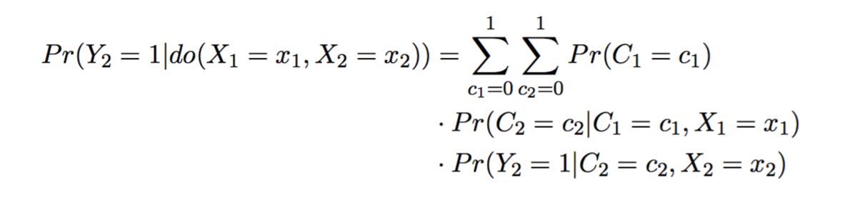

Slide 14
lvls[[1]] <- c(0) # violation
lvls[[2]] <- c(0, 0.5, 1, 6)
lvls[[3]] <- c(0)
lvls[[4]] <- c(0,0.5,1)
lvls[[5]] <- c(0, 1, 5)
lvls[[6]] <-c(0, 0.5)
lvls[[7]] <- c(0) # violation
lvls[[8]] <- c(0)
lvls[[9]] <- c(0)
lvls[[10]] <- c(0)
lvls[[11]] <- c(0, 1, 6)

