Slide 1
Project Presentation of CO-OP Project at Industry (Module-2) (22CS421)
On
DNS Benchmarking and System Optimization Tool
Akira Singh Aryan Thakur Harleen Kaur
2210991219 2210991392 2210990366
Supervised By
Dr. Lalit Sharma
Department of Computer Science and Engineering,
Chitkara University, Punjab

Slide 2
Introduction
The Domain Name System (DNS) is a critical component of the internet that translates human-readable domain names into machine-readable IP addresses. Every time a user accesses a website, a DNS query is performed, which directly impacts the loading speed. If the DNS server is slow or inefficient, it increases latency and results in a poor browsing experience. Since different DNS servers perform differently depending on location and network conditions, users often face inconsistent speeds. This project focuses on analyzing DNS performance and helping users select the most efficient DNS server for faster and more reliable internet access.
2

Slide 3
Objective
Benchmark multiple DNS servers based on performance
Measure latency using real-time network requests
Identify the fastest and most reliable DNS server
Allow users to apply the best DNS automatically
Enable users to monitor DNS performance continuously
Provide graphical visualization for easy comparison
Support exporting results for further analysis and reporting
3

Slide 4
Technologies Used
Python – Core programming language
Tkinter – GUI development
Socket Programming – Network communication & latency check
Matplotlib – Data visualization using graphs
OpenPyXL – Excel file generation
ReportLab – PDF report generation
CSV Module – Lightweight data export
4

Slide 5
Working Principle
The application connects to DNS servers using socket programming (port 53)
It records the time taken to establish the connection
Latency is calculated in milliseconds
Results are stored and compared across all DNS servers
The DNS with the lowest latency is identified as the fastest
Users can apply the selected DNS to their system (with admin permissions)
5

Slide 6
Key Features
DNS latency benchmarking with accurate measurement
Live monitoring mode for continuous performance tracking
Add and delete custom DNS servers
Automatic detection of fastest DNS
Graphical representation of latency data
Export results in PDF, CSV, and Excel formats
Dark and Light theme support for better UI experience
Works on Windows, macOS, and Linux
6

Slide 7
Output & Visualization
Displays DNS results in a structured table format
Shows latency comparison using bar graphs
Updates data dynamically in live mode
Provides logs for tracking operations and results
Exported reports can be used for further analysis
7

Slide 8
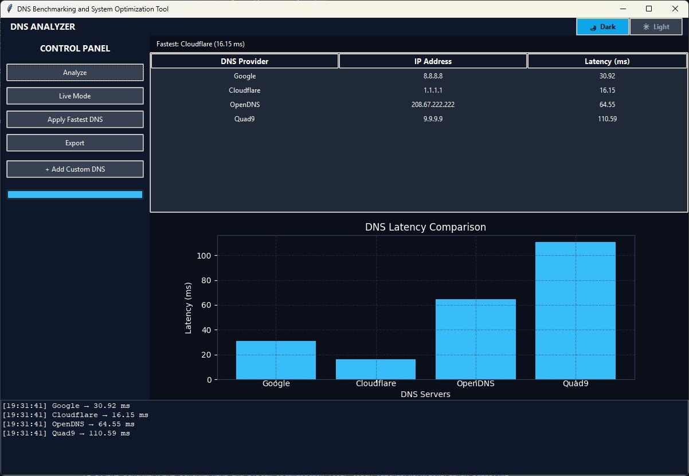
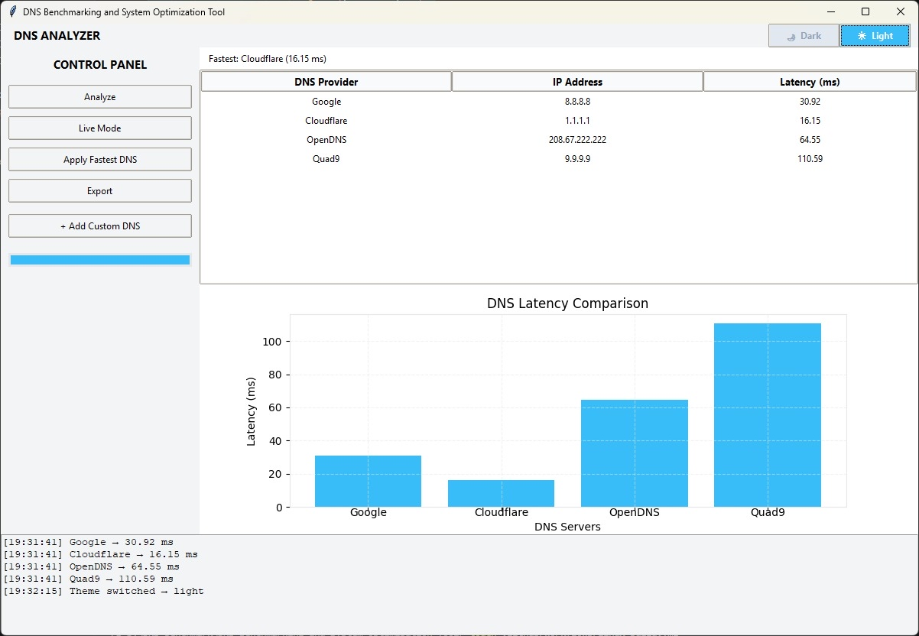

Slide 9
Conclusion
The project provides an effective solution for analyzing DNS performance
Helps users improve internet speed by selecting the optimal DNS server
Integrates GUI, real-time monitoring, and data visualization in one application
Supports cross-platform functionality (Windows, macOS, Linux)
Offers export features for reporting and analysis
User-friendly interface makes it accessible for both technical and non-technical users
9

Slide 10
Thank You
10

