Slide 1
Back End Engineering-I Project
Team Details:
Group-23
Harleen Kaur (2310992006)
Liza (2310992053)
Madhav Bhalla (2310992055)
Faculty Coordinator:
Mr. Vikas Patel
:
Chikara University Institute of Engineering and Technology,
Chikara University, Punjab India

Slide 2

Baby Care Centre
WEBSITE

Slide 3
TABLE OF CONTENTS
Introduction
Problem Statement
Technical Details
Frontend - User Data Form
Backend - API Overview
Key Features
Results
Conclusion

Slide 4
INTRODUCTION
Overview: The Baby Care Centre is a dedicated facility offering exceptional care for newborns and infants. Our primary focus is on providing a safe, nurturing environment where babies receive the highest standard of care from trained professionals. In addition to our round-the-clock baby care services, we offer comprehensive support for parents to ensure their well-being and peace of mind.
Vision Statement: To be the leading Baby Care Centre, offering a safe, nurturing, and innovative environment where every child’s health, happiness, and development are prioritized, and every parent feels supported and empowered.

Slide 5
Mission Statement: Our mission is to provide high-quality, compassionate care for infants, ensuring their physical, emotional, and developmental well-being. We are dedicated to offering parents expert guidance and unwavering support, fostering an environment of trust and love for both babies and families.

Slide 6
PROBLEM STATMENT
Challenges Students Face:
Parents often face challenges in accessing reliable, expert care for their infants, leading to stress and uncertainty. There is a lack of affordable, accessible childcare and health support, leaving many parents feeling overwhelmed.
Statistics:
2.4 million global infant deaths in 2020, with most being neonatal (WHO).
60% of parents feel unsure about infant health decisions (AAP).
40% of parents report difficulty finding affordable baby healthcare (CDC).
72% of parents seek health advice online (Pew Research).

Slide 7
TECHNICAL DETAILS
Hardware Requirements
1 TB Storage
Iris Xe graphics
64 Bit Operating System
4.60 GHz Processor
16 GB RAM
Intel Core i3 Processor

Slide 8
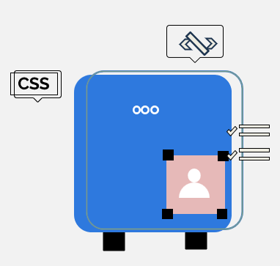
FRONTEND - USER DATA FORM
Features:
Collects user details: Name, Email, Age, Phone No and Message
User-friendly design with subtle styling
Validations for inputs
Code Example:
Highlights from the HTML form structure.
Show styled elements with CSS (e.g., buttons, input fields).

Slide 9
BACKEND - API OVERVIEW
Technologies Used:
Node.js
File System (for storing user data locally)
Endpoints:
POST /users: Saves user data to a JSON file
GET /users: Retrieves all saved user data

Slide 10
KEY FEATURES
Homepage Overview: Easy navigation with details on services like baby care, health checkups, and support.
Inquiry Form: Simple form for parents to ask questions and book appointments.
Responsive Design: Mobile-friendly for a seamless experience across all devices.
Expert Guidance: Access to advice on baby health and development.
Secure Data Handling: Safe management of inquiries and user data.

Slide 11

RESULTS

Slide 12
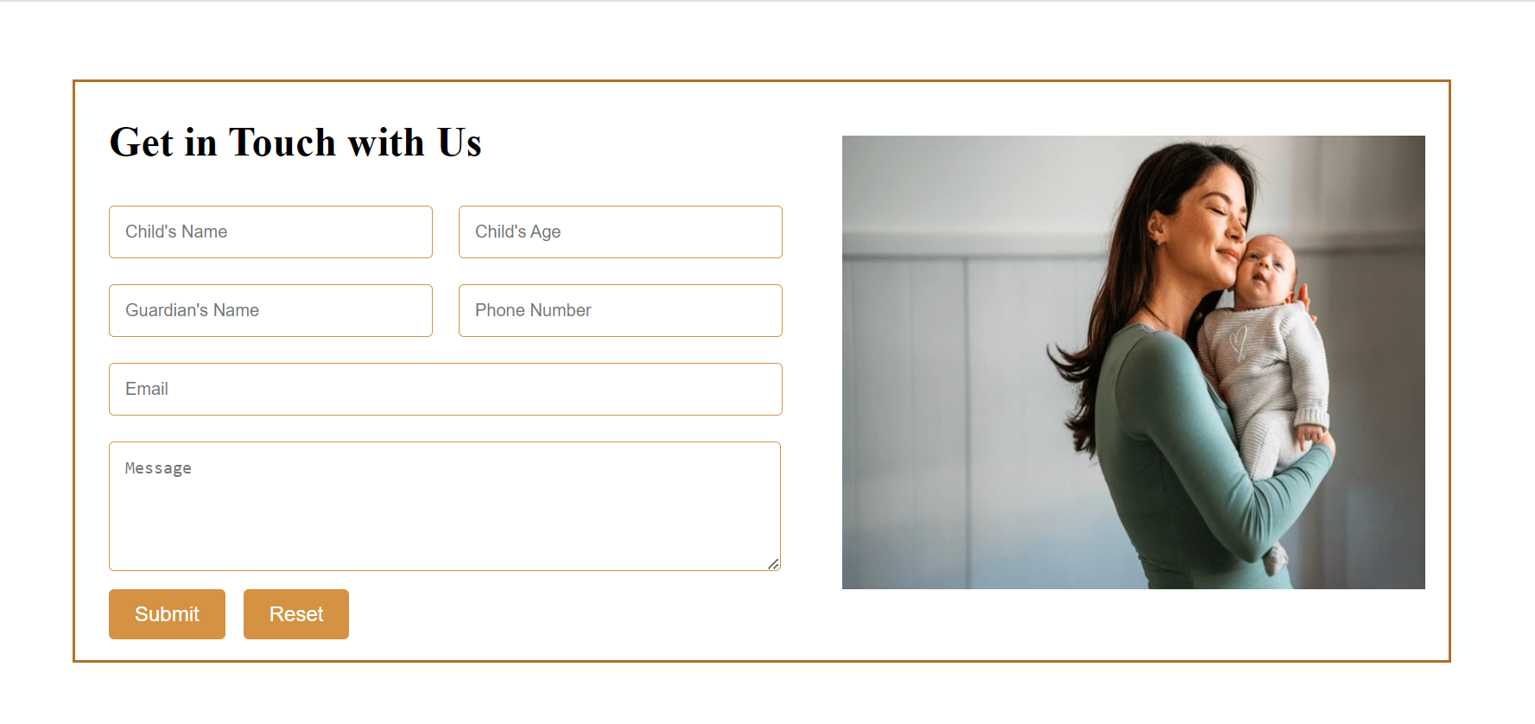

Slide 13
CONCLUSION
The Baby Care Centre website aims to provide a comprehensive, accessible, and supportive platform for parents. By offering expert guidance, a user-friendly inquiry system, and future features like appointment booking, the website will address key challenges parents face in caring for their infants. The responsive design ensures easy access on any device, while secure data handling guarantees privacy and safety. Ultimately, this website will serve as a trusted resource, enhancing both the physical and emotional well-being of babies and providing parents with the support they need every step of the way.

Slide 14


