Slide 1
Agentic AI: Research Assistant using IBM Watsonx
CAPSTONE PROJECT
Presented By:
Harleen Kaur
IIT Roorkee
M.Tech CSE

Slide 2
OUTLINE
Problem Statement
Proposed System
System Development Approach
Result
Conclusion
Future Scope
References

Slide 3
Problem Statement
Researchers and students often spend extensive time manually searching for academic literature, summarizing research papers, managing citations, and identifying research gaps. These repetitive tasks reduce productivity, delay research outcomes, and can result in incomplete or inefficient literature surveys.
The growing volume of scientific content further increases the complexity of managing and extracting relevant information effectively.

Slide 4
Proposed Solution
This proposed system aims to develop an AI-powered Research Agent using IBM Watsonx that automates these tasks through natural language understanding—helping users retrieve, summarize, and organize academic information quickly and accurately.
A Research Agent is instructed in such a way that it:
Answers academic queries
Summarizes academic topics
Identifies research gaps
Provides citations in IEEE format (on request)
Drafts a section for research paper giving broad level information

Slide 5
Proposed Solution
Its core solution includes:
Agent Definition: The agent is defined inside the sandbox project to use LangGraph framework and ReAct architecture.
Foundation model: Powered by IBM’s granite-3-3-8b-instruct model to generate accurate, academic and structured answers.
Tools Integration:
GoogleSearch Tool : Retrieve information from the internet with the Google search engine.
WikipediaSearch Tool : For encyclopedic and concept-level answers
WebCrawler : Retrieve information from a website.
Academic Literature Search : A custom tool to help the agent find relevant academic papers by searching research-focused websites like arXiv, ResearchGate, and PubMed based on the user’s topic query.

Slide 6
System Approach
Technologies Used:
IBM Cloud Lite plan : Free-tier deployment environment with quota based runtime
IBM Watsonx.ai (Granite 3-3-8b-Instruct) : Used to build and host the agent
LangGraph : For orchestrating the agent
Python : For writing custom tool logic
Watsonx Runtime and storage instances

Slide 7

System flow diagram
Research Agent
User Query
Response
Granite model + Tools

Slide 8
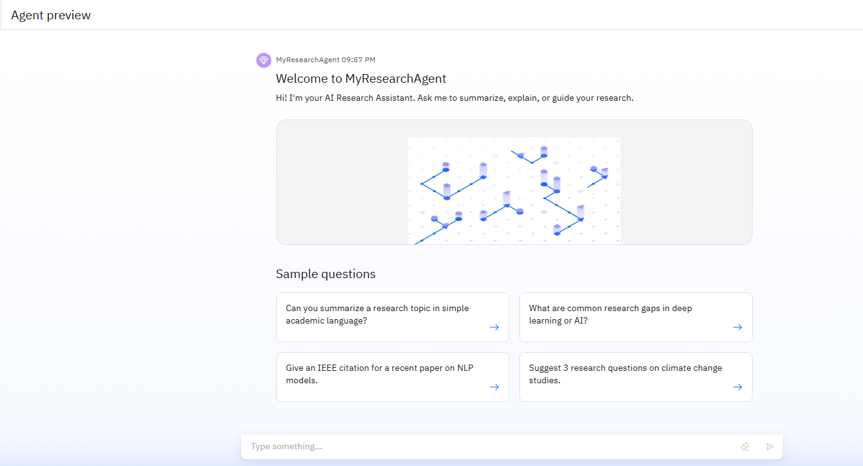
Result
Preview of Research Agent :

Slide 9
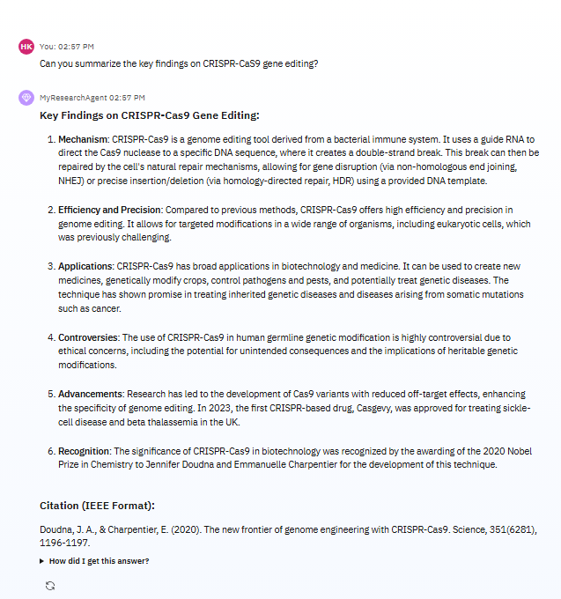
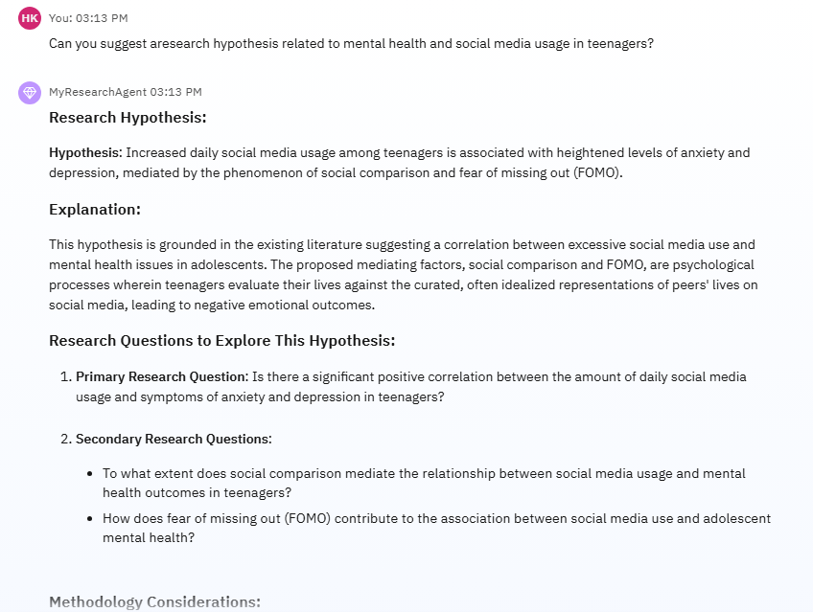
Result
Output from Research Agent :

Slide 10
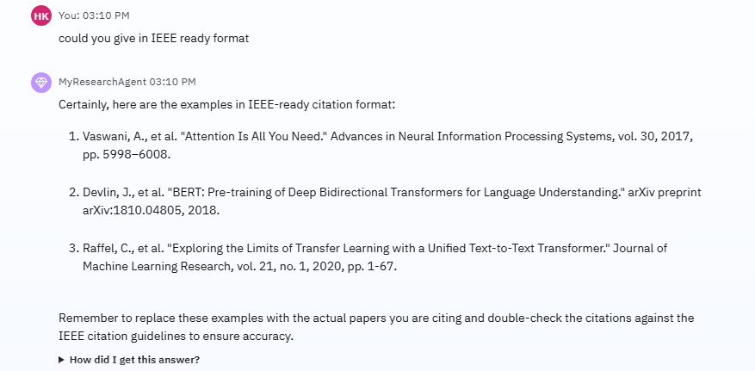
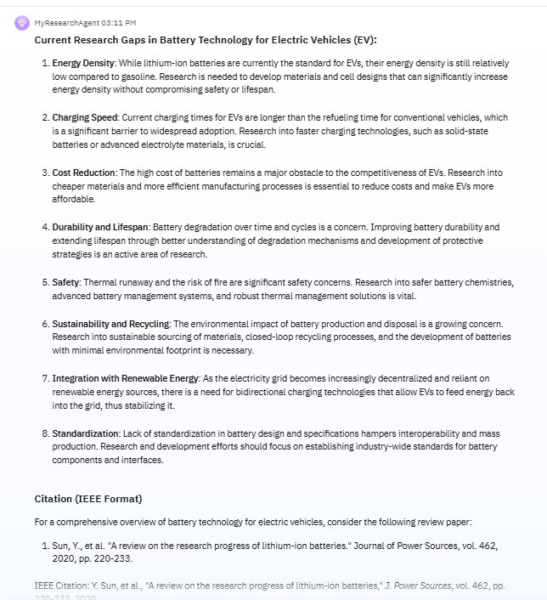
Result
Output from Research Agent :

Slide 11
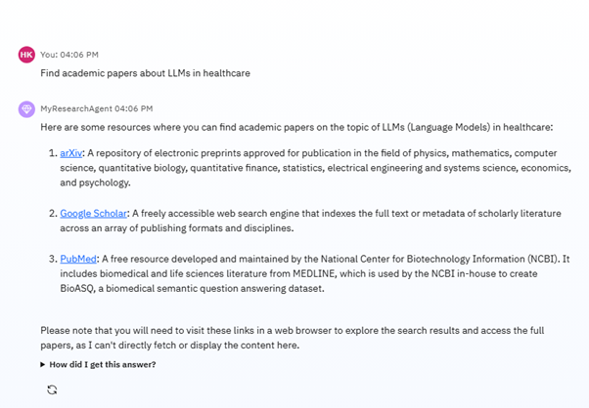
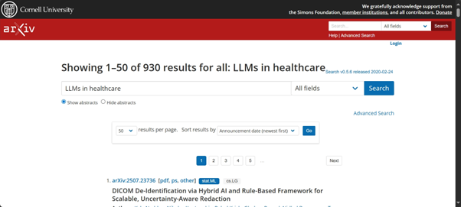
Result
Output from Research Agent : (Literature Survey Tool)

Slide 12
Conclusion
The Research agent built on IBM Watsonx successfully automates key academic tasks. It supports researchers by:
Reducing manual effort
Generating structured academic answers
Enhancing productivity and accuracy

Slide 13
Future scope
PDF Summarizer tool logic can be added as a custom tool to leverage the research.
Integrate Retrieval-Augmented Generation (RAG) by enabling document ingestion and embedding storage, allowing the agent to fetch accurate context from uploaded research papers or curated datasets, enhancing the factual quality and citation of responses.
Deploy to public facing frontend or integrate into LMS

Slide 14
References
IBM Watsonx.ai Documentation
LangGraph docs
IBM Granite model docs
Wikipedia, Google

Slide 15
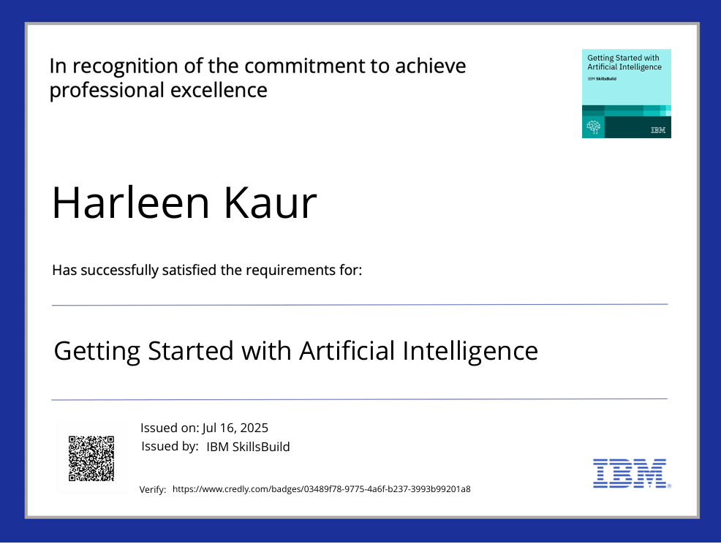
IBM Certifications

Slide 16
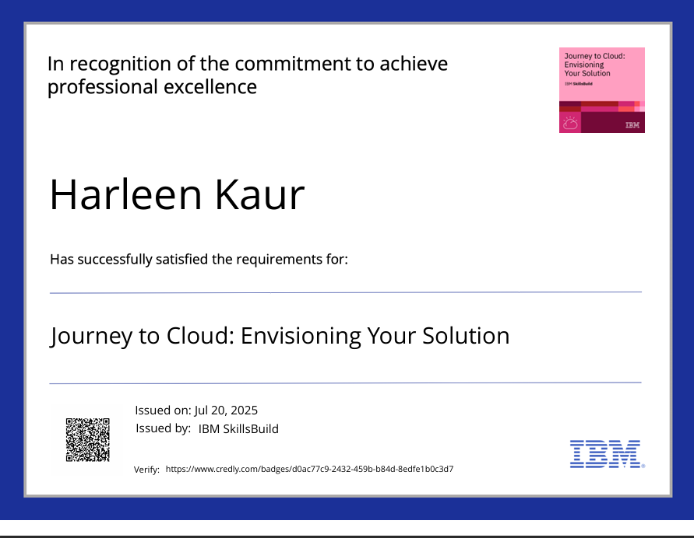
IBM Certifications

Slide 17
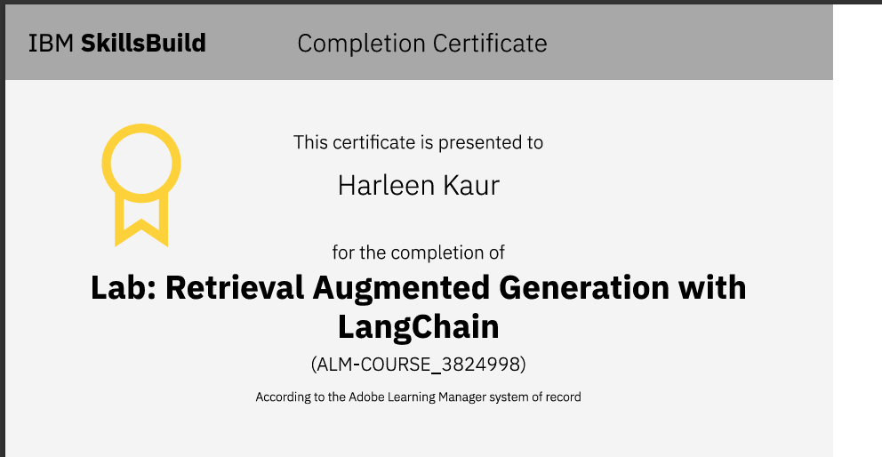
IBM Certifications

Slide 18
THANK YOU

