Slide 1
COURSE-END PROJECT
Amazon Product Review
Sentiment Analysis
Classifying customer sentiment across 4,000+ Amazon reviews using
classical ML, deep learning, and topic modeling
3,942
93.7%
0.63
Training Reviews
Positive Class
Best Macro F1

Slide 2





OVERVIEW
What We'll Cover
Exploratory Data Analysis
Understanding the class imbalance problem
5
Handling Class Imbalance
SMOTE oversampling vs. under-sampling
Model Development
Naive Bayes, SVM, XGBoost, and LSTM
Key Project
Phases
Topic Modeling
Discovering themes with NMF
From raw, imbalanced reviews
to a deployable sentiment classifier
Results & Conclusions
Best model and key business insights
Amazon Product Review Sentiment Analysis
2

Slide 3
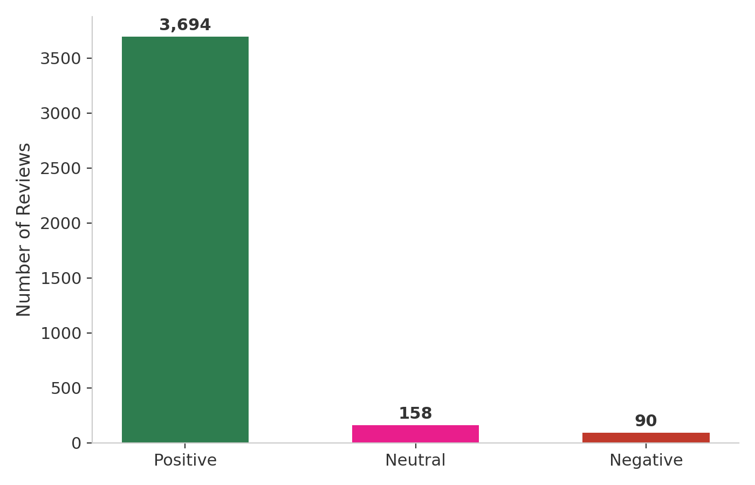

THE DATASET
34,000+ Reviews, One Big Problem
The dataset contains Amazon product reviews labeled Positive, Negative, or Neutral. After cleaning, our training set held 3,942 reviews — but the classes were severely imbalanced.
93.7%
Positive reviews
4.0%
Neutral reviews
Figure 1: Sentiment class distribution in training data
2.3%
Negative reviews
A naive model could hit 93.7% accuracy by always predicting “Positive” — and learn nothing.
Amazon Product Review Sentiment Analysis
3

Slide 4
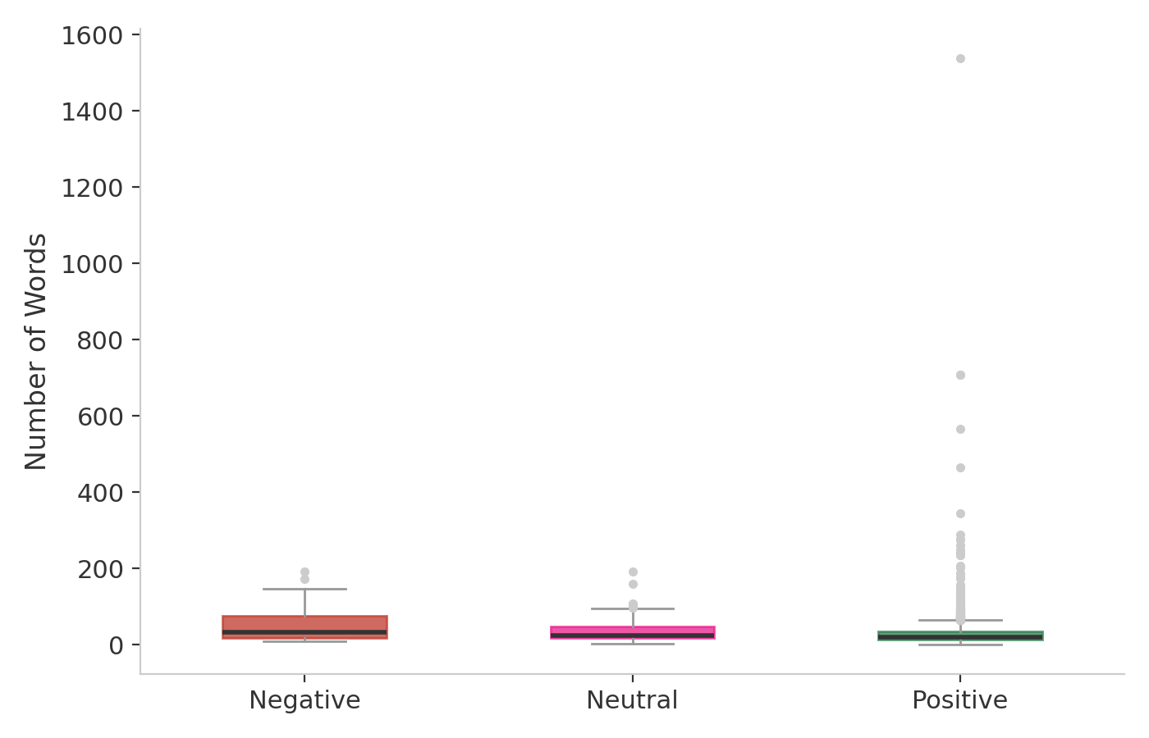
EXPLORATORY DATA ANALYSIS
Negative Reviewers Write More
~51 words
Average Negative review length
~37 words
Average Neutral review length
~30 words
Average Positive review length
Insight: customers explain complaints in detail, while positive reviews are often short praise (“Great!”, “Love it!”). This became useful context for feature engineering.
Amazon Product Review Sentiment Analysis
4

Slide 5




PREPARING THE DATA
From Raw Text to Model-Ready Features
STEP 1
STEP 2
STEP 3
STEP 4
Clean
→
Filter
→
Vectorize
→
Enrich
Lowercase, strip punctuation, remove URLs & encoding artifacts
Remove English stopwords (the, is, and...)
TF-IDF: 4,619 weighted word features
Add VADER sentiment score (-1 to +1) per review
VADER validation: avg. score by true label — Negative ≈ –0.13, Neutral ≈ 0.37, Positive ≈ 0.67 (confirms real signal)
Amazon Product Review Sentiment Analysis
5

Slide 6

ADDRESSING IMBALANCE
SMOTE vs. Under-Sampling
SMOTE OVERSAMPLING
RANDOM UNDER-SAMPLING
Generates synthetic minority examples by interpolating between real reviews — keeps all real data intact.
Shrinks the majority class to match the smallest — discards ~97% of real Positive examples.
0.52
Macro F1-Score
(Naive Bayes)
0.39
Macro F1-Score
(Naive Bayes)
Winning Strategy
Only 90 examples/class — too little data
Amazon Product Review Sentiment Analysis
6

Slide 7
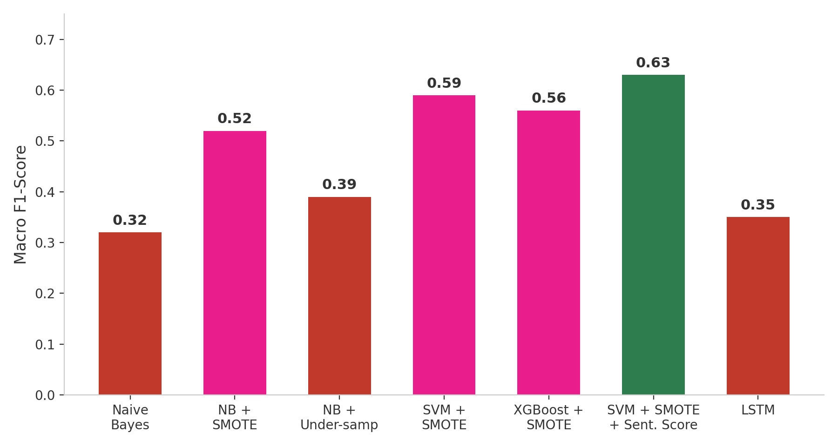
MODEL DEVELOPMENT
Seven Models, One Clear Winner
BEST MODEL
SVM + SMOTE +
Sentiment Score
0.63 Macro F1 • 93.7% Accuracy
Why SVM won:
Handles sparse, high-dimensional TF-IDF features better than tree-based models
VADER sentiment score added signal beyond word frequency alone
Amazon Product Review Sentiment Analysis
7

Slide 8
THE NUMBERS
Full Model Comparison
Model | Accuracy | Negative F1 | Neutral F1 | Positive F1 | Macro F1
Naive Bayes (baseline) | 93.7% | 0.00 | 0.00 | 0.97 | 0.32
Naive Bayes + SMOTE | 86.3% | 0.36 | 0.27 | 0.93 | 0.52
Naive Bayes + Under-sampling | 66.9% | 0.21 | 0.16 | 0.80 | 0.39
Multi-class SVM + SMOTE | 93.5% | 0.43 | 0.38 | 0.97 | 0.59
XGBoost + SMOTE | 93.3% | 0.39 | 0.32 | 0.97 | 0.56
SVM + SMOTE + Sentiment Score | 93.7% | 0.57 | 0.35 | 0.97 | 0.63
LSTM (safely oversampled) | 93.8% | 0.08 | 0.00 | 0.97 | 0.35
Macro F1 — not raw accuracy — is the right metric here, since it weighs all three classes equally rather than rewarding majority-class bias.
Amazon Product Review Sentiment Analysis
8

Slide 9

DEEP LEARNING ATTEMPT
The LSTM: Four Tries, One Honest Lesson
1
SMOTE on sequences
Interpolating word-index integers produced meaningless data — model failed completely
0.35
2
Class weights
Weights too extreme + default learning rate → unstable, erratic accuracy
Final Macro F1
Predicted “Positive” for 999 of 1,000 test reviews.
3
Softened weights
Training stabilized, but model collapsed to predicting only “Positive”
Why: only 90 real Negative and 158 real Neutral reviews — not enough diversity for a data-hungry neural network to generalize, even after oversampling.
4
Safe text oversampling
Valid approach, real learning began — but still constrained by limited data
Lesson: deep learning needs more diverse minority-class data than this dataset provides — not just more epochs.
Amazon Product Review Sentiment Analysis
9

Slide 10
UNSUPERVISED LEARNING
What Are Customers Talking About?
Using NMF (Non-Negative Matrix Factorization) on the TF-IDF matrix, five clear themes emerged — independent of sentiment labels:
Tablets / Reading
Gifting
Echo / Alexa Devices
Ease of Setup
Value / Recommendation
tablet, kindle, fire, books
loves, gift, christmas, daughter
echo, alexa, show, music
easy, use, setup, navigate
great, product, price, recommend
4.0%
2.3%
2.0%
0.9%
0.9%
Negative rate
Negative rate
Negative rate
Negative rate
Negative rate
Tablet/Reading reviews generate ~4x more complaints than Setup or Value topics — a clear, actionable business signal.
Amazon Product Review Sentiment Analysis
10

Slide 11
PUTTING IT TO WORK
Predictions on Unseen Reviews
The best model (SVM + SMOTE + Sentiment Score) was applied to 1,000 real, unlabeled reviews from test_data.csv:
Predicted vs. True Distribution
Positive
93.8%
938
40
22
93.7%
Predicted Positive
Predicted Neutral
Predicted Negative
Neutral
4%
3.9%
Negative
2.2%
This closely matches the true hidden-test distribution (937 / 39 / 24) — confirming the model generalizes reliably to genuinely new data.
2.4%
solid = predicted · light = true (hidden test)
Amazon Product Review Sentiment Analysis
11

Slide 12
KEY TAKEAWAYS
Classical ML Beat Deep Learning
Accuracy alone is misleading on imbalanced data — macro F1 told the real story
SMOTE oversampling outperformed under-sampling by preserving real training data
SVM + TF-IDF + engineered sentiment score was the best model: 0.63 macro F1
The LSTM underperformed — too little minority-class data for deep learning to generalize
Topic modeling revealed tablets generate ~4x more complaints than other product types
Thank you

