Slide 1
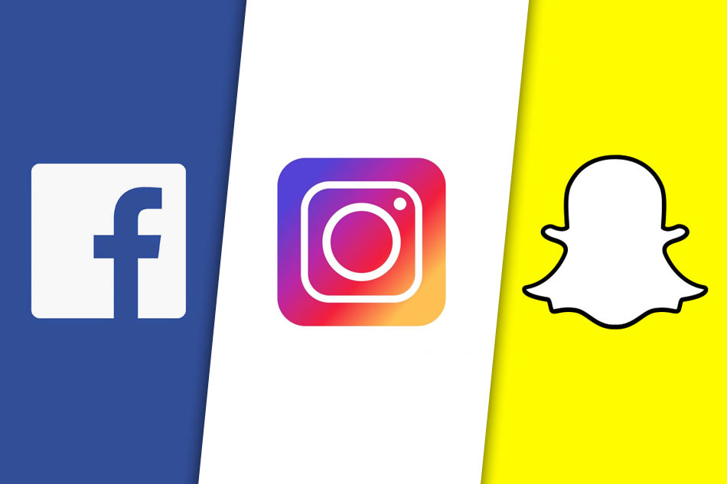
Data Privacy Concerns
on Social Media
Exploring how user information is collected, used and shared
COSC3796 IT Security and Privacy
Professor: Yazan Otoum
Group Members: Achint Pal Singh, Arjun, Harleen Kaur
Inline IEEE citations included
Key references: [1], [2], [8], [9]
Notes:
[Sources] - Uploaded report: /mnt/data/Phase 3 -report- Data Privacy Concerns on Social Media Exploring How User Information Is Collected Used and Shared (4).pdf - Theme adapted from the uploaded screenshot image. - Content based on the report title/abstract and references [1], [2], [8], [9].

Slide 2
Abstract
Study overview and why this topic matters
•
This study examines how social media platforms collect, process and share user data [1]
Core takeaway
•
A qualitative comparative approach was used with policy analysis and platform comparison [9]
Privacy risk on
social media is not
just about
breaches. It is
driven by
continuous
tracking, opaque
profiling and data
sharing built into
platform business
models
•
Findings show large-scale collection of behavioral, personal and technical data [1], [9]
•
These practices enable profiling, targeted advertising and broader cybersecurity risk [1], [9]
•
GDPR and CCPA improve transparency, but they do not fully restore user control [2], [8]
[1], [9]
Notes:
[Sources] - Uploaded report: /mnt/data/Phase 3 -report- Data Privacy Concerns on Social Media Exploring How User Information Is Collected Used and Shared (4).pdf - Based on report abstract and references [1], [2], [8], [9].

Slide 3
Introduction
Context for the research problem
Why social media matters
Why privacy risk grows
Social communication and daily interaction, and they relymedia platforms have become central to heavily on personal data to personalize content, increase engagement and generate revenue [1]
Large-scale data collection combines with complex algorithms and third-party integrations, increasing exposure to misuse, identity theft and data breaches [3], [6]
User awareness gap
Research problem
Many users do not fully understand what data is collected, how it is used or how long it is retained [6]
Platforms collect extensive user data with limited transparency and limited user control, creating both privacy and cybersecurity risks [7]
Notes:
[Sources] - Uploaded report: /mnt/data/Phase 3 -report- Data Privacy Concerns on Social Media Exploring How User Information Is Collected Used and Shared (4).pdf - Based on report introduction and research problem sections; cites [1], [3], [6], [7].

Slide 4
Research Objectives
What the presentation is designed to answer
1
Analyze data collection practices across major platforms [1], [5]
Approach in one line
2
Examine how algorithms process user behavior [9]
A qualitative comparative analysis was selected because privacy policies require interpretation and internal platform data is not publicly accessible [9]
3
Evaluate third-party data sharing [5]
4
Identify key cybersecurity risks [3], [7]
5
Assess the effectiveness of current regulations [2], [8]
Data inputs
Privacy policies [2]
Academic literature
[1], [7], [9]
Regulatory frameworks
[4], [5]
Notes:
[Sources] - Uploaded report: /mnt/data/Phase 3 -report- Data Privacy Concerns on Social Media Exploring How User Information Is Collected Used and Shared (4).pdf - Based on report objectives and methodology rationale; cites [1], [2], [3], [4], [5], [7], [8], [9].

Slide 5
Methodology
Research design, analytical framework and procedure
Research design
Data sources
Framework
Classification
Qualitative comparative analysis [9]
Policies, academic literature and regulatory frameworks [1], [2], [4], [5], [7], [9]
Content analysis, comparison, risk mapping and scoring [4], [5]
Personal, behavioral, device, location and inferred data [5]
Procedure
•
Select platforms: Facebook, Instagram, TikTok, X and Snapchat
•
Extract data types, uses and sharing patterns [1], [5]
•
Classify data using defined categories [5]
•
Compare platforms and map risks [4], [5]
•
Score risks using likelihood × impact [4]
Notes:
[Sources] - Uploaded report: /mnt/data/Phase 3 -report- Data Privacy Concerns on Social Media Exploring How User Information Is Collected Used and Shared (4).pdf - Based on methodology and implementation sections; cites [1], [2], [4], [5], [7], [9].

Slide 6
Platform-Wise Findings
How major platforms collect data and where the biggest risks appear
Facebook / Instagram
X / Twitter
TikTok
Snapchat
Data: personal details, browsing habits, device and location data
Use: personalization, ads, engagement tracking
Risk: cross-platform tracking and detailed profiling
[1]
Data: posts, device signals, interaction patterns, account activity
Use: feed ranking and engagement analysis
Risk: public data aggregation and inferred interests
[9]
Data: watch time, search activity, device settings and usage patterns
Use: algorithmic personalization and prediction
Risk: opaque behavioral profiling and cross-device tracking
[1], [9]
Data: usernames, contacts, location and communication timing
Use: feature support and location-based functions
Risk: location exposure and metadata retention
[5]
Cross-platform pattern
Even though platforms look different, their privacy issues are similar: excessive data collection, profiling, third-party sharing and possible exposure through security vulnerabilities. The core issue is the extent of collection, not just its existence [1], [5], [9]
Notes:
[Sources] - Uploaded report: /mnt/data/Phase 3 -report- Data Privacy Concerns on Social Media Exploring How User Information Is Collected Used and Shared (4).pdf - Based on the platform-wise comparative findings table and discussion in the report; cites [1], [5], [9].

Slide 7
Key Privacy & Cybersecurity Risks
The main categories identified in the study
Excessive data collection
Algorithmic profiling
Third-party data sharing
Platforms collect more personal and behavioral data than users usually expect, creating overexposure and detailed personal records [3]
User behavior is analyzed to predict preferences and patterns, leading to hidden profiling and unfair influence [9]
Data is shared with advertisers, service providers and partners, reducing control and increasing exposure [5]
Data breach / unauthorized access
Weak meaningful consent
Long-term privacy harm
Weak systems can expose stored data to unauthorized parties, causing identity theft, scams and reputational harm [7]
Users often accept privacy terms without fully understanding what is being collected or why [6]
Ongoing data accumulation can create permanent profiling, long-term surveillance and future decision impacts [7]
Notes:
[Sources] - Uploaded report: /mnt/data/Phase 3 -report- Data Privacy Concerns on Social Media Exploring How User Information Is Collected Used and Shared (4).pdf - Based on the privacy and cybersecurity risks section and risk table; cites [3], [5], [6], [7], [9].

Slide 8
Results & Discussion
What the findings mean for users and regulators
Results
Discussion
•
Behavioral data dominates platform tracking and reflects continuous monitoring of user activity [1]
•
There is a clear imbalance between user privacy and platform business models [1]
•
Major risks cluster around profiling, third-party sharing and breaches [3], [9]
•
Privacy policies can satisfy legal disclosure requirements without producing real user understanding [6]
•
Platforms prioritize behavior prediction and monetization over privacy [1], [9]
•
GDPR and CCPA improve transparency, but enforcement gaps remain and privacy often stays secondary to engagement goals [2], [5], [8]
Notes:
[Sources] - Uploaded report: /mnt/data/Phase 3 -report- Data Privacy Concerns on Social Media Exploring How User Information Is Collected Used and Shared (4).pdf - Based on results/analysis, discussion and evaluation of current safeguards; cites [1], [2], [3], [5], [6], [8], [9].

Slide 9
Future Directions
Practical measures proposed by the report
Stronger data minimization
Limit collection to what is strictly necessary to reduce unnecessary exposure and lower breach risk [5]
Simpler privacy notices
Use plain language so users understand data collection, use, storage and access [3]
Better user control
Make privacy settings easy to find and configure [4]
Reduced third-party exposure
Share less information with outside companies to improve accountability [5]
Privacy by design
Build privacy protections into defaults, architecture and encryption choices [4]
Stronger governance + transparency
Improve internal controls and explain how recommendation and targeting systems work [3], [4], [5]
Notes:
[Sources] - Uploaded report: /mnt/data/Phase 3 -report- Data Privacy Concerns on Social Media Exploring How User Information Is Collected Used and Shared (4).pdf - Based on recommendations including data minimization, user control, privacy by design and algorithmic transparency; cites [3], [4], [5].

Slide 10
Conclusion
Final message from the study
1. Collection is extensive
2. Risk is structural
3. Compliance is not enough
Social media platforms collect large volumes of data that exceed the expectations of the average user [1]
Privacy harms go beyond breaches to include profiling, weak consent and long-term surveillance effects [6], [7]
Stronger protection requires privacy to be embedded in system design, controls and day-to-day data management [2], [4]
Reference links
[1] doi.org [2] eur-lex.europa.eu [3] www.ftc.gov [4] nvlpubs.nist.gov [5] web-archive.oecd.org [6] www.pewresearch.org [7] scholarship.law.upenn.edu [8] leginfo.legislature.ca.gov [9] ojs.aaai.org
Notes:
[Sources] - Uploaded report: /mnt/data/Phase 3 -report- Data Privacy Concerns on Social Media Exploring How User Information Is Collected Used and Shared (4).pdf - Based on the conclusion section and report references [1]-[9].

