Slide 1
Virtual Environment
Anaconda

Slide 2
How to set up a virtual environments using conda for the Anaconda Python distribution
A virtual environment is a named, isolated, working copy of Python that that maintains its own files, directories, and paths so that you can work with specific versions of libraries or Python itself without affecting other Python projects.
Virtual environmets make it easy to cleanly separate different projects and avoid problems with different dependencies and version requiremetns across components.
The conda command is the preferred interface for managing intstallations and virtual environments with the Anaconda Python distribution.
If you have a vanilla Python installation or other Python distribution see virtualenv

Slide 3

Check conda is installed and in your PATH
Open a terminal client.
Enter conda -V into the terminal command line and press enter.
If conda is installed you should see something like the following.

Slide 4
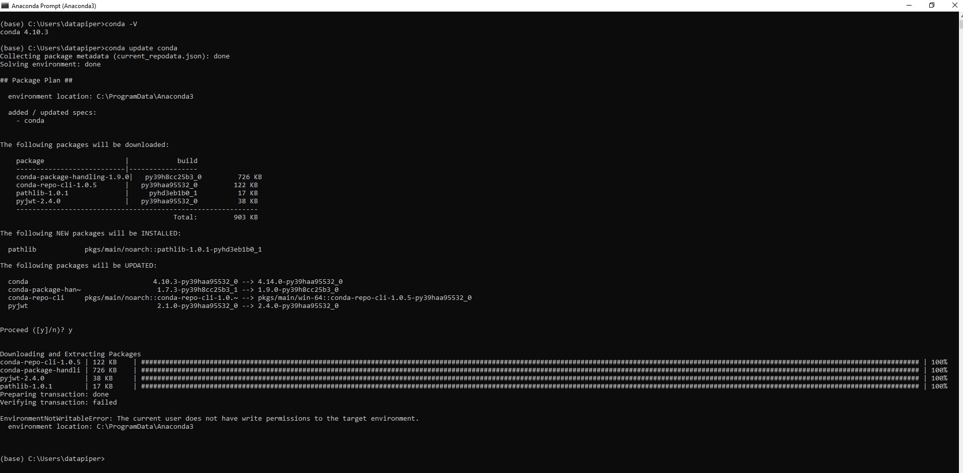
Check anaconda is upto date
conda update conda

Slide 5
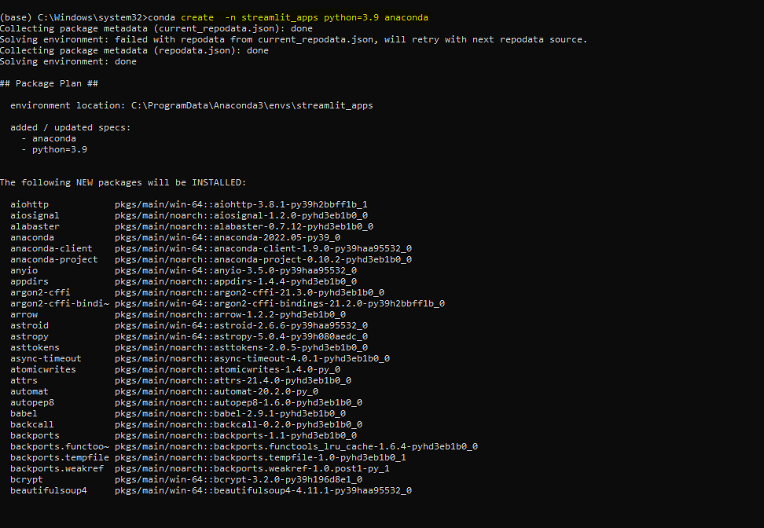
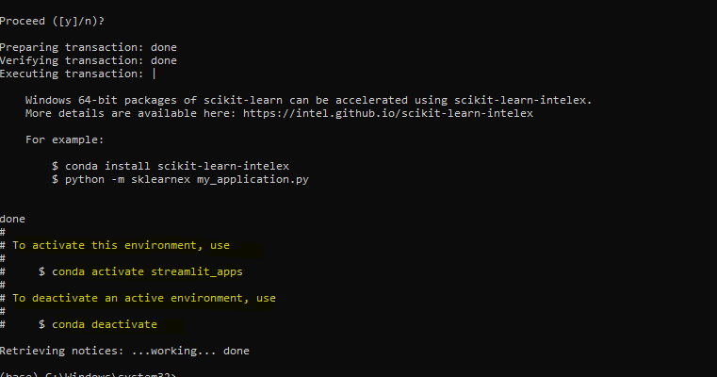
Create a Virtual env
In the terminal client enter the following where yourenvname is the name you want to call your environment, and replace x.x with the Python version you wish to use. (To see a list of available python versions first, type conda search "^python$" and press enter.)
create -n streamlit_apps python=3.9 anaconda

Slide 6
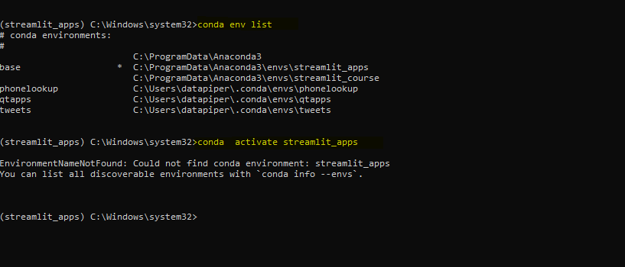
Activate your virtual environment
To activate or switch into your virtual environment, simply type the following where yourenvname is the name you gave to your environement at creation.
List all venv available
conda env list
To activate
conda activate streamlit_apps

Slide 7
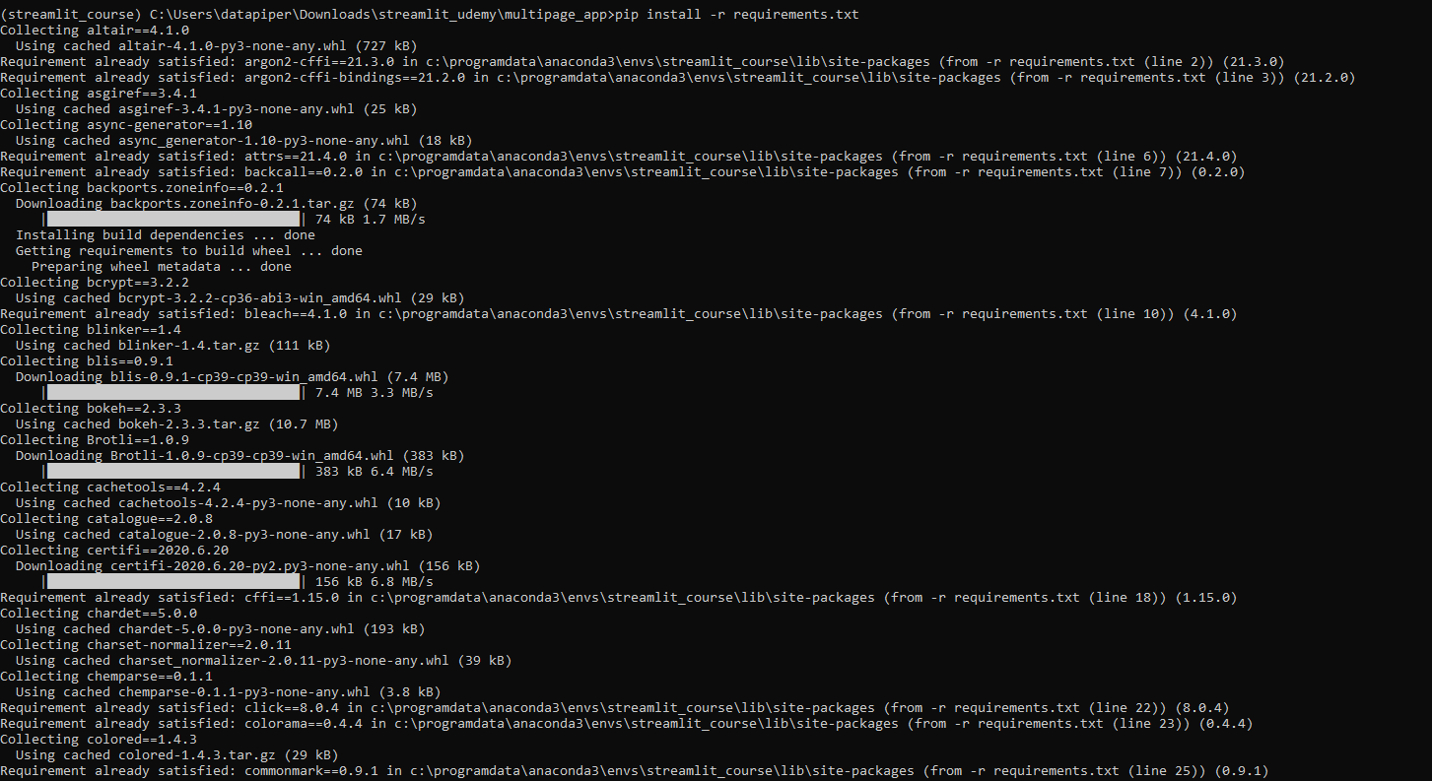
Download requirements.txt
Download requirements.txt
Copy requirements.txt require to Present working directory
pip install -r requirements.txt

Slide 8
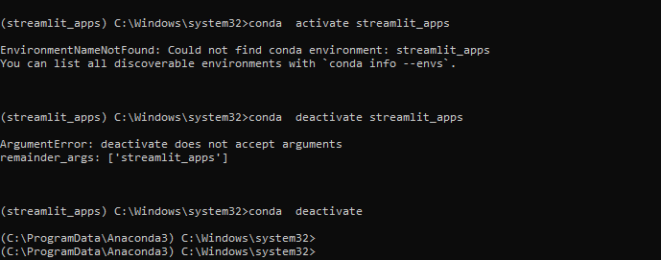
To deactive your venv
conda deactivate

