Slide 1
Low-Crosstalk Silicon Photonic Optical Phased Array for 1550 nm FMCW LiDAR
PROJECT PROPOSAL PRESENTATION · ECE 544 SILICON PHOTONICS DESIGN
Jacob Alfieri & Jordan Harlow
Department of Electrical and Computer Engineering, Colorado State University · Fall 2026
32 optimized emitter positions, 88 µm aperture (preliminary result)

Slide 2
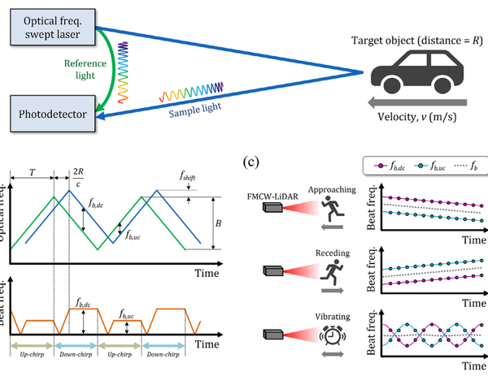
FMCW LiDAR and optical phased arrays
INTRODUCTION · BACKGROUND
LiDAR (light detection and ranging) is a remote-sensing technique that measures the distance to objects by sending out laser light and analyzing the light reflected back.
Frequency-modulated continuous-wave (FMCW) LiDAR sweeps the laser frequency and compares the returning light with the outgoing light, measuring both distance and velocity. It is largely immune to interference from sunlight and other LiDARs [1].
To scan the beam without moving parts, an optical phased array (OPA) places a row of tiny light emitters on a silicon chip and gives each one an adjustable phase. Tilting the phase across the row steers the beam, much as a phased-array radar does [2–4].
Figure 1: FMCW LiDAR [F1].

Slide 3
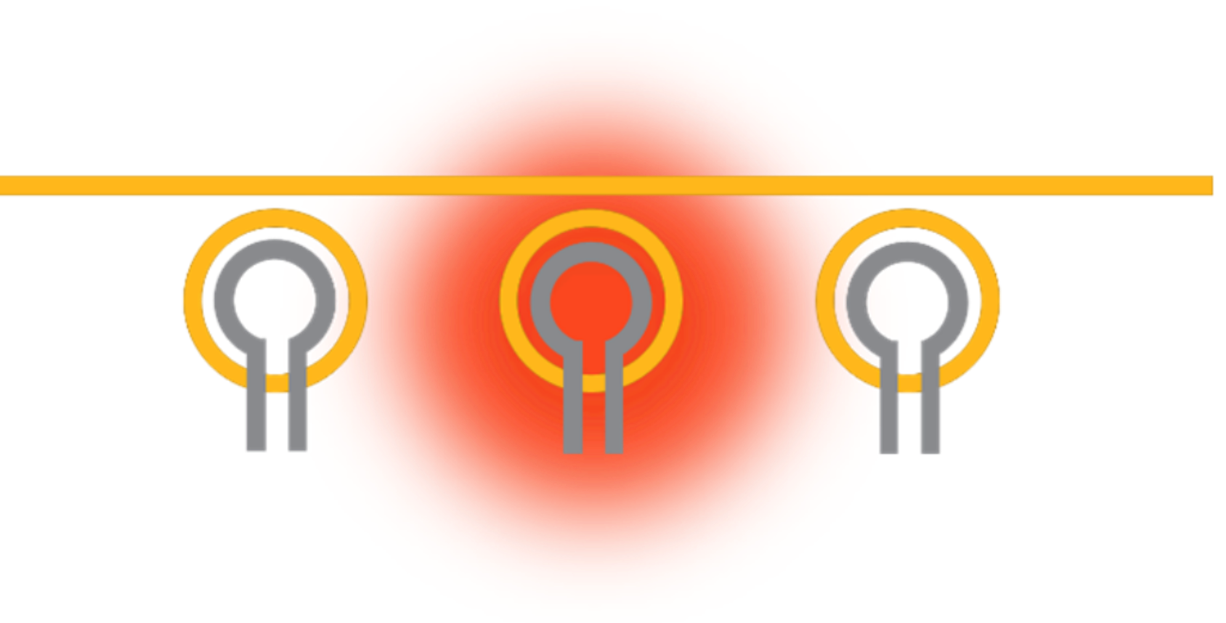
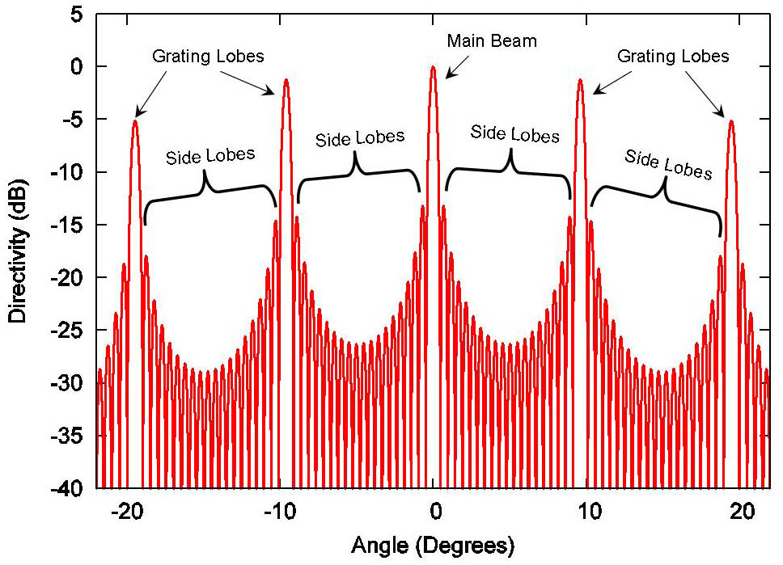
Emitter spacing: crosstalk vs. grating lobes
INTRODUCTION · IMPORTANCE & MOTIVATION
Importance: solid-state LiDAR has no moving parts, so it is more reliable, smaller, cheaper at volume and faster at pointing to arbitrary angles. It is less bulky and less prone to wear than conventional mechanical scanners.
The trade-off: packing emitters tightly avoids grating lobes but causes crosstalk. Spacing them out avoids crosstalk but brings back grating lobes, which cause ghost beams. This makes crosstalk a major open problem in literature reviews [4].
Motivation: we will design a 1×32 OPA transmitter whose emitters stay at least 1.5 µm apart but are irregularly spaced to suppress grating lobes while steering across ±45° at 1550 nm.
Figure 2: Optical and thermal crosstalk [F2].
Figure 3: Grating lobes [F3].

Slide 4
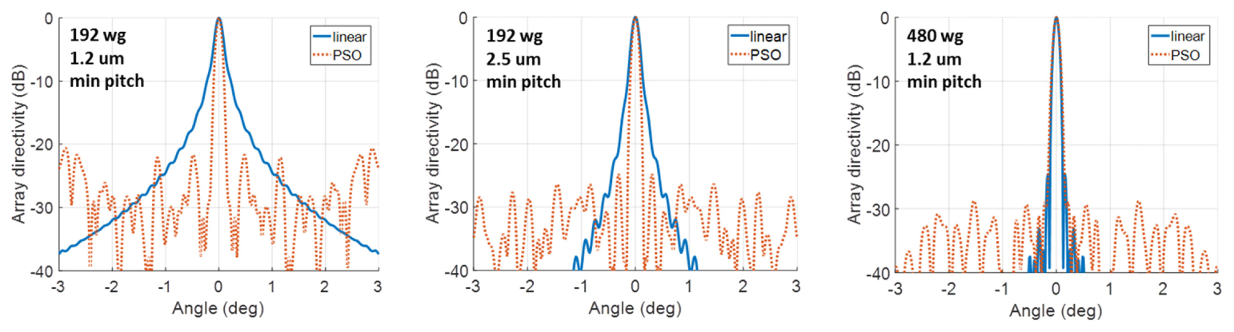
Uniform and irregular silicon OPAs
RELATED WORK
Uniform silicon OPAs
Irregular (aperiodic) arrays
The first silicon OPA used 16 emitters at 2 µm spacing and steered only 2.3° [5]. That small range is exactly the spacing problem described above. Later work scaled the approach to 4096 emitters [2] and demonstrated FMCW ranging [3]. These arrays are compact and manufacturable in CMOS foundries, but they still trade steering range against crosstalk, and each heater-based phase shifter draws about 25 mW [6].
Spacing emitters irregularly spreads the energy of the grating lobes into a low background of side lobes. This allows wide spacing with no strong duplicate beams, and the background falls as the number of emitters grows [7]. A 128-emitter irregular array demonstrated wide, high-resolution steering without grating lobes [8]. The drawbacks are that side-lobe suppression is limited by the emitter count and that it degrades if positions or phases are poorly chosen.
Figure 4: Linear vs. PSO-optimized optical phased arrays with 192 and 480 waveguides [7].

Slide 5
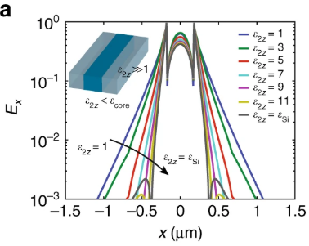
Silicon nitride and crosstalk suppression
RELATED WORK
Silicon nitride platforms
Silicon nitride handles much higher optical power than silicon [9], because silicon suffers two-photon absorption at high intensity [10]. Nitride, however, needs larger bends and wider spacing, and its heaters are less efficient. Hybrid designs use nitride only to distribute power and silicon for everything else [11], at the cost of an extra layer.
Crosstalk suppression
Varying the width of neighboring waveguides (“superlattices”) reduces their coupling enough to allow very tight spacing [12]. Engineered claddings made of sub-wavelength silicon strips achieve the same by shortening the evanescent field [13]. Both work well, but they need either several waveguide designs or very small features. Literature reviews list crosstalk, phase errors and power handling as the main open problems [4].
Figure 5: A multilayer cladding suppresses the evanescent field [13].

Slide 6
O1 array design · O2 component design
PROJECT OBJECTIVES & METHODOLOGY
O1 · Array design
O2 · Component design
Choose 32 irregular emitter positions, at least 1.5 µm apart, that keep every side lobe at least 10 dB below the main beam across ±45° of steering.
Design the emitter (a grating antenna), a 1-to-2 power splitter and a heater-based phase shifter, with targets for neighbor crosstalk, splitter loss and phase-shifter power.
METHODOLOGY
METHODOLOGY
Use Python to compute the array factor, and an optimizer to search for positions that minimize the worst side lobe over the full steering range.
Estimate coupling between neighboring waveguides with the EIM and Marcatili's approximation; confirm in Lumerical MODE. Tune the emitter in FDTD and export its emission pattern for O1. Design the splitter in MODE/EME and the phase shifter in HEAT, which sets how far apart the heaters must be.
Python
MODE
FDTD
EME
HEAT

Slide 7
O3 circuit · O4 LiDAR estimate · O5 layout
PROJECT OBJECTIVES & METHODOLOGY
O3 · Full-circuit simulation
O4 · LiDAR estimate
O5 · Circuit layout (stretch goal)
Connect the components into the complete 1×32 circuit and show that the beam steers smoothly across ±45°, including realistic manufacturing variation and a simple calibration.
Translate the simulated losses and beam quality into range resolution and maximum range.
Place the emitters at the O1 positions and the heaters at the O2 spacing.
METHODOLOGY
METHODOLOGY
METHODOLOGY
Build the circuit in INTERCONNECT. For each steering angle, Python sets the heater powers, reads the light leaving each emitter and computes the beam. Add random width and thickness variation, then calibrate the heaters to restore the beam.
Use the circuit loss and beam quality from O1–O3 with standard FMCW LiDAR relations [1].
Build the layout in KLayout, run the PDK's design-rule check (DRC) and fix all violations, then confirm the layout's connectivity matches the O3 circuit.
INTERCONNECT
Python
KLayout
SiEPIC PDK

Slide 8
Deliverables, pass criteria and dates
PROJECT TENTATIVE OUTCOME
Deliverable | Pass criterion | Done by
O1 · 32 emitter positions | All gaps ≥ 1.5 µm; every side lobe ≤ −10 dB over ±45°, using the FDTD emitter pattern | Oct. 25
O2 · Component library (S-parameters) | Neighbor crosstalk < −20 dB · 1×2 MMI loss < 0.3 dB · heater P_{π} ≤ 25 mW, < 5 % on neighbor | Nov. 1 (M1)
O3 · Full 1×32 circuit (INTERCONNECT) | Smooth steering across ±45°; calibration recovers the beam under fabrication variation | Nov. 8 / 15 (M2, M3)
O4 · LiDAR estimate | Range resolution and maximum range from simulated loss and beam quality | Nov. 15 (M3)
O5 · GDSII layout (stretch goal) | Zero DRC errors in the SiEPIC EBeam PDK; connectivity matches the O3 circuit | Nov. 15, if time allows
Final IEEE paper | Submitted | Nov. 30 (M5)
Simulation and design only: fabrication is out of scope this semester.

Slide 9
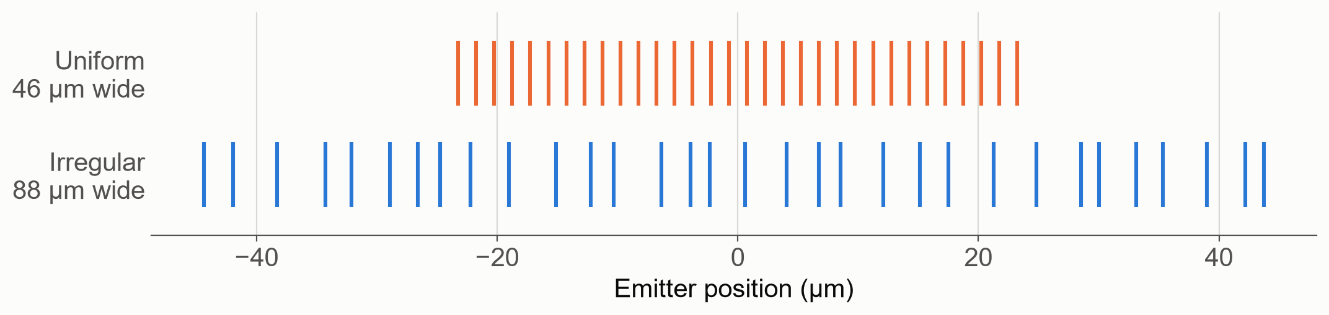
Array-factor model and search setup
PRELIMINARY RESULTS
Far field of N emitters at positions xₙ
31 gaps
AF(θ) = (1/N) Σ_{n} exp[ j (2π/λ) x_{n} (sin θ − sin θ₀) ]
each 1.5–4.0 µm: the design variables
30 starts
gradient-based search, about 1 min on a laptop
Steering shifts the pattern, so one window covers all of ±45°:
Python
worst side lobe for |sin θ − sin θ₀| ≤ 1 + sin 45°
our own NumPy/SciPy code; ideal emitters for now
Code: github.com/harlowjordan/ECE544-Project

Slide 10
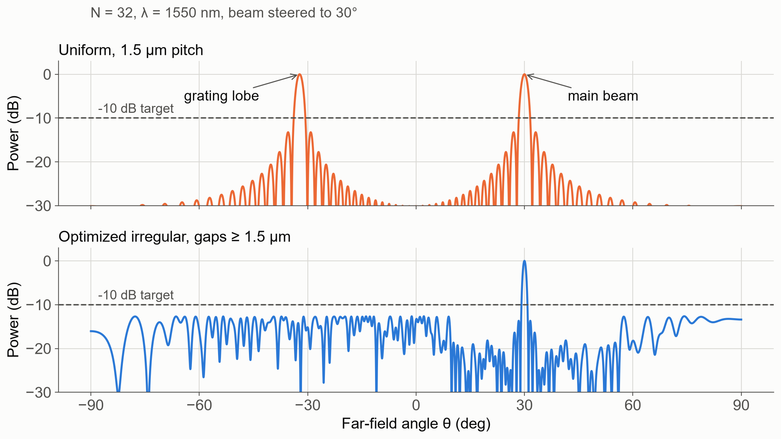
Far field at 30° steering, N = 32
PRELIMINARY RESULTS · 1
Worst side lobe over ±45° · N = 32 · all gaps ≥ 1.5 µm
0 dB
Uniform, 1.5 µm pitch
−7.2 dB
Random gaps (median of 300 arrays)
−12.6 dB
Optimized gaps (target: −10 dB)

Slide 11
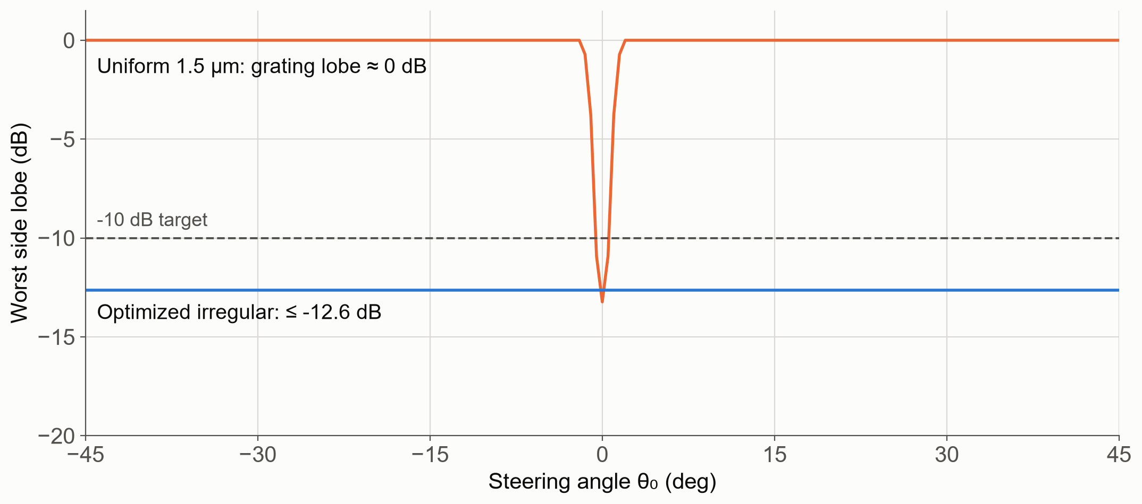
Worst side lobe vs. steering angle
PRELIMINARY RESULTS · 2
Worst side lobe at each steering angle
±0.5°
Steering range where the uniform array is ≤ −10 dB
−12.6 dB
Optimized array, every angle from −45° to +45°
0.86°
Broadside beam width (uniform: 1.64°); aperture 88 vs. 46 µm

Slide 12
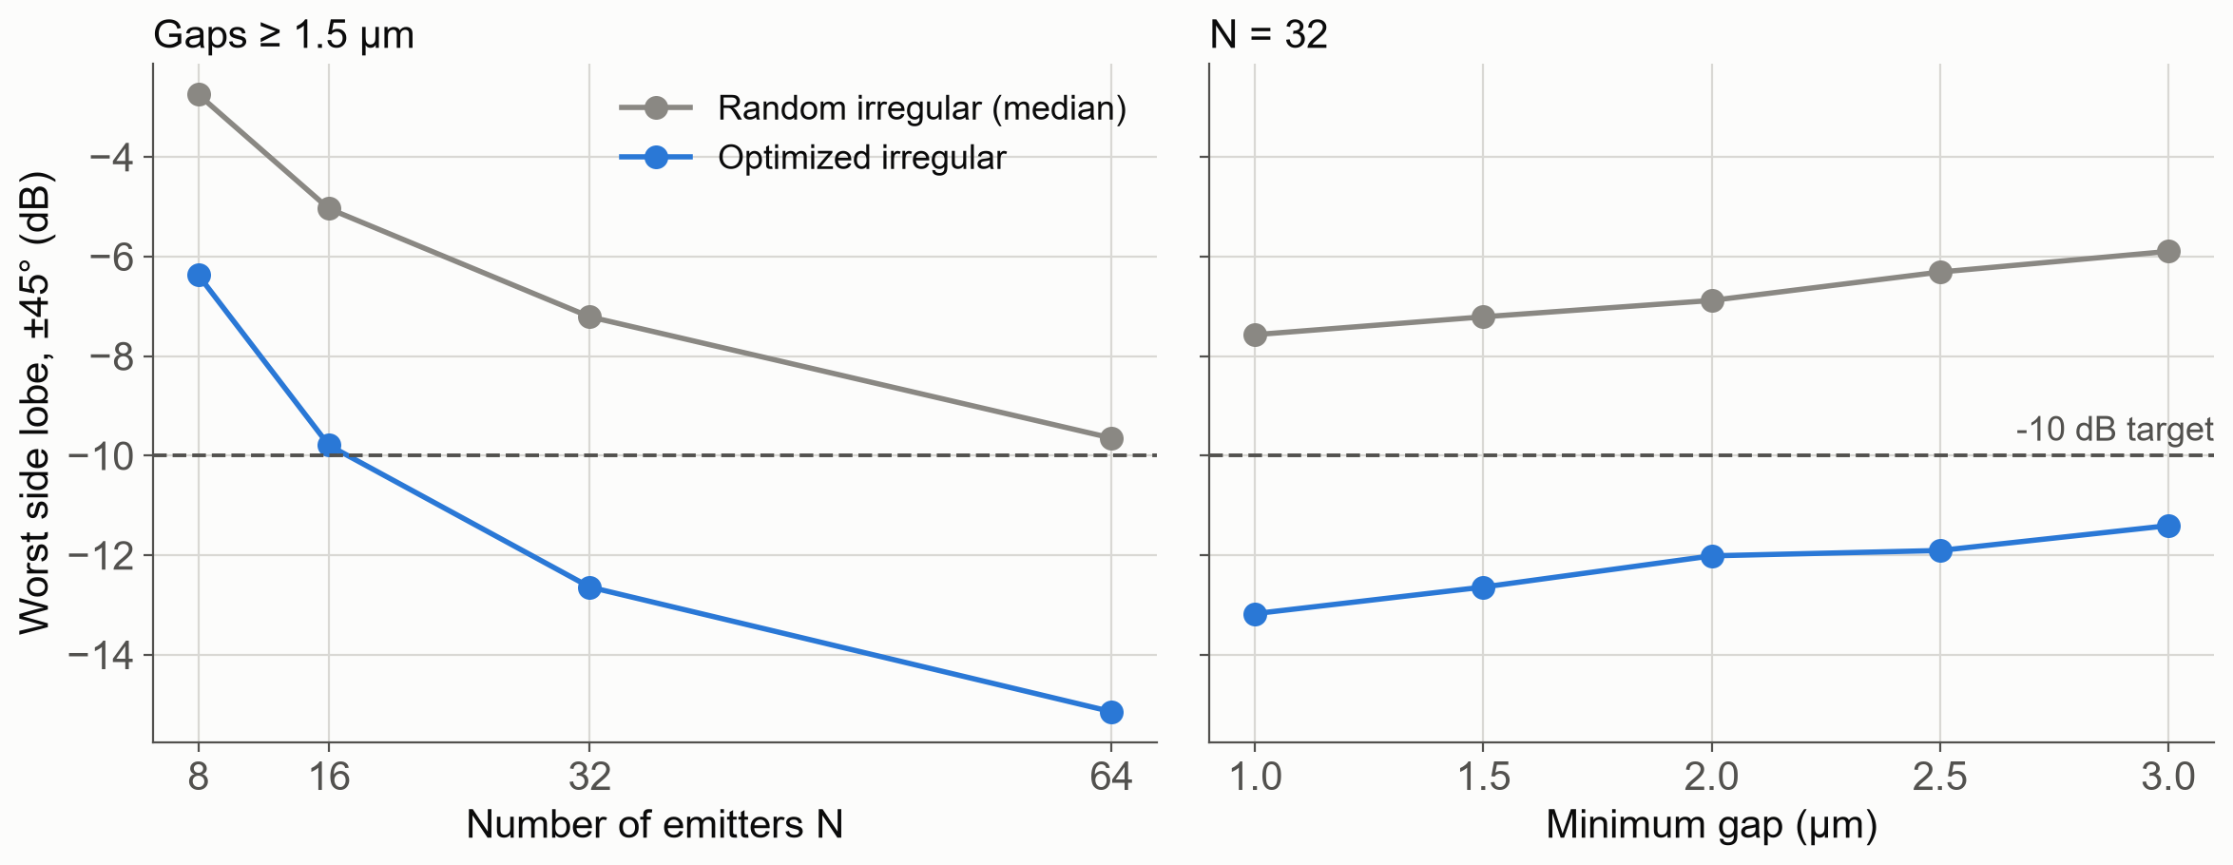
Worst side lobe vs. emitter count and gap
PRELIMINARY RESULTS · 3
Re-optimized at each point; gaps from the minimum up to minimum + 2.5 µm
−9.8 dB
N = 16, gaps ≥ 1.5 µm, optimized
−11.4 dB
N = 32, gaps ≥ 3 µm, optimized
5.4 dB
Optimized vs. random gaps (N = 32, gaps ≥ 1.5 µm)

Slide 13
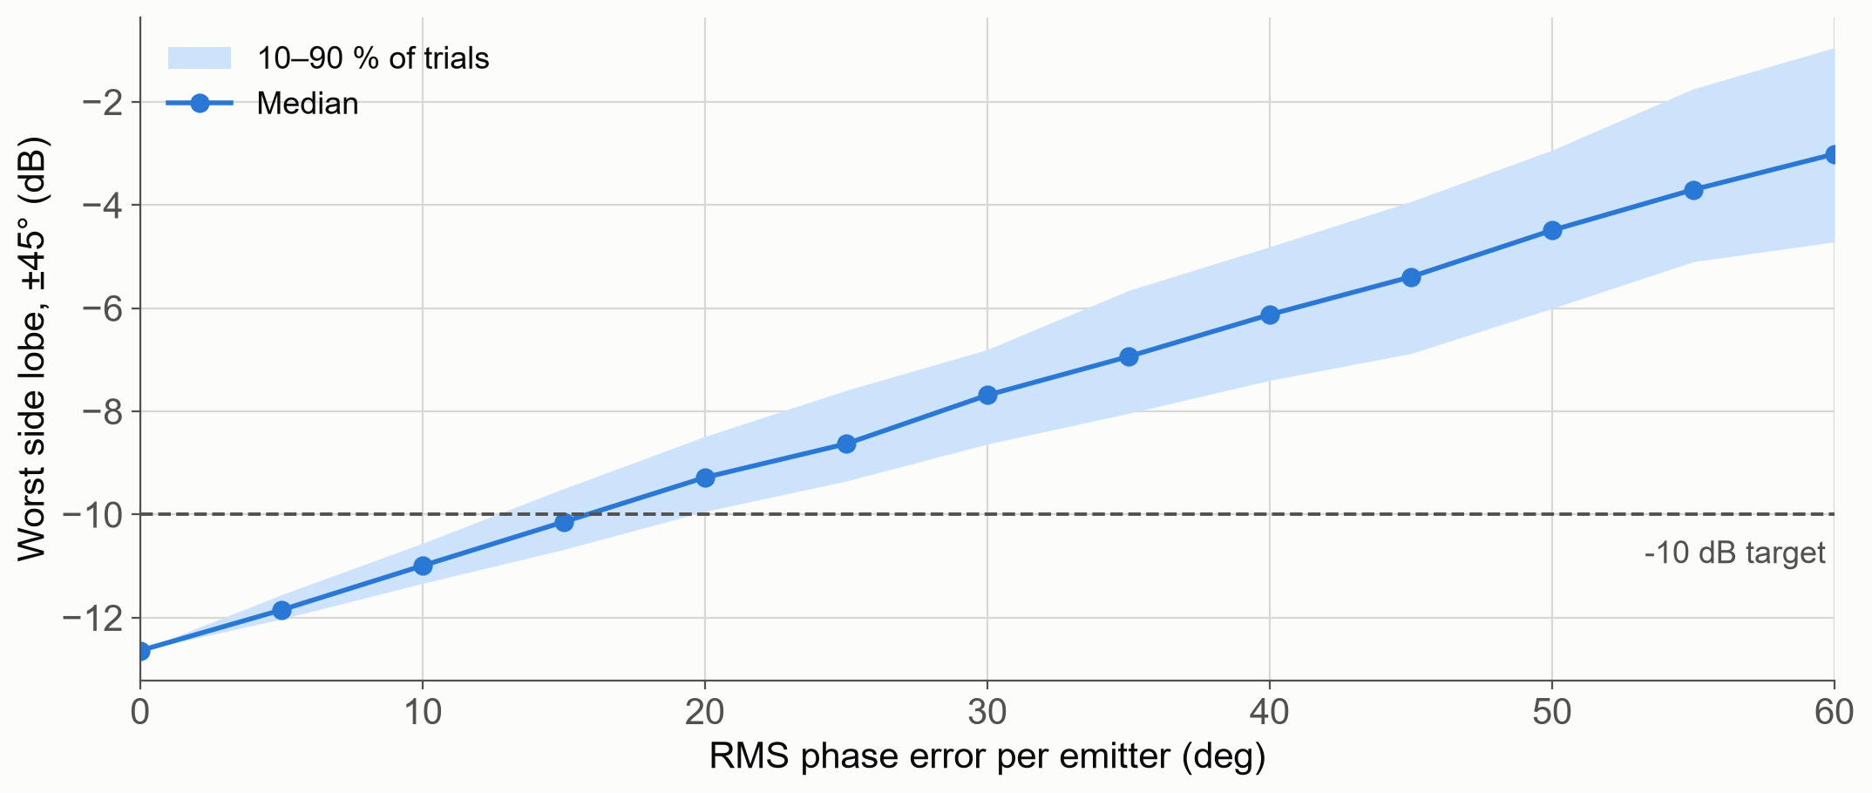
Worst side lobe vs. random phase error
PRELIMINARY RESULTS · 4
Gaussian phase error on every emitter · 300 trials per point
≈ 15° rms
Where the median crosses −10 dB
−11.0 dB
Median at 10° rms
−7.7 dB
Median at 30° rms

Slide 14
Risks, fallback plans and evidence
RISK MANAGEMENT
Risk | Plan B | Evidence
Real emitter pattern pushes side lobes above −10 dB | Re-optimize with the FDTD pattern; otherwise report the level we reach | 2.6 dB margin today
Crosstalk at 1.5 µm worse than −20 dB | Widen the minimum gap | 3 µm gaps → −11.4 dB
Fabrication variation scrambles phases | Heater calibration in O3 | Need < 15° rms
1×32 too big for the time left | Fall back to 1×16, with a relaxed side-lobe spec | 1×16 ≈ −10 dB
3-D FDTD too slow | Simulate short sections; 2.5-D solvers | —
Schedule slip | Technical work ends Nov. 15; week of Nov. 23 is buffer | —

Slide 15
Summary and next steps
CONCLUSION
Problem
Wide steering needs < 0.9 µm emitter pitch, where crosstalk distorts the beam; at 1.5 µm, a uniform array steers only ±2°.
Approach
Irregular 1×32 OPA with all gaps ≥ 1.5 µm on 220-nm SOI, simulated from components to the full circuit.
First result
−12.6 dB worst side lobe over ±45° with ideal emitters (target −10 dB).
Next
FDTD emitter pattern → components → full circuit → LiDAR estimate; final paper Nov. 30.
Thank you · Questions?

Slide 16
References
REFERENCES
[1] B. Behroozpour, P. A. M. Sandborn, M. C. Wu, and B. E. Boser, “Lidar system architectures and circuits,” IEEE Commun. Mag., vol. 55, no. 10, pp. 135–142, 2017.
[2] J. Sun, E. Timurdogan, A. Yaacobi, E. S. Hosseini, and M. R. Watts, “Large-scale nanophotonic phased array,” Nature, vol. 493, no. 7431, pp. 195–199, 2013.
[3] C. V. Poulton, A. Yaacobi, D. B. Cole, M. J. Byrd, M. Raval, D. Vermeulen, and M. R. Watts, “Coherent solid-state LIDAR with silicon photonic optical phased arrays,” Opt. Lett., vol. 42, no. 20, pp. 4091–4094, 2017.
[4] M. Hu, Y. Pang, and L. Gao, “Advances in silicon-based integrated lidar,” Sensors, vol. 23, no. 13, p. 5920, 2023.
[5] K. Van Acoleyen, W. Bogaerts, J. Jágerská, N. Le Thomas, R. Houdré, and R. Baets, “Off-chip beam steering with a one-dimensional optical phased array on silicon-on-insulator,” Opt. Lett., vol. 34, no. 9, pp. 1477–1479, 2009.
[6] N. C. Harris, Y. Ma, J. Mower, T. Baehr-Jones, D. Englund, M. Hochberg, and C. Galland, “Efficient, compact and low loss thermo-optic phase shifter in silicon,” Opt. Express, vol. 22, no. 9, pp. 10487–10493, 2014.
[7] T. Komljenovic, R. Helkey, L. Coldren, and J. E. Bowers, “Sparse aperiodic arrays for optical beam forming and LIDAR,” Opt. Express, vol. 25, no. 3, pp. 2511–2528, 2017.
[8] D. N. Hutchison, J. Sun, J. K. Doylend, R. Kumar, J. Heck, W. Kim, C. T. Phare, A. Feshali, and H. Rong, “High-resolution aliasing-free optical beam steering,” Optica, vol. 3, no. 8, pp. 887–890, 2016.
[9] C. V. Poulton, M. J. Byrd, M. Raval, Z. Su, N. Li, E. Timurdogan, D. Coolbaugh, D. Vermeulen, and M. R. Watts, “Large-scale silicon nitride nanophotonic phased arrays at infrared and visible wavelengths,” Opt. Lett., vol. 42, no. 1, pp. 21–24, 2017.
[10] H. K. Tsang and Y. Liu, “Nonlinear optical properties of silicon waveguides,” Semicond. Sci. Technol., vol. 23, no. 6, p. 064007, 2008.
[11] Q. Wang, S. Wang, L. Jia, Y. Cai, W. Yue, and M. Yu, “Silicon nitride assisted 1×64 optical phased array based on a SOI platform,” Opt. Express, vol. 29, no. 7, pp. 10509–10517, 2021.
[12] W. Song, R. Gatdula, S. Abbaslou, M. Lu, A. Stein, W. Y.-C. Lai, J. Provine, R. F. W. Pease, D. N. Christodoulides, and W. Jiang, “High-density waveguide superlattices with low crosstalk,” Nat. Commun., vol. 6, p. 7027, 2015.
[13] S. Jahani, S. Kim, J. Atkinson, J. C. Wirth, F. Kalhor, A. A. Noman, W. D. Newman, P. Shekhar, K. Han, V. Van, R. G. DeCorby, L. Chrostowski, M. Qi, and Z. Jacob, “Controlling evanescent waves using silicon photonic all-dielectric metamaterials for dense integration,” Nat. Commun., vol. 9, p. 1893, 2018.
Figure sources
[F1] designworldonline.com/faq-on-the-basics-of-fmcw-lidar-part-1
[F2] optics.ansys.com/hc/en-us/articles/47617107334291
[F3] en.wikipedia.org/wiki/Grating_lobes
Preliminary-result figures (slides 9–13): our own Python code, github.com/harlowjordan/ECE544-Project/tree/main/ProjectProposalPresentation/prelim

