Slide 1


Slide 2
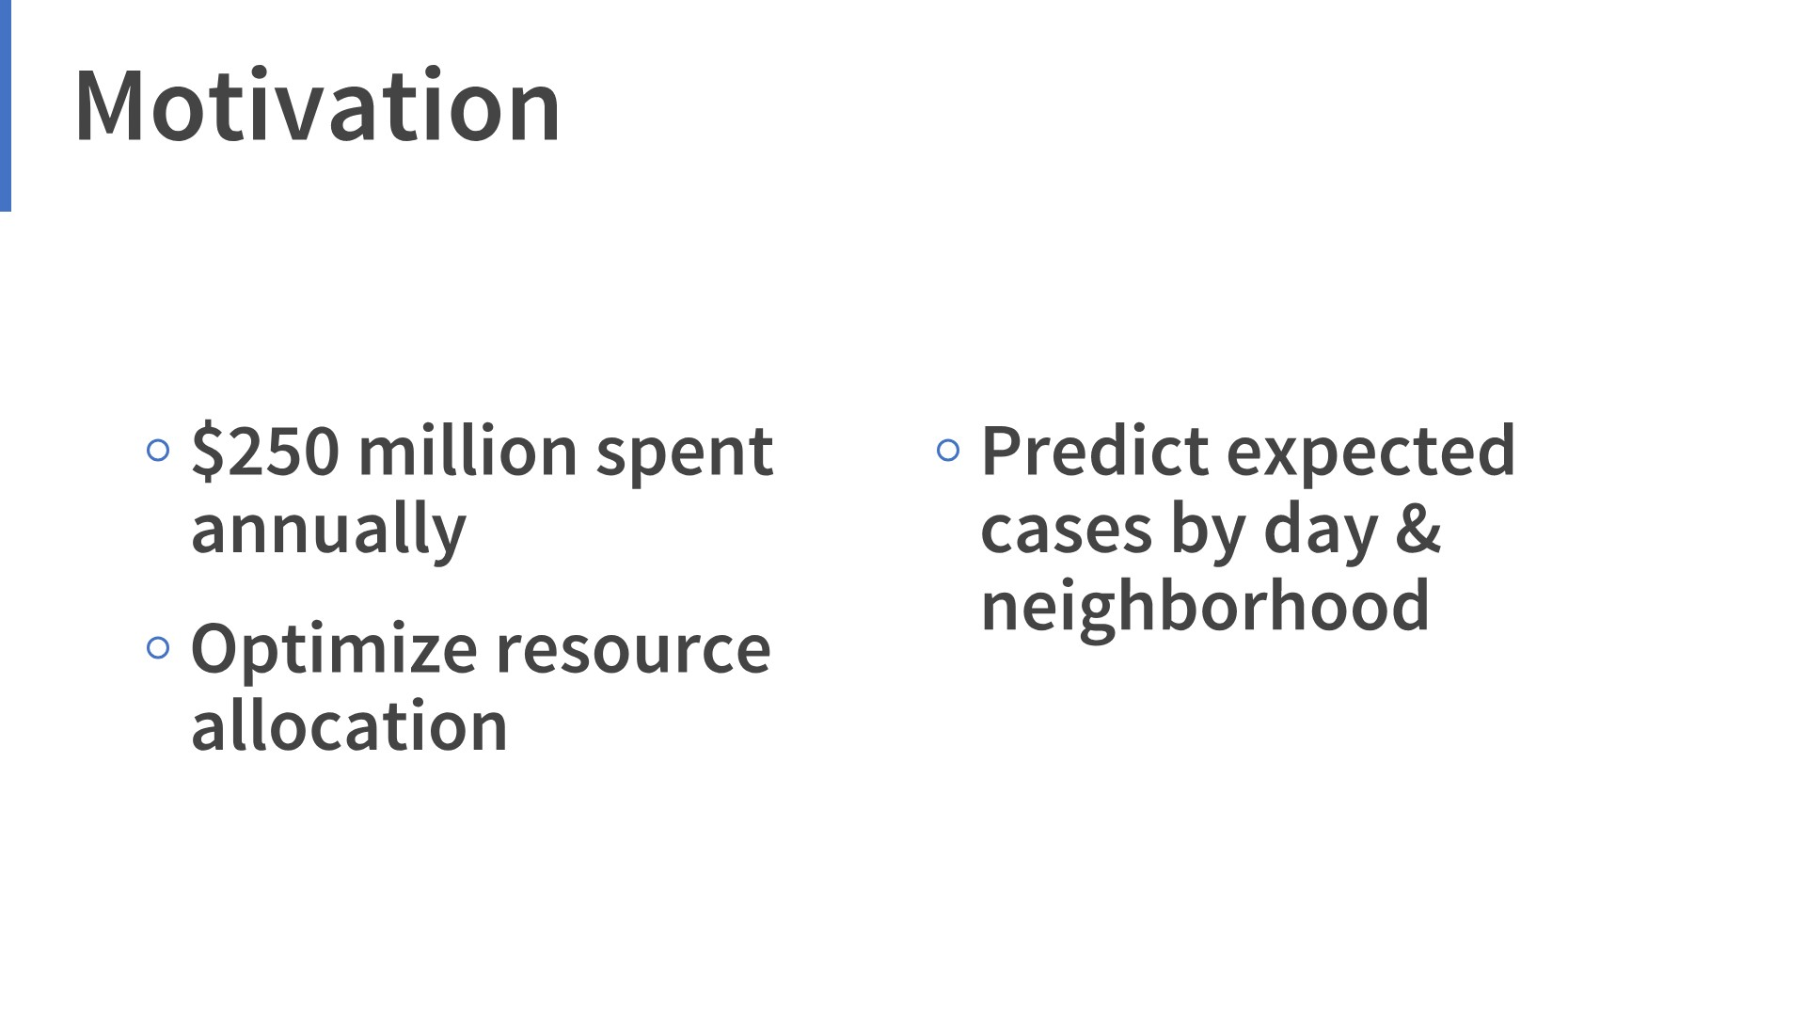

Slide 3
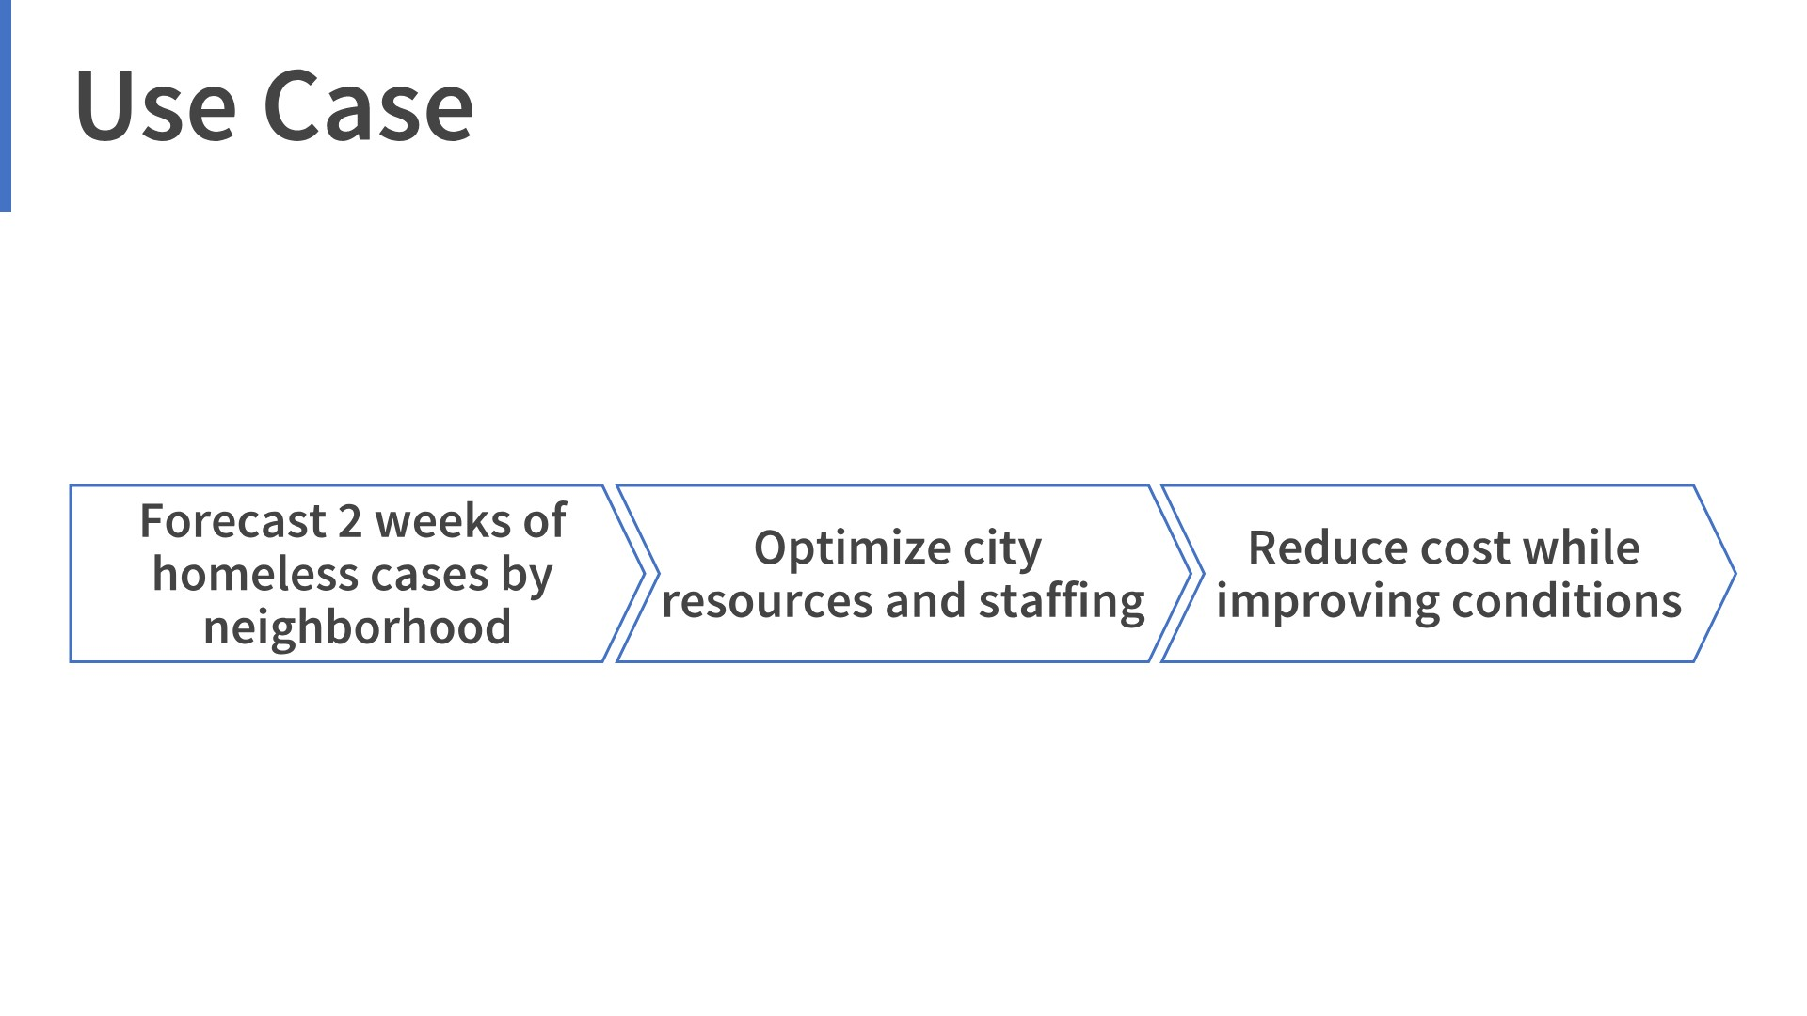

Slide 4
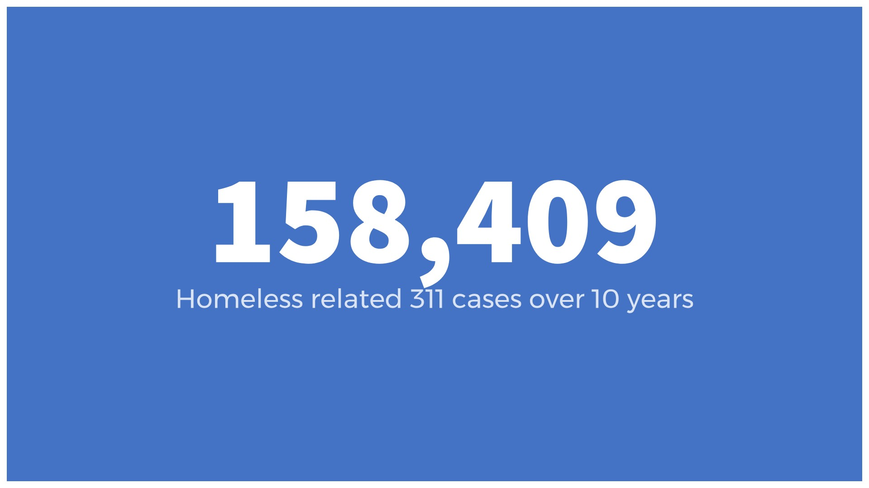

Slide 5
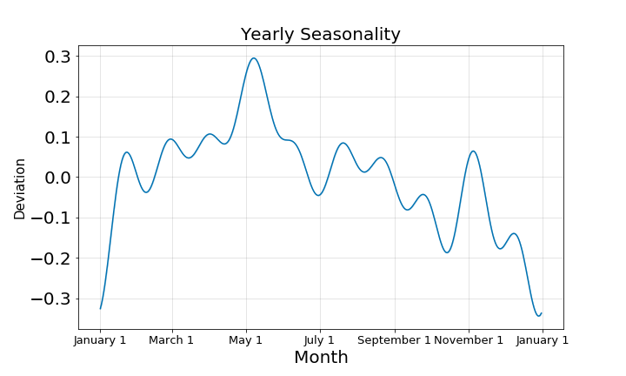

Slide 6
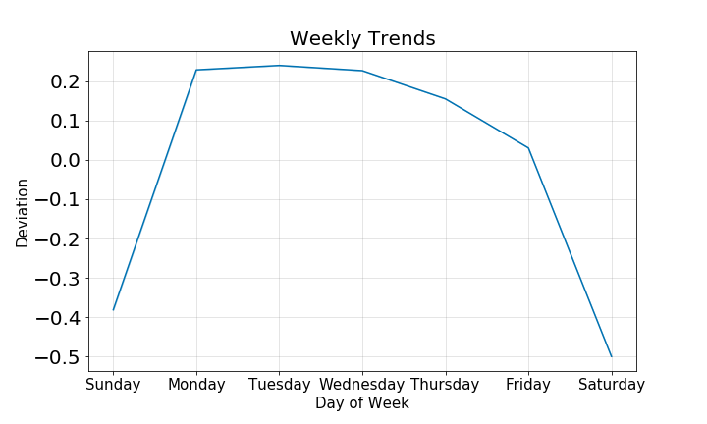

Slide 7

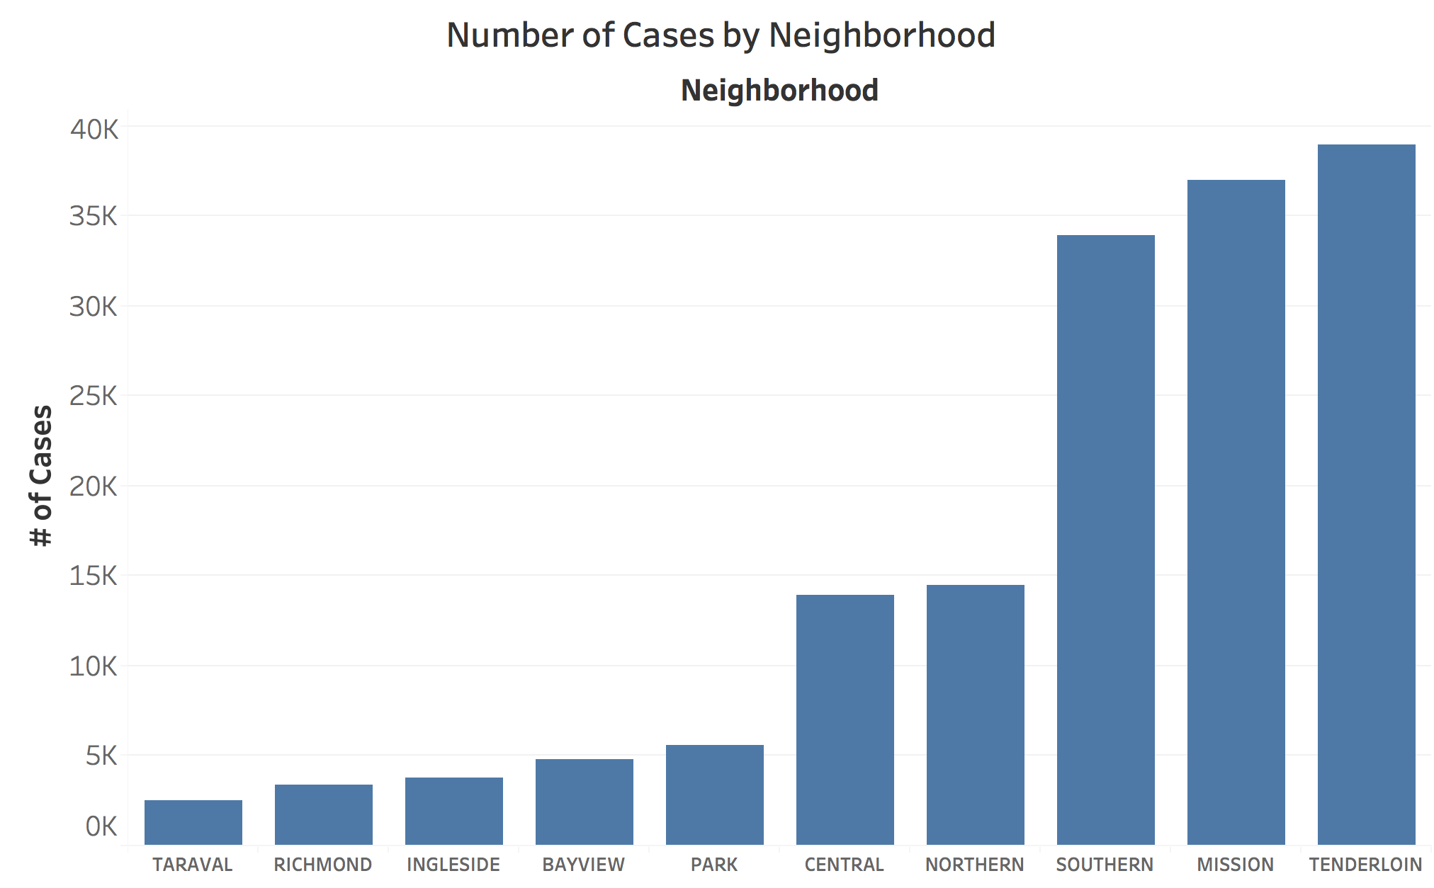

Slide 8
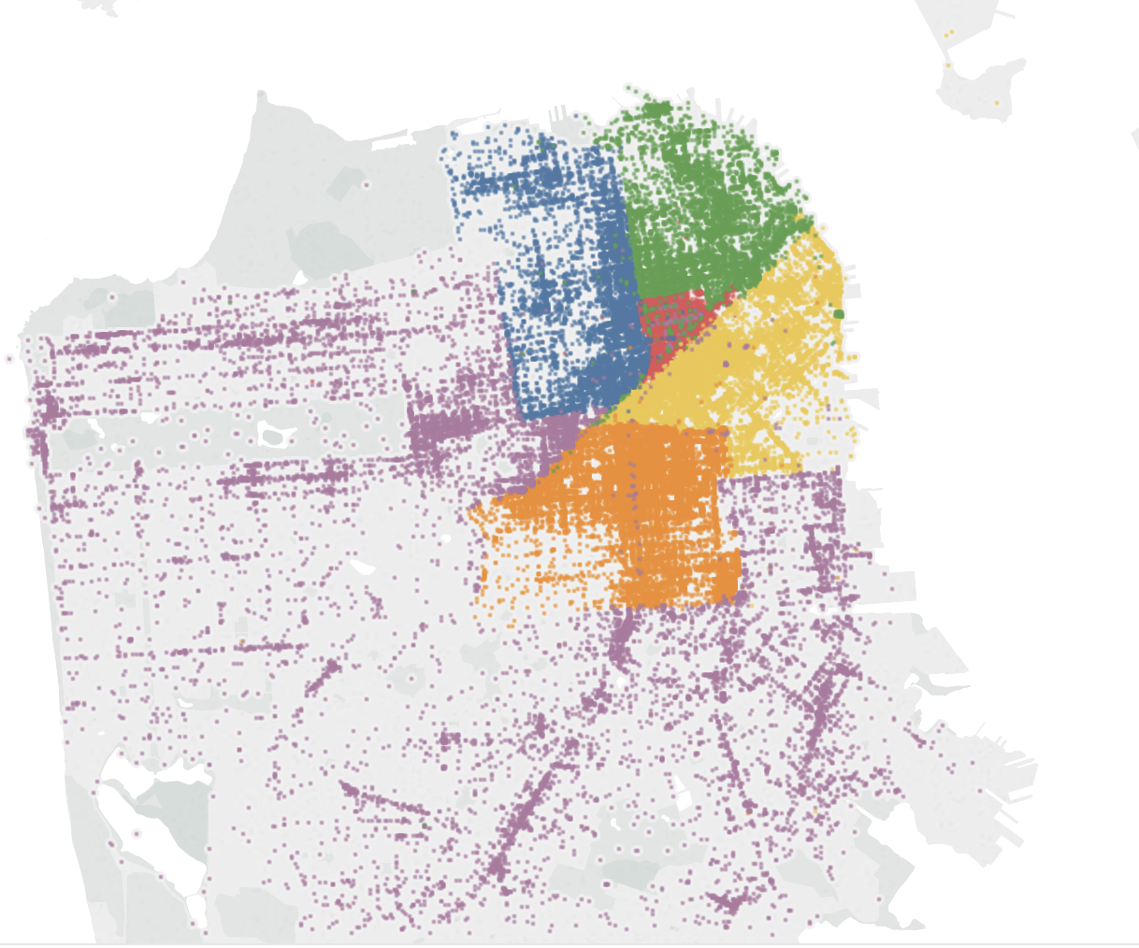
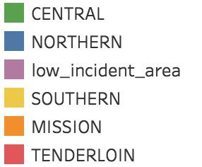
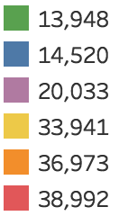

Slide 9
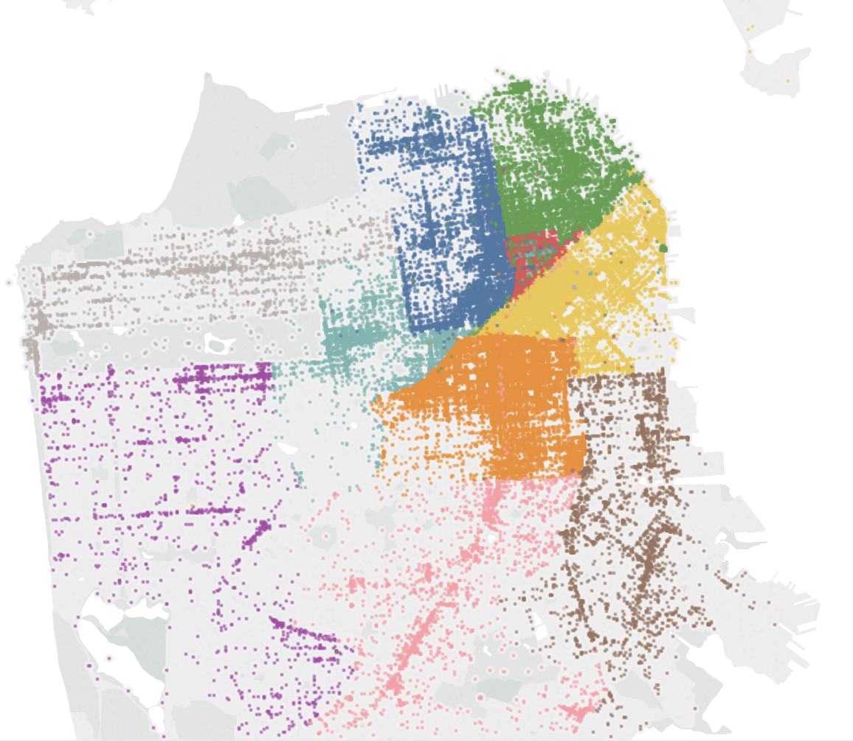
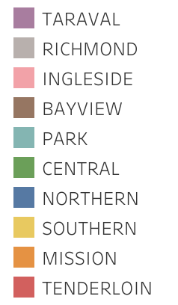
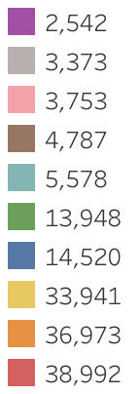

Slide 10
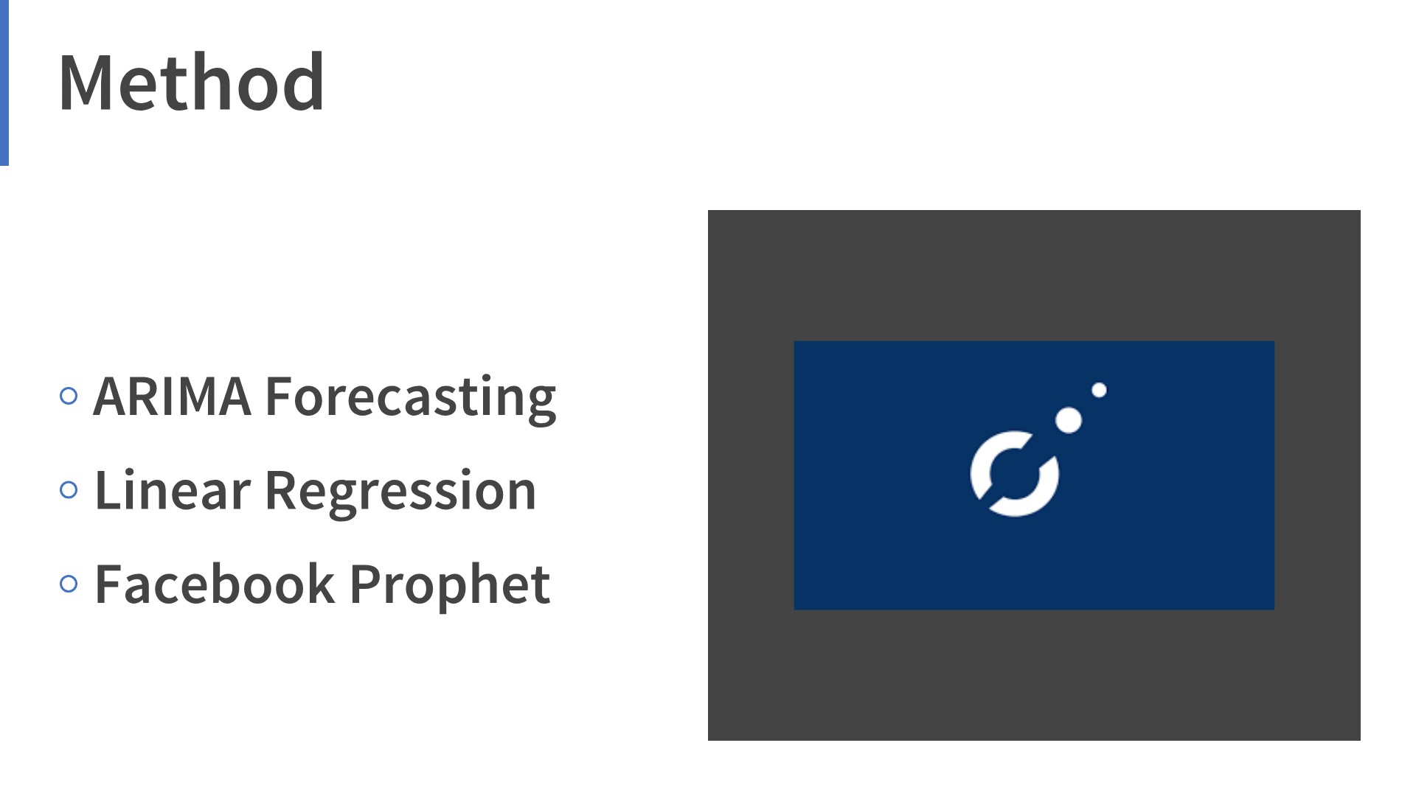

Slide 11
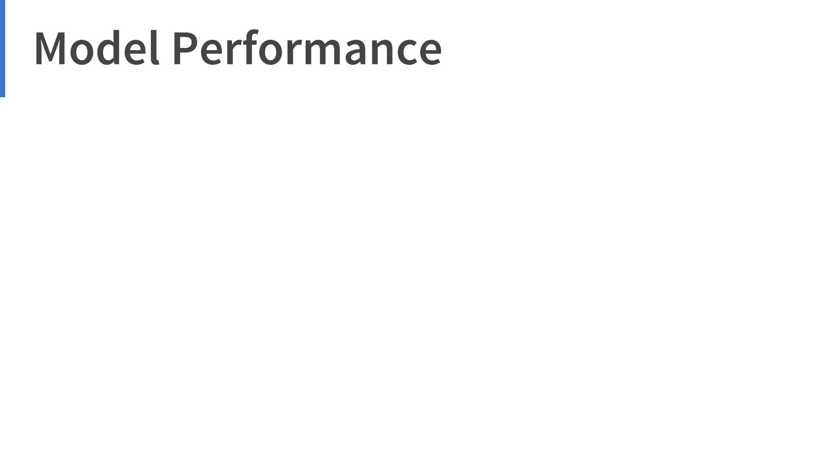
Neighborhood | Best Model | Mean of test set | MAE | % of Incidents
Tenderloin | ARIMA (6,1,7) | 15.4 | 2.35 | 24%
Mission | ARIMA(14,1,2) | 22.6 | 2.91 | 23%
Southern | Random Forest | 24 | 2.75 | 21%
LIA | Random Forest | 17.8 | 1.93 | 13%
Central | OLS | 14.6 | 1.46 | 10%
Northern | Random Forest | 14.2 | 1.57 | 9%

Slide 12
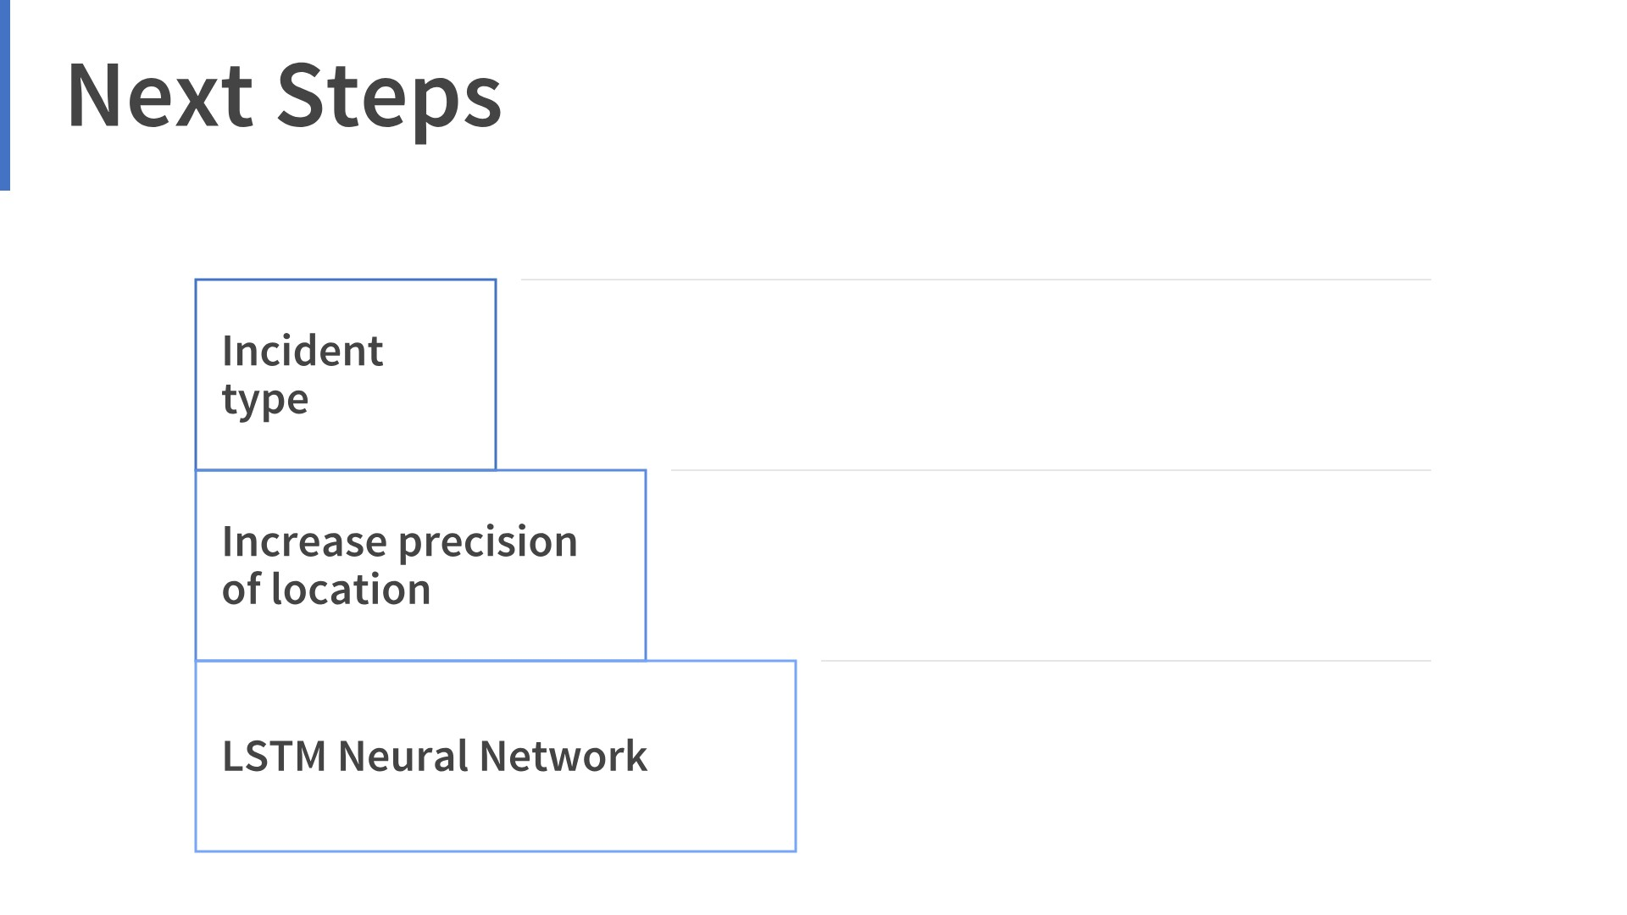

Slide 13


