Slide 1
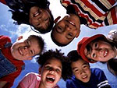

EMOTIONAL DEVELOPMENT

Slide 2
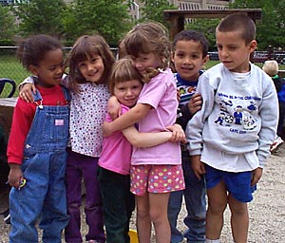
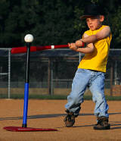
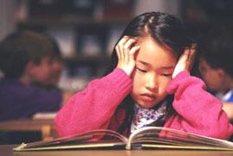
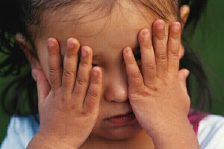
4 Areas of Development...
Human beings develop in 4 different aspects of growth. The areas are all inter-connected, so when one is affected it may influence the others.
Social
Physical
Intellectual
Emotional development involves the recognition and expression of feelings and emotions.
Emotional

Slide 3
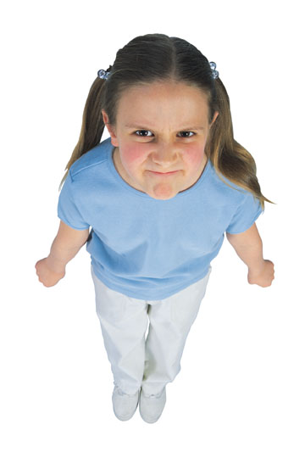
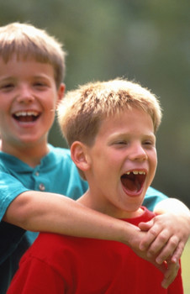
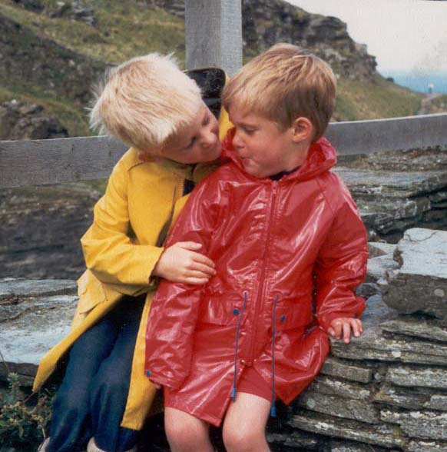
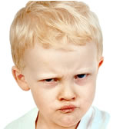
Emotions...
JOY
ANGER
CARING
HATRED
LOVE
Only children know how they feel, and they may not be able to verbally express it; all feelings are valid; children must learn how to control and show feelings; society has expectations of how they should feel and how they should show it
JEALOUSY
HAPPINESS
EMPATHY

Slide 4
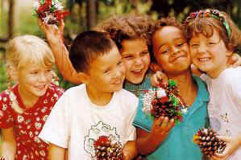
Achieving happiness can be accomplished in several ways. It may be due to an individual “making reasonable progress towards the realization of a goal”, or as the result from positive input into the five different sensory systems (hearing, smelling, vision, touch, tasting).
Happiness...
Being “happy” can be “learned”. Children can discover, within themselves, attitudes and methods of coping with everyday life and challenges that cause them to be happy. The satisfaction they feel stimulates the pleasure center of the brain, which in turn releases chemicals that sustain the feelings of elation.

Slide 5
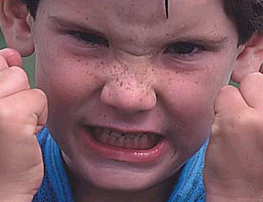
Anger...
Anger is a completely normal, usually healthy, human emotion. Anger usually results from feeling hurt, threatened or frustrated in some way.
To help a child deal with anger, use the old adage of “count to 10”. Anger releases strong chemicals such as adrenaline into the bloodstream and affects judgment. Teach the child to take a couple of minutes to calm down, breathe deeply, and think carefully. They may need to put some space between them and the person that made them angry.
The goal is not to suppress anger but to express it in non-aggressive ways. Blaming, accusations, threats, physical contact and name-calling are aggressive responses. Verbal communication is a passive and a far more effective way to respond in the midst of conflict.

Slide 6
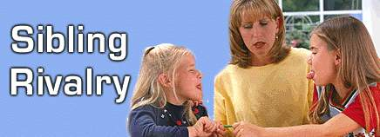
Jealousy becomes a recognizable emotion before the age of 2 years. Jealousy includes feelings of envy, protectiveness, suspicion, or resentment.
Jealousy...
Sibling rivalry is another common form of jealousy. It is a competition between brothers and sisters for the attention or affection of the parents. It often occurs when a new baby is born into the family, or when one child has a health condition that demands a parent’s attention. In older children it is often an issue concerning “fairness” or “equality”.
One of the most common sources of jealousy in the young child is the resentment of affections the mother and father have for each other. The child does not understand that the parents have enough love for everyone.

Slide 7
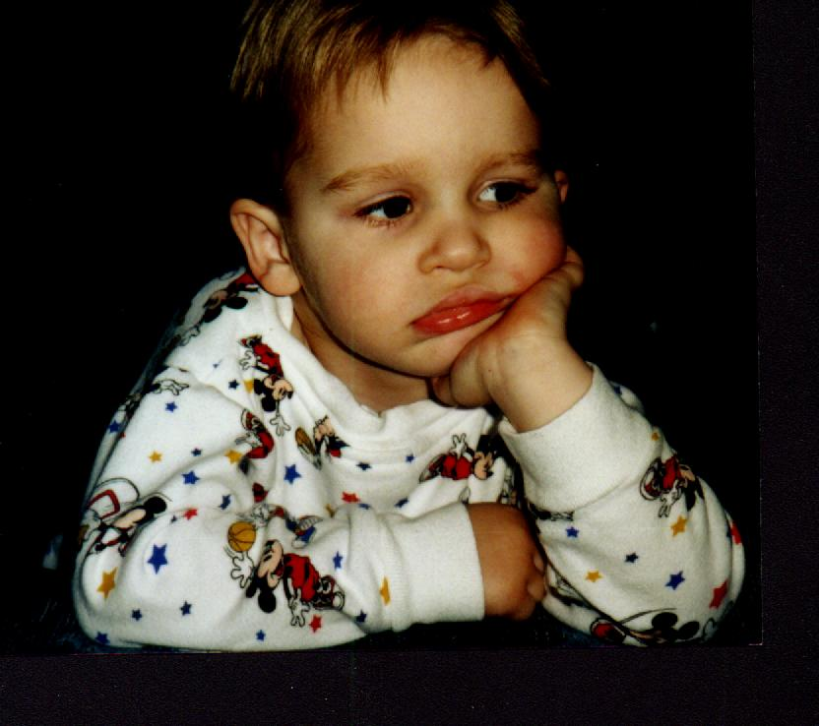
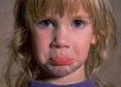
Sadness and depression...
Periods of sadness are to be expected in children, and normal, but most are resilient and memories of distressing situations fade over time and have little or no long-term impact.
Symptoms of depression: frequent sad look, cries often, and frequently talks about sad thoughts and memories, trouble concentrating, prone to angry outbursts, difficulty finding enjoyable activities, changes in eating habits, exhibits attention-getting behavior, develops sleep disturbances, suffers unexplained daytime fatigue, difficulty with peer relationships, school avoidance or school phobia; changes in home relationships and interactions, a desire to be alone most of the time, chronic physical complaints; declining school performance, poor self-esteem.
Heredity, inconsistent parenting, and exposure to negative ways of viewing the world can lead to increased incidence of sadness and excessive/prolonged sadness called depression.

Slide 8
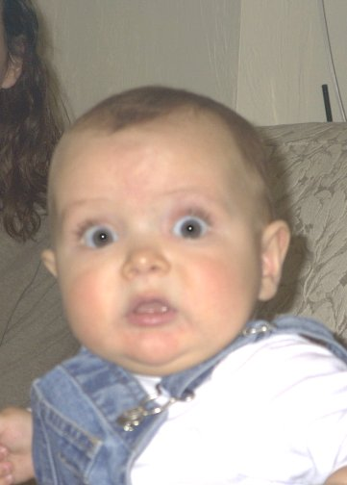

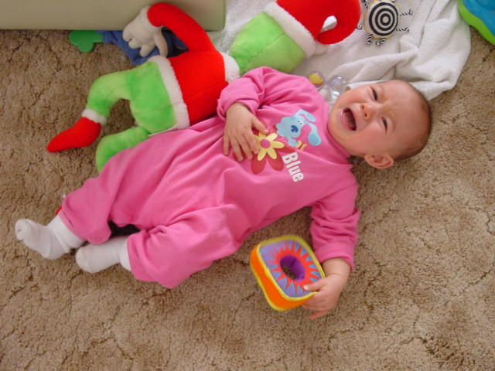
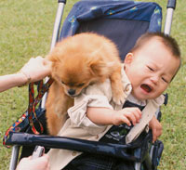
Being fearful and learning to cope with those fears is a major part of emotional development. Fears may be real or perceived. Fear is a protective response, as the child must decide “should I run away or stay and face it?”
Fears...
The emotion of fear is first exhibited early in infancy. The baby expresses reactions of fear to loud noises, sudden movements, or of the sensation of being dropped.
Around 8 months. Children become fearful in social situations involving strangers or being separated from parents. As the child’s mobility increases through crawling, they may become fearful of heights or new sounds.

Slide 9
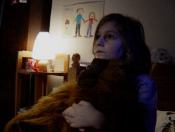

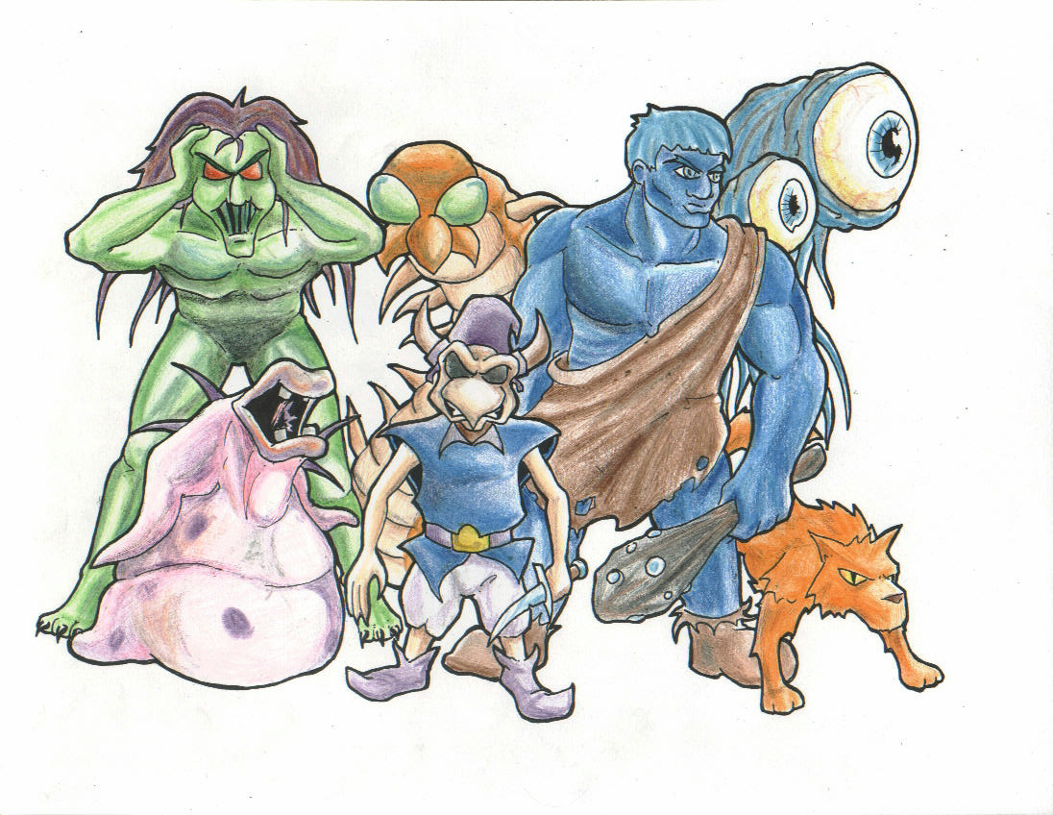

The toddler may fear the dark, animals, stories, monsters, imaginary creatures, and storms.
The focus of the caregiver regarding the toddler’s fears must be two-fold. The toddler must learn to confront imaginary fears, but learn to understand the real and reasonable fears such as strangers, fire, and heights.

Slide 10

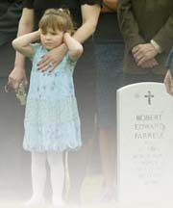
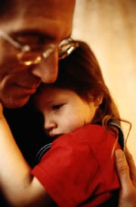
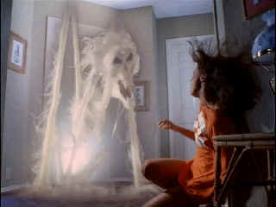
The older school-age child develops new fears based on life’s realities. Personal knowledge or experiences may have introduced fears such as war, divorce, and death. Children need honest answers and enough information to clarify concerns and calm these real fears.
They learn about, and are afraid of the supernatural. This is a time to monitor TV watching.

Slide 11
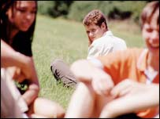
As children approach adolescence, they fear failure or not belonging. Being part of the group and having friends becomes critical at this time.
The adolescent worries about the future, asking questions like “who am I?” and “what will I be?” They may even fear high school graduation when they are expected to make these decisions.

Slide 12
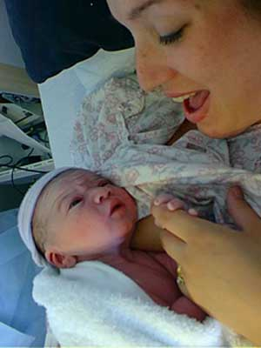

The struggle for independence...
A constant emotional struggle persists throughout the development of the child into an adult. It is the battle between the dependence of childhood and the independence (autonomy) of adulthood. This struggle is normal, but does not happen without conflict.
The parent must monitor their child’s level of maturity and ability to make well-thought out decisions. Until the child is able to live a successful life independently, the parents must maintain control and judgment.
The newborn human infant is totally dependent upon the parent. The job of the parent is to meet the basic human needs of the child, and prepare them to live on their own.

Slide 13
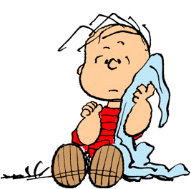
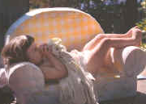
Security blankets...
Security is one of a child’s most basic needs, ranking just above food, water, and shelter. The child who uses the security blanket is balancing the need for security with a desire for independence. The “security friend” is an important way the child has to soothe himself – the way his parents used to soothe him as an infant. With a security friend the child is in control; the child is doing the holding; the “friend” is a source of warmth and comfort.
Children often find the need for a security friend between the ages of 15-18 months. Holding it is often accompanied by other rhythmic movements such as rocking, thumb-sucking, or hair-twirling. The attachment may be temporary, or intense and lasting for years. Most children drop this psychological dependence long before the age of 5.
Research shows no psychological difference in people who had or did not have a security friend during childhood.

Slide 14

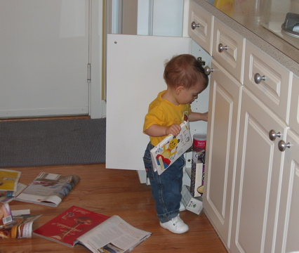
Being naughty...
By the age of 1 year, children recognize the difference between being “good” and being “naughty”. When they know they have been good, they seek a sign of approval. Caregivers can now begin to set limits.
Children naturally test the limits set for them. They may use the word “no”, but continue the unacceptable action anyway. They often do this to fulfill their need for attention. They are not capable of understanding or considerate of another person’s point of view. They are egocentric.

Slide 15
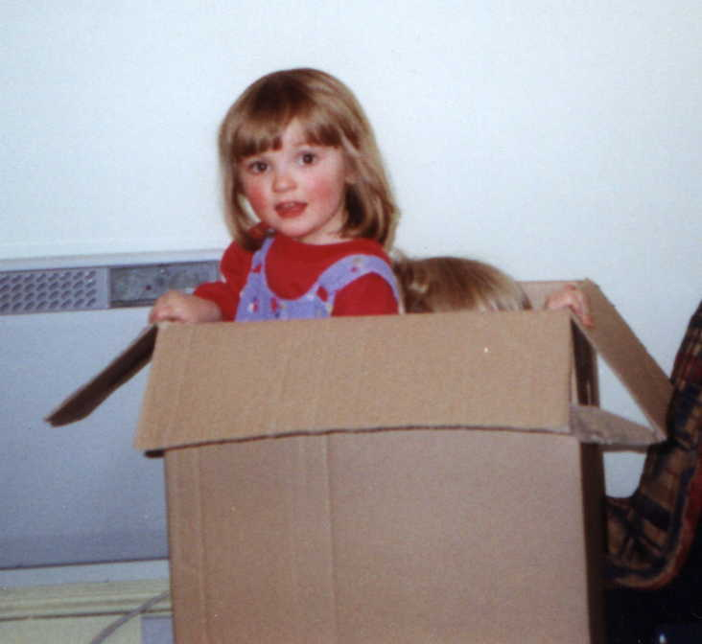
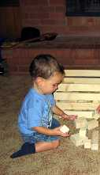
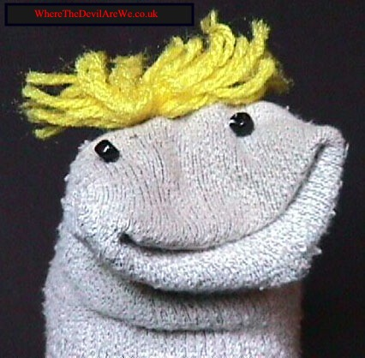
Imagination and creativity...
Using imagination and developing creativity is essential for cognitive, social, and emotional development of children. Creativity is essential for problem-solving.
Symbolic representation: using an object or symbol to represent something else. This is not a sock; it’s a talking creature. This is not a cardboard box, it is an airplane; it’s not a bunch of wooden blocks, they are wild horses.
In order to foster imagination and creativity, adults should allow preschoolers unstructured time for child- directed play and provide a variety of materials. This will help children realize their creative potential, instill a love for learning and develop an internal motivation for completing tasks.

Slide 16
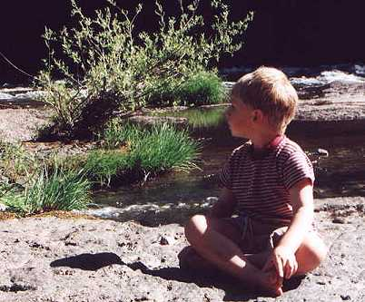
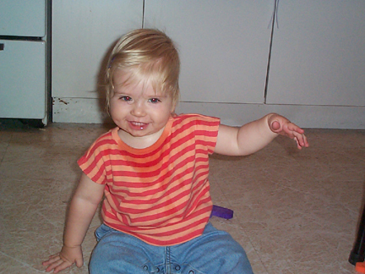
Imaginary friends...
"Imagination is more important than knowledge.
For knowledge is limited to all we now know and understand, while imagination embraces the entire world, and all there ever will be to know and understand."
-ALBERT EINSTEIN
Imaginary friends are created in the minds of children for the purpose of companionship, play, as a scapegoat, someone who consoles, a protector, an extra conscience, or as a way of coping with stress. They show up at around 3 years of age and usually disappear in early elementary school. Having an imaginary friend is rarely a sign of emotional problems, but is simply one form of creativity.

Slide 17

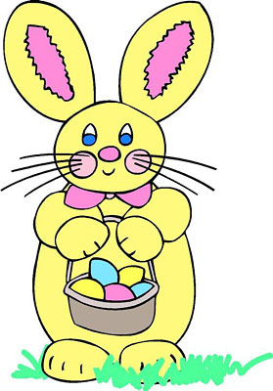
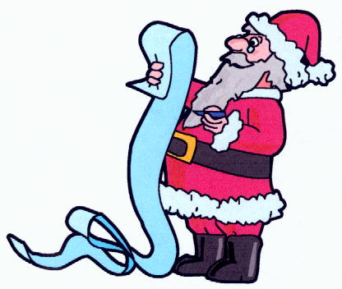
Childhood myths...
The Tooth Fairy, Santa Claus, and the Easter Bunny are examples of folklore mythology which adults know are fiction, but which is sometimes presented to children as fact. Although some parents consider the promotion of such myths as outright lies to their children, who may challenge their credibility at some later date, the psychological community in general does not consider it harmful. Some families participate in the roles of these myths long after the child has discovered the fiction as a form of play or tradition.
There may be some good purposes in promoting childhood myths. The tooth fairy encourages children to look forward to the loss of a tooth, rather than to fear the process. It gives children a reason to give up a part of themselves that they may have grown attached to. They also develop a sense of faith in things unseen, and may help them understand the difference between “real” and “imaginary”.

Slide 18
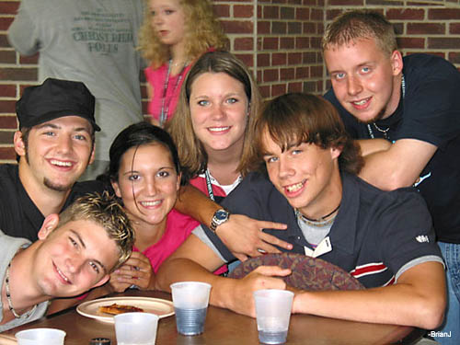
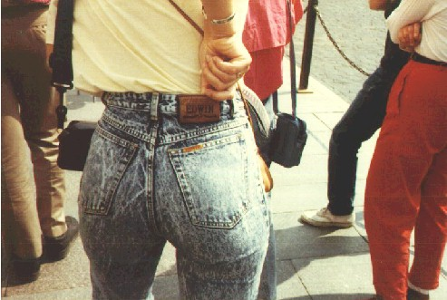
Conformity...
In order to live within a society, a child must be able to follow certain standards and regulations. This is conformity.
Conformity also provides an opportunity for “belonging”, which is critical for self-esteem.
Children use conformity, however, as they strive for greater independence from the parent. Nearing adolescence, the child begins to conform to their friends ideas, separating themselves from their parent’s ideas. They like the same music groups, movies, manner of dress and speech, activities, and video games as their friends. Eventually the child will begin to express their own individuality. If parents overreact, children get defensive.

Slide 19

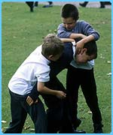
Stress can be positive or negative. It can be a reaction to an exciting or important event such as a major test or big sporting event. This kind of stress, within limits, is positive and can help challenge a person to do their best.
Stress...
Some stress is negative, distress, and can cause feelings of fear, hopelessness, worry, anxiety, and doubt. Mild or moderate levels of distress are normal, and needed to teach children coping skills. Intense feelings of distress can interfere with a person’s ability to function normally.
Common causes of stress in children include conflicts with others, poor health or unhealthy habits, having an overly-full schedule, major life changes such as divorce, death, or moving.

Slide 20
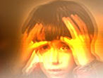
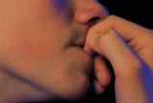
The brain releases stress hormones , one of which is called cortisol.
Symptoms of stress...
A child under stress may exhibit one or more signs:
Loss of interest in previously enjoyed activities
Explosive crying or screaming
Verbal or physical aggressiveness
Cruelty to pets and playmates
Physical symptoms such as rapid heartbeat, headaches, fatigue, restlessness, upset stomach or neck pain
Loss of humor or sense of joy
Nightmares, sleep-walking, or teeth-grinding
Hair twisting, nail biting, stuttering, excessive fidgeting
Threats to harm someone or destroy property
Immersion in computer, e-mail, or TV
Jumpiness or fear of sudden sounds

Slide 21
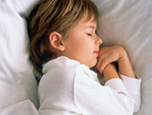
Nightmares are bad dreams, starting between the ages of 3 and 6, and affecting 10 to 50 percent of children. They tend to increase when children are under stress, especially after traumatic experiences, and may reflect how a child views the events of the day. Nightmares tend to occur a few hours before a child awakes, when dreaming is more intense. When awakened by bad dreams, children can often remember some details and may want to talk about them. When you comfort a child during a nightmare, he or she will most likely respond well to your reassurance.
Dreaming...
Dreams are a sequence of images that appear involuntarily while sleeping; often a mixture of real and imaginary characters, places, and events. All human beings dream.
A night terror usually occurs just a few hours after a child falls asleep. He may sit up, struggle, moan, talk or scream. His heart may race and he may sweat. The event can last anywhere from 10 to 30 minutes. The child may not be aware of the parent’s presence, and the child will probably have no memory of waking up at all.

Slide 22

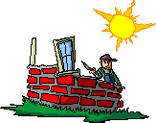







What is a "value"?
A value is a STRONG BELIEF. Developing values and making decisions consistent with those values can influence emotional well-being.
Money or what it can buy
Career
Good health
Miss Popularity
Education
Country
Friends
Religious faith
Family

Slide 23

What are "goals"?
A goal is some point you want to reach within your value system.
There are 2 types of goals: 1. long term goals; they make take months or years to achieve
2. short term goals; they may be accomplished in hours or days
What are "standards"?
Standards are “limits or conditions or the manner” in which you go about reaching your goals.
When expressing standards verbally, you tend to use words like “no matter what…”, “even if…”, “only if…”, “as long as…”

Slide 24
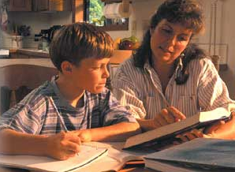
Values are learned...
Goals are achieved.
Children learn values, usually from parents, but influenced by caregivers, friends, teachers, religious leaders, siblings, grandparents, etc. When children are able to set goals within a value system and work successfully to achieve them, it is part of self-actualization or fulfillment. This creates the emotional well-being.

Slide 25
EMOTIONAL DEVELOPMENT

