Slide 1
EMBEDDED SYSTEM DESIGN PROJECT
ESE-4009
Interfacing ultrasonic sensor with beaglebone black
Submitted by:-
Gurdeep Singh (C0751603)
EMBT 4th SEM

Slide 2
IoT based Visitor Counter using Beaglebone Black
LIST OF HARDWARE COMPONENTS USED IN THE PROJECT ARE LISTED BELOW:
BeagleBone Black
Ultrasonic sensors
Temperature Sensor
LCD (16x2)
Buzzer
Wi-Fi Module
Motor Driver
DC Motor

Slide 3
Interfacing ultrasonic sensors with beaglebone black
Hardware Components required for interfacing:
Ultrasonic sensors
Beaglebone black
Jumper wires
Breadboard
Software used for this interfacing are:
Putty
Winscp
eclipse

Slide 4
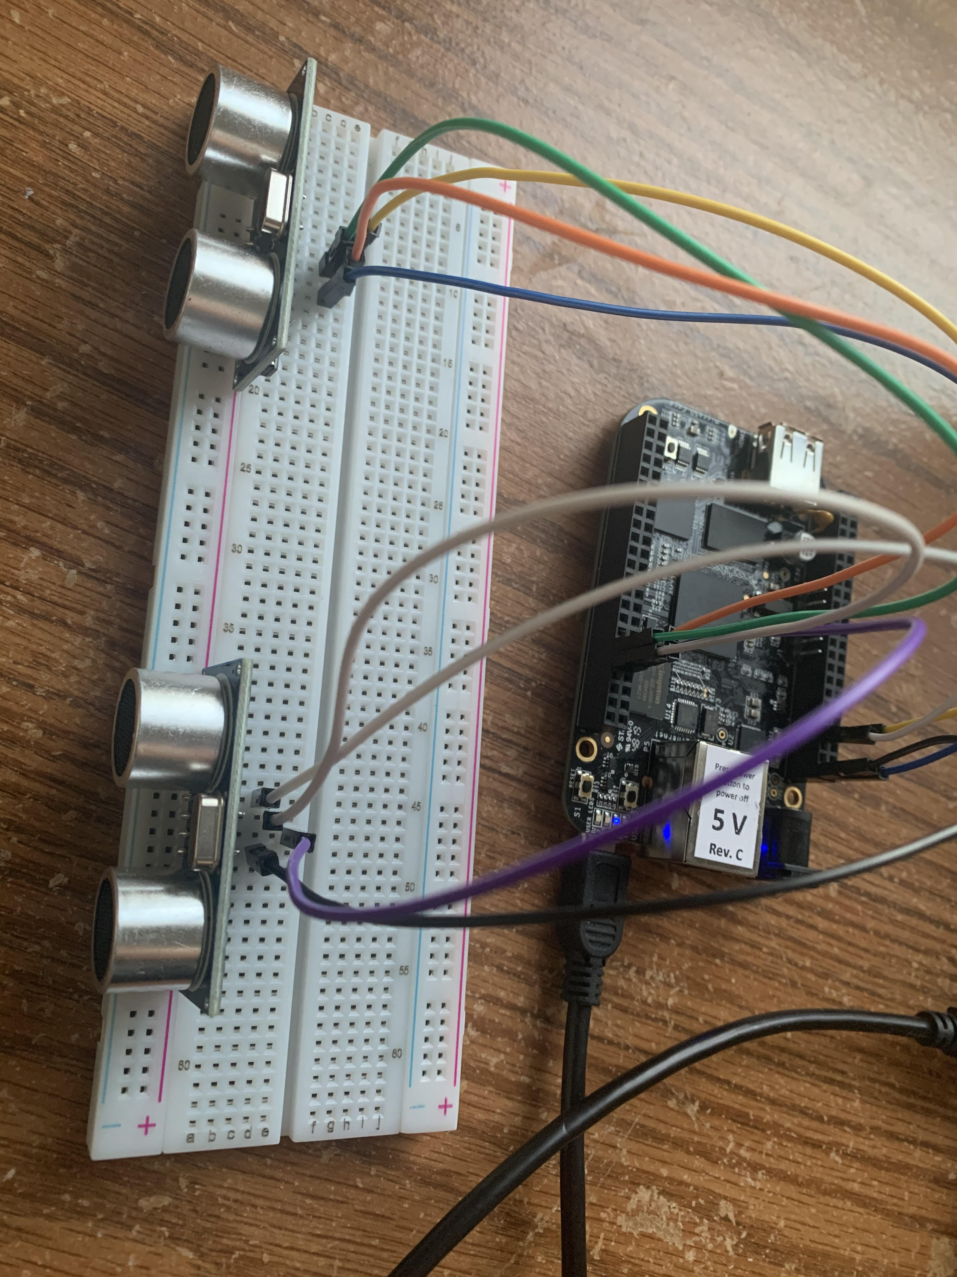

Slide 5
Beaglebone black
Beaglebone is compact, low-cost, open-source Linux computing platforms that can be used to build complex applications that interface high-level software and low-level electronic circuits.
Beaglebone Black Rev C is a development kit based on an AM335x processor which integrates an ARM Cortex™-A8 core operating at up to 1GHz and has abundant peripheral devices.
Processor: AM335x 1GHz ARM® Cortex-A8
512MB DDR3 RAM
4GB 8-bit eMMC on-board flash storage
3D graphics accelerator
NEON floating-point accelerator
2x PRU 32-bit microcontrollers

Slide 6
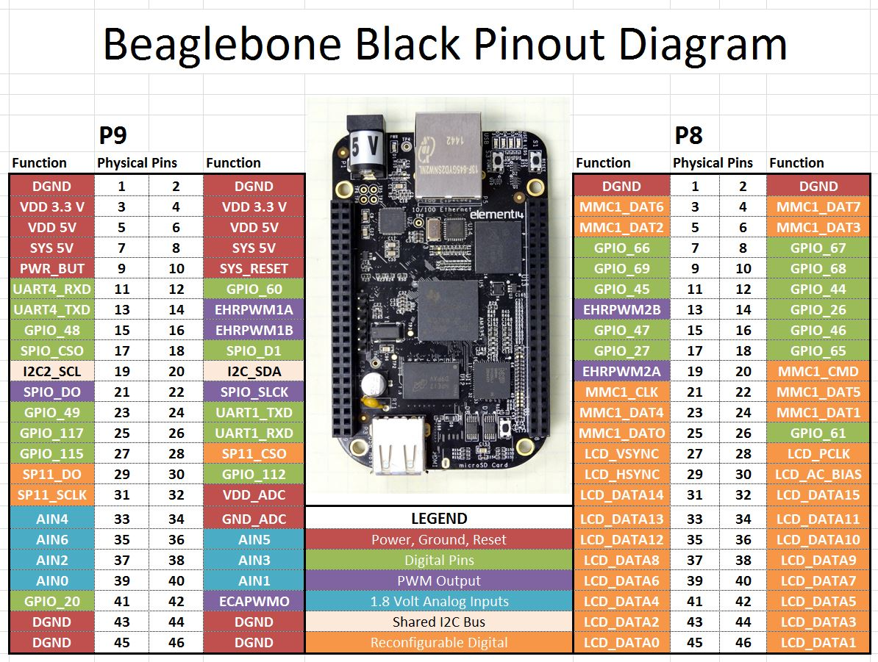

Slide 7
Ultrasonic sensor
Ultrasonic ranging module HC - SR04 provides 2cm - 400cm non-contact
measurement function, the ranging accuracy can reach to 3mm.
The modules includes ultrasonic transmitters, receiver and control circuit.
The basic principle of work:
(1) Using IO trigger for at least 10us high level signal
(2) The Module automatically sends eight 40 kHz and detect whether there
is a pulse signal back.
(3) IF the signal back, through high level , time of high output IO duration
is the time from sending ultrasonic to returning.
Test distance = (high level time×velocity of sound (340M/S) / 2.
This sensor has additional control circuitry that can prevent inconsistent "bouncy" data depending on the application.

Slide 8
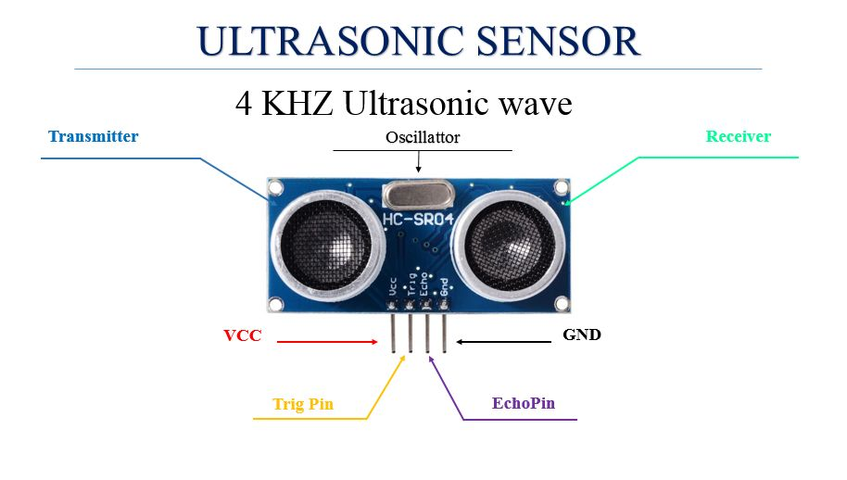

Slide 9
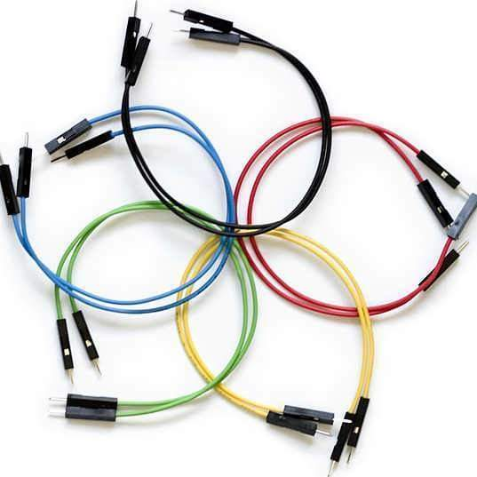
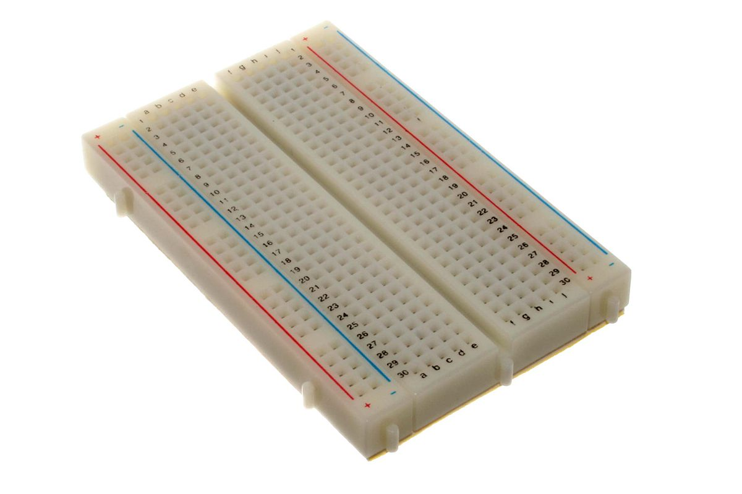
Jumper wires and breadboard

Slide 10
putty
PuTTY is an SSH and telnet client, developed originally by Simon Tatham for the Windows platform.
PuTTY is open source software that is available with source code and is developed and supported by a group of volunteers.
PuTTY was originally written for Microsoft Windows, but it has been ported to various other operating systems.
PuTTY comes bundled with command-line SCP and SFTP clients, called "pscp" and "psftp" respectively, and plink, a command-line connection tool, used for non-interactive sessions.

Slide 11
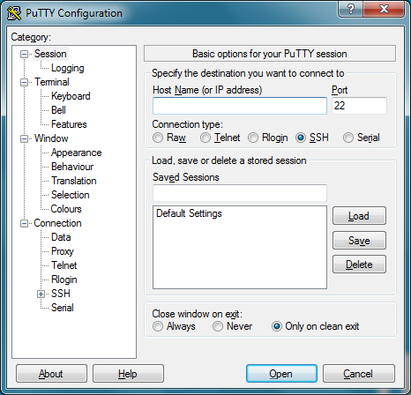

Slide 12
WInscp
WinSCP (Windows Secure Copy) is a free and open-source SFTP, FTP, WebDAV, Amazon S3 and SCP client for Microsoft Windows.
Its main function is secure file transfer between a local and a remote computer.
For secure transfers, it uses Secure Shell (SSH) and supports the SCP protocol in addition to SFTP.
It provides limited remote command execution and scripting capabilities.
WinSCP is based on the implementation of the SSH protocol from PuTTY and FTP protocol from FileZilla.

Slide 13
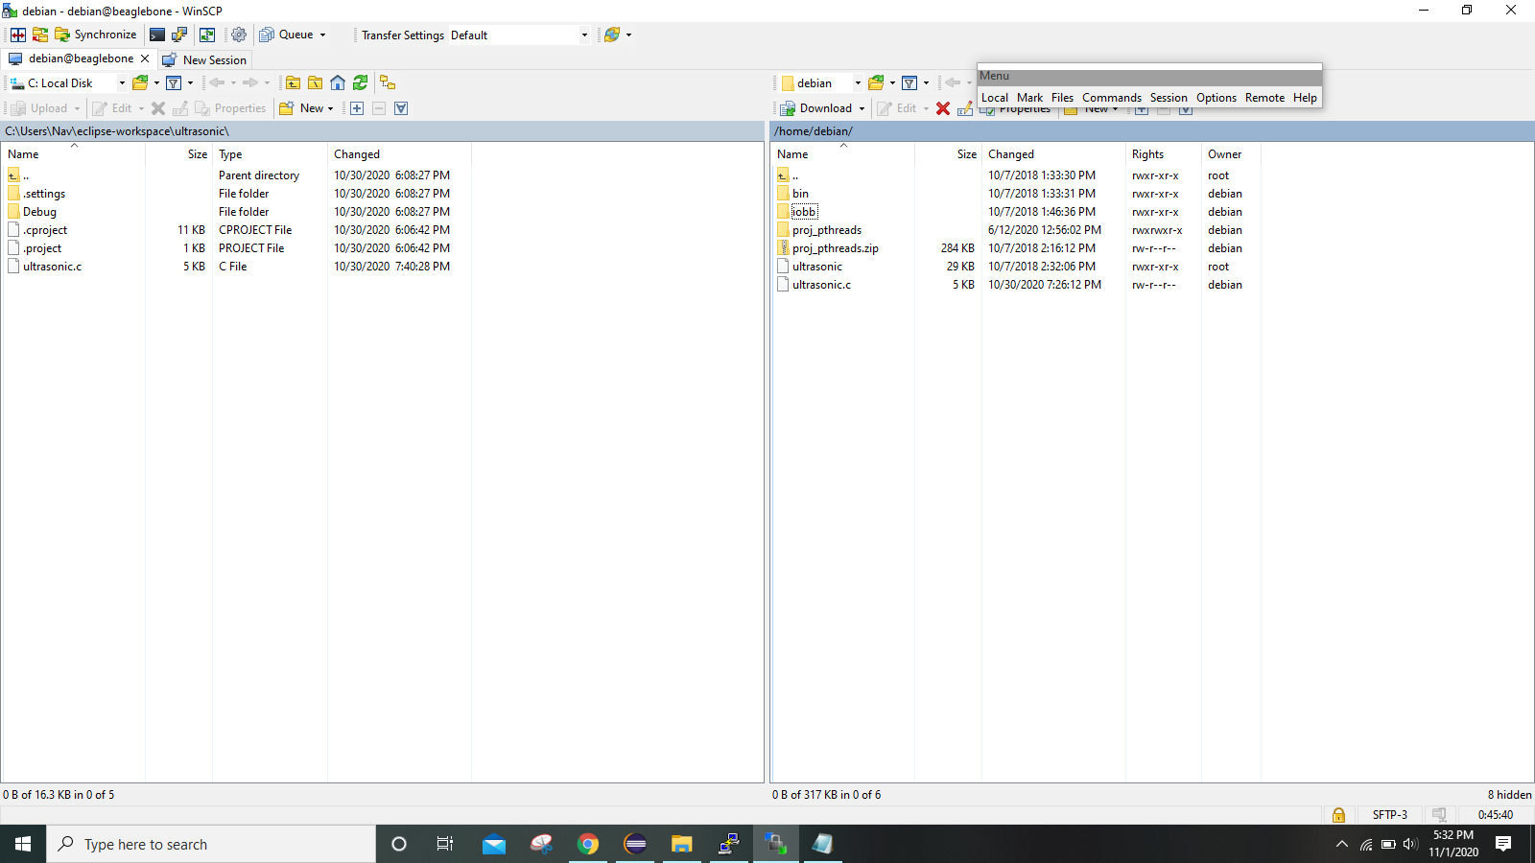

Slide 14
eclipse
Eclipse is an integrated development environment (IDE) used in computer programming.
Eclipse is written mostly in Java and its primary use is for developing Java applications, but it may also be used to develop applications in other programming languages via plug-ins, including Ada, ABAP, C, C++, C#, JavaScript, PHP, Python, R, Rust, Scala, and Scheme.
Eclipse software development kit (SDK) is free and open-source software, released under the terms of the Eclipse Public License, although it is incompatible with the GNU General Public License.

Slide 15
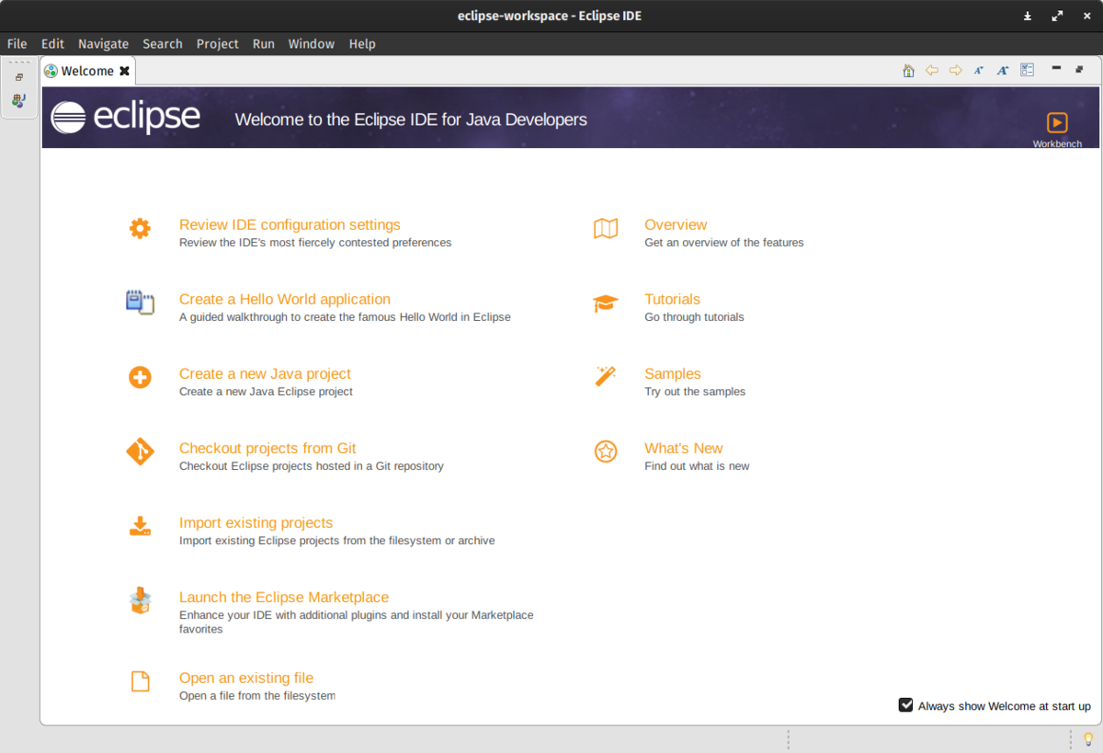

Slide 16
connections
Ultrasonic sensors are connected to GPIO pins of the beaglebone.
Ultrasonic sensor for entry is connected to GPIO P8, echo is connected to pin 9 and Trig is connected to pin 10.
Ultrasonic sonic for exit is connected to GPIO P8, echo is connected to pin 11 and Trig is connected to pin 12.
Vcc for the ultrasonic sensors for entry and exit are connected to pin 5 and 6 of P9.
Ground for the ultrasonic sensors for entry and exit are connected to pin 1 and 2 of P9.

Slide 17
Working
There are two ultrasonic sensors used for both entry and exit.
Both the sensors continuously measure distance of obstacles in front of them.
Range of ultrasonic sensor is set for 15 cm.
If a person comes inside range of sensor 1 it will be counted as person entered inside.
If a person comes inside range of to sensor 2 it will be counted as person exit.
A limit of 10 person is set, if already 10 persons are inside other persons have to wait outside until someone exit.

Slide 18


Slide 19
references
PuTTY. (n.d.). Retrieved from Wikipedia, the free encyclopedia: https://en.wikipedia.org/wiki/PuTTY
shabaz. (2019, August 14). BeagleBone Black (BBB) and PocketBeagle I/O (GPIO), SPI and I2C Library for C – 2019 Edition. Retrieved from element14: https://www.element14.com/community/community/designcenter/single-board-computers/next-genbeaglebone/blog/2019/08/15/beaglebone-black-bbb-io-gpio-spi-and-i2c-library-for-c-2019-edition
WinSCP Review and Download. (n.d.). Retrieved from ssh.com: https://www.ssh.com/ssh/winscp/
https://github.com/shabaz123/iobb

Slide 20
Thank You

