Slide 1
SOEN 6611 – Deliverable 2
iBank: Problems 4 to 6
Software Measurement – 6611
Team-E
Jeyasurya Chandrasekaran
Harmanjot Singh
Fall 2026

Slide 2
Agenda
Problem 4(a): Implementing iBank in Java
Problem 4(b): Testing iBank with representative data
Problem 5: Physical and Logical SLOC
Problem 6: Source code readability
AI interaction log
Conclusion and references
Declaration

Slide 3
Problem 4(a): iBank Architecture
Layered, object-oriented design (Java 17, Swing)
OOP principles applied
ui (21 classes)
Screen (template method) · 11 screens · AbmController · UiKit · KeypadPanel · AccountChooser
Abstraction: Account is abstract; ChequingAccount and SavingsAccount define their own overdraft rule.
Encapsulation: Money stores cents in an immutable value object; balances change only through credit and debit.
Polymorphism: every screen overrides Screen.build(); every error is an IbankException with its own message key.
Dependency inversion: services depend on the BankHost interface and an injected java.time.Clock.
Single responsibility: one class per use case group, e.g. CashDispenser only plans and removes notes.
Use-case traceability: UC1 to UC16 of D1 map to service methods and screens (named in Javadoc).
service (13 types)
AuthenticationService · TransactionService · OperatorService · CashDispenser · ComplianceMonitor · AuditLog
«interface» BankHost
InMemoryBankHost (simulated)
model (13 types)
Money · Account · Card · Client ...
Cross-cutting: exception (12) · security (2) · i18n (1) · data (1)
64 production files · 287 methods · 52 JUnit tests.
Entry point IbankApp wires the objects (manual dependency injection, no framework).
Notes:
iBank is layered: Swing UI talks only to the controller; the controller calls services; services work on the domain model and reach the bank through the BankHost interface, so the simulated host can be replaced by a real one.

Slide 4
Problem 4(a): Generality, Security, Usability
Generality
Security
Usability
Configurable rules: AbmConfig builder holds limits ($500, $1,000 per day), $20 unit, 3 PIN tries, 30 s timeout, $100 cheque availability, $10,000 report level.
Any note mix: CashDispenser searches combinations of any denominations loaded (e.g. $20 and $50).
Pluggable host: BankHost interface; InMemoryBankHost simulates the network (D1 A6).
Several actors: iBank clients, other-bank clients, staff.
Languages: adding one is a new .properties file.
PIN storage: PBKDF2-HMAC-SHA256, 120,000 iterations, random salt; constant-time comparison.
PIN entry: masked field; char[] wiped after use; never logged.
Card lock: after 3 wrong PINs (UC11); stays locked.
Weak PINs refused: 1111, 1234, 9876, length < 4.
Least privilege: other-bank cards see only withdraw and balance.
Masking: receipts and audit log show only last 4 digits.
Compliance: 24-hour cash aggregate of $10,000 flagged (UC12).
Bilingual: English and French for every screen and error.
Large controls: 52 px buttons, 18 pt text, high contrast.
Accessible: screen-reader names on every control; full keyboard use; on-screen keypad.
Guidance: remaining daily limit shown before a withdrawal; quick amounts.
Idle timeout: session ends after 30 s; card returned.
Receipts: optional (UC10).
Notes:
Each column answers one of the three product qualities the project asks for.

Slide 5
Problem 4(a): Exceptions and Error Messages
Checked exception hierarchy
Exceptional behaviour → helpful message (examples)
IbankException
messageKey + arguments
Situation | Message shown (EN; FR also available)
Wrong PIN, 1st try | The PIN is not correct. You have 2 attempt(s) left before the card is locked.
3rd wrong PIN | Card **** 1234 is locked for your protection ... contact your bank.
$30 withdrawal | Withdrawals must be in multiples of $20.00.
Over daily limit | This exceeds your limit. You can withdraw up to $380.00 now.
Amount "12a" | "12a" is not a valid amount. Use digits only, e.g. 120 or 120.50.
Low balance (FR) | Fonds insuffisants. Vous pouvez utiliser jusqu'à 150,75 $ ...
ABM out of service | This ABM is temporarily out of service. No money was moved.
New PIN 1234 | This PIN is too easy to guess. Avoid repeated or consecutive digits.
AuthenticationException
CardLockedException
CardNotFoundException
InsufficientFundsException
LimitExceededException
InvalidAmountException
CashUnavailableException
ServiceNotAllowedException
AccountNotFoundException
InvalidPinFormatException
OutOfServiceException
all extend IbankException
Flow: service throws → AbmController.perform() catches → Messages.describe(e) → dialog.
Safety: a failed dispense reverses the debit; RuntimeException is logged, client sees error.unexpected.
Uncaught errors: default handler writes to the audit log.
Notes:
All business failures are checked exceptions under IbankException. Each carries a message key; the controller turns it into a helpful message in the client's language. Unexpected runtime errors are logged and the client sees a safe generic message.

Slide 6
Problem 4(a): Reuse and Programming Style
Internal reuse (within iBank)
External reuse (outside iBank)
Reused element | Used by
Screen (template method) | All 11 screens: title, form rows, buttons, rebuild on language change
UiKit | Every button, label and field (one look and feel)
AccountChooser | Balance, withdraw, deposit, transfer, pay bill
KeypadPanel | PIN entry (any text field can use it)
Money | All amounts: parsing, arithmetic, CAD formatting
AbmController.perform | One error-handling path for all transactions
IbankException | 12 exception types share message-key logic
Java SE 17: Swing (GUI), JCA PBKDF2 and SecureRandom, ResourceBundle and MessageFormat (i18n), NumberFormat (CAD), java.time Clock, java.util.logging.
JUnit 5 (Jupiter): unit and parameterized tests.
Apache Maven, Checkstyle: build and style checking.
Style and IDE independence
Style: Google Java Style Guide [9]; Checkstyle google_checks.xml reports 0 violations.
Readability aids: Javadoc on public types, no magic numbers, all user text in resource files.
No IDE needed: plain javac via build.sh / build.bat, or Maven (standard layout); no IDE files in the project.
Notes:
Internal reuse avoids duplicated code inside iBank; external reuse relies on the Java platform and well-known libraries instead of writing our own.

Slide 7
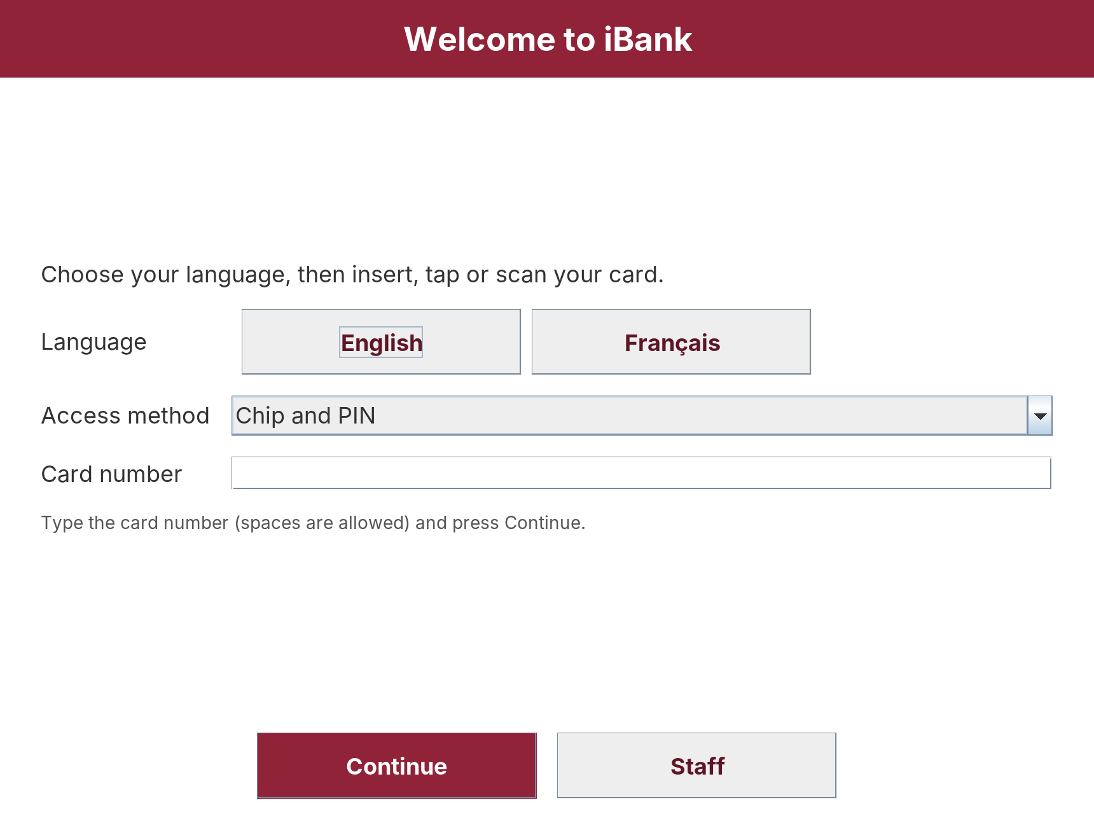
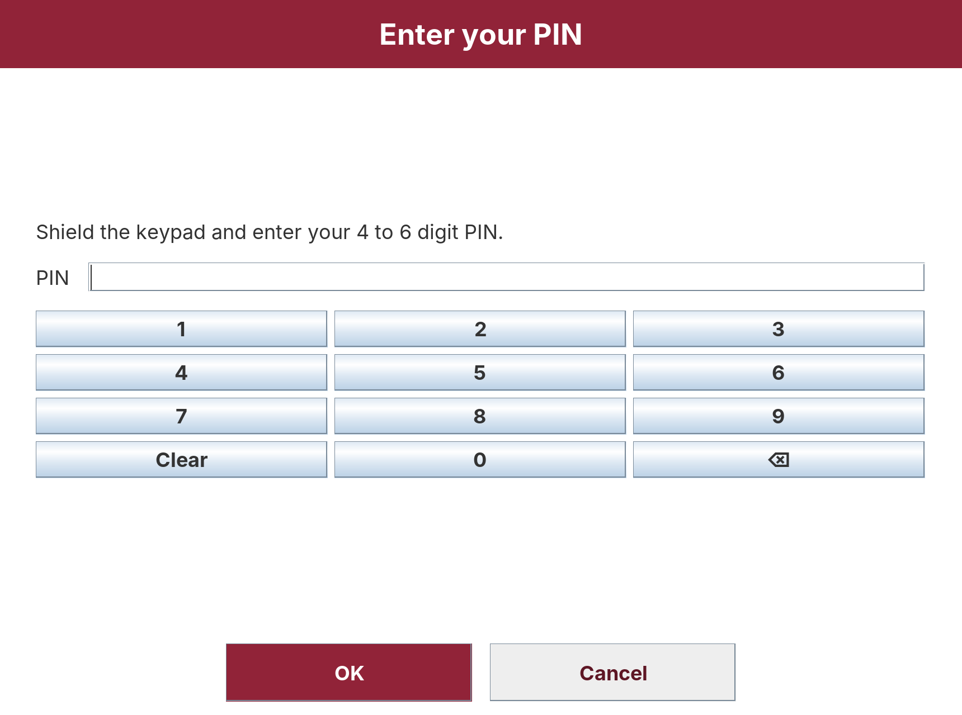
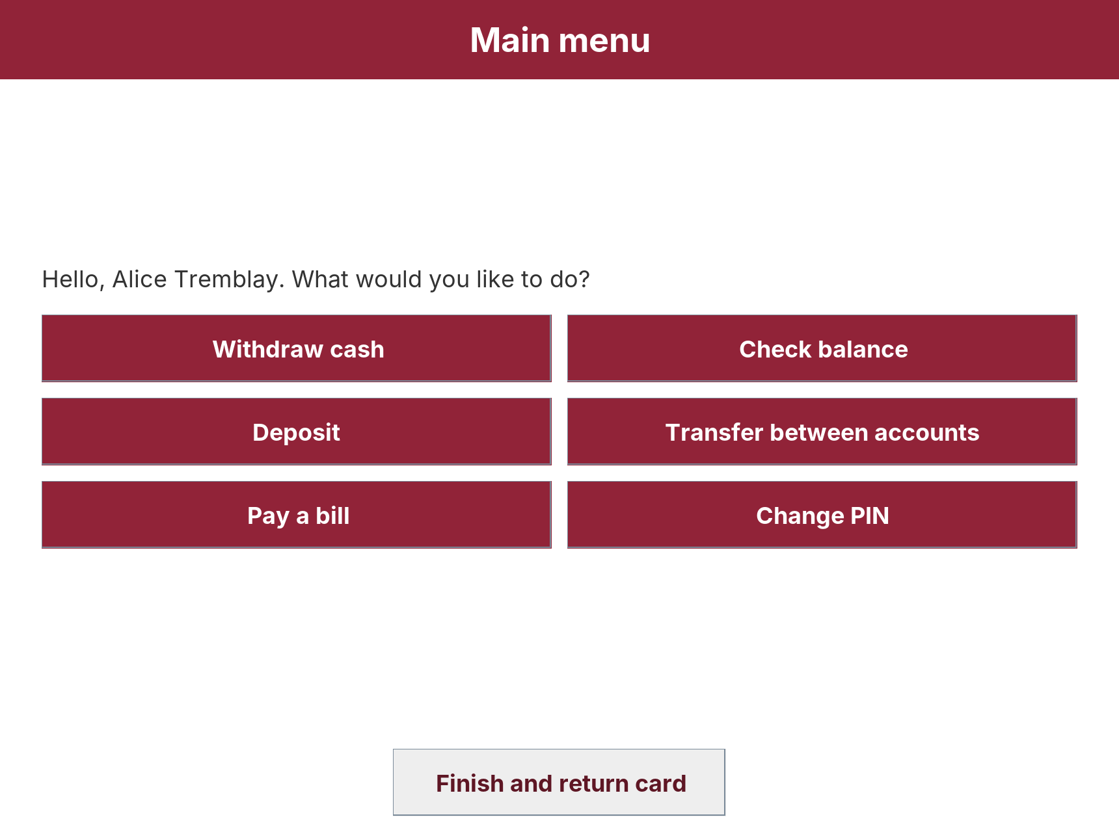
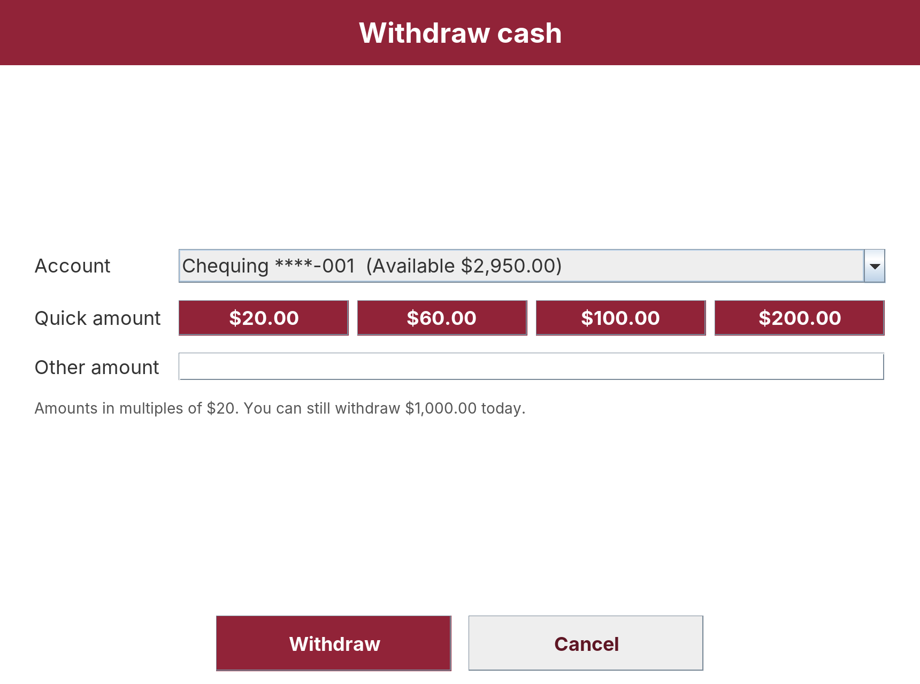
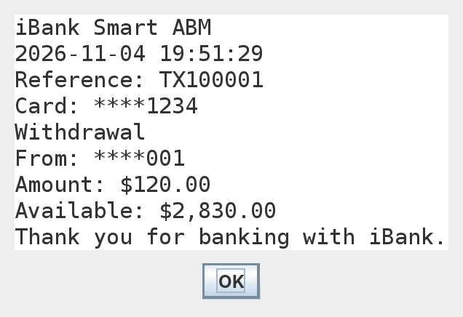
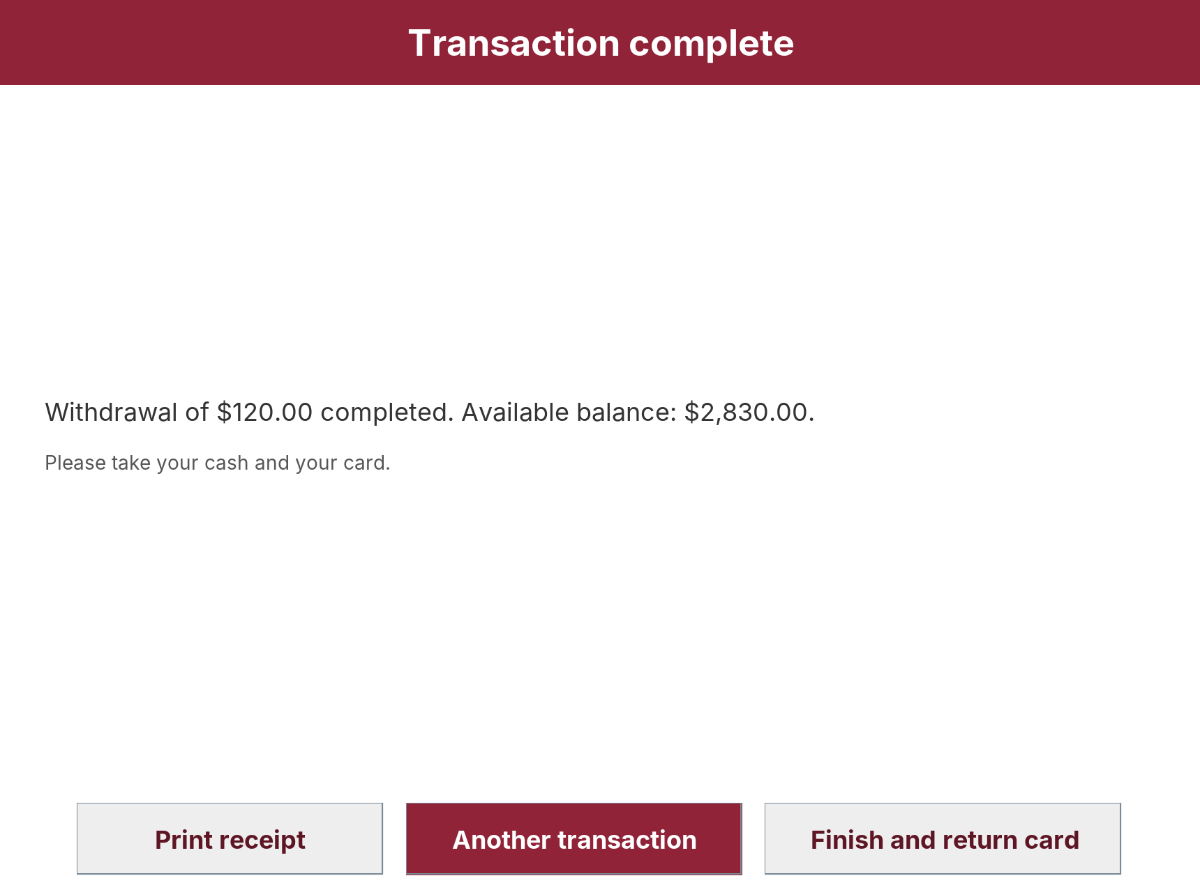
Problem 4(a): Graphical User Interface (Swing)
UC8: PIN + keypad
UC1, UC8: language, access method, card
Main menu (iBank client)
Masked receipt
UC2: quick amounts, remaining limit
Result, UC10 receipt option
Notes:
Main flow of UC2 Withdraw Cash: welcome, PIN, menu, withdraw, result. The welcome screen offers English or French and three access methods.

Slide 8
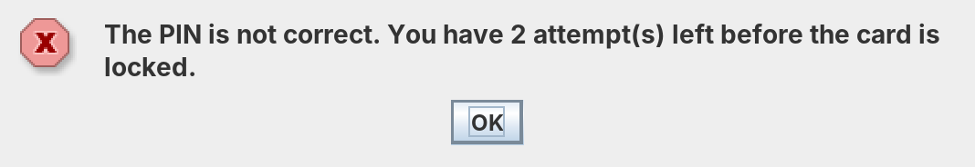
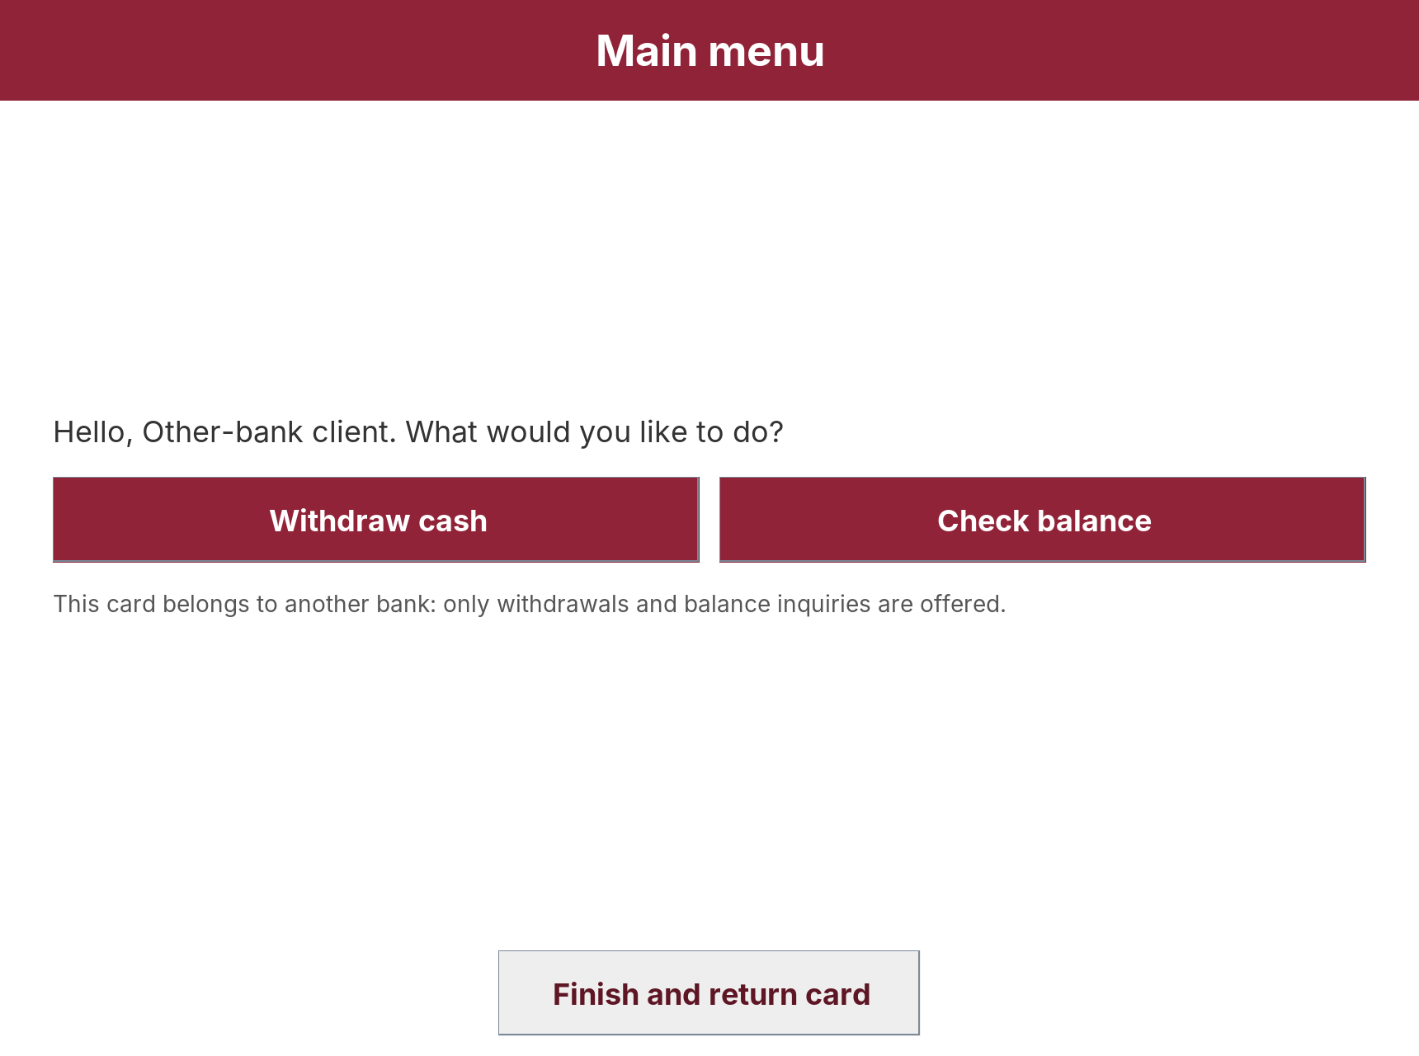
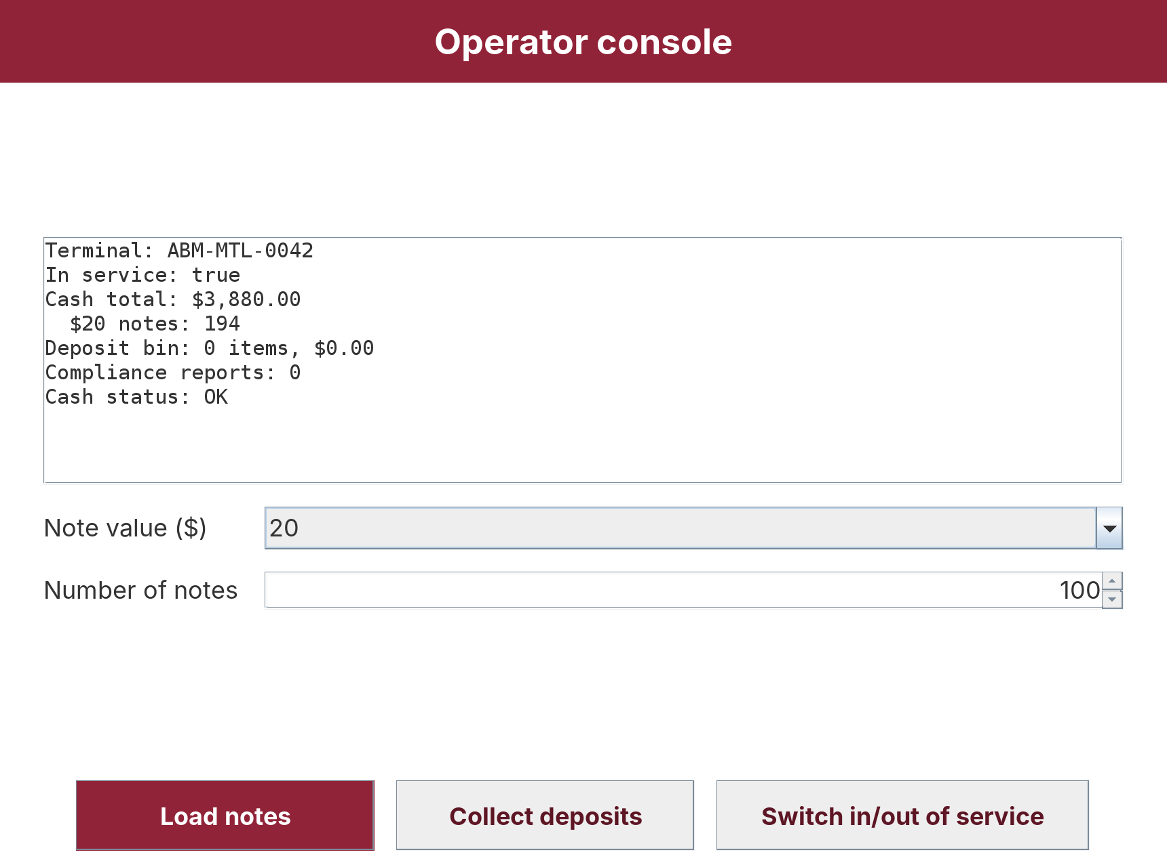
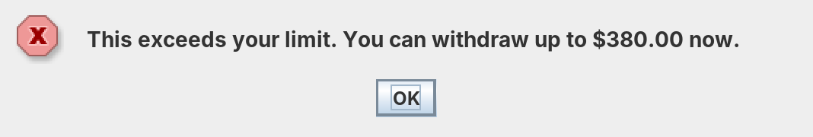
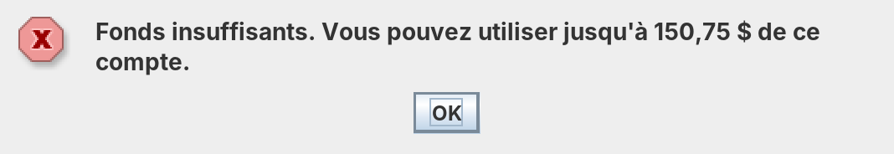
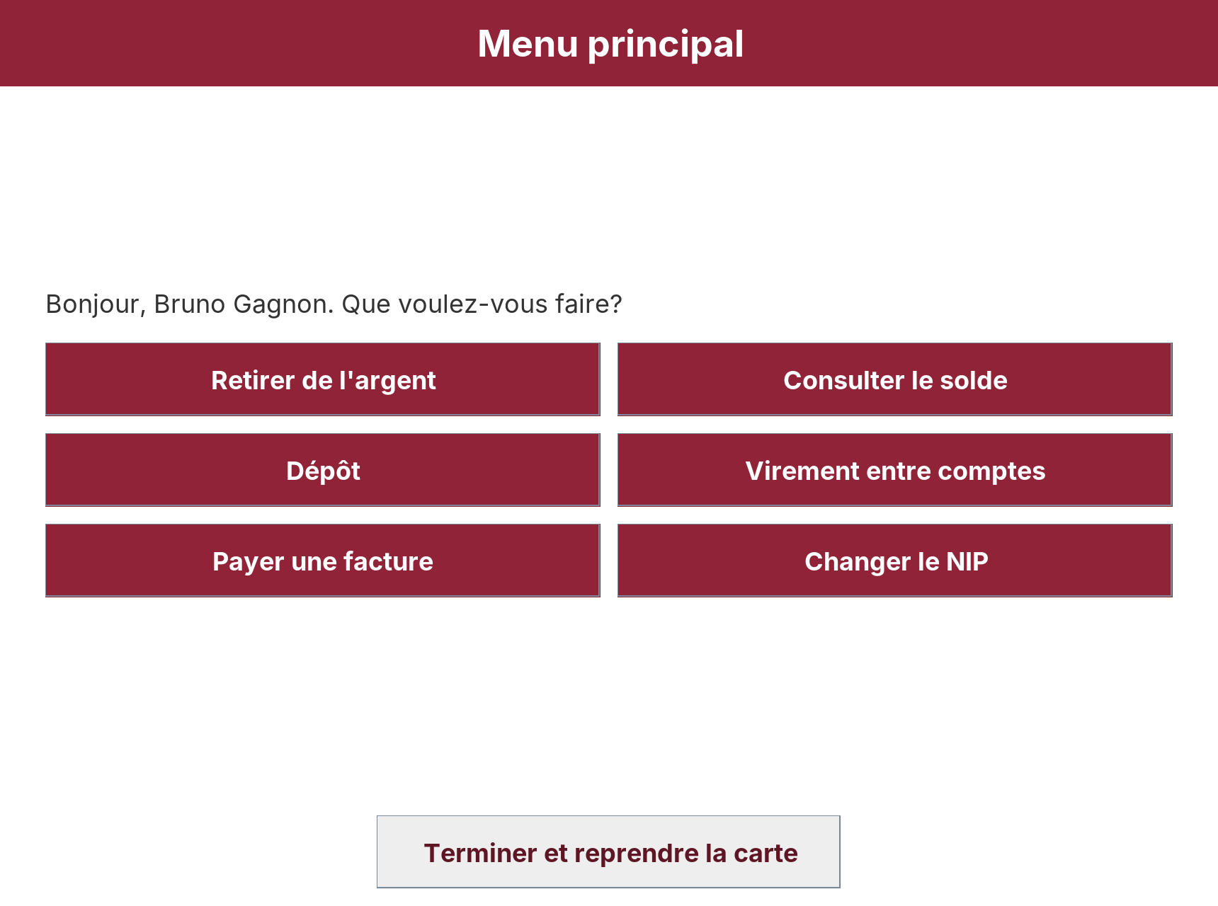
Problem 4(a): GUI – Errors and Other Actors
Wrong PIN: attempts left
Daily limit: amount still allowed
Other-Bank Client: 2 services only
Staff: UC13–UC15 console
French menu: Bruno's card opens the session in French (Menu principal, Retirer de l'argent ...).
Inactivity: after 30 s the session closes and the card is returned (info dialog).
Staff console: separate operator login (UC16); load notes, collect deposits, diagnostics, in/out of service.
Same error in French
Notes:
Errors appear as dialogs in the client's language and say what to do next. Other-bank clients see only two services. Staff use a separate console.

Slide 9
Problem 4(b): Test Strategy and Data
Representative data (SampleData, fictional)
Card | PIN | Holder | Why it is representative
4520 0000 0000 1234 | 2468 | Alice (iBank, EN) | Chequing $2,450 + $500 overdraft, savings $8,000, 2 payees: main flows
4520 0000 0000 5678 | 1357 | Bruno (iBank, FR) | Balance $150.75 (cents): insufficient funds, French text
5100 0000 0000 9012 | 8642 | Other-bank client | Restricted services (D1 Other-Bank Client)
4520 0000 0000 3456 | 9753 | Dana (iBank) | Card already locked
Staff CUST01 | 7391 | Cash custodian | Operator use cases UC13–UC16
Techniques
Levels
Equivalence classes: valid / invalid amounts (empty, text, negative, 3 decimals).
Boundary values: $500 vs $520; $1,000 daily; 3rd PIN; $9,999 vs $10,000 cash; $100 cheque hold.
Use-case scenarios: main flow and extensions 2a, 4a, 5a of D1 Withdraw Cash.
Controlled time: injected clock moves to the next day to test the daily limit reset.
Automated: JUnit 5, 52 tests (6 classes) on model, security and services; test code kept in src/test.
GUI: manual scenario runs on every screen in EN and FR; screenshots on the previous slides.
Static: Checkstyle, 0 violations.
Notes:
Representative data covers each actor kind and the boundaries of each rule. All data are fictional.

Slide 10
Problem 4(b): Test Results
Test class | Tests | Examples of what is checked
TransactionServiceTest | 14 | Withdraw debits and dispenses; $30 rejected; $520 over limit; daily limit resets; cheque hold $900 of $1,000; same-account transfer; $10,000 flagged once
MoneyTest | 15 | "120,50" and "$40" parse; "", "abc", "-20", "10.001" rejected; EN/FR formats
SecurityTest | 9 | Salted hashes differ; weak PINs 1111/1234/9876 refused
AuthenticationServiceTest | 5 | 2 tries left, then lock; lock survives right PIN; no PIN in audit log
CashDispenserTest | 4 | $140 = 2×$50 + 2×$20; $60 found by backtracking; refusal keeps notes
OperatorAndMessagesTest | 5 | Operator login; all 108 keys exist in FR; masked receipt
52 / 52
tests passed
0
Checkstyle violations
16 / 16
D1 use cases implemented
Defect found by testing: a parameterized case for "120,5" (French decimal comma) was misread by the test's CSV source; fixed by quoting the value. Manual GUI testing found long error text cut off in dialogs and a truncated French button label; both fixed (text wrapping, button width from text).
Limits: GUI tested manually, not automated; the host is simulated, so network faults are not covered.
Notes:
Command: mvn test. All 52 tests passed (0 failures, 0 errors, 0 skipped).

Slide 11
Problem 5: SLOC Counting Scheme
Physical SLOC
Worked example: CardIssuer.java (manual count)
One per line holding at least one code token.
Not counted: blank lines, comment-only lines.
A line with code and a trailing comment counts.
Lines with only a brace count (they hold a token).
package ca.concordia.ibank.model; P1 L1 (R1)
/** Who issued a card. ... */ – –
public enum CardIssuer { P2 L2 (R3)
IBANK, P3
OTHER_BANK; P4 L3 (R1)
/** Returns true if ... */ – –
public boolean allows(TransactionType service) {
P5 L4 (R3)
return this == IBANK || service == TransactionType.WITHDRAWAL
P6 L5 (R1)
|| service == ...BALANCE_INQUIRY; P7
} P8
} P9
Logical SLOC (one per logical statement)
R1 each ';' outside parentheses: statement, field, import, package, abstract method (so for(;;) counts once).
R2 each if, else (not else if), for, while, do, switch, case, default, try, catch, finally.
R3 each class, interface, enum, method or constructor declaration with a body.
R4 an enum constant list without ';'.
Not counted: braces, annotations, comments, lambda arrows.
Result: 16 lines = 3 blank + 4 comment + 9 physical; 5 logical. The tool gives the same numbers (row CardIssuer in sloc_per_class.csv).
Scope: all 64 Java files in src/main/java (UI, sample data and app included). Excluded: test code (src/test, 546 lines), .properties text, build scripts, tools/measure.py.
Notes:
Scheme based on the SEI framework for counting source statements [1] and the USC SLOC counting standard [2]. Counted with our script tools/measure.py, which tokenizes Java so that comments and string contents are not miscounted.

Slide 12
Problem 5: Physical and Logical SLOC of iBank
2,349
Physical SLOC
1,763
Logical SLOC
Line category (all files) | Lines
Total lines | 3,107
Blank | 488
Comment only | 270
Physical SLOC | 2,349
Logical: R1 semicolons | 1,287
Logical: R2 control keywords | 122
Logical: R3 declarations | 353
Logical: R4 enum lists | 1
Logical SLOC (R1+R2+R3+R4) | 1,763
Largest classes: TransactionService (168 P / 121 L), AbmController (153 / 121).
Per-class data feed WMC correlation in D3.
Notes:
Totals: 2349 physical SLOC and 1763 logical SLOC in 64 files. Logical is about 75% of physical, because statements spanning lines and closing braces add physical lines only.

Slide 13
Problem 6(a): Selecting a Readability Metric
Learned from human ratings
Buse–Weimer 2010 [3]: 25 features; needs trained tool
Selection criteria
Simpler size / entropy model
Posnett et al. 2011 [4]: 3 features, open formula
C1 peer-reviewed, validated on human ratings
C2 transparent, reproducible formula
C3 applies to Java methods
C4 has an interpretable threshold
C5 continues D1 GQM Q2 (Buse–Weimer data)
Source code
readability metrics
Textual + structural
Scalabrino et al. 2018 [5]: needs tool and identifiers' semantics
Prose-style formulas
SRES, Börstler et al. 2016 [6]: no validated code thresholds
Understandability
Cognitive Complexity [7]: control flow, overlaps v(G) in D3
Selected: Posnett et al. meets C1–C5; Buse–Weimer fails C2 (tool not available), Scalabrino C2, SRES C1/C4, Cognitive Complexity measures a different attribute.
Notes:
We compared readability metrics against five criteria and selected the Posnett-Hindle-Devanbu model.

Slide 14
Problem 6(b): Readability Measure of iBank
Metric (Posnett, Hindle and Devanbu [4])
z = 8.87 − 0.033·V + 0.40·L − 1.5·H
Readability = 1 / (1 + exp(−z)), in (0, 1)
V Halstead volume N·log₂(n) [8]; operands = identifiers and literals, operators = keywords, operators, separators.
L lines of the method (header to closing brace).
H Shannon entropy (log₂) of the method's token frequencies.
Threshold: ≥ 0.5 = readable (more likely readable than not).
65%
methods ≥ 0.5
0.88
median
0.62
mean
187 of 287 methods readable. 47 of 61 classes have a mean score ≥ 0.5.
Per-method values: measurements/readability_per_method.csv.
Notes:
Readability is computed for every method and constructor with a body (287 in total).

Slide 15
Problem 6(c): Qualitative Conclusions
What the thresholds tell us
Lowest-scoring methods (refactoring candidates)
Mostly readable: 65% of methods score ≥ 0.5, median 0.88: most methods are short accessors, constructors and one-task methods.
Length dominates: 1–3 lines: 140/144 readable; 4–6: 46/80; ≥ 7 lines: 1/63. V grows faster than the +0.40·L bonus.
Model limit: it was fitted on short snippets [3], [4], so it is strict with longer, still clear methods; it ignores names and comments.
Not a quality verdict: a low score marks a candidate for review, not a defect; results must be read with the D3 metrics v(G), WMC, LCOM*.
Action for D3: split the long methods on the right (e.g. one helper per form row group, sample data per client) and re-measure.
Class.method | L | V | z
SampleData.populate | 28 | 2383 | -65.98
WelcomeScreen.build | 38 | 2402 | -63.01
OperatorScreen.build | 35 | 2098 | -53.7
WithdrawScreen.build | 25 | 1728 | -45.38
ReceiptFormatter.format | 18 | 1648 | -44.57
DepositScreen.build | 28 | 1626 | -40.56
Why low: these are screen builders and the sample-data builder: long straight-line code creating many widgets or objects; their volume V is above 1,600.
Why acceptable for now: each does one job in straight-line code and has tests; splitting them would raise readability without changing behaviour.
Notes:
The threshold 0.5 separates short, simple methods from long ones. The model was fitted on short snippets, so for long methods a low score says 'consider splitting', not 'unreadable'.

Slide 16
AI Interaction Log
Part | Tool and example prompt (CASTROFF-based) | Output and evaluation
P4 | Claude (Anthropic), in Claude Code. "Context: SOEN 6611 D2, iBank from our D1 use case model. Role: senior Java developer. Task: implement iBank in Java Swing with OOP, checked exceptions, EN/FR messages, JUnit 5 tests. Format: Maven project. Constraints: no IDE files, Google Java Style." | Draft idea or syntax to implement the code. Evaluated: we ran 52 tests and Checkstyle, tried every screen in EN/FR, fixed cut-off dialogs and a French label, renamed classes to meet the style guide.
P5 | Claude. "Context: iBank source. Task: write a counting script for Physical and Logical SLOC following SEI/USC rules; exclude tests. Format: CSV per class plus totals." | Script and counts. Evaluated: rules R1–R4 written out by us; CardIssuer counted by hand and matched the tool.
P6 | Claude. "Context: readability metrics for Java. Task: compare candidates as a mind map, apply the chosen one per method, explain the thresholds. Style: cite peer-reviewed sources." | Mind map and scores. Evaluated: formula coefficients cross-checked with secondary sources citing ; conclusions on length bias written by us.
Non-use | AI did not choose the final metric, the thresholds or the test data values. | Team made these choices and reviewed all AI output.

Slide 17
Conclusion
Problem 4: iBank is implemented in Java Swing (64 files, 16 use cases, EN/FR) and passes 52/52 tests.
Problem 5: 2,349 Physical SLOC and 1,763 Logical SLOC (tests excluded).
Problem 6: Posnett et al. readability: 65% of methods ≥ 0.5; long methods are the candidates for refactoring.
Next (D3): v(G), WMC, CF, LCOM*, UCP and COCOMO 81, SLOC–WMC correlation.
References
[1] R. E. Park, “Software size measurement: A framework for counting source statements,” SEI, CMU/SEI-92-TR-20, 1992.
[2] V. Nguyen, S. Deeds-Rubin, T. Tan, and B. Boehm, “A SLOC counting standard,” in COCOMO II Forum, 2007.
[3] R. P. L. Buse and W. R. Weimer, “Learning a metric for code readability,” IEEE Trans. Softw. Eng., vol. 36, no. 4, pp. 546–558, 2010.
[4] D. Posnett, A. Hindle, and P. Devanbu, “A simpler model of software readability,” in Proc. MSR 2011, pp. 73–82, doi: 10.1145/1985441.1985454.
[5] S. Scalabrino, M. Linares-Vásquez, R. Oliveto, and D. Poshyvanyk, “A comprehensive model for code readability,” J. Softw. Evol. Process, vol. 30, no. 6, e1958, 2018.
[6] J. Börstler, M. E. Caspersen, and M. Nordström, “Beauty and the beast: On the readability of object-oriented example programs,” Softw. Qual. J., vol. 24, pp. 231–246, 2016.
[7] G. A. Campbell, “Cognitive Complexity: A new way of measuring understandability,” SonarSource, 2018.
[8] M. H. Halstead, Elements of Software Science. New York, NY, USA: Elsevier, 1977.
[9] Google, “Google Java Style Guide.” [Online]. Available: https://google.github.io/styleguide/javaguide.html
[10] M. S. Turan et al., “Recommendation for password-based key derivation,” NIST SP 800-132, 2010.
[11] Proceeds of Crime (Money Laundering) and Terrorist Financing Act, S.C. 2000, c. 17 (Canada).

Slide 18
Declaration
I certify that all AI interactions for this submission are completely and accurately documented in this log. All content derived from or inspired by AI has been independently evaluated and modified as per AI Interaction Log.
Team-E: Jeyasurya Chandrasekaran, Harmanjot Singh

