Slide 1

Housing Price Prediction
Presented by
Kaipu Sai Priya – 4368386
Nitika – 4373067
Sai Kiran Varada– 4370413
Harmanpreet Singh- 4370867

Slide 2
TABLE OF CONTENTS
PROJECT OVERVIEW
ESSENTIAL ELEMENTS FOR DATASET
DATA INFORMATION
DATA PROCESSING
EXPLORATORY DATA ANALYSIS
MODEL BUILDING
MODEL EVALUATION
MODEL COMPARISON
CONCLUSION

Slide 3
PROJECT OVERVIEW
The project aims to forecast home prices using machine learning. The Boston housing prices dataset includes a variety of variables, such as property taxes, crime rates, community features, and the number of rooms, that affect housing costs. Making more educated judgments can be facilitated by precise forecasts for investors, homeowners, and real estate agents.
MYHOME
REAL ESTATE

Slide 4
Essential Element for Data Set
Variable Information:
CRIM: Per capita crime rate by town.
ZN: Proportion of residential land zoned for large lots.
INDUS: Proportion of non-retail business acres per town.
CHAS: Charles River dummy variable (1 if tract bounds river; 0 otherwise).
NOX: Nitrogen oxide concentration (parts per 10 million).
RM: Average number of rooms per dwelling.
AGE: Proportion of owner-occupied units built prior to 1940.
DIS: Weighted distance to major employment centers.
RAD: Index of accessibility to radial highways.
TAX: Full-value property tax rate per $10,000.
PTRATIO : Pupil-teacher ratio by town.
B: Proportion of Black residents.
LSTAT: Percentage of lower status of the population.
MEDV: Median value of owner-occupied homes in $1,000s.

Slide 5
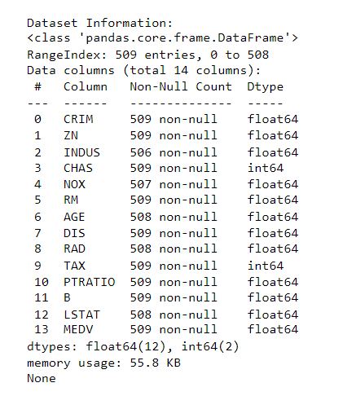
Data Information
The Data Frame contains 509 entries with 14 columns, containing data on housing conditions, town attributes, environmental factors, lifestyle and economic indicators, and social aspects. Environmental factors like nitrogen oxide concentration, average rooms per dwelling, and the proportion of owner-occupied units built before 1940 are also included. It provides a comprehensive perspective on housing-related factors, useful for examining patterns in different towns, despite missing values in 'INDUS', 'NOX', 'AGE', 'RAD', and 'LSTAT'.

Slide 6
Data Processing
The process of preprocessing data involves preparing the dataset for machine learning. It entails addressing missing numbers, eliminating outliers, and cleansing the data.
Managing Missing Values
To handle missing values in the dataset, we filled gaps in numerical attributes like 'AGE' and 'RM' by appending mean or median values. This approach ensured data integrity, accounting for about 5% of the data, allowing for comprehensive analysis without significant loss of information.
Handling Outliers
Outliers were identified in features like 'CRIM' (crime rate) and 'TAX' (tax rate) using the Interquartile Range (IQR) method. Despite identifying over twenty potential outliers, we chose not to remove them recognizing that these extreme values might represent real-world scenarios that provide valuable insights.
Feature Engineering
Feature engineering involves creating new attributes from existing ones to enhance the model's accuracy. For this dataset, features such as 'tax-to-age' and 'age-to-room' ratios were introduced, offering additional context and improving the model's predictive performance.

Slide 7

Managing Missing Values
To handle missing values in the dataset, we filled gaps in numerical attributes like 'AGE' and 'RM' by appending mean or median values. This approach ensured data integrity, accounting for about 5% of the data, allowing for comprehensive analysis without significant loss of information.

Slide 8
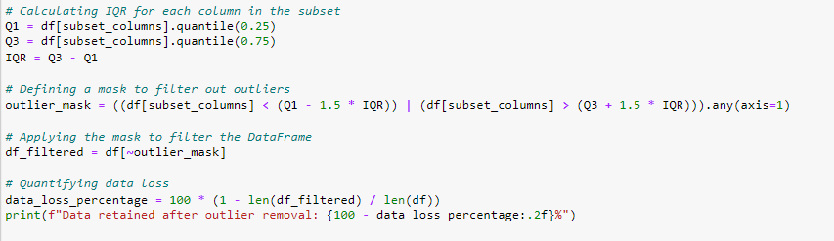
Handling Outliers
The Interquartile Range (IQR) method was used to identify outliers in 'CRIM' (crime rate) and 'TAX' (tax rate) in the housing dataset, revealing over twenty potential outliers. We decided not to remove these outliers, recognizing they could represent realistic data points that provide valuable insights into areas with unique characteristics, like high crime rates or unusual tax scenarios.

Slide 9
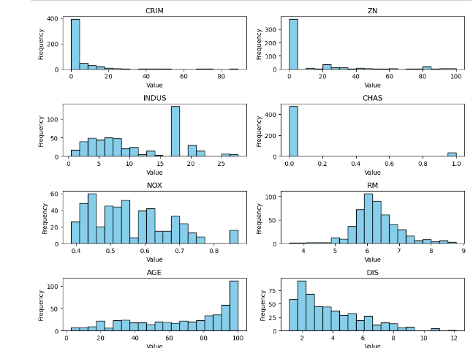
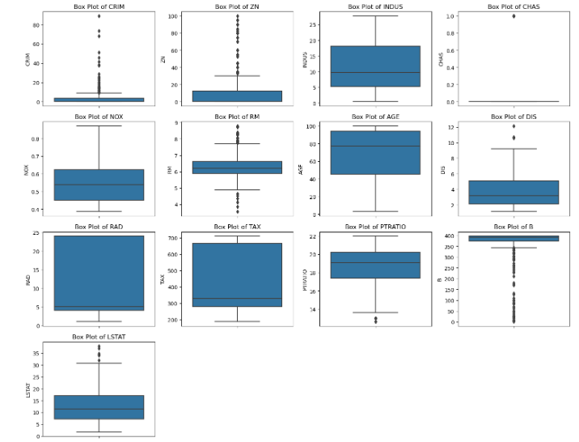
Exploratory Data Analysis (EDA)
Exploratory Data Analysis (EDA) is a useful tool for figuring out patterns and connections as well as the structure of the information. We investigated the data and discovered correlations between attributes using a variety of visualization approaches.
Histograms
Box plots

Slide 10
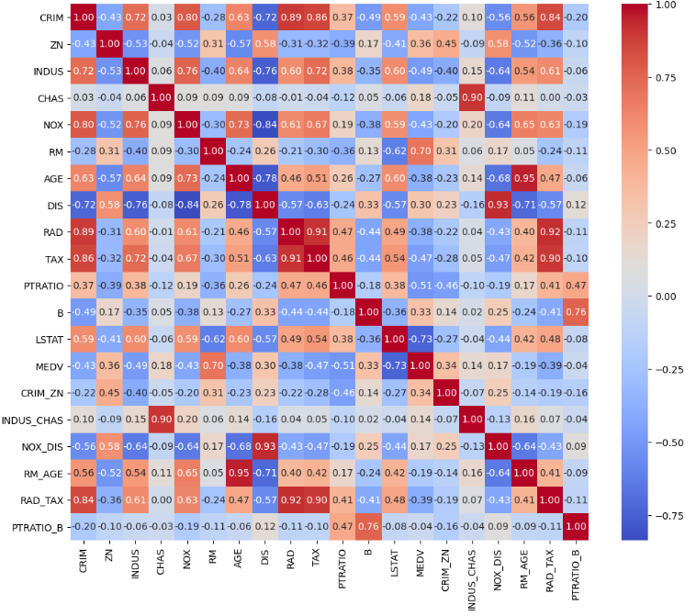
Correlation Analysis
The analysis of the housing dataset revealed strong positive correlations between features like 'RAD' and 'TAX', while negative correlations suggested higher pollution levels. Significant correlations were found between 'RM' and 'MEDV', and 'LSTAT' showed an inverse correlation.

Slide 11
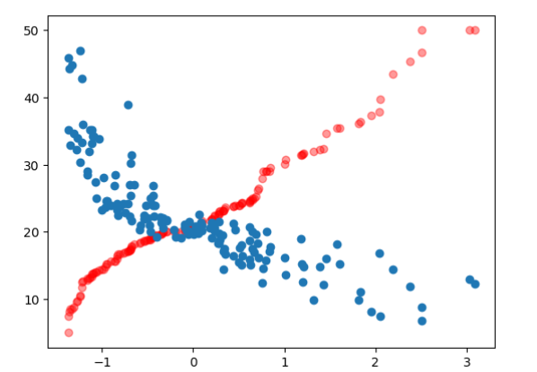
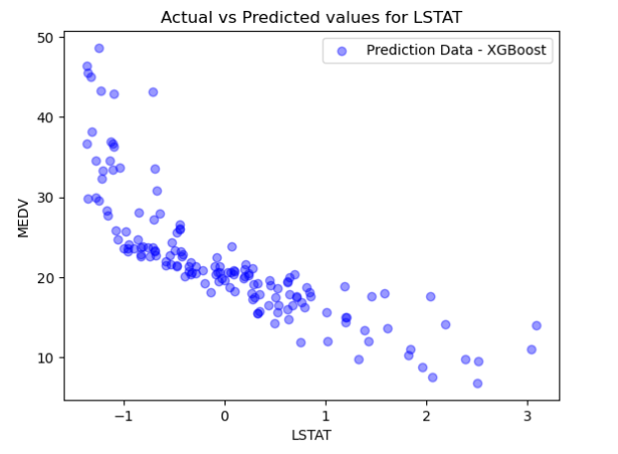
Model Building
Building the machine learning models was the next step once We had preprocessed the data and realized how the characteristics related to one another. We decided on XGBoost and RandomForestRegressor, two well-liked algorithms.
RandomForestRegressor
XGBoost Regressor

Slide 12
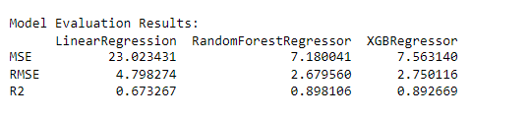
Model Evaluation
The effectiveness of our machine learning algorithms was assessed using Mean Squared Error (MSE), Root Mean Squared Error (RMSE), and the R-squared (R²) statistics.
Linear Regression: Reported an MSE of 23.023, an RMSE of 4.798, and an R² of 0.673, showing a moderate fit to the data with a basic linear approach.
Random Forest Regressor: Achieved an MSE of 7.524, an RMSE of 2.783, and an R² of 0.890, indicating that its ensemble method with multiple decision trees offers a much better fit.
XGBoost Regressor: Recorded an MSE of 7.563, an RMSE of 2.750, and an R² of 0.893, slightly outperforming Random Forest in RMSE and R², though with a marginally higher MSE.

Slide 13
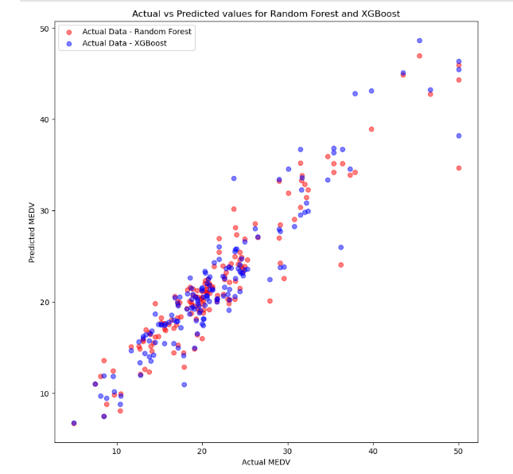
Model Comparison
A comparison of Random Forest and XGBoost models using our housing dataset was conducted, focusing on Mean Squared Error (MSE), Root Mean Squared Error (RMSE), and R-squared (R²) values as our evaluation metrics.
Random Forest Regressor: Achieved an MSE of 7.524, an RMSE of 2.783, and an R² of 0.890; the scatter plot indicated a strong correlation, but with higher dispersion in high-value housing predictions.
XGBoost Regressor: Recorded an MSE of 7.563, an RMSE of 2.750, and an R² of 0.893; its predictions closely tracked actual values with less dispersion at higher price ranges, suggesting it may better handle complex patterns and outliers in high-end housing data.
To summarise, XGBoost's performance in the high-value segment indicated a more refined approach, making it a potentially better choice for models targeting higher-priced housing predictions.

Slide 14
Conclusion
To summarize, the application of machine learning to forecast housing prices resulted in encouraging outcomes. The comprehensive analysis offered insights into the variables affecting housing prices, and the trained models showed a respectable degree of precision and dependability.
When RandomForestRegressor and XGBoost were compared, RandomForestRegressor performed better. The most important features that contributed to the predictions were found through the feature importance analysis, which offered insightful information about the housing market.
The possible advantages and disadvantages of applying this application in the real estate sector were examined through the discussion of monetary value estimates and risk assessments. To ensure that the application keeps getting better, this report's conclusion included recommendations for more work and research.

Slide 15



THANK YOU

