Slide 1
Machine Learning
In python

Slide 2
Why
To deal with unseen data
To make things more accurate and robust

Slide 3
How machines learn
It is inspired by kids. Just as they learn things from there parents and surrounding,
Machines learn things from the data that we provide to it and then became able to deal with unseen data.

Slide 4
Two types of Machine Learning
Supervised machine learning
Unsupervised machine learning

Slide 5
Supervised Machine Learning
Data is already labeled in this type of machine learning.
For example: Spam email detection
Number of output: 2
It can be spam or not a spam email

Slide 6
Unsupervised Machine Learning
Data is not already labeled in this type of machine learning.
For example: Feedback segmentation
Number of output: ?
It can make many categories like positive feedback, negative feedback, abusive feedback….etc

Slide 7
Supervised machine learning
Classification
Regression

Slide 8
How Knn works
Kneighbors classifier find nearest data point to the test data point and assign same label to test data point.

Slide 9
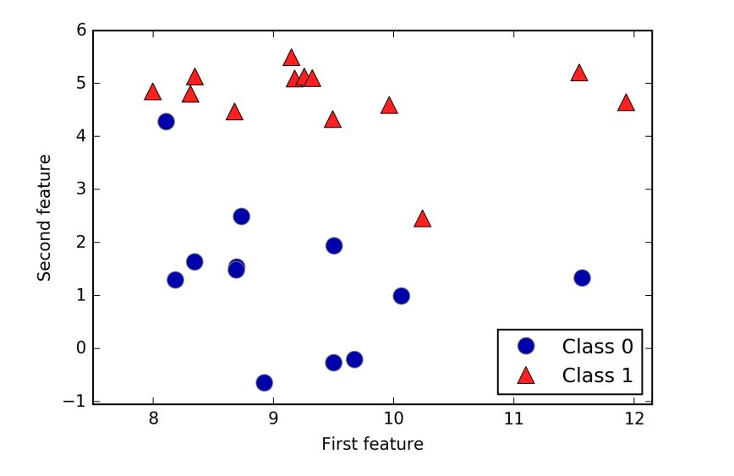
Lets discuss here

Slide 10
We can also change number of neighbors to look upon

Slide 11
Linear Regression
Designed for regression problems,
Draws a straight line for prediction
Lets see how.

Slide 12
Plot points manually

Slide 13
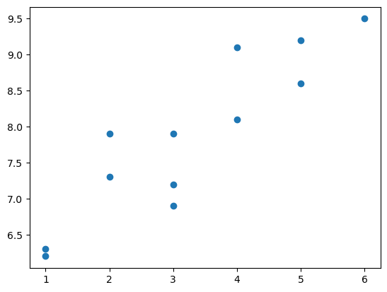
Let suppose data points

Slide 14
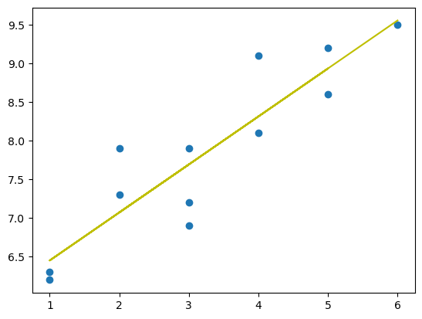
Line of best fit Where error is least

Slide 15
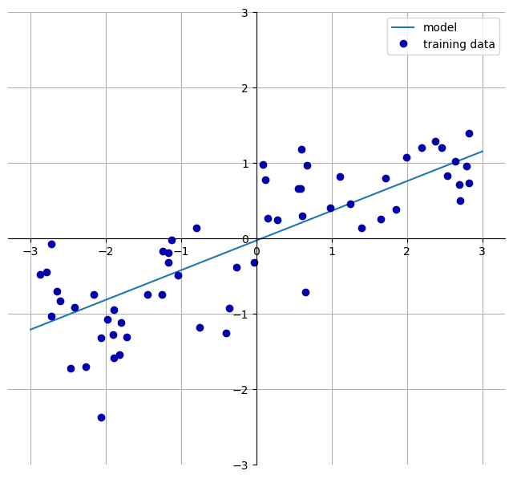
Linear regression, line of best fit

Slide 16
How well our model works?
We have a trained model which is also making some predictions, but are these predictions even correct?

Slide 17
Splitting our data
To check how well our model works, we usually split our data into two chunks. On one chunk model is trained and on other chunk we test the model.

Slide 18
ML model: Logistic regression
Used for classification problems
Instead of giving prediction directly, it will give probability for each possible prediction. Then we suppose max probability as predicted value.

