Slide 1

SPEAR PHISHING
By Harmandeep Singh Sethi

Slide 2
AGENDA
What is Spear Phishing?
- Phishing vs Spear phishing
- How does spear phishing works?
How to identify Spear phishing campaigns?
- Ways to identify the attacks.
Danger/impact of these campaigns?
Organization level
Individual level

Slide 3
What to do if you are a victim of Spear phishing attack?
Immediate Response
Steps to follow later
How to avoid Spear phishing cyberattack
- Do’s and Don’t
An Example of Spear Phishing

Slide 4
What is Spear phishing?
Spear Phishing is a type of cyberattack where an email or some sort of electronic communication spam message is targeted towards a specific individual, organization or business.
The goal is to trick targets into clicking a link or opening an attachment which may lead to loss of password, personal details, credit card information etc

Slide 5
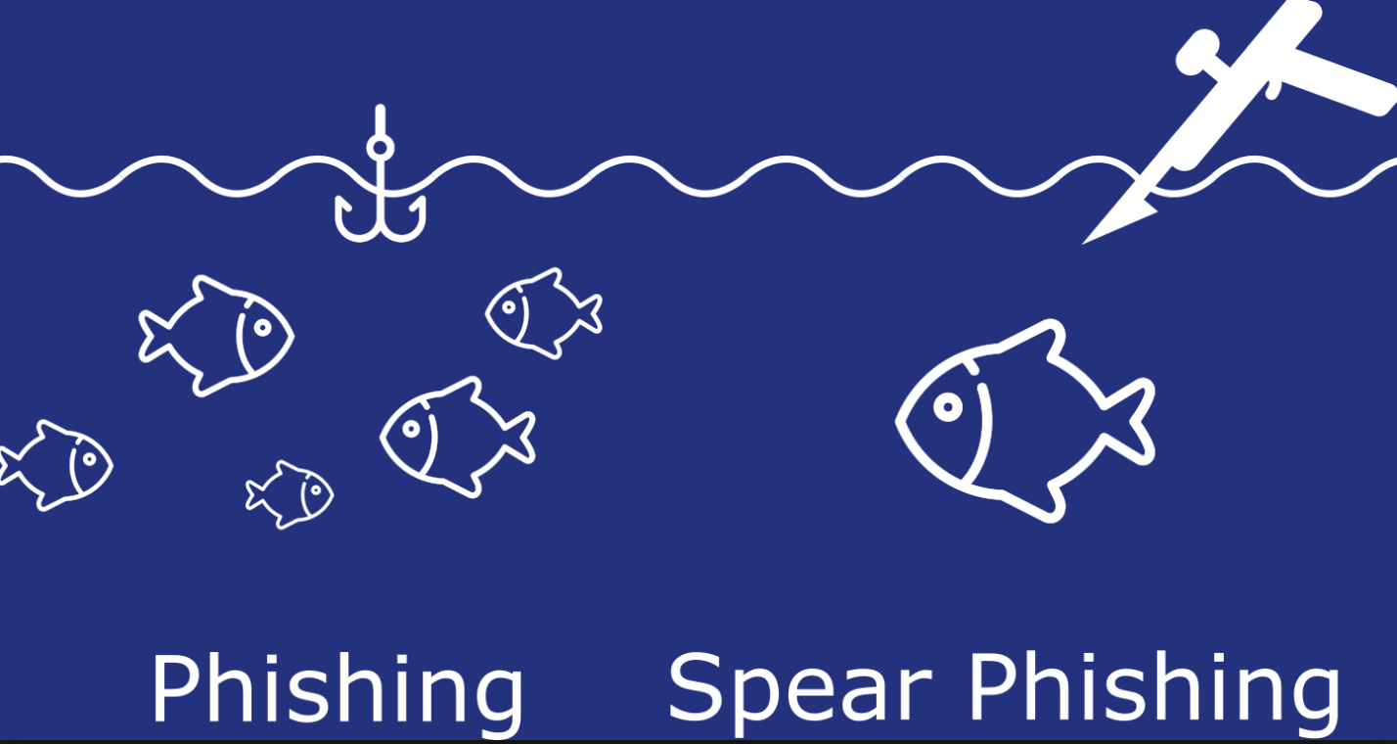
Phishing vs Spear phishing
Traditional phishing attacks are usually conducted by sending malicious emails to as many people as possible. The attackers know that the more people they reach, the more people are likely to fall victim
A spear phishing attack will be highly targeted. Before crafting the message for the attack, the attacker will research the intended victims’ social media profiles, like LinkedIn, Twitter and Facebook. Afterwards, the attacker will try to build a profile on the victims’ life, work and interests. This will be used to create a highly customized message that will come across as credible and relevant to the victim. In addition, the attacker will gather information about the victims’ friends and colleagues. Such as their names and email addresses. This in order to make the email appear like it is sent from one of them.

Slide 6
How does Spear phishing work?
Spear-phishing attackers target victims who put personal information on the internet. They might view individual profiles while scanning a social networking site. From a profile, they will be able to find a person’s email address, friends list, geographic location, and any other posts. With all of this information, the attacker would be able to act as a friend or a familiar entity and send a convincing but fraudulent message to their target.
These messages often contain urgent explanations on why they need sensitive information. Victims are asked to open a malicious attachment or click on a link that takes them to a spoofed website where they are asked to provide passwords, account numbers, PINs, and access codes.
An attacker posing as a friend might ask for usernames and passwords for various websites, such as Facebook, so that they would be able to access posted photos. In reality, the attackers will use that password, or variations of it, to access different websites that have confidential information such as credit card details or Social Security Numbers.

Slide 7
How to Identify Spear fishing Campaign?
Check Sender Email Address and Name
Attackers often use same name as friends, relatives, colleagues asking to share sensitive information.
Check the Email Format
If you observe the email format not matching with any of the emails you used to receive from that sender in the past, take further measures to confirm the legitimacy of the email
Scan the Attachments
Use the online virus scan tools to make sure the attachments are free from any virus or harmful code.

Slide 8
Verify Shared Links
- The simple trick to identify the legitimacy of the link is by hovering over the link. It gives you a complete address of the link that you shall be redirected to after clicking. If you see the web address or the link path is suspicious, never click the links
Make a Phone Call
- If the demand in the email is sensitive and can lead to some bigger problems in case of information leak, don’t hesitate to make a phone call to the sender to confirm the legitimacy of the email and the information demanded.

Slide 9
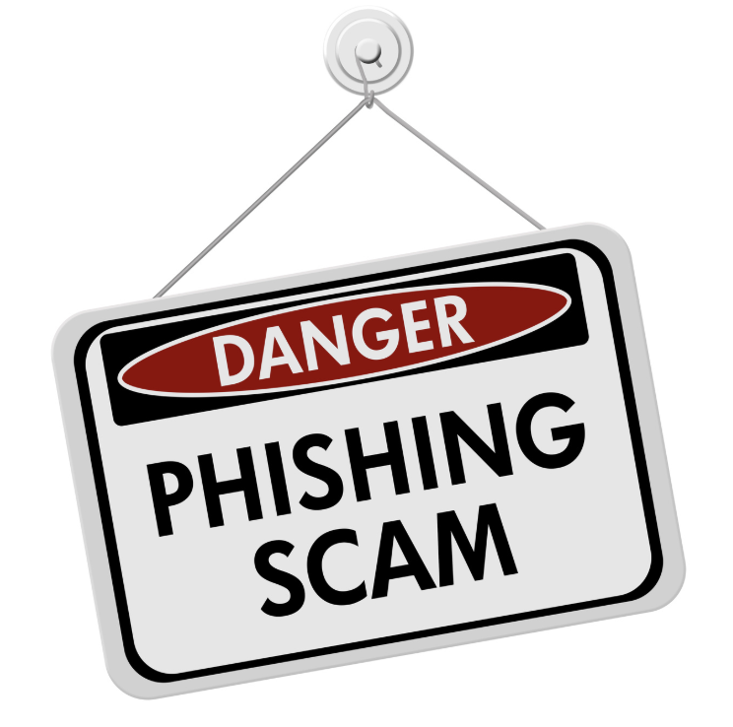
Dangers of Spear Phishing attacks
Organization level
Successful attacks can give attackers long-term access to an organization’s sensitive networks, data and assets.
It may lead to loss of revenue, sales ,organization’s profile and company’s brand value.
The average impact of a successful spear-phishing attack is around $1.6 million.
Victims can see drop in their stock prices by upto 15%.

Slide 10

Individual Level
Individual can lose their sensitive data such as credit card information, Social security number, bank details
It can lead to lose of their personal records, history, health records and family information

Slide 11
What to Do If You Click On a Spear Phishing Link?
Immediate Steps:
Terminate the session.
Disconnect your device from the Internet by disconnecting the ethernet cable that comes from your router and connects to your device. If you are using Wi-Fi, simply turn the power off to the router or disconnect the computer from the Wi-Fi
Back up all of your files.
Now that you are not connected to the outside world, you should conduct a backup of all your files. You can save your backup onto a DVD, thumb drive,or an external hard drive
Conduct a full system scan using your antivirus/anti-malware software.
Remember to ensure that your operating system and anti-virus/malware are kept up to date with the latest security updates. You should turn on the “Automatic Update” function in both.

Slide 12
Later stage:
Change the password to your email application
- While changing your password, consider activating two-factor authentication
Report the attack to your company’s security team
Follow your company policy.
If you fall victim to this sort of attack at your organization, follow the policy that is prescribed by your employer. It would not be a bad idea to turn off your computer to help prevent the spread of any infection into the network.

Slide 13
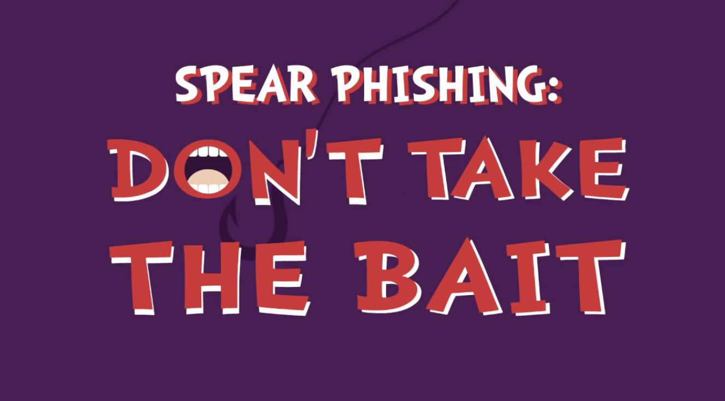
How to avoid a spear phishing attack?
Watch what personal information you post on the internet: Look at your online profiles. How much personal information is available for potential attackers to view?
Have smart passwords: Do not just use one password or variations of passwords for every account that you own.
Frequently update your software: If your software provider notifies you that there is a new update, do it right away. The majority of software systems include security software updates that should help to protect you from common attacks

Slide 14
Do not click links in emails: If an organization, such as your bank, sends you a link, launch your browser and go directly to the bank’s site instead of clicking on the link itself. You can also check the destination of a link by hovering your mouse over it. If the URL does not match the link’s anchor text or the email’s stated destination, there is a good chance that it could be malicious.
Implement a data protection program at your organization: A data protection program that combines user education around data security best practices and implementation of a data protection solution will help to prevent data loss due to spear-phishing attacks.

Slide 15
An Example of Spear Phishing
A spoofed email is sent to an enterprise’s sysadmin from someone claiming to represent www.itservices.com, a database management SaaS provider. The email uses the itservices.com customer mailing template.
The email claims that itservices.com is offering a free new service for a limited time and invites the user to sign up for the service using the enclosed link.
After clicking on the link, the sysadmin is redirected to a login page on itservice.com, a fake website identical to the itservices.com registration page.
At the same time, a command and control agent is installed on the sysadmin’s machine, which can then be used as a backdoor into the enterprise’s network to execute the first stage of an APT.

Slide 16
