Slide 1
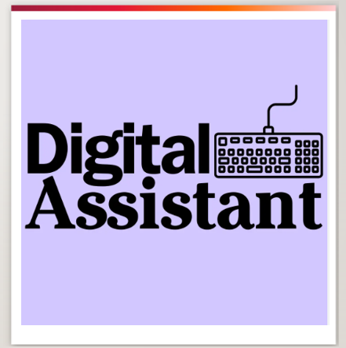
Compliance Digital Assistant
Empowering Compliance Officers with Intelligent Policy Query Resolution
November 2025
Harmeet Singh – Senior Consultant

Slide 2

Current Challenges
High Query Volume: Over 40,000 policy-related queries raised annually via emails, calls, and messages.
Manual Effort: Responses require extensive research across multiple, complex policy and regulatory documents.
Inefficient Process: Current approach is time-consuming, inconsistent, and resource-intensive.
Rising Risk Exposure: Increasing policy complexity leads to outdated, inaccurate, or inconsistent guidance being issued.

Slide 3

Business Impact
Delayed responses and lower productivity for Compliance Officers.
Increased operational costs and employee frustration.
Heightened compliance and reputational risks due to inconsistent policy interpretations.
Opportunity
Introduce an AI-powered Digital Assistant capable of interpreting policy documents and providing real-time, accurate responses to Compliance-related queries.

Slide 4
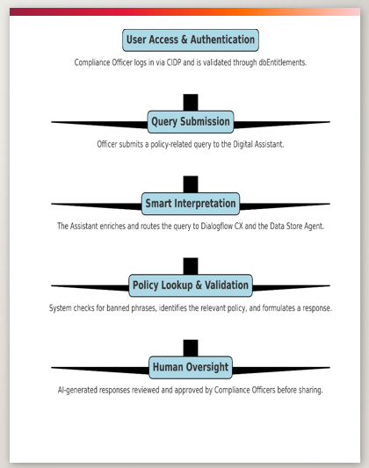
How It Works – End-to-End Workflow
User Access & Authentication: Compliance Officer logs in via CIDP and is validated through Entitlements.
Query Submission: Officer submits a policy-related query to the Digital Assistant.
Smart Interpretation: The Assistant enriches and routes the query to Dialogflow CX and the Data Store Agent.
Policy Lookup & Validation: The system checks for banned phrases, identifies the most relevant policy source, and formulates a compliant response.
Human Oversight: During initial phases, all AI-generated responses are reviewed and approved by Compliance Officers before being shared.

Slide 5
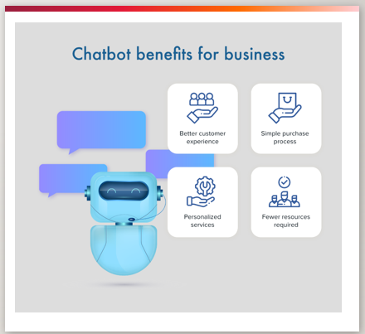
Business Value and Benefits
Efficiency: Significant reduction in manual effort and response turnaround time.
Accuracy: Ensures guidance is consistent, traceable, and aligned with the latest policies.
Scalability: Handles increasing query volumes without expanding Compliance headcount.
Governance: Provides full auditability and traceability of all queries and responses.

Slide 6

Technology Stack
Dialogflow CX: Conversational flow and intent management
Vertex AI: Model storage, training, and datastore
API Gateway: Middleware for orchestration and API integration
Gemini: Generative AI for FAQ summarization, Converts multi-page documents into concise, readable responses.
Google Cloud Platform: Hosting and scalability
Python: For regression pack, Generate faq summary
GKE Cron Job: To automate the process of updated document ingestion

Slide 7

Roadmap - planned enhancements
Add multilingual support
Automated sync with Policy Portal
Integration with Google Playbook
Integration with Entitlement
On-boarding new tenants
Integrating tool to generate MI reports to see the usage.

Slide 8

Role – Senior Consultant (CGI)
Designed and implemented DIGITAL Assistance middleware.
Integrated Dialogflow CX with Vertex AI and Gemini.
Led the orchestration layer for seamless communication.
Ensured secure data handling and performance optimization.
Create a regression test suite using Python

Slide 9


