Slide 1
Case Study: Cyclistic Bike-Share
Harmeet Gill • 13.09.2022

Slide 2
Agenda
Scenario
The Ask
The Answers
The Recommendations
Next Steps

Slide 3
Scenario
Cyclistic first launched in 2016 and has now grown to a fleet of 5,824 bikes and 692 stations across Chicago.
They offer single-ride passes, full-day passes, and annual memberships.
The company’s financial analysts have determined that annual members are more profitable than casual riders, therefore, the Director of Marketing wants to focus on converting casual riders into members.
To begin, my team wants to understand the difference between casual riders and annual members.

Slide 4
The Ask
Three questions will guide the future marketing program:
How do annual members and casual riders use Cyclistic bikes differently?
Why would casual riders buy Cyclistic annual memberships?
How can Cyclistic use digital media to influence casual riders to become members?
I have been assigned the first question: How do annual members and casual riders use Cyclistic bikes differently?

Slide 5
The Ask (Contd.)
Business Task
Understand the difference between user types in order to devise a new marketing campaign aimed at converting casual riders into Cyclistic members.
Key Stakeholders
Lily Moreno, Director of Marketing Marketing Analytics Team Executive Team: approves recommendations

Slide 6
The Answers

Slide 7
All riders prefer the classic or electric bike.

Slide 8
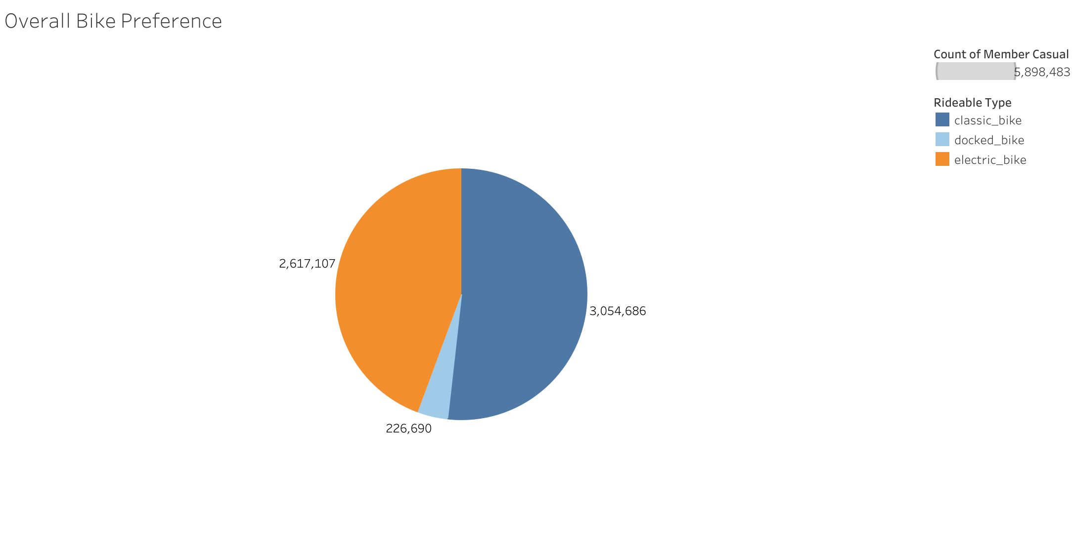

Slide 9
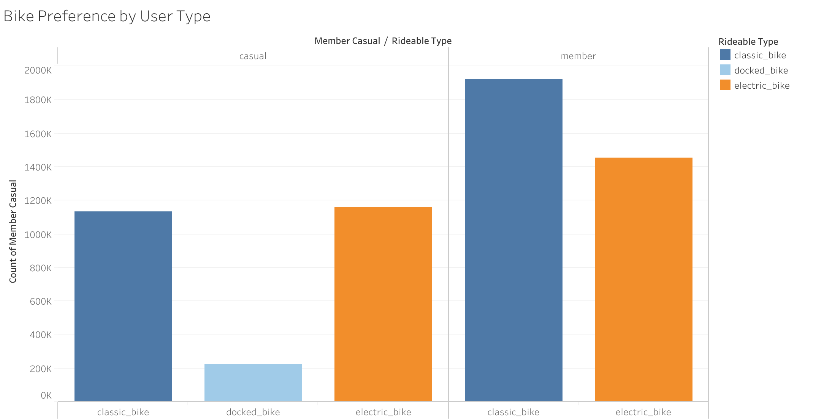

Slide 10
Members take more rides, but casual riders take longer trips.

Slide 11
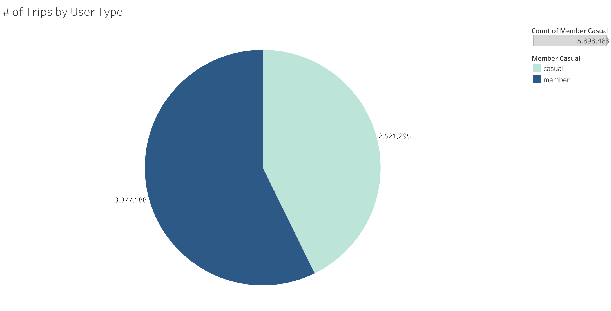

Slide 12
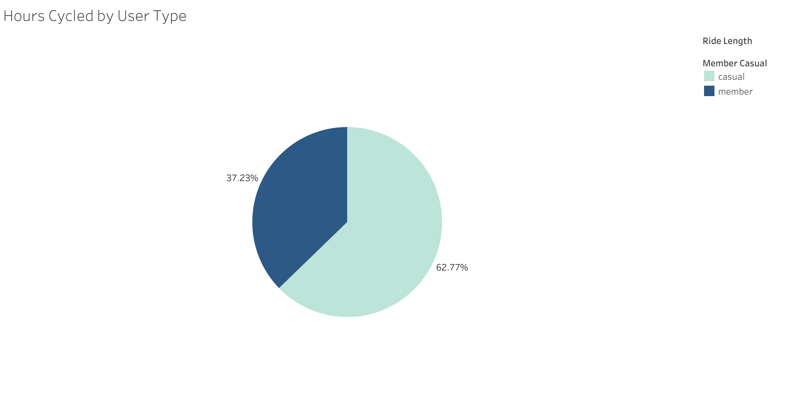

Slide 13
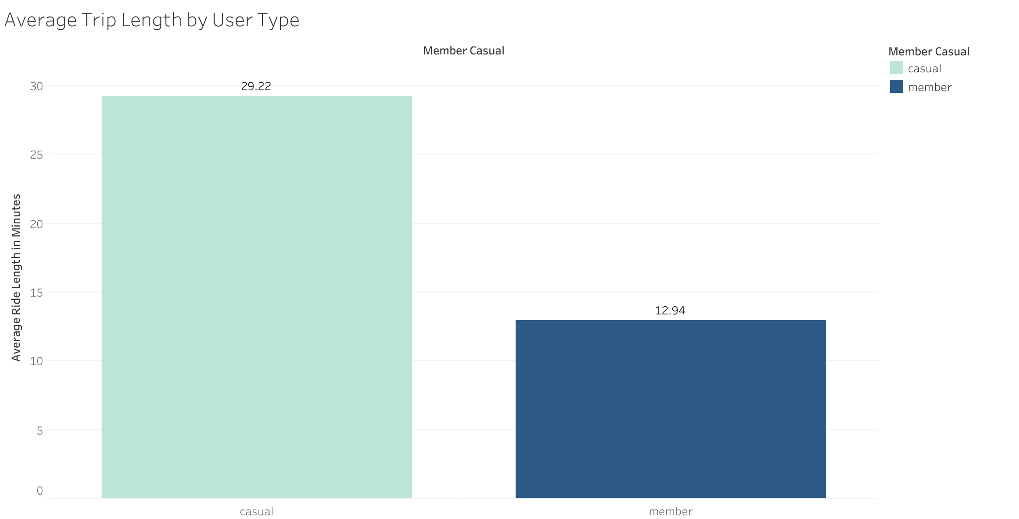

Slide 14
As the weather gets better, the number of rides increase.

Slide 15
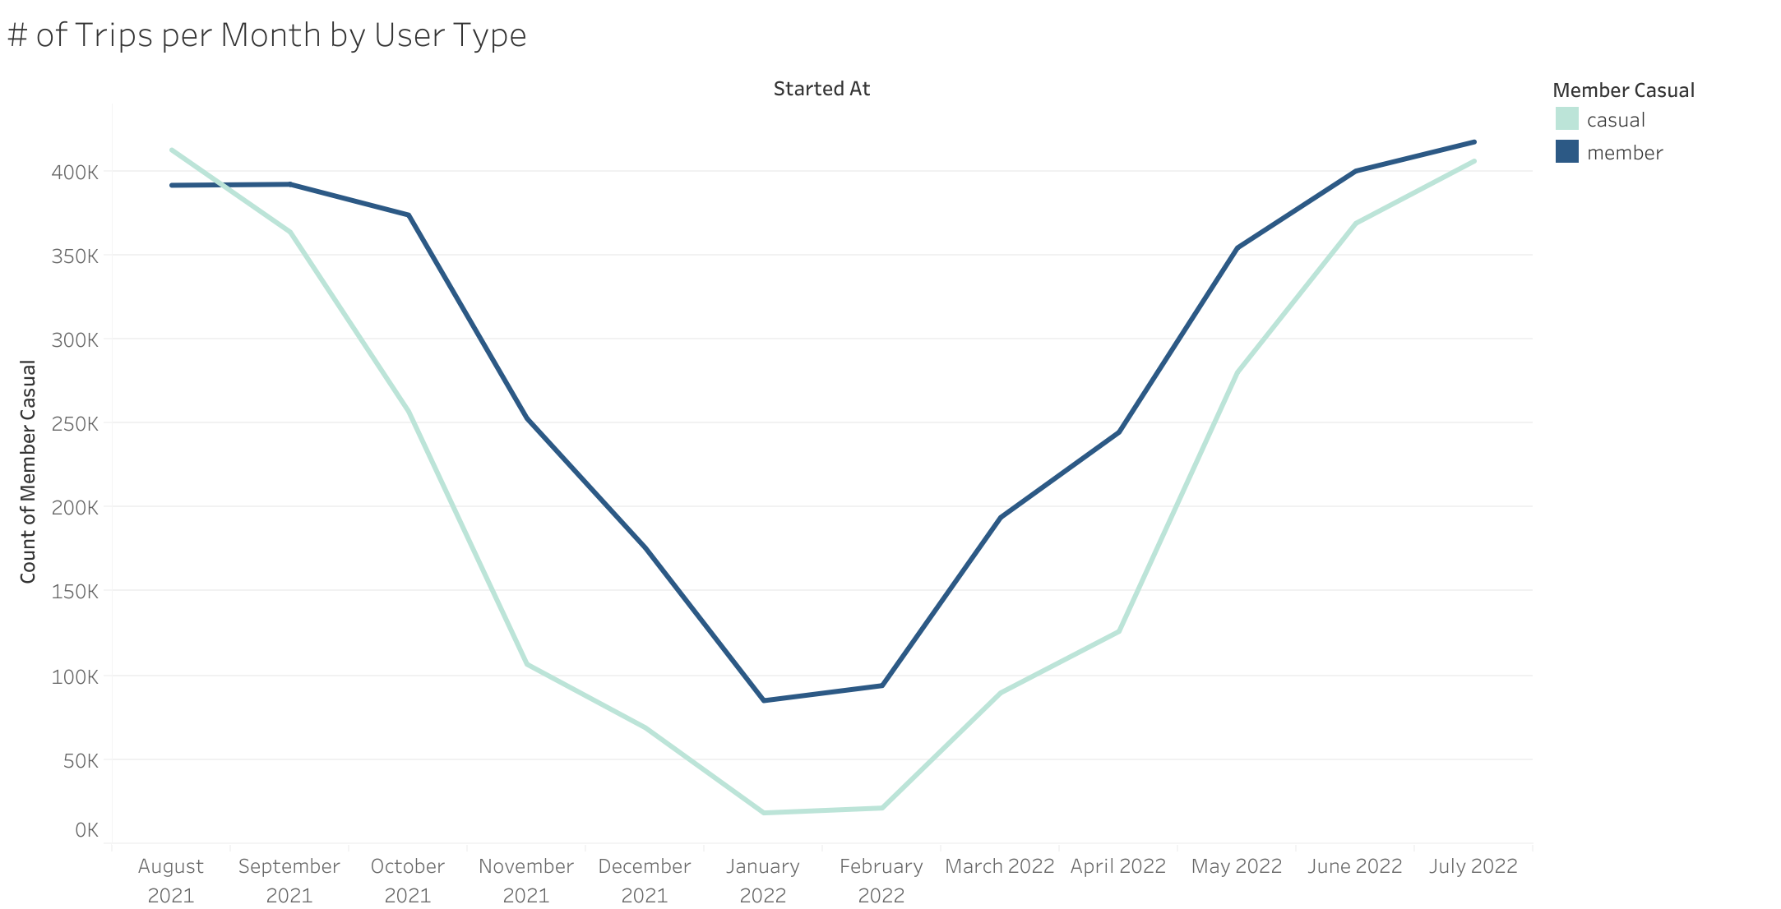

Slide 16
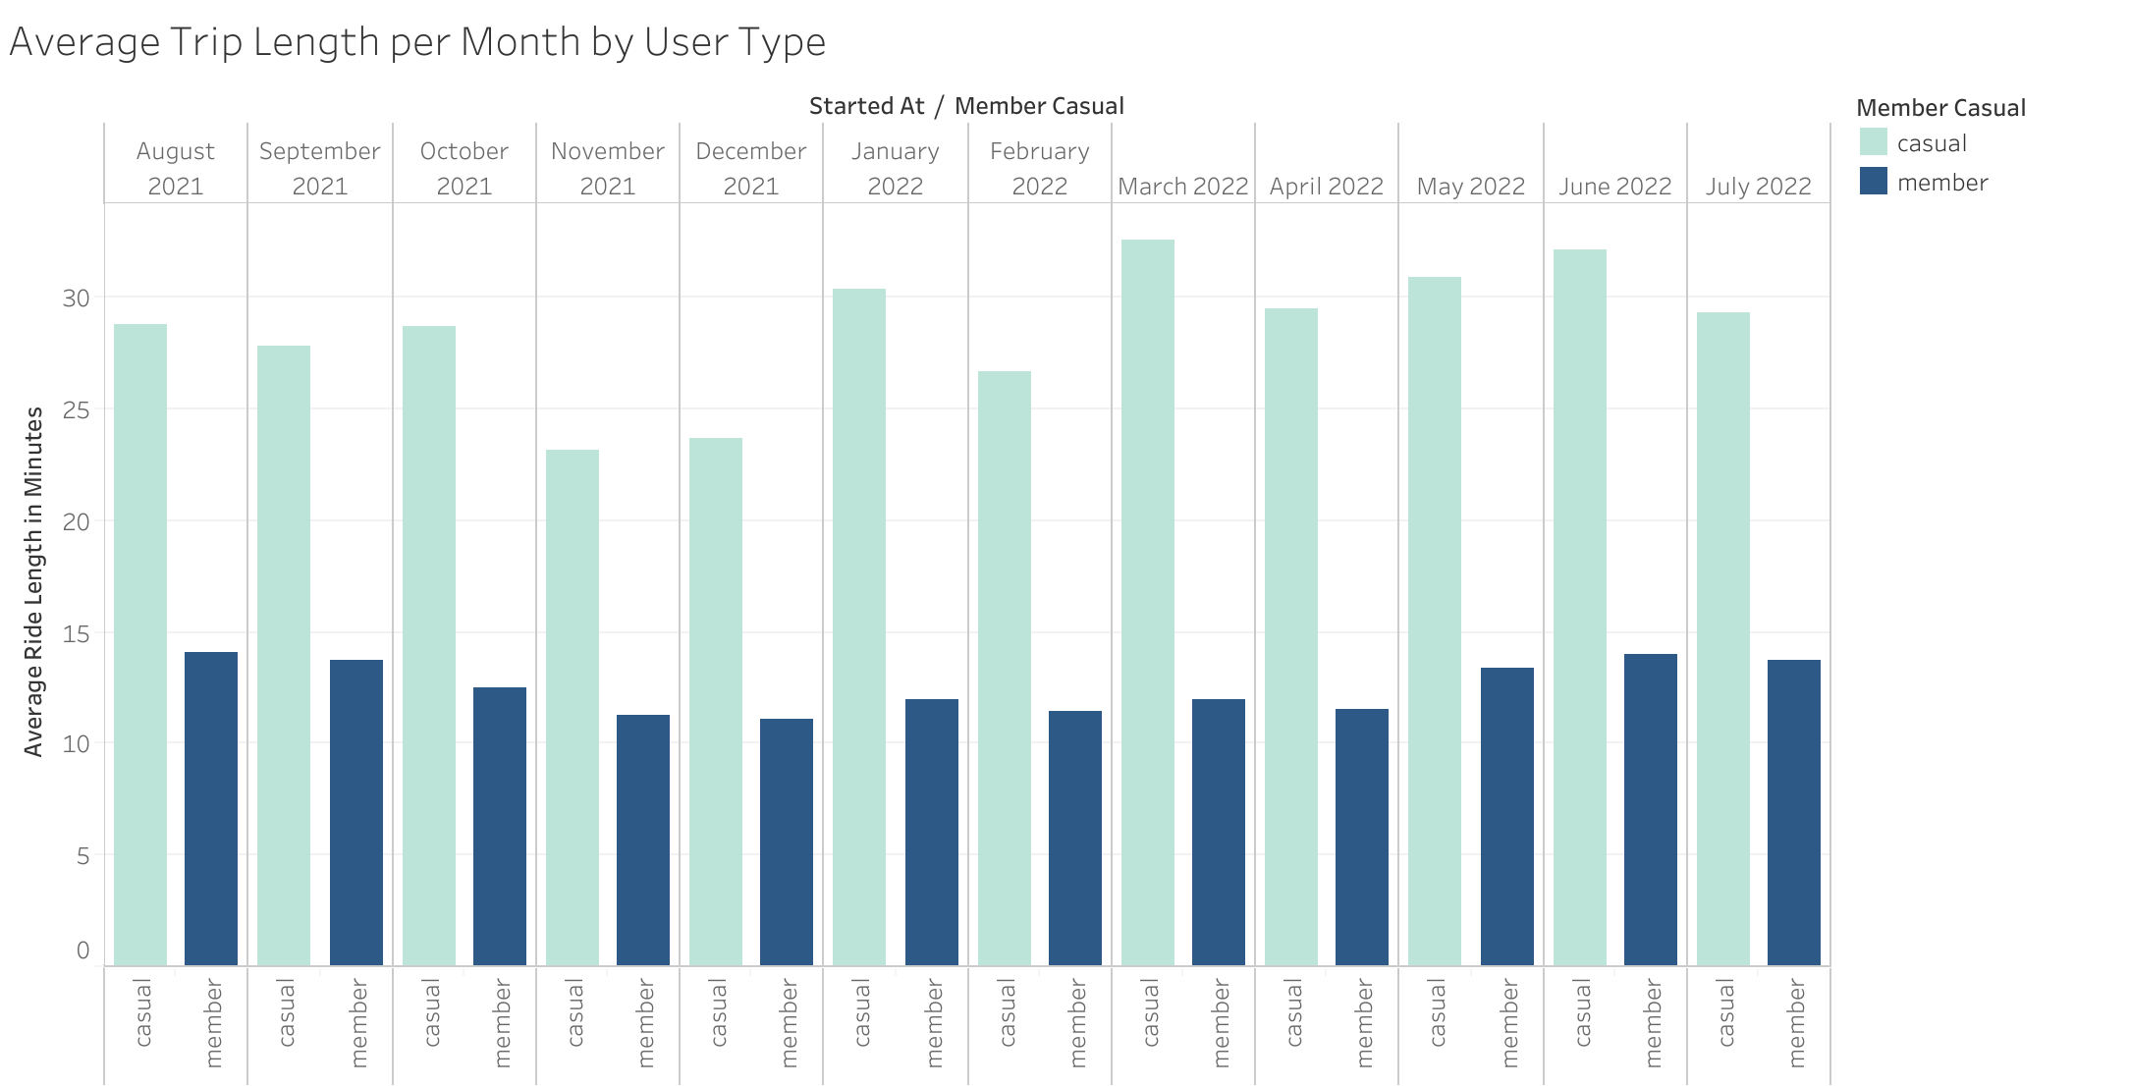

Slide 17
Members ride during the week, casuals ride on the weekend.

Slide 18
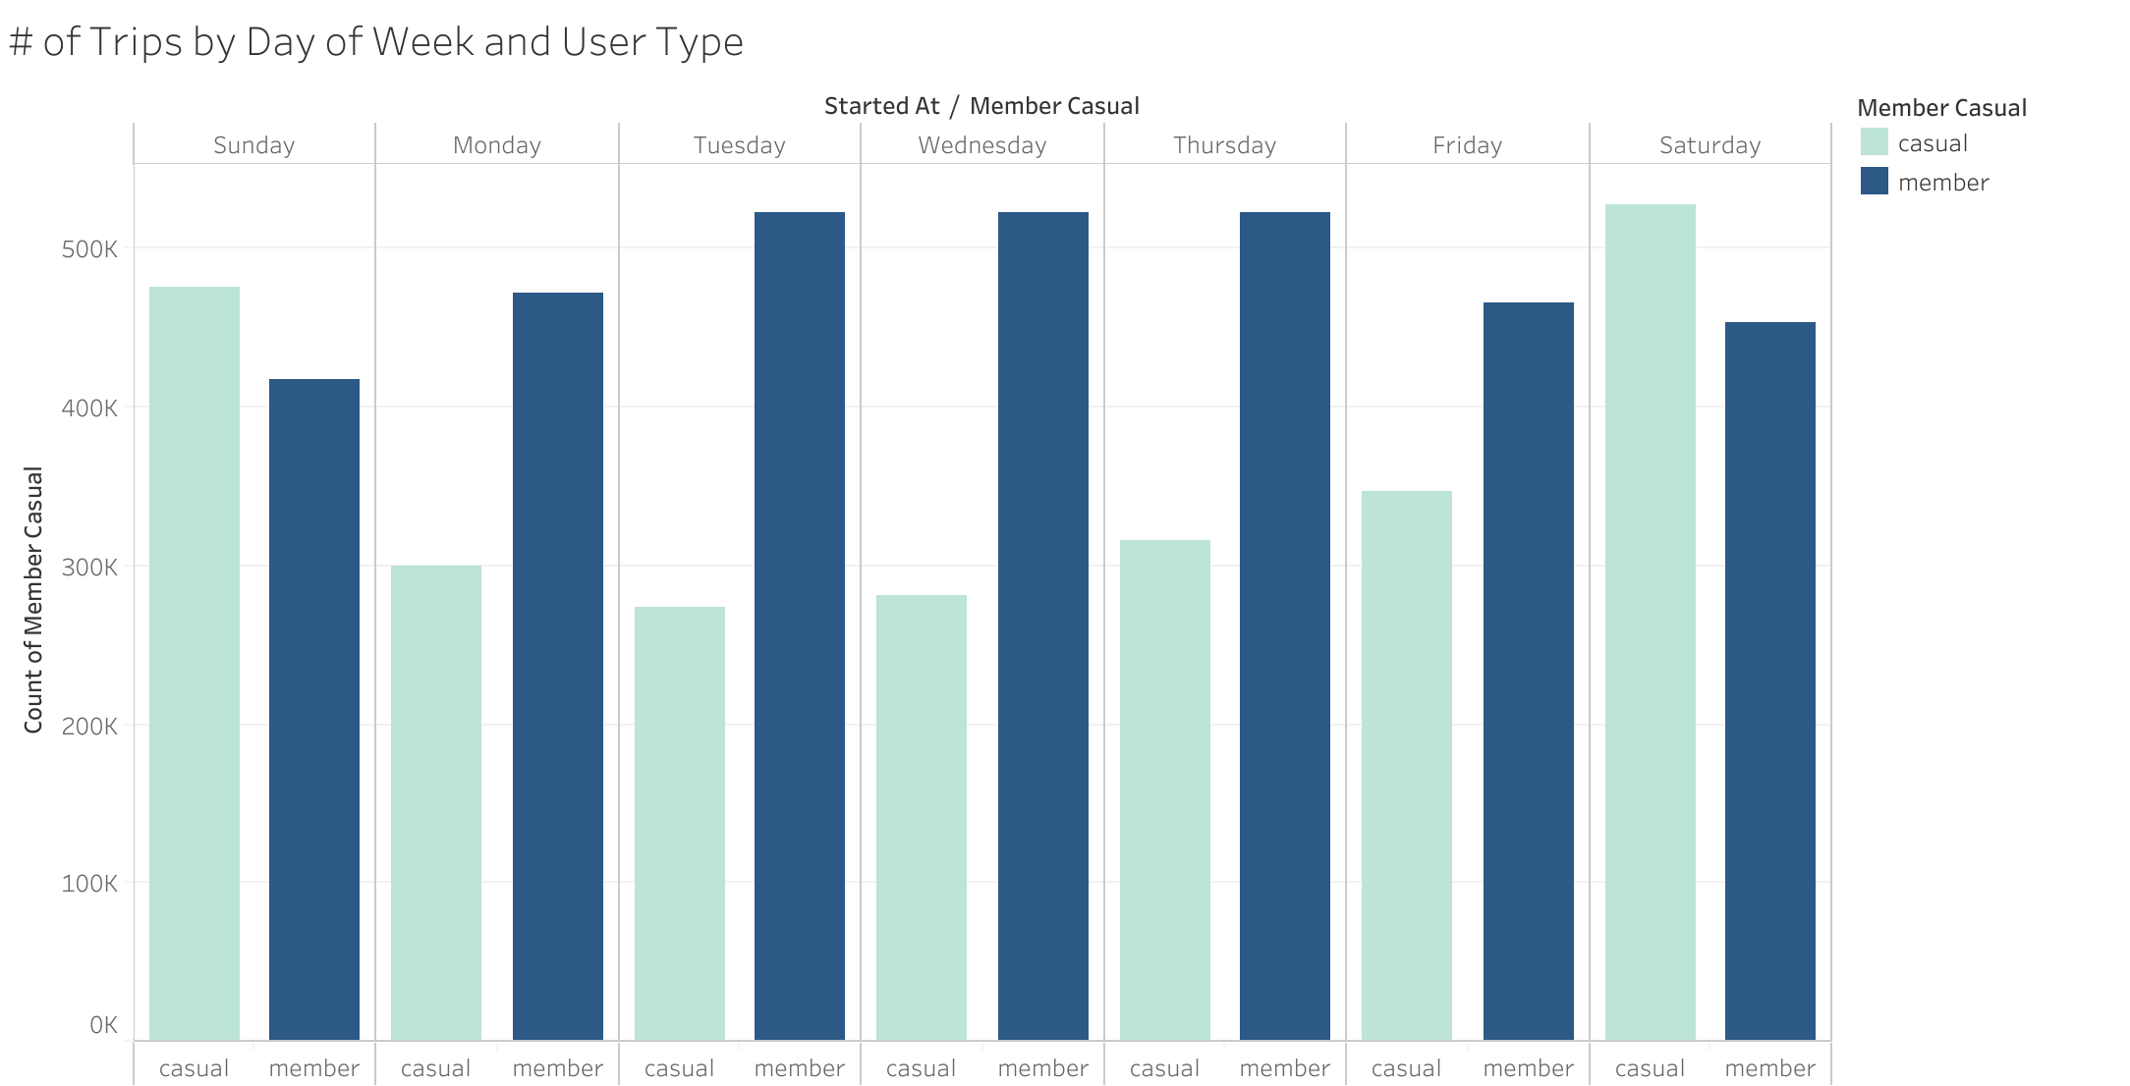

Slide 19
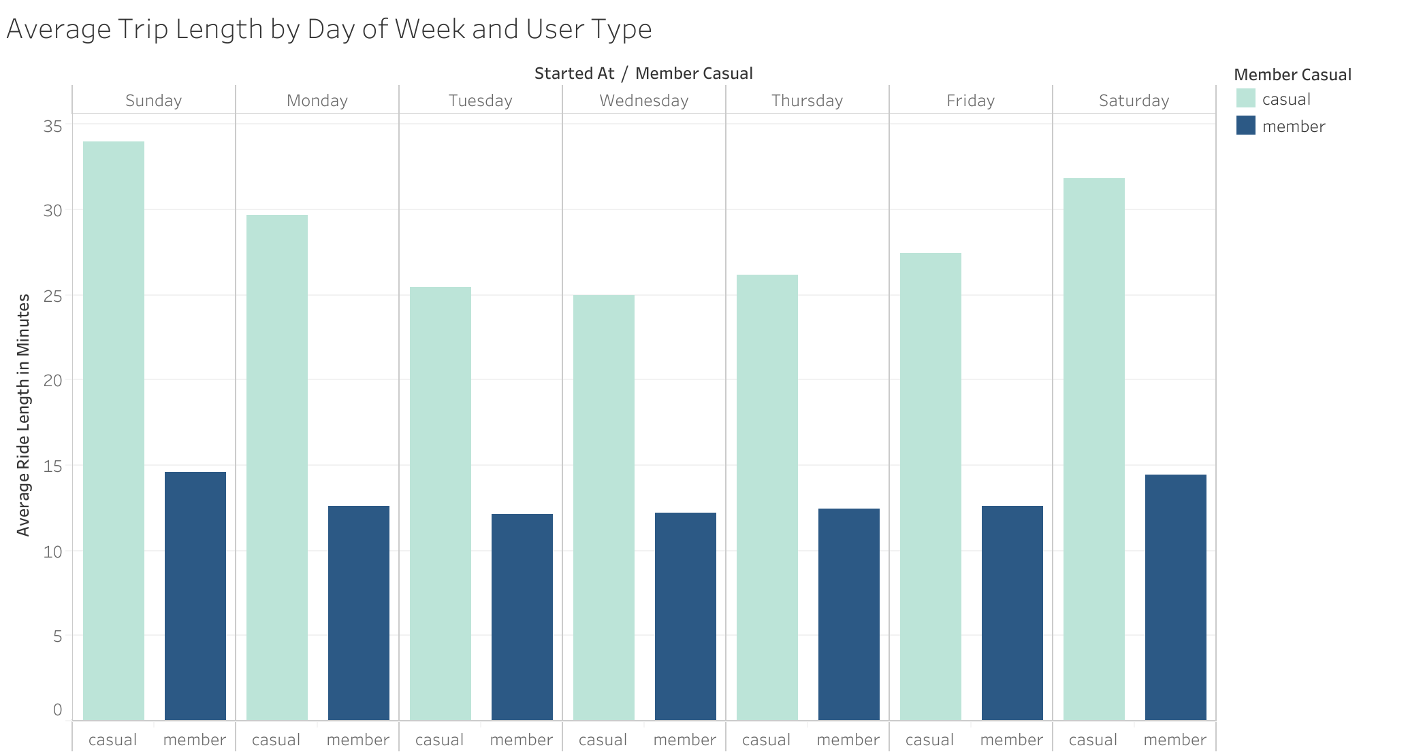

Slide 20
The Recommendations
Focus primary campaigns during the summer months.
Offer weekend-only or summer-only memberships.
Offer weekday student discounts.

Slide 21
Next steps
Look further into demographic data to see the age, occupation, income levels, etc. of all riders to see if there are underlying differences between members and casual riders.
Conduct customer surveys with specific questions – this will provide better insight into cycling habits and preferences.
Compare data pre-, post-, and during the COVID-19 pandemic to see if attitudes towards bike-sharing have changed.

