Slide 1
LINUS Music Recommendation System
Harpreet Singh
Ishmeet Singh
Harmeet Singh

Slide 2
Outline
Problem
Music Recommendation
System Architecture
Algorithm – Core Recommender Model
Mobile Application (GUI)
Results/ Demo
Short Comings
Feedback/ Questions

Slide 3
Problem
Tired of hitting SKIP button in your music player ?
Hate spending hours in creating playlists of your favorite songs ?
We need some intelligent music players, which are smart enough to know our taste in music and keep creating playlists automatically.
Music players like Spotify, Pandora and apple music are doing the same stuff, but in different way.
Applications like Spotify and Pandora works on the same concept, Spotify mainly uses social tags to recommend songs in its’s radio feature and Pandora is investing a huge amount of capital on musicians who perform social tagging manually for each song.

Slide 4
Music Recommendation
Music Recommendation is a way to filter out songs according to the user’s taste. It typically produce a list of recommendations to the user in the form of radio.
User feedback is used to refine the station's results, deemphasizing certain attributes when a user "dislikes" a particular song and emphasizing other attributes when a user "likes" a song.
We introduce an audio based similarity recommendation system which performs comparison on the basis of audio features and recommend songs according to the user’s feedback in the form of likes/ dislike.

Slide 5
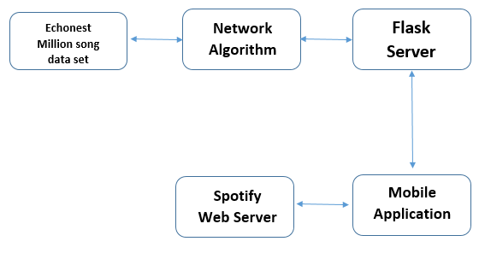
System Architecture

Slide 6
Algorithm- Core Recommender
The user is presented with various songs from which he can choose any song he likes. Once a pre set option is selected, our system will recommend five similar songs and add those songs in the current playlist.
The data features of all the songs has been represented in the form of audio feature vectors and all the candidate songs are represented in the form of Adjacency Matrix based on the audio feature vectors.
Two separate lists for liked and disliked songs are formed, and keeps on updating on every like/ dislike done by user.
For each candidate song, let da be the distance to the nearest accepted, and let ds be the distance to the nearest skipped. If da <ds, then add the candidate to the set S.

Slide 7
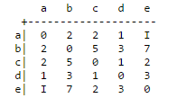
Algorithm- Core Recommender
Audio Feature Vectors for all the candidate songs
Audio Feature Vectors for all the candidate songs
Seed Song
Core- Algorithm
da
ds
Liked Song List
Disliked Song List
Adjacency Matrix for Candidate Songs
Recommendations

Slide 8
Mobile Application (GUI)
We have developed Android Mobile Application as our user interface and have used Android Studio as IDE.
It has an interface like a music player, has all the functionalities like play/ pause/ like/ dislike/ playlist.
We have used Spotify API to play the song and to access album art cover directly from Spotify song URI.
We have also added Spotify’s authentication feature, in which it validates the credentials of user’s Spotify account directly from the Spotify’s server and it requires Spotify’s premium account to use its Android SDK API.

Slide 9
Short Comings
Social Tags: Earlier we had planned to perform recommendation using social tags as well, but we were unable to classify genres with large number of tags.
Web and IOS app Unavailable: Due to time constraint, we could not able to work on these platforms.
Access Data Locally: We are accessing our music data set locally, as it would be quite expensive to host 2.3GB of data on server.

Slide 10
Feedback

