Slide 1
LINUS Music Recommendation System
Harpreet Singh
Ishmeet Singh
Harmeet Singh

Slide 2
Outline
Problem
Music Recommendation
System Architecture
Algorithm – Core Recommender Model
Mobile Application (GUI)
Results/ Demo
Short Comings
Feedback/ Questions

Slide 3
Problem
Tired of hitting SKIP button in your music player ?
Hate spending hours in creating playlists of your favorite songs ?
We need an intelligent music player, which is smart enough to know your taste in music and keeps creating playlists automatically.
Applications like Spotify and Pandora work on the same concept, Spotify uses collaborative filtering and audio features to recommend songs in its radio feature and Pandora invests a huge amount of capital on musicians who perform social tagging manually for each song.

Slide 4
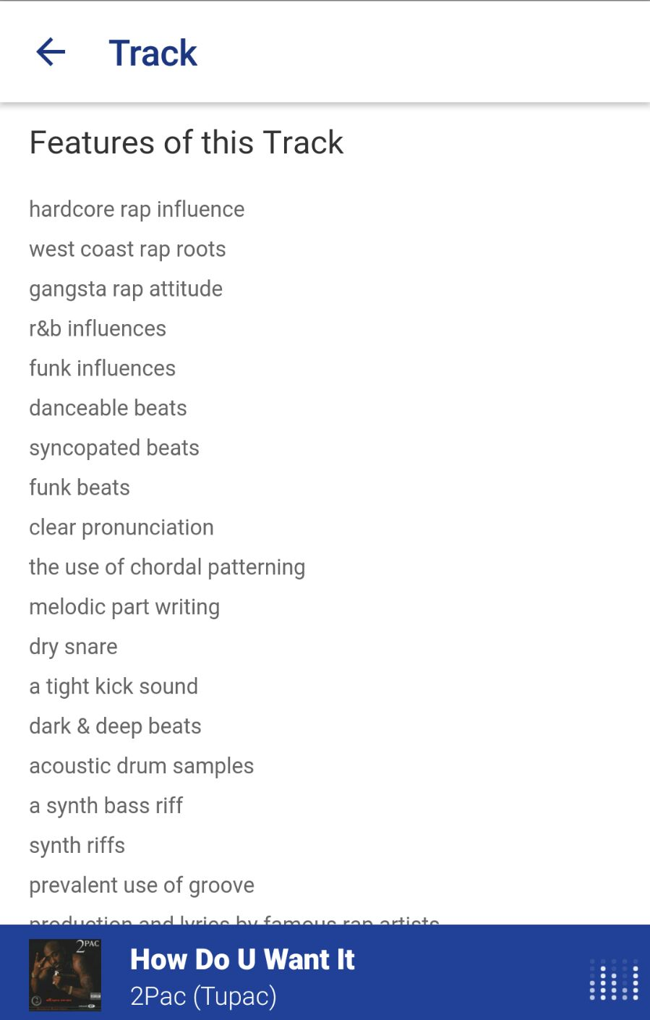
Features From Pandora
Pandora invests a huge amount of capital on musicians who perform social tagging manually for each song.
Each song from Pandora has large number of features and tags, so it becomes quite difficult to classify a song with better accuracy.

Slide 5
Music Recommendation
Music Recommendation is a way to filter out songs according to the user’s taste. It typically produce a list of recommendations to the user in the form of a continuously updating playlist.
We introduce an audio based similarity recommendation system which performs comparison on the basis of audio features and recommend songs according to the user’s feedback in the form of likes/ dislike.

Slide 6
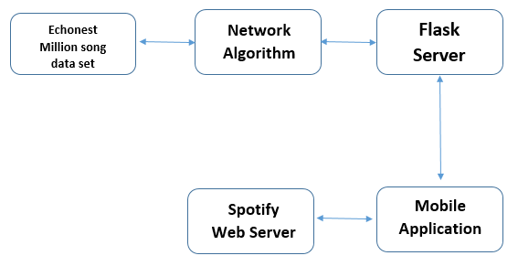
System Architecture

Slide 7
Algorithm- Core Recommender
The data features of all the songs has been represented in the form of audio feature vectors and all the candidate songs are represented in the form of Adjacency Matrix based on the distance between them.
The user is presented with various songs from which he can choose any song he likes. Once a seed song is selected, our system will recommend N similar songs to start with.
Two separate lists for liked and disliked songs are formed, and keeps on updating on every like/ dislike done by user.
For each candidate song, let da be the distance to the nearest accepted, and let ds be the distance to the nearest skipped. If da <ds, then add the candidate to the set S.

Slide 8
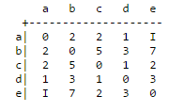
Algorithm- Core Recommender
Audio Feature Vectors for all the candidate songs
Audio Feature Vectors for all the candidate songs
Seed Song
Core- Algorithm
da
ds
Liked Song List
Disliked Song List
Adjacency Matrix for Candidate Songs
Recommendations

Slide 9
Demo

Slide 10
Mobile Application (GUI)
We have developed Android Mobile Application as our user interface and have used Android Studio as IDE.
It has an interface like a music player, has all the functionalities like play/ pause/ like/ dislike/ playlist.
We have used Spotify API to play the song and to access album art cover directly from Spotify song URI.
We have also added Spotify’s authentication feature, in which it validates the credentials of user’s Spotify account directly from the Spotify’s server and it requires Spotify’s premium account to use its Android SDK API.

Slide 11
Short Comings
Social Tags: Earlier we had planned to perform recommendation using social tags as well, but we were unable to classify genres with large number of tags.
Web and IOS app Unavailable: Due to time constraint, we could not able to work on these platforms.
Access Data Locally: We are accessing our music data set locally, as it would be quite expensive to host 2.3GB of data on server.

Slide 12
Feedback

