Slide 1

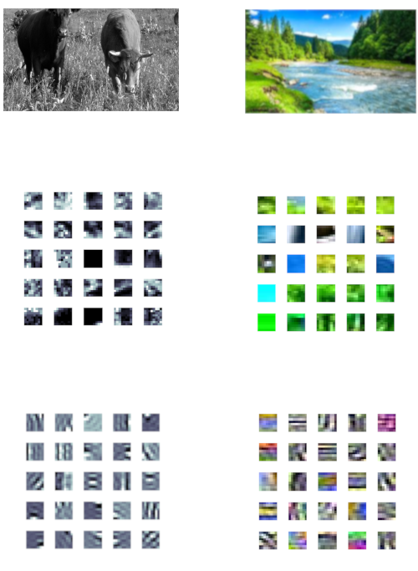
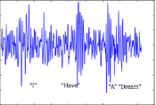
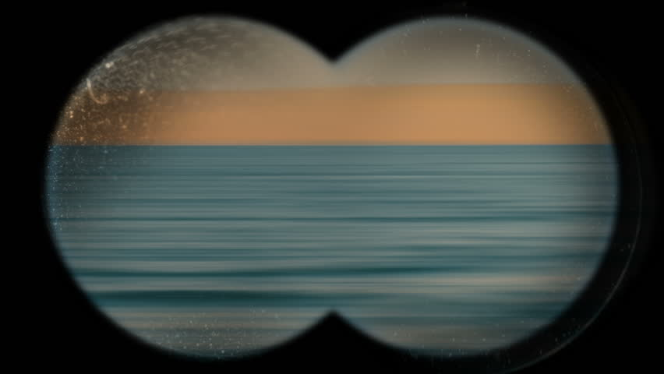

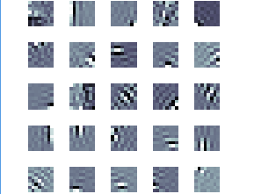
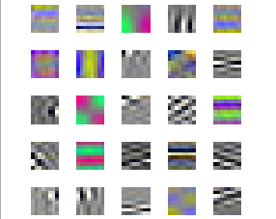
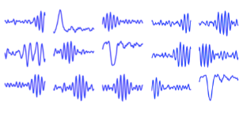
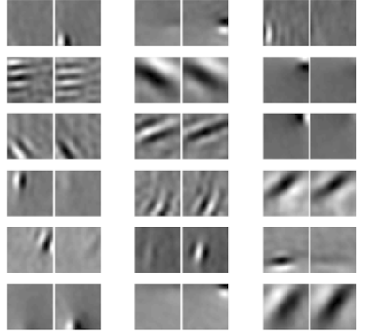
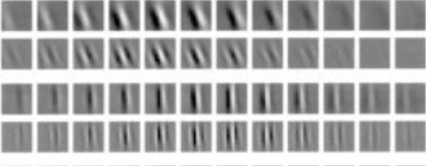
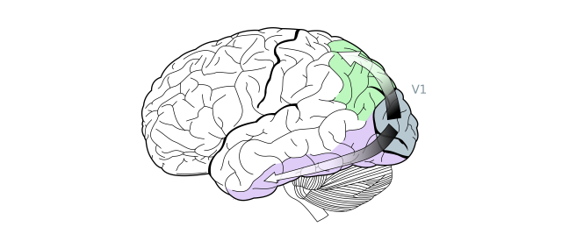
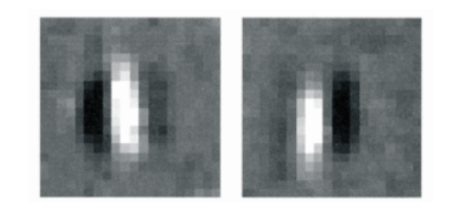
Efficient Neural Coding of Images and Video to Derive Receptive Fields
Harmeet Singh, Patrick Nolan, Zachary Barrett, Mark V. Albert
Abstract
Methods
Results
Figure 3: Different Stimuli Undergoing Same Efficient Coding Process
Figure 2: Grayscale vs Color Image Encoding
The way in which the brain efficiently encodes images is integral to the field of Computational Neuroscience. Through millennia of evolution, the brain has become predisposed to rapidly respond to natural images. A natural image is an image of an object that has been consistently present throughout the evolution of humans (i.e. trees, rocks, water, animals, etc.). In this experiment, natural images are taken and fed through an algorithm akin to the one that the brain employs. This algorithm, Independent Component Analysis (ICA), breaks these natural images into separate, easier to compose parts. ICA is used for all image processing in exactly the same manner, whether that be viewing greyscale images, color images, or even video. Using ICA, our program created 8x8 pixel "fields" of individual neurons being activated, displaying what part of a neuron responds to the natural image, and with what intensity. The filters that were generated for grayscale images map us a cohesive picture of neural reaction. The filters for color images show that levels of light primary stimuli while color is secondary stimuli, as most receptive patches were still entirely in black and white. By becoming acquainted with how the brain encodes images, the field of Computational Neuroscience can be understood more thoroughly which allows for more in depth topics to be delved into in the future. This process can help further the understanding of how the brain interprets images at a primary level.
Grayscale
Color
Audio
Binocular
Video
Natural Image
Full Image being processed
Natural Images
Sample
Algorithm images are fed through
ICA
8x8 pixel samples from various natural images
Produced Neural Receptive field
Resulting receptive fields
Receptive fields derived from the 8x8 samples after running the images through ICA
Through our experiments, we’ve come to the conclusion that luminescence is a key component for image processing in the brain, more so than color.
References
This figure illustrates the region in the brain where the Primary Visual Cortex is located . Below this figure is a a real visual receptive field.
Grayscale images, color images, video, audio, and binocular images all undergo the same process at their lowest level.

