Slide 1


NAME : HARMESH G V
SECTION : K22UG
ROLL NO : 39
TITLE : AUTOMATED DATA CLEANING, ITERATIVE METHOD

Slide 2
TABLE OF CONTENT
S.NO | CHAPTER
1. | PROBLEM STATEMENT
2. | SOLUTION APROACH
3. | METHODLOGY
4. | RESULT
5. | ANALYSIS
6. | CONCLUSION
7. | REFRENCE

Slide 3
Automated Data Cleaning: Handling Missing Values with Precision
In the realm of data science and engineering, the challenge of handling missing values in datasets is a critical aspect of data preprocessing. This presentation explores an innovative automated data cleaning project that tackles this issue head-on, employing sophisticated algorithms to distinguish between discrete and continuous data columns and predict missing values through an iterative process. By leveraging machine learning techniques such as linear regression and random forest classification, this approach aims to streamline data preprocessing and significantly improve data quality before analysis.

Slide 4
PROBLEM STATEMENT
Repetitive data cleaning tasks during EDA inspired the creation of an automated iterative data cleaning framework. The system categorizes data into continuous and discrete types, applies traditional imputation methods for initialization, and uses machine learning models to iteratively predict and refine missing values.
The framework ensures scalability, maintains data integrity, and tracks changes through an iteration process, streamlining data cleaning and reducing manual intervention. This innovation enables efficient and reliable data preprocessing for analytics and machine learning tasks

Slide 5
Understanding the Data Landscape
Continuous Data
Discrete Data
Importance of Distinction
Continuous data represents measurements on a continuous scale, such as temperature, height, or time. These variables can take any value within a range and often require specialized handling in data cleaning processes.
Discrete data consists of distinct, separate values, often representing categories or counts. Examples include gender, product types, or number of children. Handling missing values in discrete data requires different techniques compared to continuous data.
Distinguishing between continuous and discrete data is crucial for selecting appropriate imputation methods and ensuring the accuracy of predictions for missing values.

Slide 6
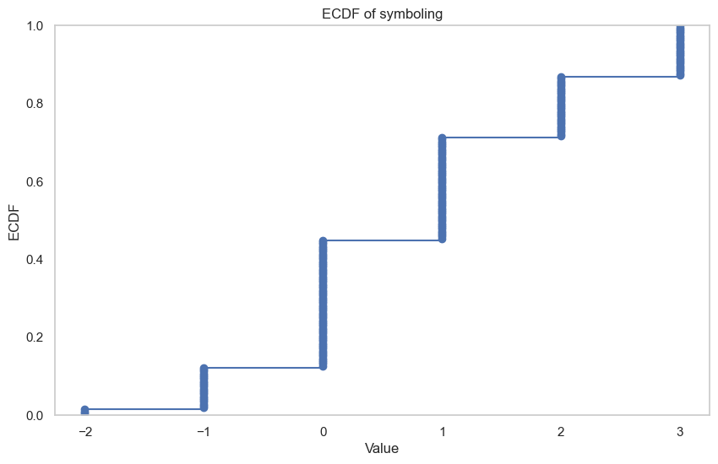
Discrete Data

Slide 7
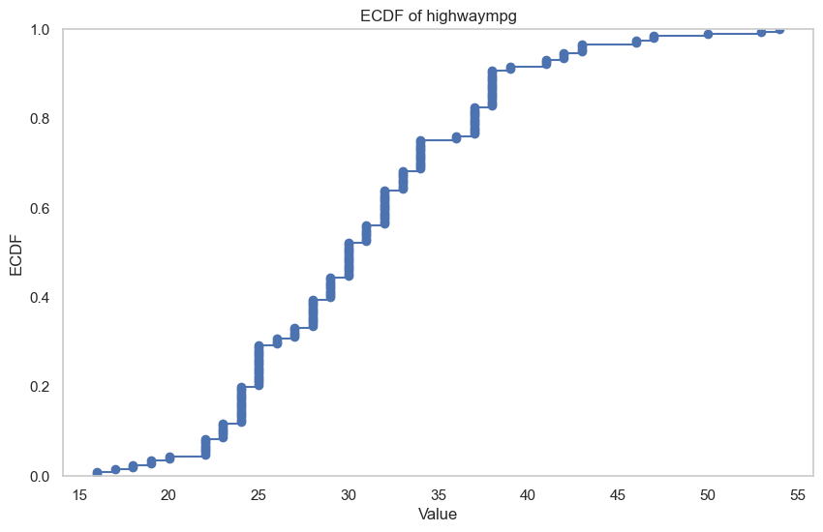
Continuous Data

Slide 8

Linear Regression for Continuous Data
1
Data Preparation
The algorithm first identifies continuous columns in the dataset. It then separates the available (non-missing) data for training purposes.
2
Model Training
A linear regression model is trained using the complete entries from other columns as features to predict the values in the target continuous column.
3
Prediction and Imputation
The trained model is then used to predict the missing values in the continuous column, effectively filling in the gaps in the dataset.
4
Iterative Refinement
This process is repeated iteratively, with each iteration potentially improving the accuracy of predictions as more data becomes available.

Slide 9
Random Forest Classification for Discrete Data
1
Ensemble Learning Approach
2
Feature Importance
Random Forest classification leverages an ensemble of decision trees to make predictions, offering robust performance for discrete data imputation.
The algorithm automatically identifies the most relevant features for predicting missing values in each discrete column, improving accuracy and efficiency.
4
Probability Estimates
3
Handling Imbalanced Data
Beyond simple predictions, Random Forest provides probability estimates for each class, allowing for more nuanced imputation strategies if needed.
Random Forest can effectively handle imbalanced datasets, which is common in real-world scenarios with missing values.

Slide 10





Iterative Refinement Process
Initial Imputation
Model Retraining
Prediction Refinement
Convergence Check
The process begins with an initial round of predictions for both continuous and discrete columns, filling in missing values with best-guess estimates.
Using the newly imputed data, the models (linear regression and random forest) are retrained to capture any new patterns or relationships revealed by the filled-in values.
The retrained models make new predictions for the initially missing values, potentially improving accuracy based on the additional information from the previous iteration.
The algorithm checks for convergence by comparing the new predictions with the previous ones. If significant changes are observed, the process continues; otherwise, it terminates.

Slide 11




One-to-One Learning Across Data Columns
Inter-Column Relationships
Pattern Recognition
The algorithm leverages relationships between different columns to inform predictions, capturing complex dependencies in the data.
By analyzing patterns across columns, the system can identify subtle correlations that might be missed by simpler imputation methods.
Balanced Learning
Targeted Imputation
The one-to-one approach ensures that each column contributes equally to the learning process, preventing bias towards columns with fewer missing values.
This method allows for more precise imputation by focusing on the most relevant features for each specific missing value.

Slide 12
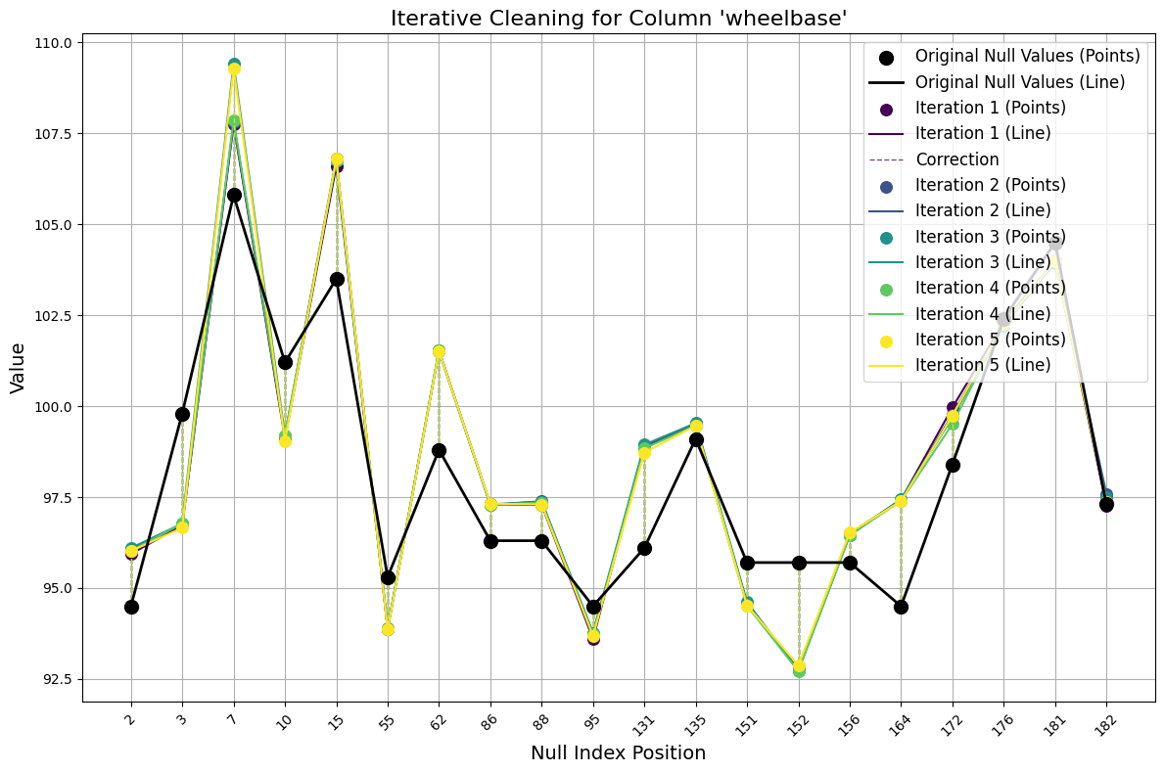
mean

Slide 13
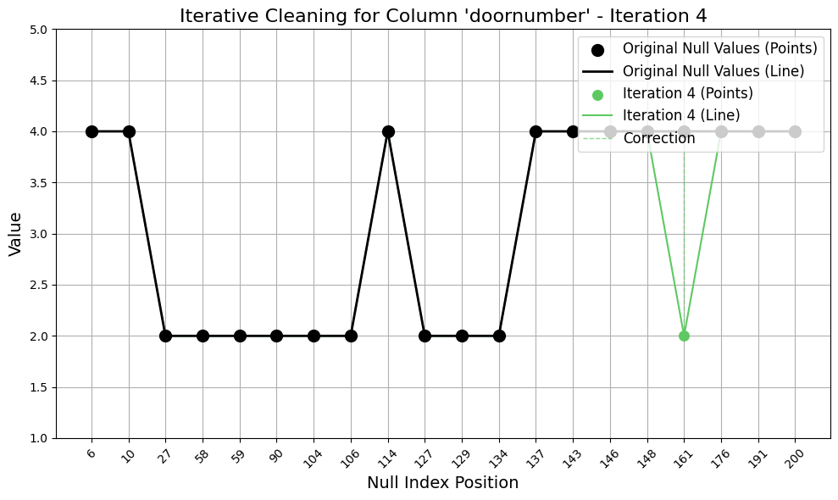
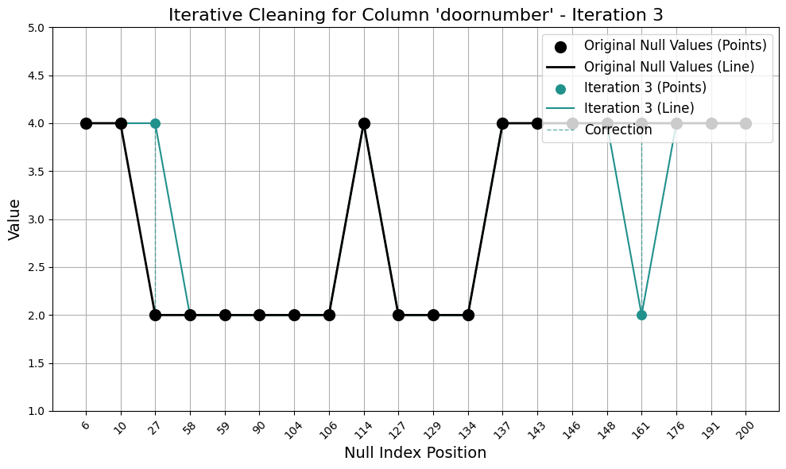
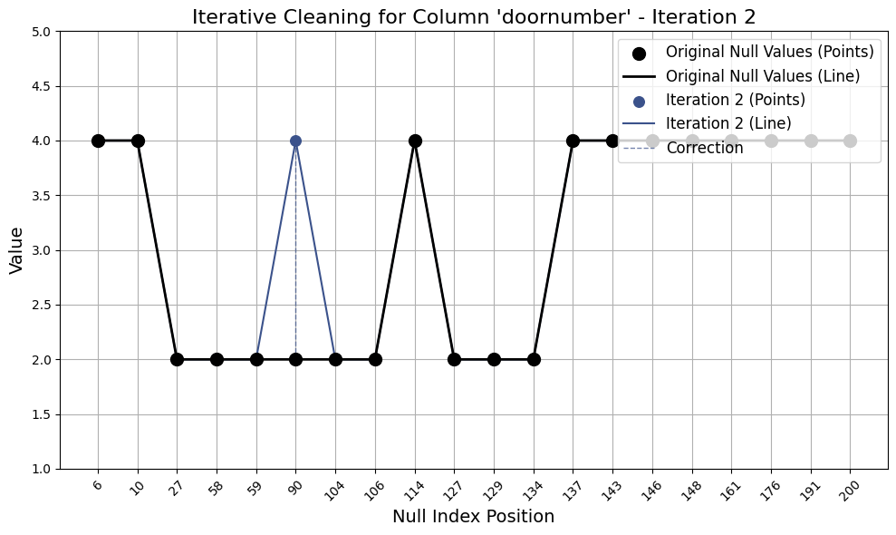
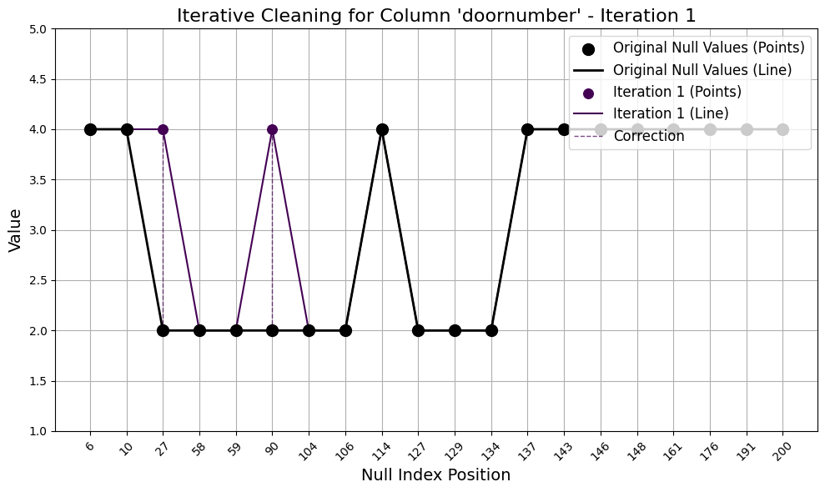

Slide 14
Challenges and Limitations
Data Sparsity
Non-Linear Relationships
When a large proportion of values are missing, the accuracy of imputation may decrease due to limited information for learning patterns.
Linear regression may not capture complex, non-linear relationships in continuous data, potentially leading to suboptimal imputations in some cases.
Computational Complexity
Assumption of Missingness Mechanism
The iterative nature of the algorithm can be computationally intensive, especially for large datasets with many columns and missing values.
The algorithm assumes data is missing at random , which may not always hold true in real-world scenarios, potentially introducing bias.

Slide 15
Future Directions and Enhancements
1
Advanced ML Models
Incorporate more sophisticated machine learning models, such as deep learning architectures, to capture complex patterns in data imputation.
2
Automated Hyperparameter Tuning
Implement automated hyperparameter optimization to fine-tune the imputation models for each specific dataset.
3
Ensemble Methods
Explore ensemble approaches that combine multiple imputation techniques to improve overall accuracy and robustness.
4
Explainable AI Integration
Incorporate explainable AI techniques to provide insights into the imputation process, enhancing transparency and trust in the results.

Slide 16
REFRENCES
Jarrett, D., Cebere, B., Liu, T., Curth, A., & van der Schaar, M. (2022). HyperImpute: Generalized Iterative Imputation with Automatic Model Selection. In Proceedings of the 39th International Conference on Machine Learning (ICML 2022). https://doi.org/10.48550/arXiv.2206.07769

