Slide 1

Secure Net Messenger
A TCP based Desktop Chatting Application

Slide 2
Project Members & Guide
Ankit Makwana (206400307085)
Harmik Sarvaliya (206400307087)
Vivek Gokhale (206400307090)
Darshan Patel (206400307103)
Project Guide: H.V. Katpara

Slide 3
Concept of a group chat based on TCP
Server
Client A
Client C
Client B

Slide 4
What is TCP?
The Transmission Control Protocol (TCP) is one of the core protocols of the Internet protocol suite, often simply referred to as TCP/IP.
Using TCP, applications on networked hosts can create connections to one another, over which they can exchange streams of data using Stream Sockets.

Slide 5

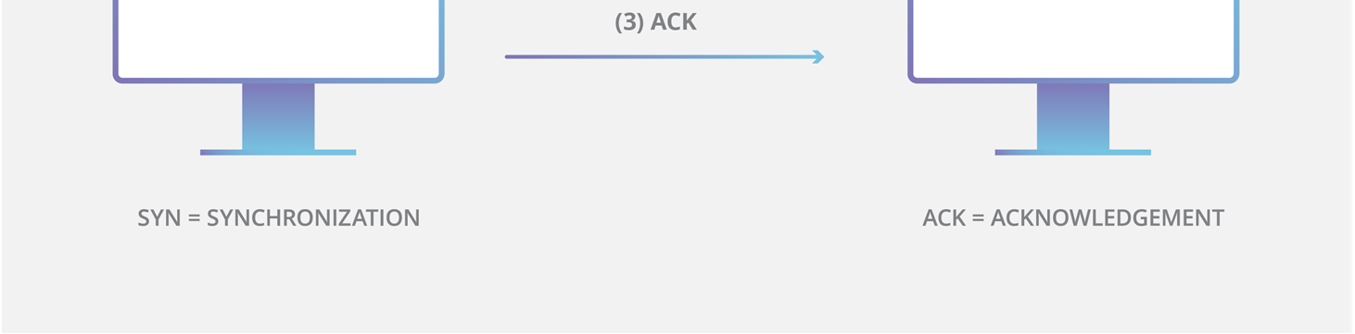

Slide 6
Socket-based TCP communication
IP addr = IP1
IP addr = IP2
Port = 25
Port = 25
Client
Server
IP Address + Port Number = Socket
Socket socket = new Socket(“127.0.0.1”, 60001)

Slide 7
Client & Server implementation
In the proposed system, Those who create a chatroom (admin to that specific room) hosts chat server (server logic).
Those who joins chatroom as member runs client logic on thier machine.
Chat server actively listenes to incoming join requests and creates a ServerSocket.
Chat client request to join chatroom through Socket communication.

Slide 8
Communication by Socket Input Stream and Output Stream
Chat Client
Chat Server
InputStream
InputStream
Socket
ServerSocket
OutputStream
OutputStream
Socket sock = new Socket("127.0.0.1", 61000);
ServerSocket server = new ServerSocket(61000);
Socket sock = server.accept();

Slide 9
Java I/O Package
java.io.InputStream
java.io.OutputStream
java.io.PrintWriter
java.io.BufferedReader
Java Network Package
java.net.Socket
java.net.ServerSocket

Slide 10
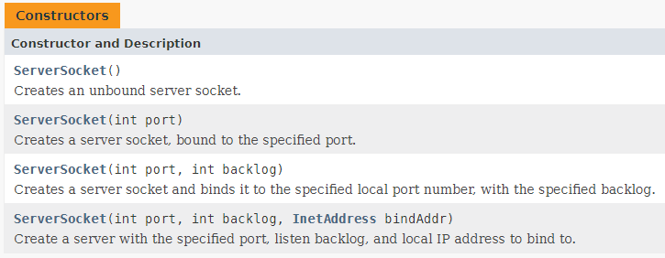
Class ServerSocket

Slide 11
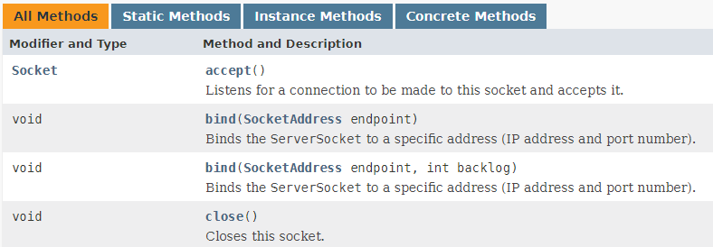
Class ServerSocket

Slide 12
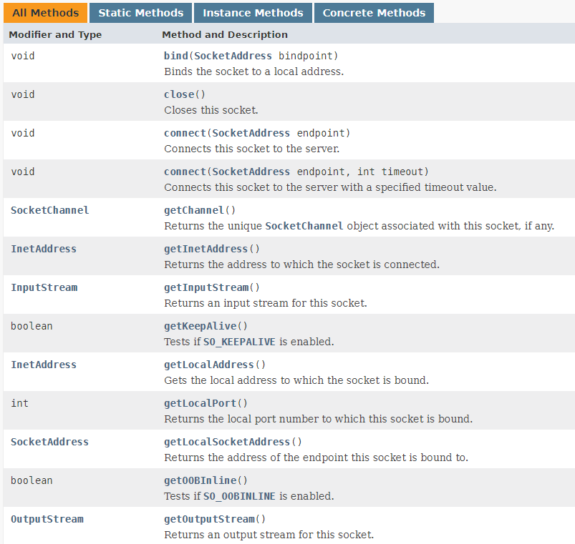
Class Socket

Slide 13
Class Socket

Slide 14
Sample Server Socket Implementation
try {
ServerSocket server = new ServerSocket(1728);
while (true) {
Socket connection = server.accept();
provideService(connection);
}
}
catch (IOException e) {
System.out.println("Server shut down with error: " + e);
}
//provideService() method defines logic to communicate with client and providing them service. ex.PrintWriter, BufferReader, etc.

Slide 15
Sample Client Socket Implementation
try {
Socket connection = new Socket(computerName,serverPort);
InputStream in = connection.getInputStream();
OutputStream out = connection.getOutputStream();
}
catch (IOException e) {
System.out.println("Attempt to create connection failed with error: " + e);
}
// Use the streams, in and out, to communicate with the server. InputStream to read, OutputStram to write to.

Slide 16
Thread Java programming
A thread of execution is the smallest sequence of programmed instructions that can be managed independently by a scheduler, which is typically a part of the operating system.
A Thread is a thread of execution in a program. The Java Virtual Machine allows an application to have multiple threads of execution running concurrently.

Slide 17
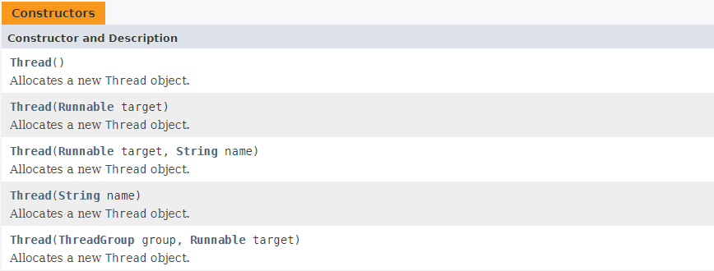
Thread Constructors and methods

Slide 18
Thread Constructors and methods

Slide 19
Thread chat server concept of multi-client access
Chat
Server
thread
Chat Client-1
thread
Chat Client-2
thread
Chat Client-3
N - Clients
TCP based Network
Multi-thread Service

Slide 20
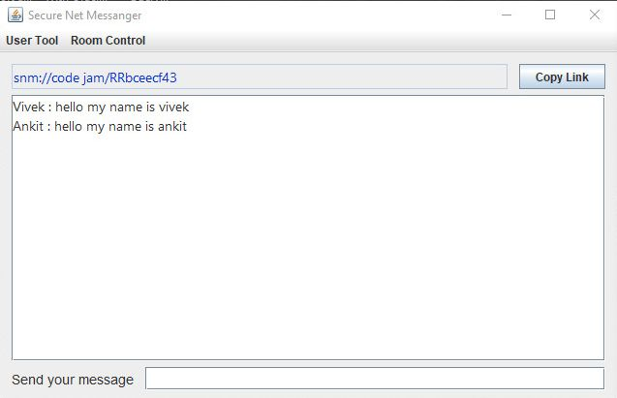
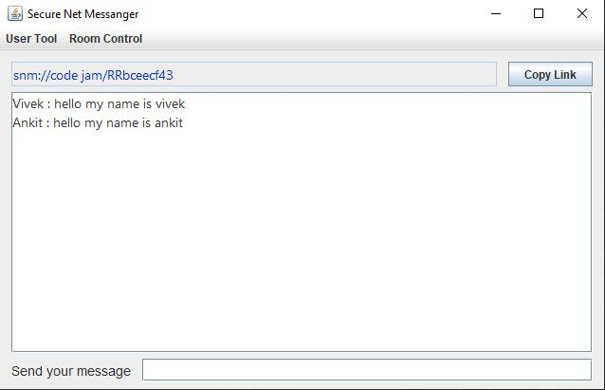
Chat Window Simulation

Slide 21
END

