Slide 1
TIC-TAC-TEO Game Application
Classic Two-Player Offline Game

Slide 2
Introduction
Classic two-player Tic Tac Toe game
Fully offline gameplay — no internet required
Clean and user-friendly interface for effortless gameplay
Developed using Flutter
Available via: https://tictacteoharmik.netlify.app/

Slide 3
Key Features
Offline Multiplayer — Play with friends on the same device
Modern & Attractive UI
Player Name Input
Turn-based Gameplay with Clear Indication
Draw & Win Detection
Winning celebration animation for a joyful experience.

Slide 4
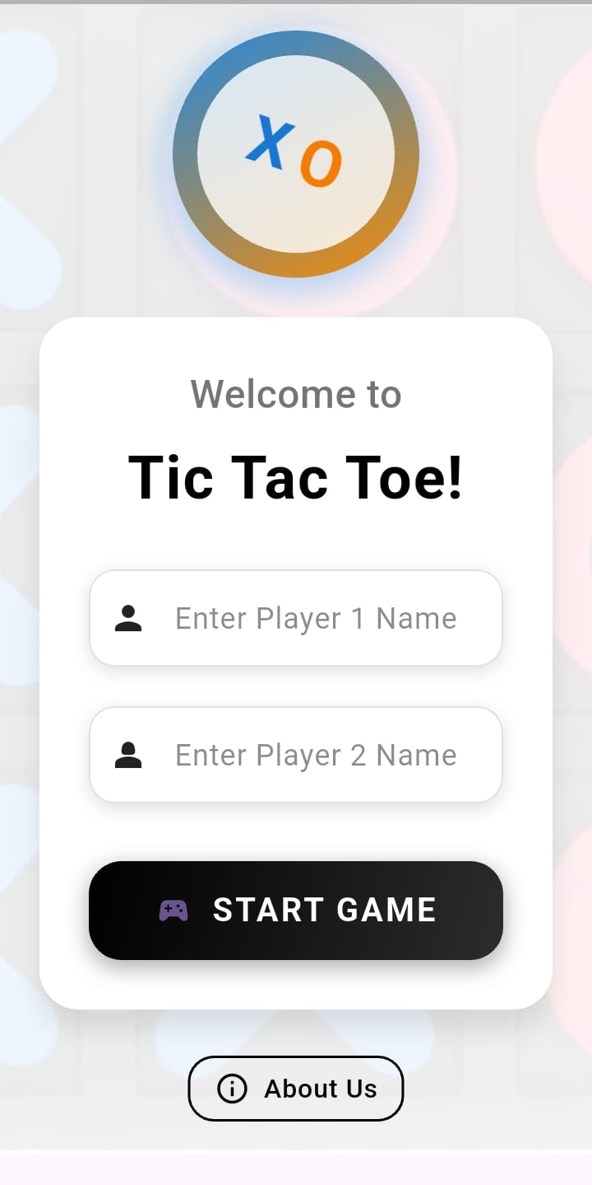
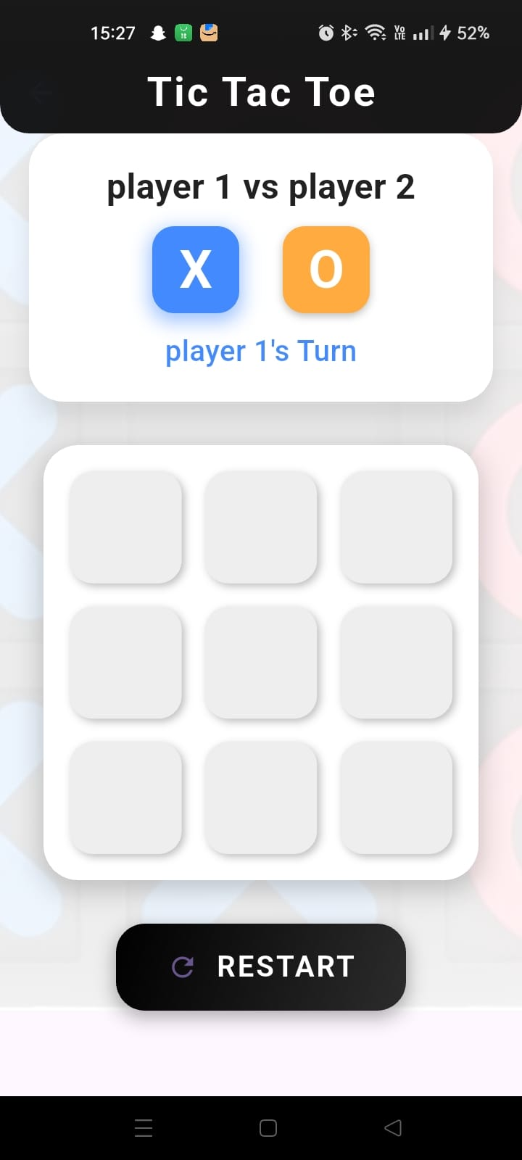
Screenshots Overview
1. Welcome Screen (Player Name Input)
2. Game Board Screen (Turn Indication)

Slide 5
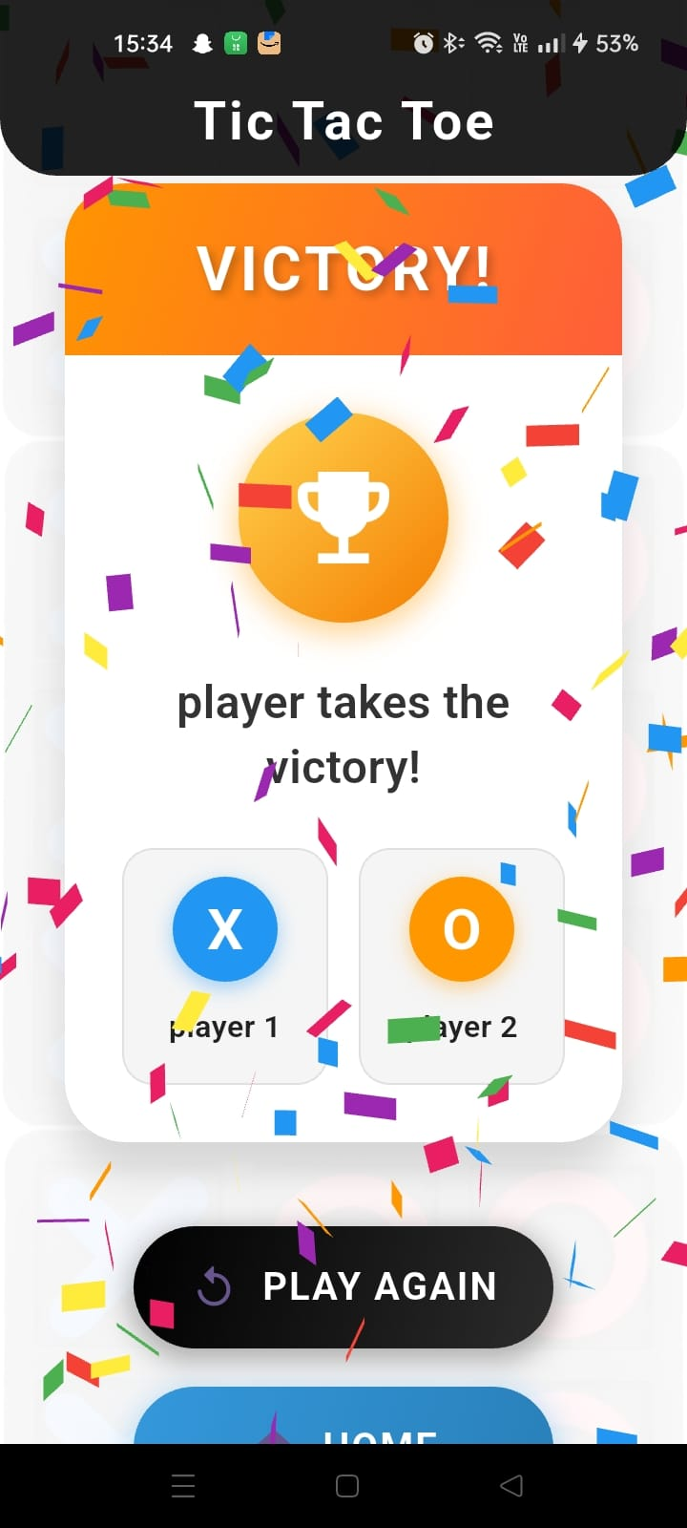
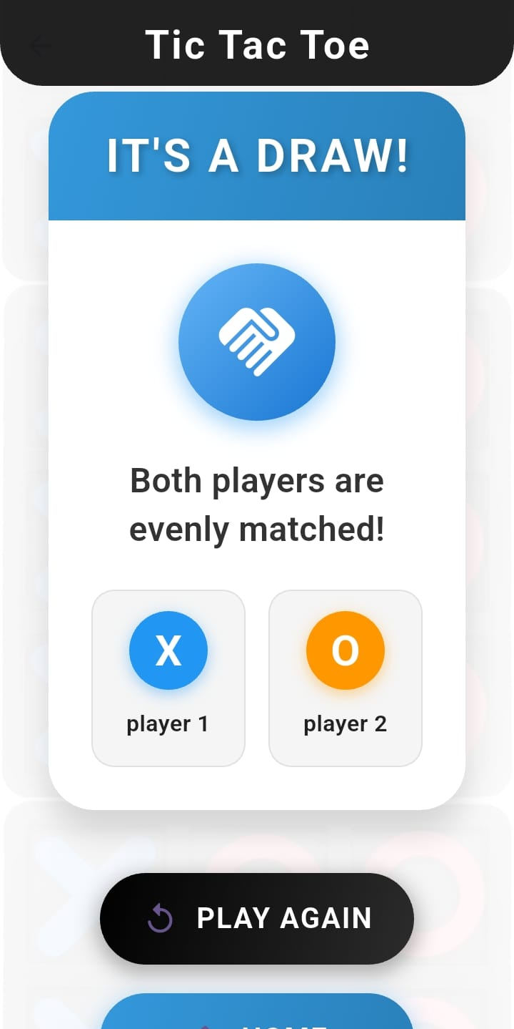
3. Victory Screen with Celebration
4. Draw Screen with Message

Slide 6
Technical Stack
Framework: Flutter
Language: Dart
Platform: Android
Gameplay: Offline, Two-Player Mode
UI Tools: Custom widgets, Animations

Slide 7
Future Improvement
Score Tracking Feature
Sound Effects & Music
More UI Customizations
Single-Player Mode with AI
Multiplayer Online (different devices)

Slide 8
Thank You
every great project starts with small steps.

