Slide 1
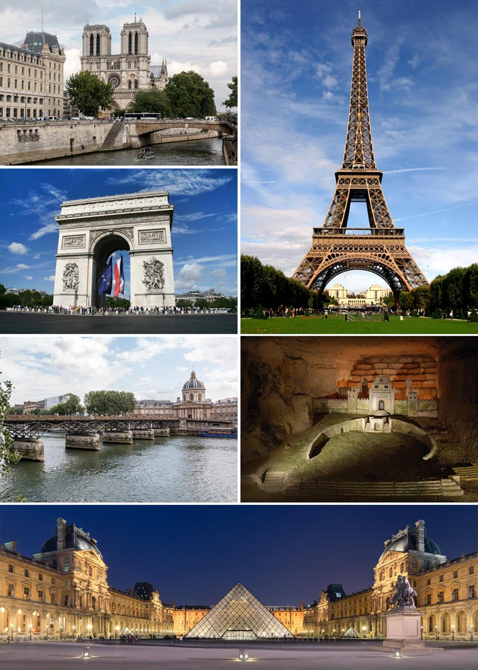
Fun Quiz
Capitals of countries of the world

Slide 2

Contents
Introduction
Have a quick demonstration
Project architecture
How to develop questions
How to navigate between questions
How to score the result
Additional feature of the project
Challenges and lessons!
Teamworking
Coding
…
Future plan
Any improvement on the project for future?
Q/A

Slide 3
Introduction
My project is about a general knowledge quiz where you answer the capitals of the cities of the world and you get your score in the end. You can skip to the next question or come back to the last question without any problems and can also check all the correct answers in the end. You can provide the feedback as well by filling the feedback form. For starting the quiz, you have to type your name and it will direct you to the quiz page.

Slide 4

Project Architecture
Look in the slide notes below for topics to consider talking about
Notes:
Consider talking about:
Origins
Middle Ages to Louis XIV
18th and 19th centuries
20th and 21st centuries

Slide 5
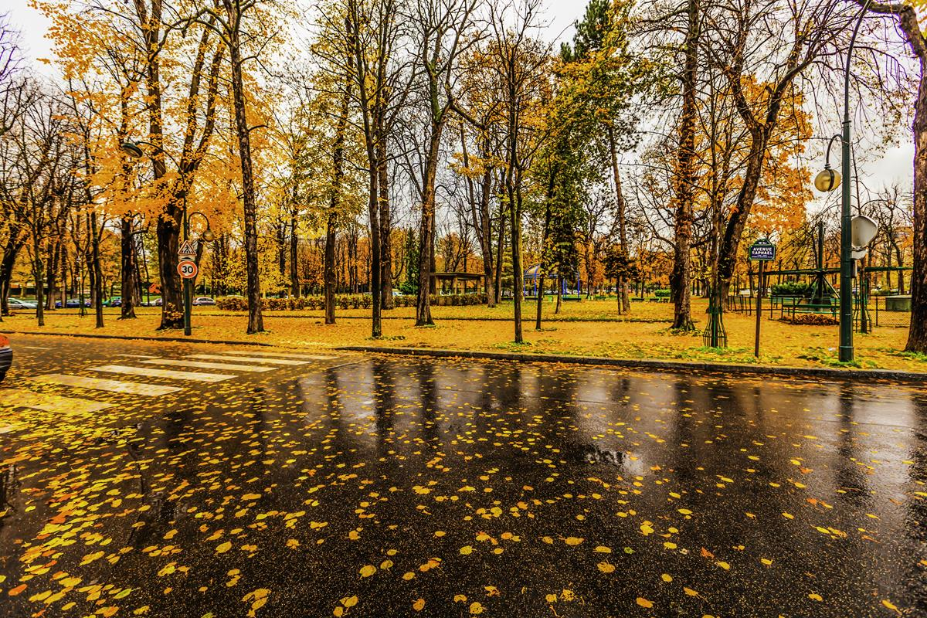
How to develop questions:
I developed the questions, answers, buttons in HTML and gave styling in CSS file and called functions from js file. I used events like onclick and created divs for each question.
Notes:
Consider talking about:
Climate

Slide 6
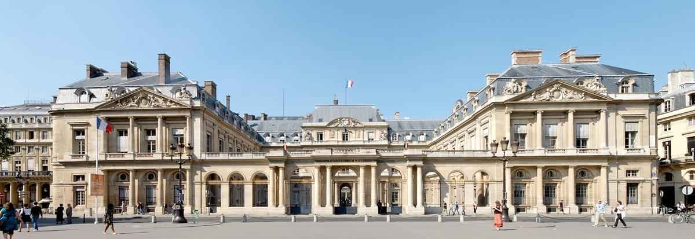
How to navigate between QUIZ-questions
I used display none, block feature in css and in js file, I used event like onclick for displaying previous and next question as I had made different divs and given them id’s so I could use onclick for each question div.
Notes:
Consider talking about:
City government
Métropole du Grand Paris
Regional government
National government
Police force

Slide 7
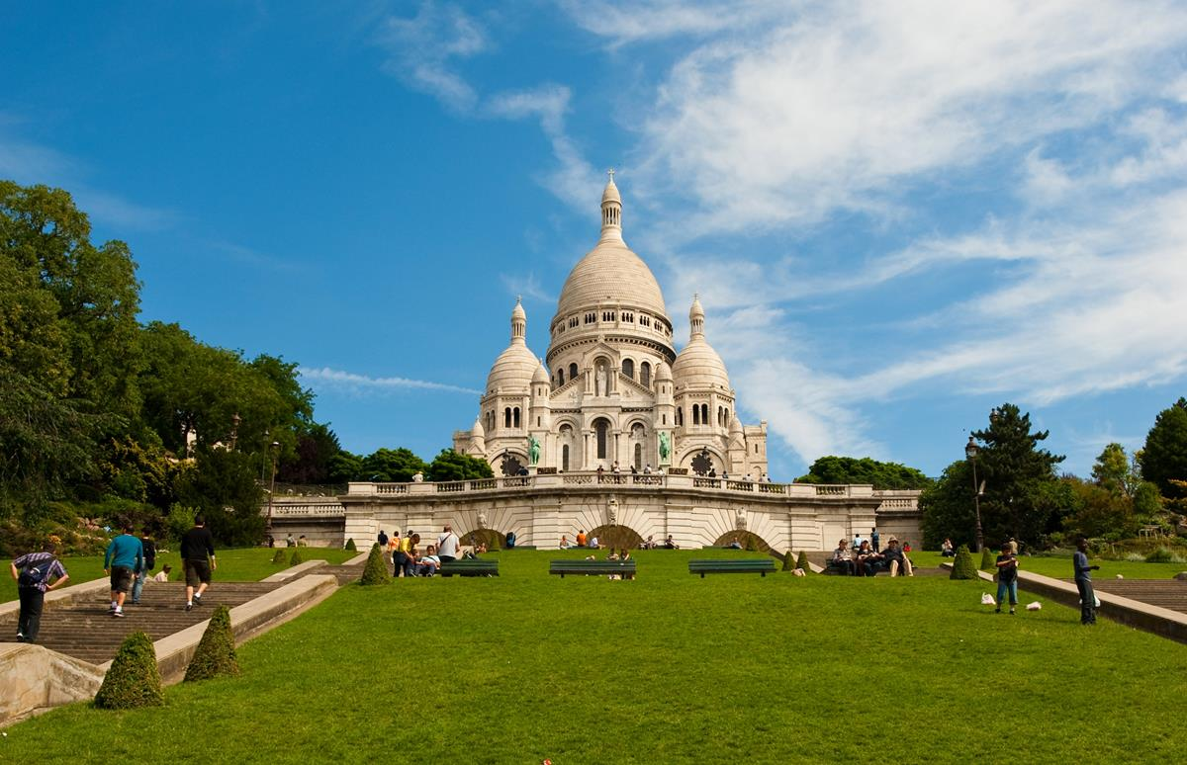
How to score the QUIZ result
I used the getScore and returntScore in function. Used onclick in html and called functions from js file.
Used for loop and if and else for score.
Notes:
Consider talking about:
Migration
Religion

Slide 8
Additional Feature I worked on:
I added an extra feedback form and a homepage.
In the homepage, first you write your name and press okay and then the quiz starts. We canto keep track of students and their information, as in who finished the quiz and their scores.

Slide 9
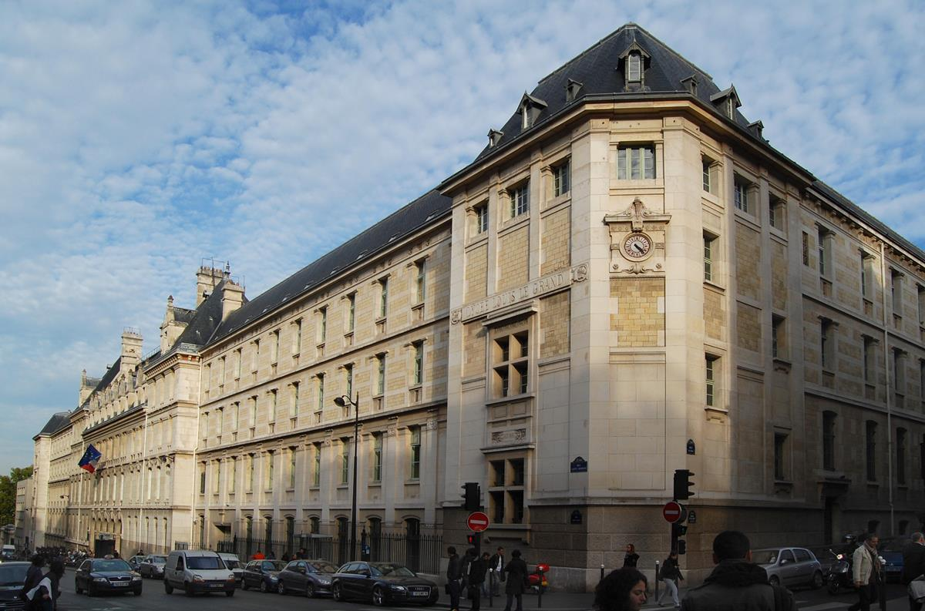
Challenges that I faced during this project:
I faced difficulties making js file and calling functions because its case sensitive so I had to focus a lot when it wasn’t working. I did this project myself so I felt like I was out of options and I couldn’t explore my ideas as I didn’t have a partner to discuss with or for feedback
Notes:
Consider talking about:
Libraries

Slide 10
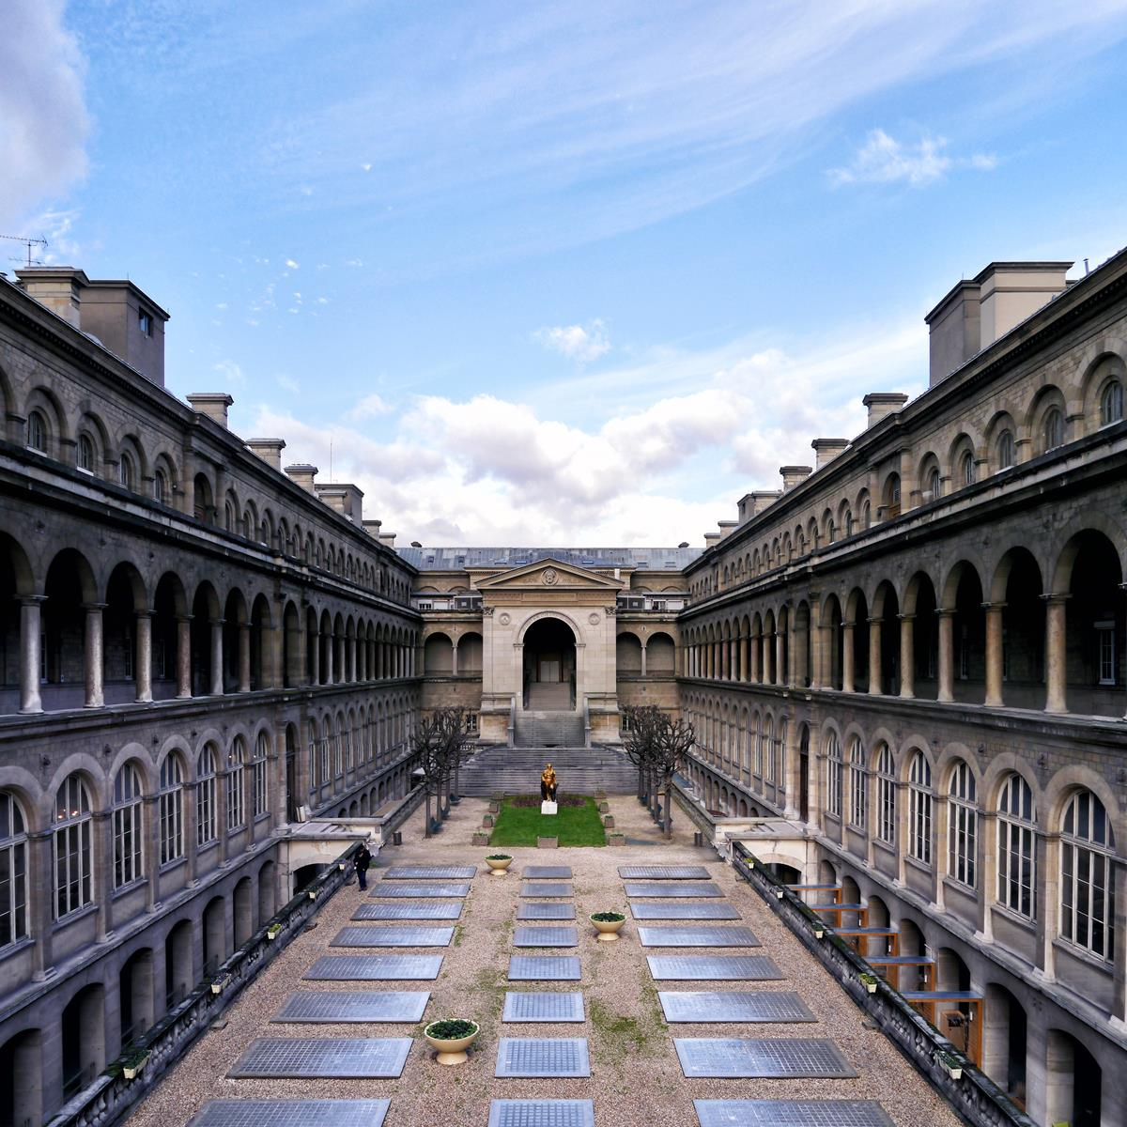
Lessons I learned:
I learnt that testing is very important after every change because it kept telling me that if I was going in the right direction. Also, I learnt how to use window prompt and applied it in my project. When you start, it asks you to write your name and the take you to the quiz.

Slide 11
Thank You
Notes:
Consider talking about:
Twin towns and partner cities
Other relationships

Slide 12
Question & Answers
Notes:
Consider talking about:
Monuments and attractions
Hotels

